Slide 1
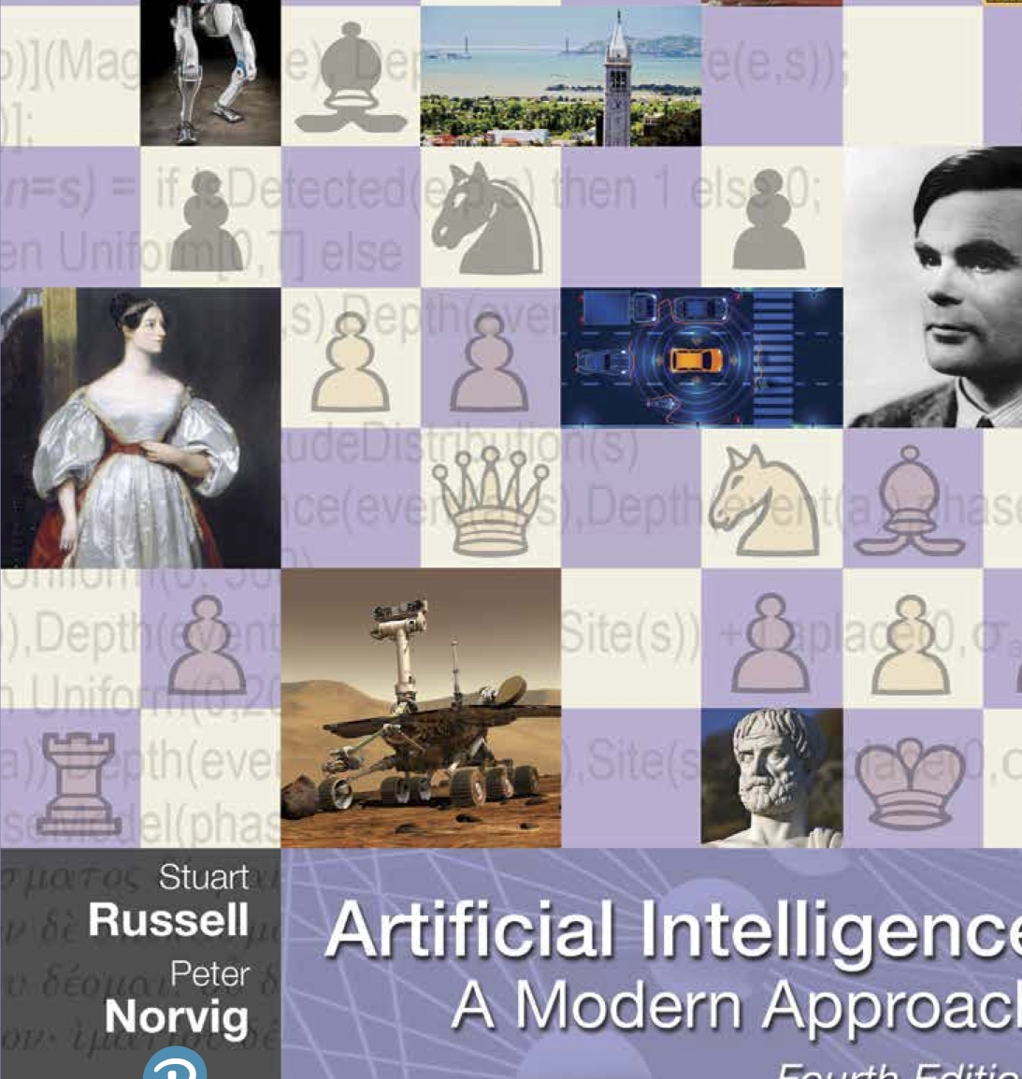
CS 5/7320 Artificial Intelligence Introduction AIMA Chapters 1 + 27
Slides by Michael Hahsler based on slides by Svetlana Lazepnik with figures and cover art from the AIMA textbook.
This work is licensed under a Creative Commons Attribution-ShareAlike 4.0 International License.
Online Material

Slide 2
Overview
What is AI?
AI Today
History of AI
?
AI Ethics & Safety

Slide 3
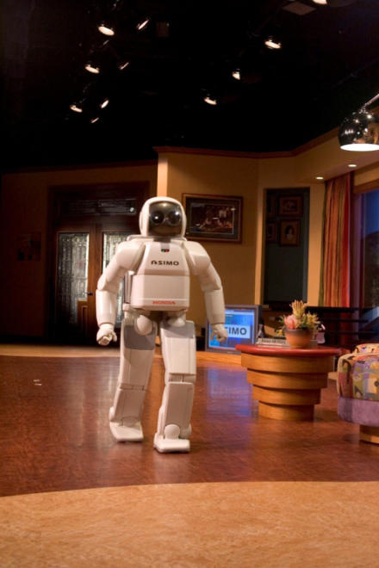
What is AI?
ASIMO (Advanced Step in Innovative Mobility) is a humanoid robot created by Honda in 2000

Slide 4
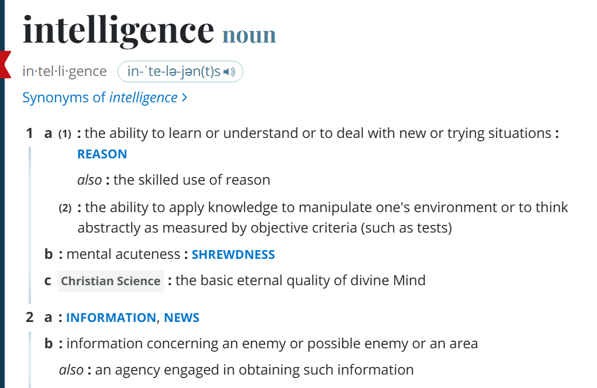
What is Intelligence?
Definition from Merriam-Webster

Slide 5
The Goal of AI
“Have machines solve problems that are challenging for humans.”
We call such a machine an intelligent agent.
Narrow AI
Artificial general intelligence (AGI)
An intelligent agents can solve a specific problem.
A hypothetical intelligent agent which can understand or learn any intellectual task that human beings can. [Wikipedia entry on AGI]
How can we achieve this? Create an agent that can
Think like a human?
Act like a human?
Think rationally?
Act rationally?

Slide 6
Cognitive Sciences
Think like a human?
Act like a human?
Think rationally?
Act rationally?
The brain as an information processing machine.
How to understand cognition as a computational process?
Introspection: try to think about how we think.
Predict the behavior of human subjects.
Image the brain, examine neurological data
Requires scientific theories of how the brain works. Note: The brain does not work like artificial neural networks from ML!
AI consciousness
What does it mean that a machine is conscient/sentient?
How can we tell? (What do we do?)

Slide 7
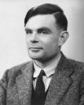
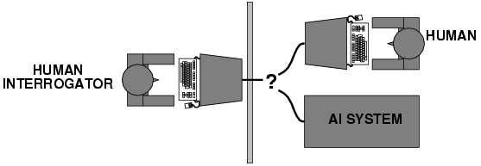
Alan Turing (1950) "Computing machinery and intelligence“
Think like a human?
Act like a human?
Think rationally?
Act rationally?
Alan Turing rejects the question “Can machines think?”
The Turing Test tries to define what acting like a human means
What capabilities would a computer need to have to pass the Turing Test? These are still the core AI areas.
Natural language processing
Knowledge representation
Automated reasoning
Machine learning
Turing predicted that by the year 2000, machines would be able to fool 30% of human judges for five minutes. ChatGPT (2023) is probably doing a least that!

Slide 8
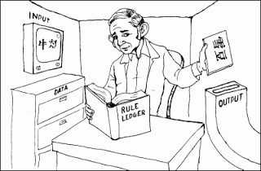
Turing Test: Criticism
What are some potential problems with the Turing Test?
Some human behavior is not intelligent.
Some intelligent behavior may not be human.
Human observers may be easy to fool.
A lot depends on expectations.
Anthropomorphic fallacy: humans tend to humanize things.
Imitate intelligence without intelligence. E.g., the early chatbots ELIZA (1964) simulates a conversation using pattern matching.
Is passing the Turing test a good scientific goal?
Engineering perspective: Imitating a human is not a good way to solve practical problems.
We can create useful intelligent agents without trying to imitate humans.
Chinese Room Argument
Thought experiment by John Searle (1980): Imitate intelligence using rules.

Slide 9
Thinking Rationally?
Think like a human?
Act like a human?
Think rationally?
Act rationally?
Thinking Rationality: Draw sensible conclusions from facts, logic and data.
Logic: A chain of argument that always yield correct conclusions. E.g., “Socrates is a man; all men are mortal; therefore, Socrates is mortal.”
Logic-based approach to AI: Describe problem in formal logic notation and apply general deduction procedures to solve it. Issues:
Describing real-world problems and knowledge using logic notation is hard.
Computational complexity of finding the solution.
Much intelligent or “rational” behavior in an uncertain world cannot be defined by simple logic rules.
What about the logical implication
$study hard \underset{⇒}{}A in my AI course$
Should it rather be
$$study hard AND be lucky \underset{⇒}{}A in my AI course$$

Slide 10
Acting Rationally
Think like a human?
Act like a human?
Think rationally?
Act rationally?
Acting rational means to try to achieve the “best” outcome.
Best means that we need to do optimization.
The desirability of outcomes can be measured by the economic concept of utility.
If there is uncertainty about achieving outcomes, then we need to maximizing the expected utility.
Optimization has several advantages:
Generality: optimization is not limited to rules.
Practicality: can be adapted to many real-world problems.
Well established: solvers, simulation and experimentation.
Avoids philosophy and psychology in favor of a clearly defined objective.
Bounded rationality: In practice, expected utility optimization is subject to the agent’s knowledge and computational constraints.

Slide 11
What type of AI do we cover in this course?
think like a human?
act like a human?
think rationally?
act rationally.
Create a narrow AI agent that can
That is, use machines that act in a way to solve a specific hard problem that traditionally would have been thought to require human intelligence.

Slide 12
Fields Related to AI
Philosophy logic, methods of reasoning, mind vs. matter, foundations of learning and knowledge
Mathematics logic, probability, optimization
Economics utility, decision theory
Neuroscience biological basis of intelligence
Cognitive science computational models of human intelligence
Linguistics rules of language, language acquisition
Machine learning design of systems that use experience to improve performance

Slide 13
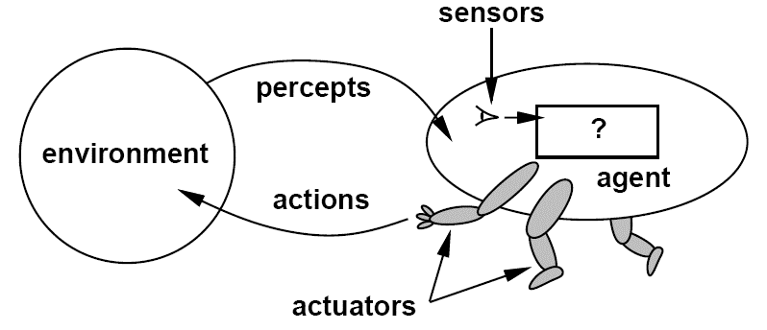
What are the Components of an Intelligent Agent?
Intelligent agents need to
Communicate with the environment.
Represent knowledge, reason and plan to achieve a desired outcome.
Optional
Learn to improve performance.
Developer
Agent interacting with the environment [Artificial Intelligence: A Modern Approach, Editions 1-3]

Slide 14
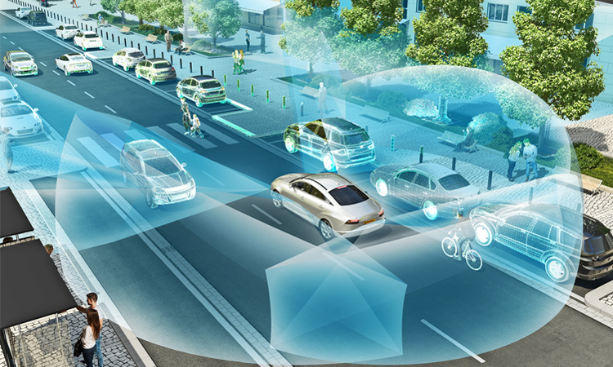
Example: Self-Driving Car
Percept:
Action:
People crossing the street
Stop the car

Slide 15
Example: Large Language Model
Percept:
Action:
prompt
next most likely word
More words are created word-by-word.

Slide 16
Machine Learning vs. Artificial Intelligence
AI
ML
Deep Learning
Designing an intelligent agent
Vision
Sensors
Motion
NLP
Knowledge representation
Planning
Goals
Learning from examples instead of being programmed
Supervised learning
Unsupervised learning
RL
ML
ML
ML
Agent interacting with the environment [Artificial Intelligence: A Modern Approach, Editions 1-3]

Slide 17
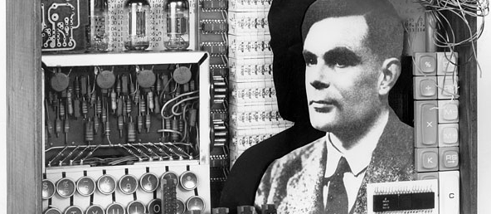
The History of AI

Slide 18
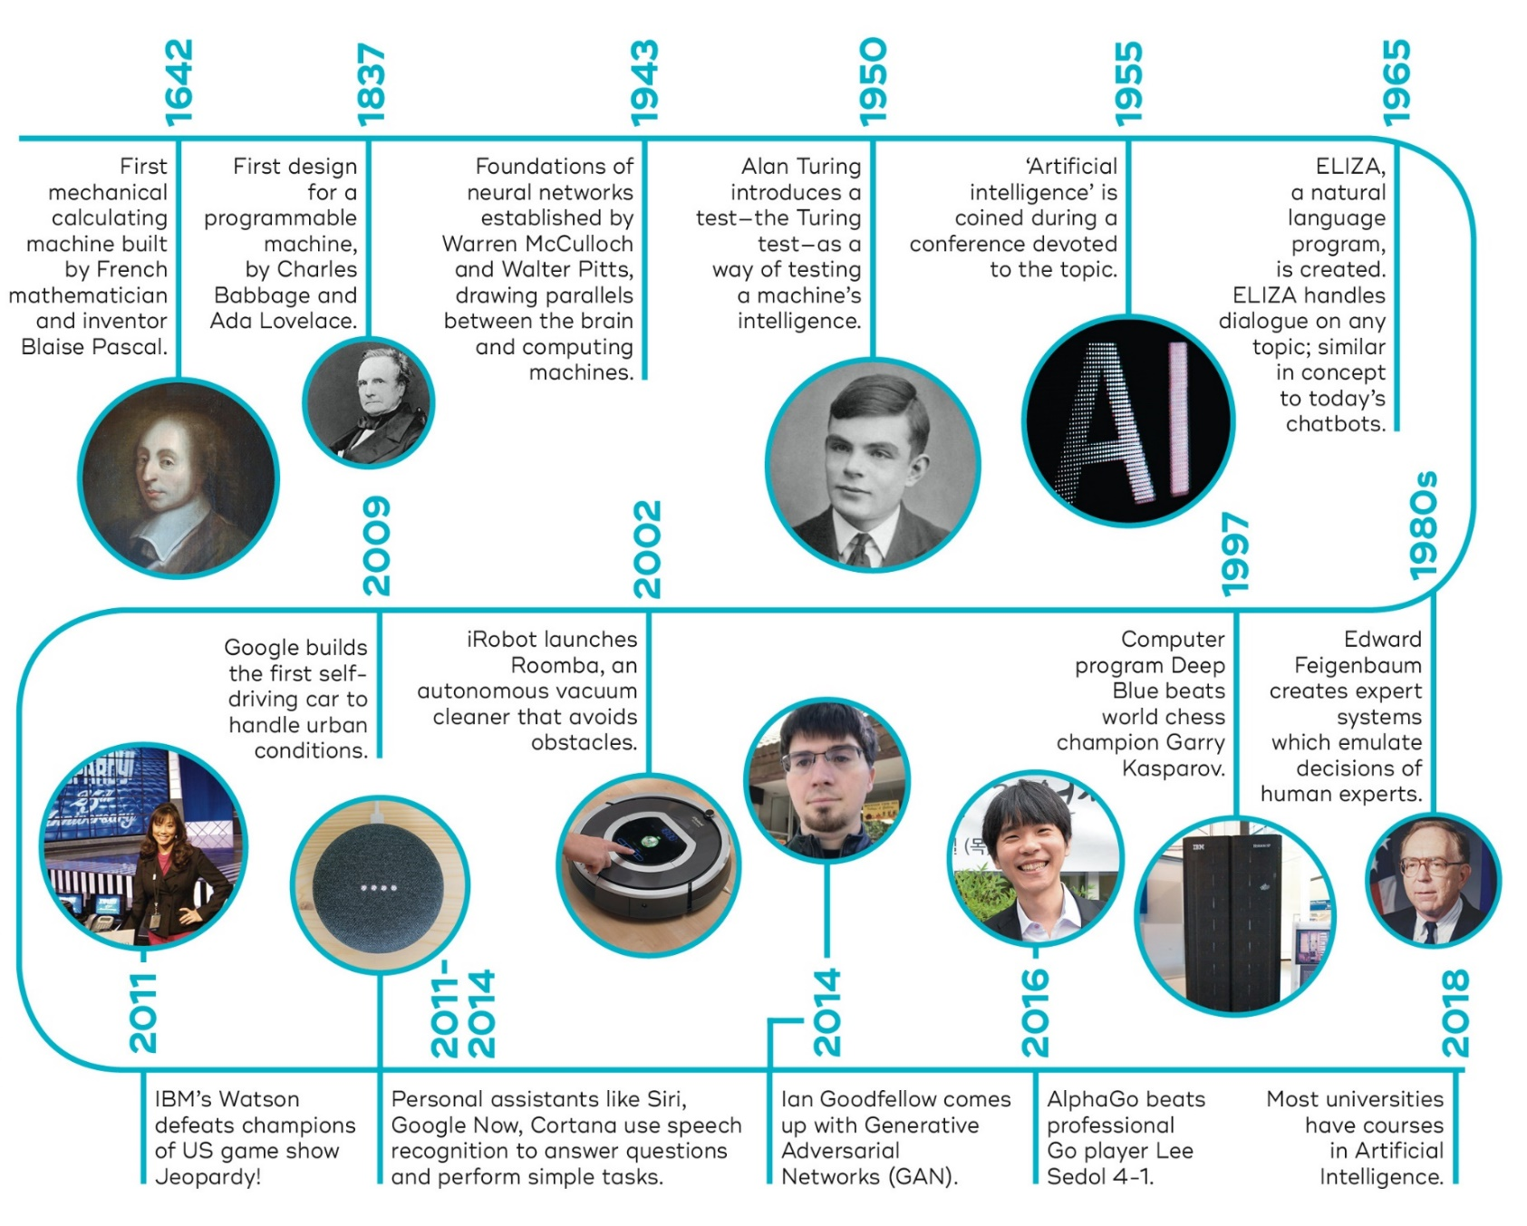
The Ti of AI
1974-1980
First AI Winter
1987-1993
Second AI Winter
1989: Universal approximation theorem for neural networks.
2010
2015
2017
2022
Transformer architecture and large language models LLMs
Generative AI models:
DALL-E
ChatGPT, Bard
…
Deep Learning Revolution (learning layered artificial neural networks) starts fueled by NVIDIA GPUs. enables leaps in image processing and speech recognition.
Now Google
Source: https://qbi.uq.edu.au/brain/intelligent-machines/history-artificial-intelligence + additions

Slide 19
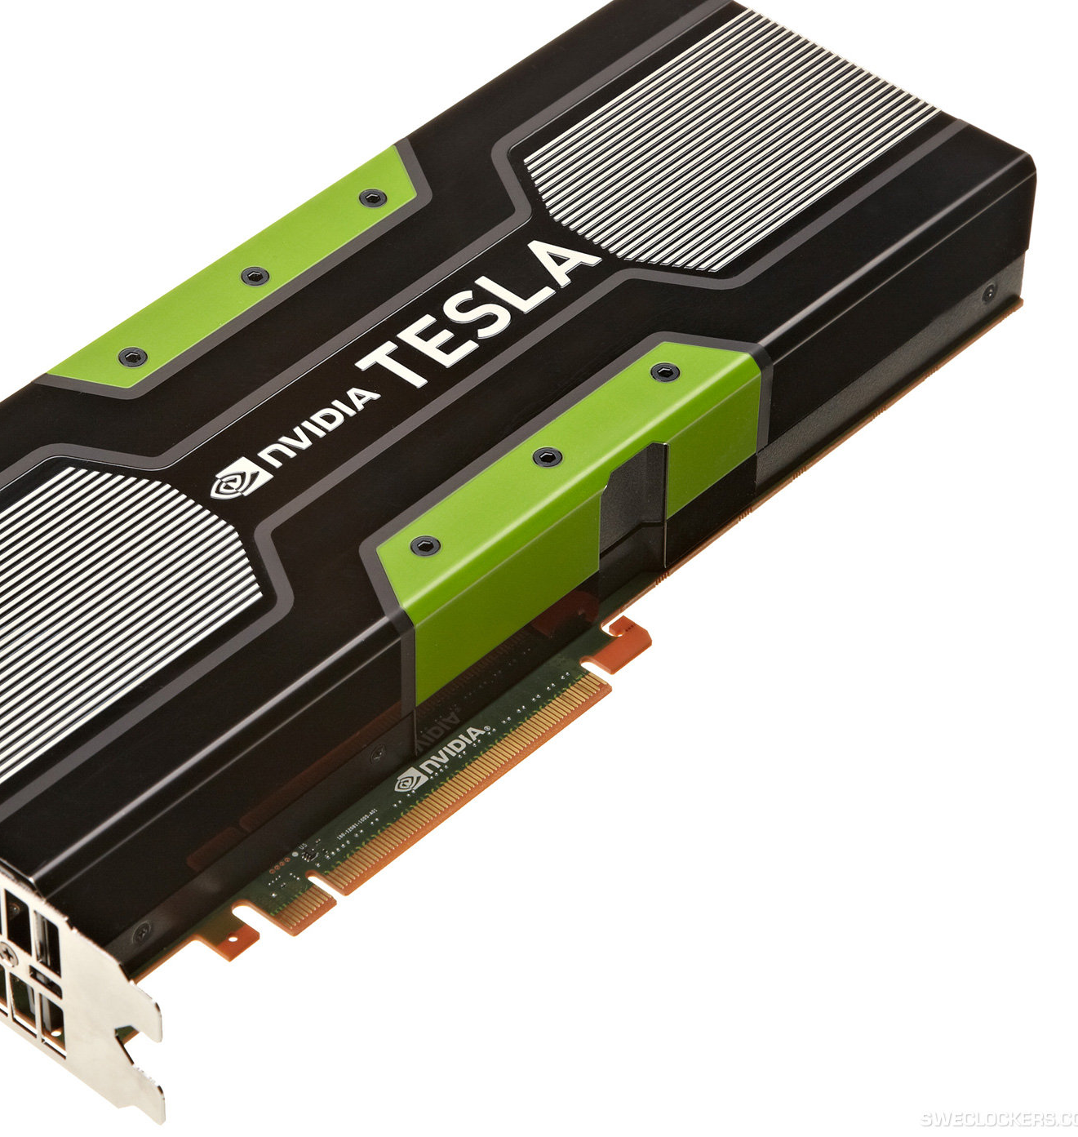
What accounts for recent successes in AI?
Faster computers and specialized hardware (GPUs).
Lots of data (the Internet, text, sensors) and storage (cloud)
Dominance of machine learning.
New optimization methods (deep learning).

Slide 20
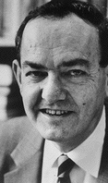
AI is harder than originally thought Herbert Simon, 1957
“It is not my aim to surprise or shock you--- but … there are now in the world machines that think, that learn and that create. Moreover, their ability to do these things is going to increase rapidly until---in a visible future---the range of problems they can handle will be coextensive with the range to which human mind has been applied. More precisely: within 10 years a computer would be chess champion, and an important new mathematical theorem would be proved by a computer.”
Simon’s prediction came true --- but 40 years later instead of 10

Slide 21
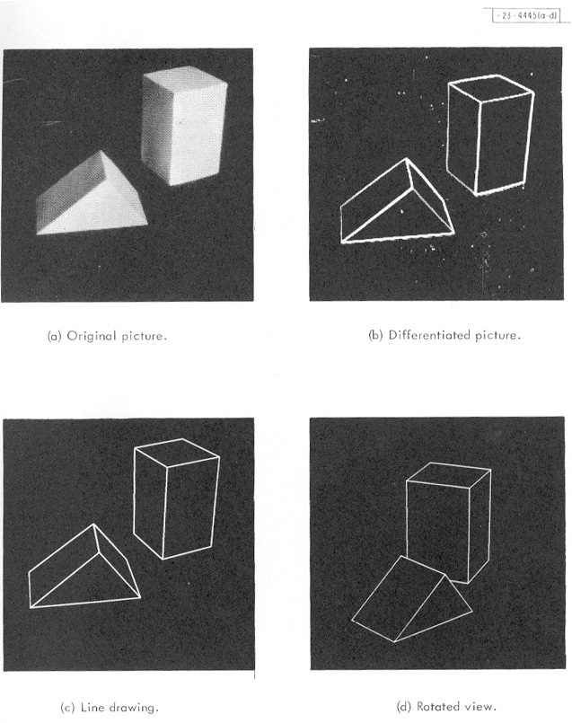
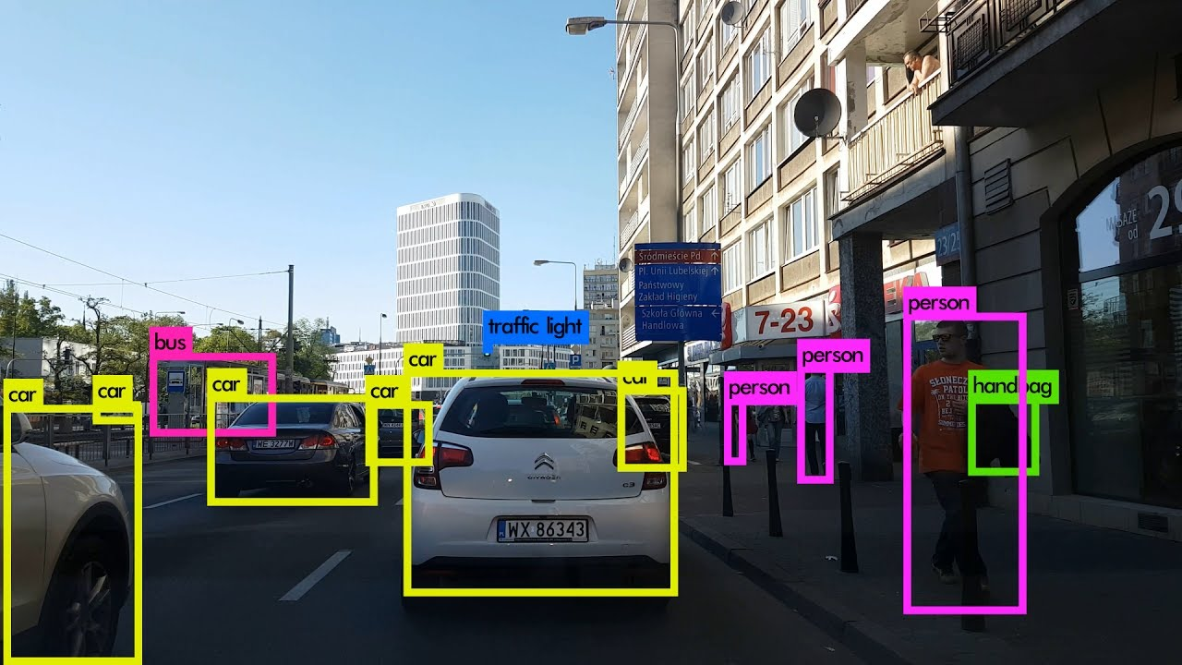
From Blocks World to Modern Object Recognition
Roberts (1963)
Now
This is a lot harder! But we can do it now….

Slide 22
“Moravec’s Paradox”
Hans Moravec (1988): “It is comparatively easy to make computers exhibit adult level performance on intelligence tests or playing checkers, and difficult or impossible to give them the skills of a one-year-old when it comes to perception and mobility.”
A teenager can learn how to drive in a few hours with very little input, but we still have no truly self-driving car.
https://www.newsweek.com/googles-new-two-legged-robot-future-warfare-429831

Slide 23
The AI Effect: AI gets no respect?
As soon as a machine gets good at performing some task, the task is no longer considered to require much intelligence
Calculating ability used to be prized – not anymore.
Chess was thought to require high intelligence – now computers play at a super-human level.
Learning once thought uniquely human - now machine learning is a well-developed discipline.
Art? “Even a monkey can do this!”

Slide 24
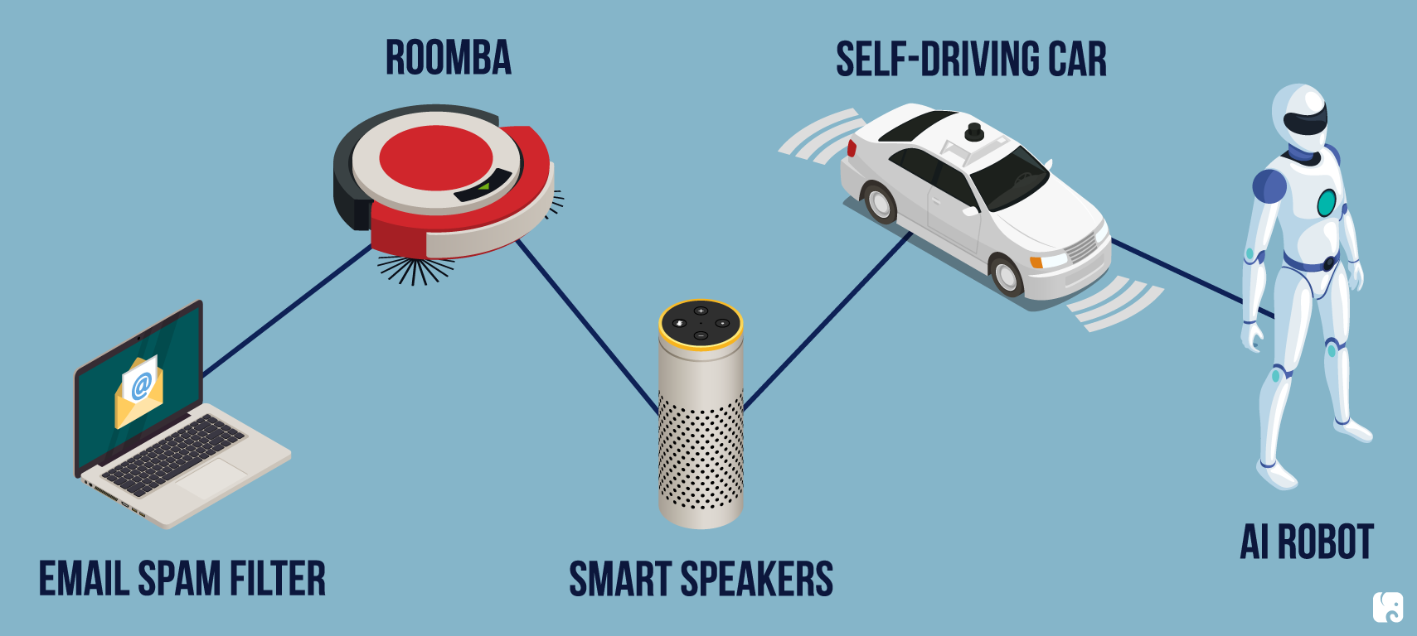
AI Today

Slide 25
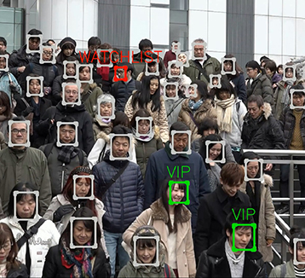
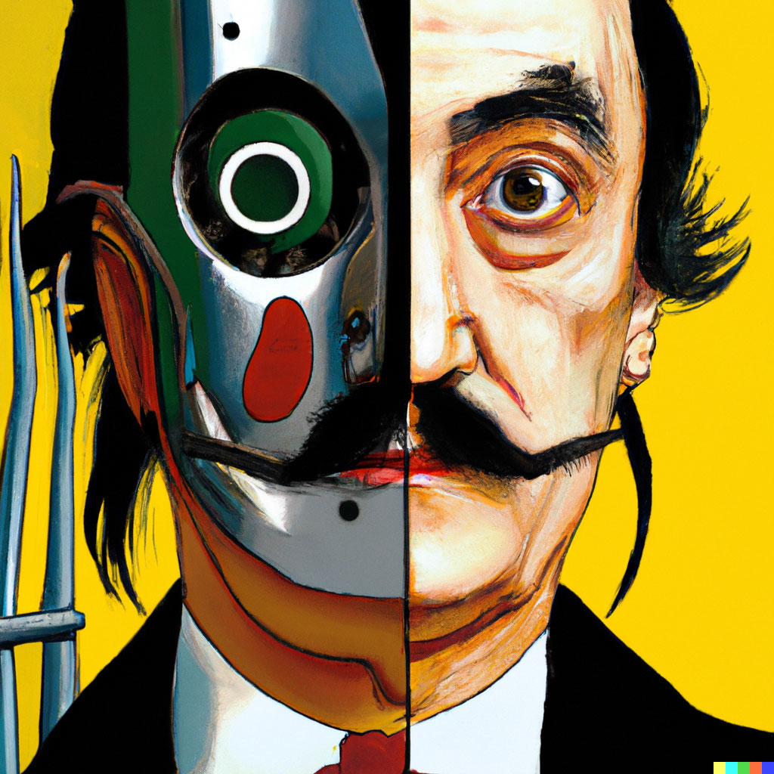
Vision and Image Processing
OCR: read license plates, handwriting recognition (e.g., mail sorting).
Face detection: now standard for smart phone cameras.
Vehicle safety systems
Visual search
Image generation
All these technologies operate now at superhuman performance.
DALL-E

Slide 26
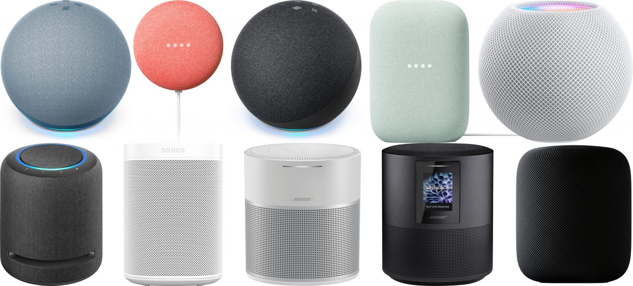
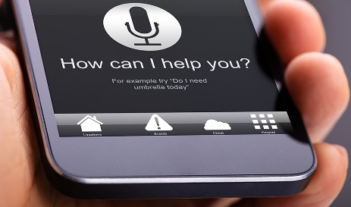
Natural Language Processing
Text-to-speech
Speech-to-text to detect voice commands
Machine translation
Text generation (Q/A systems) using Large Language Models
These technologies operate now with close to or even superhuman performance.
Humans use language to reason. Does that mean AI that can create good language can reason?
Language understanding is still elusive!

Slide 27
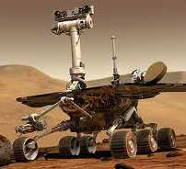
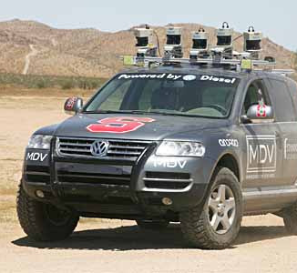
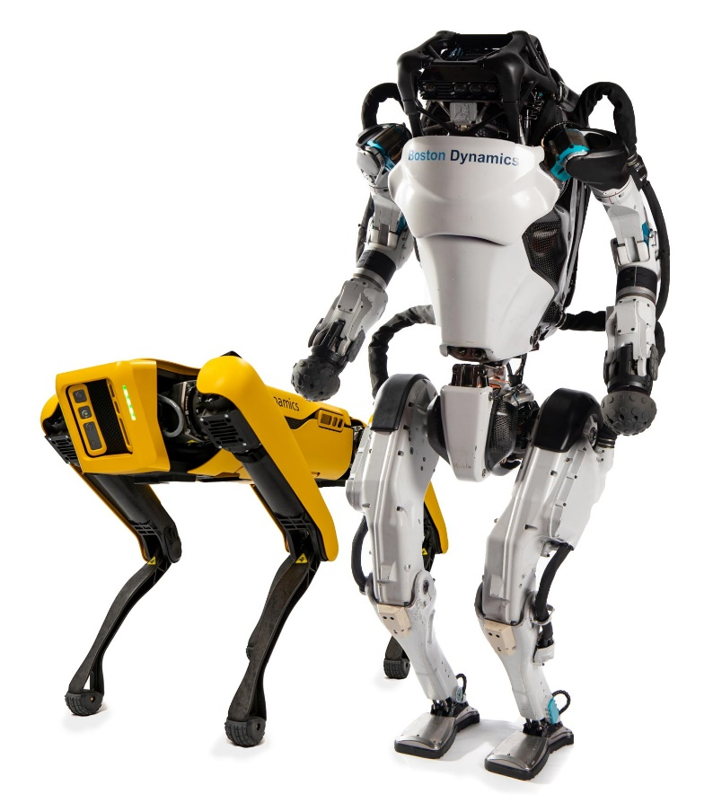
Robotics
Mars rovers
Autonomous vehicles
DARPA Grand Challenge
Google self-driving cars
Autonomous helicopters and drones
Robot soccer
RoboCup
Personal robotics
Humanoid robots
Robotic pets
Personal assistants?

Slide 28
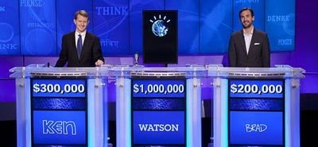
Question Answering: IBM Watson
Listens to spoken language.
Speaks.
Finds questions to factual answers.
YouTube video of Watson
PCWorld article: IBM Watson wins on Jeopardy (February 2011)

Slide 29
Math, Games and Puzzles
1996: A computer program written by researchers at Argonne National Laboratory proved a mathematical conjecture (Robbins conjecture) unsolved for decades
NY Times story: “[The proof] would have been called creative if a human had thought of it”
1996/97: IBM’s Deep Blue defeated the reigning world chess champion Garry Kasparov in 1997
1996: Kasparov Beats Deep Blue “I could feel --- I could smell --- a new kind of intelligence across the table.”
1997: Deep Blue Beats Kasparov “Deep Blue hasn't proven anything.”
2007: Checkers was “solved” --- a computer system that never loses was developed. Science article
2017+: AlphaZero learns chess, shogi and go by playing itself. Science article
2019: MuZero learns to play Atari computer games.
AI exhibits superhuman performance on almost all games.

Slide 30
Logistics, Scheduling and Planning
1991
During the 1991 Gulf War, US forces deployed an AI logistics planning and scheduling program that involved up to 50,000 vehicles, cargo, and people
May 1999
NASA’s Remote Agent software operated the Deep Space 1 spacecraft during two experiments in May 1999
2004
In 2004, NASA introduced the MAPGEN system to plan the daily operations for the Mars Exploration Rovers
2018
Optimized Prime: How AI And Anticipation Power Amazon's 1-Hour Deliveries

Slide 31
Information agents
Search engines
Chat Agents / Automated helpdesks
Recommendation systems
Spam filtering
Medical diagnosis systems
Fraud detection
Automated stock trading

Slide 32
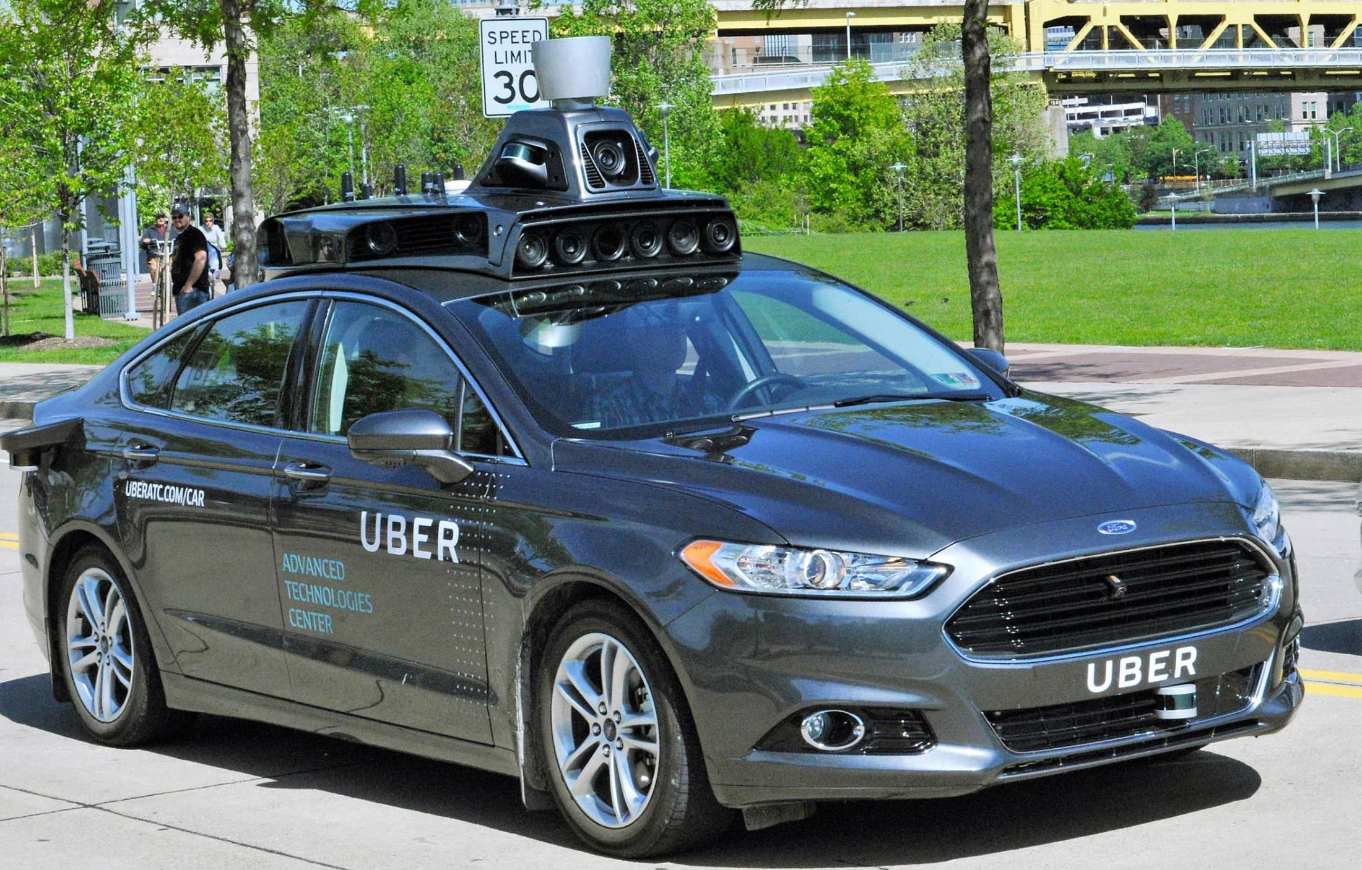
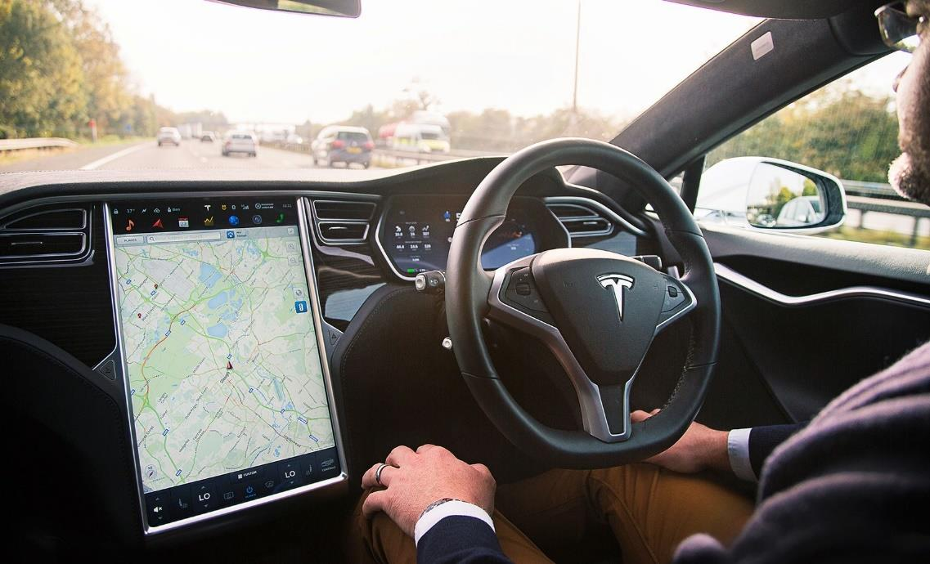
Self-driving Cars and Safety
SAE Automation Levels
Level 1 - Driver Assistance (“hands on”)
Level 2 - Partial Automation (“hands off”)
Level 3 - Conditional Automation
Level 4 - High Automation
Level 5 - Full Automation (“steering wheel optional”)
Components
Sensing
Maps
Path planning
Controlling the vehicle
Why is this so hard?

Slide 33
Large Language Models (LLMs)
…
Source: https://chat.openai.com/

Slide 34
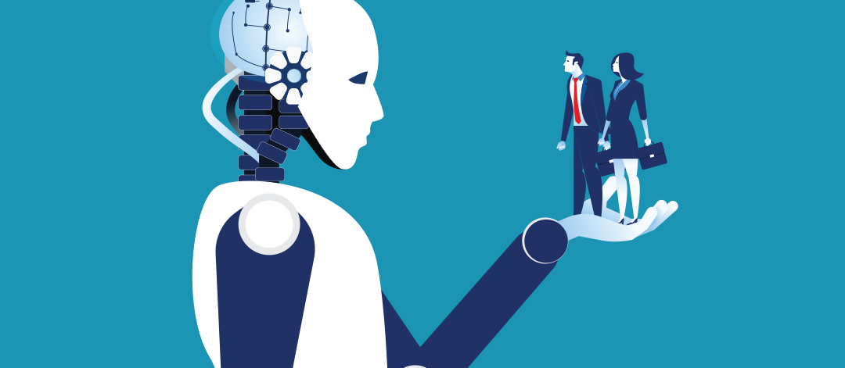
AI Ethics & Safety
A new Frontier for Fairness and Freedom AIMA Chapter 27

Slide 35
Commonly-Cited Safety and Ethics Principles
Use of AI by companies and organizations
Ensure safety
Protect individuals
Uphold human rights and values
Limit harmful uses of AI
Establish accountability: Liability?
Avoid concentration of power: Winner-takes-All
Ensure fairness: Equal opportunity/equal impact. Reflect diversity/inclusion
Provide transparency: Explanations to build trust
Respect privacy: Surveillance?
Contemplate implications for employment: Income and purpose.
Governance
Acknowledge legal/policy implications
Next, we look at the implementation of these principles in different countries.

Slide 36
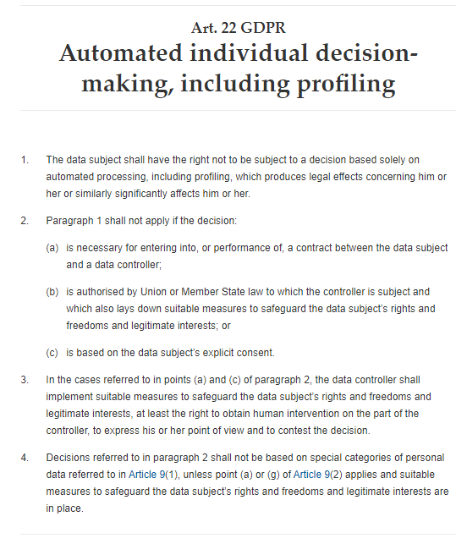
European Union
2016
Has regulations since 2016 included in the General Data Protection Regulation (GDPR)
Art. 22 GDPR – Automated individual decision-making, including
California’s CCPA was not modeled after the GDPR

Slide 37
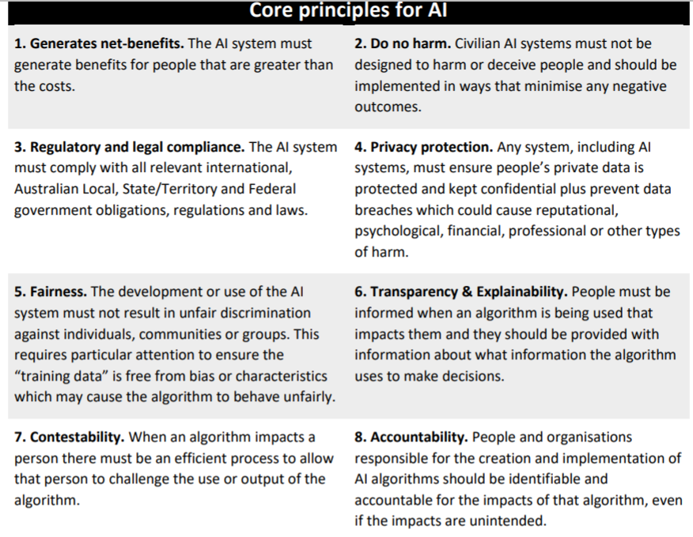
Australia: AI Ethics Framework for Industry A set of voluntary AI Ethics Principles (2019)
2019

Slide 38
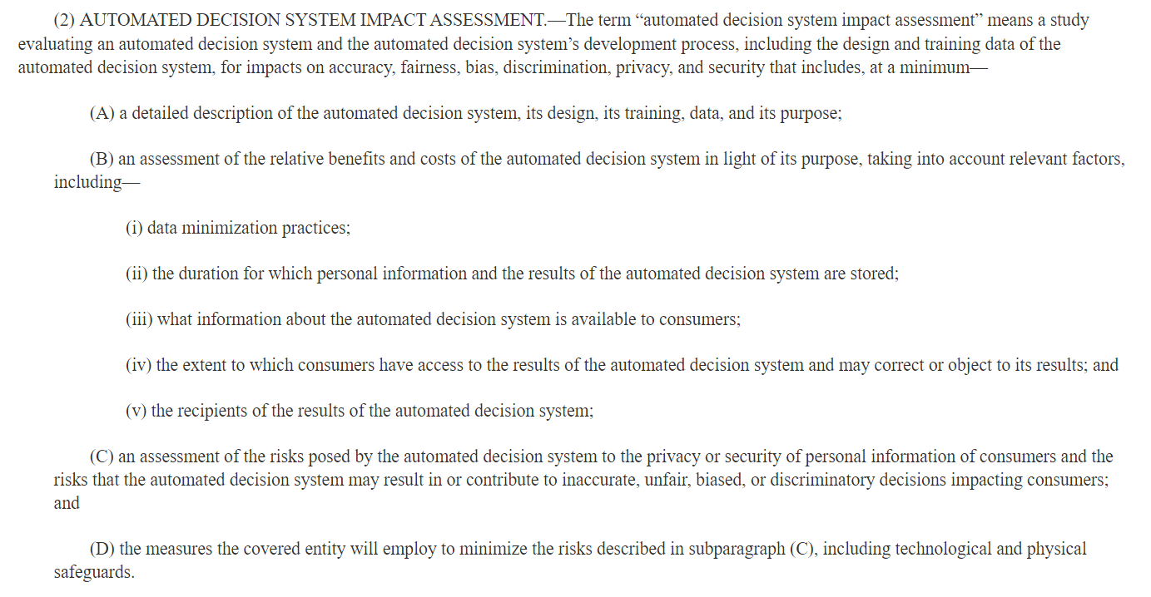
In the United States
Bill Introduced in 2019
Did not receive a vote in Congress.

Slide 39
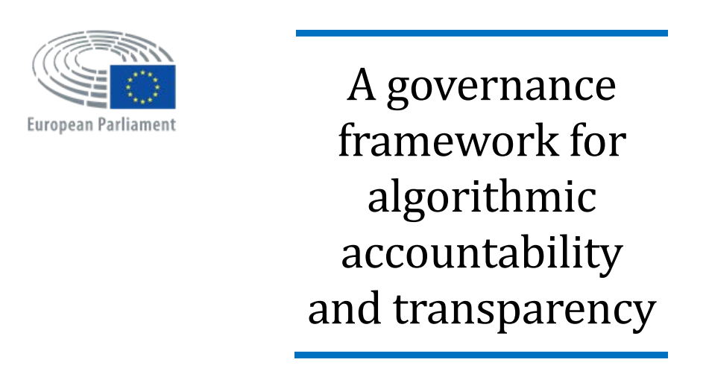
European Union Study
2019
https://www.europarl.europa.eu/thinktank/en/document.html?reference=EPRS_STU(2019)624262

Slide 40
Google
2021
Source: https://ai.google/static/documents/recommendations-for-regulating-ai.pdf, 2021

Slide 41
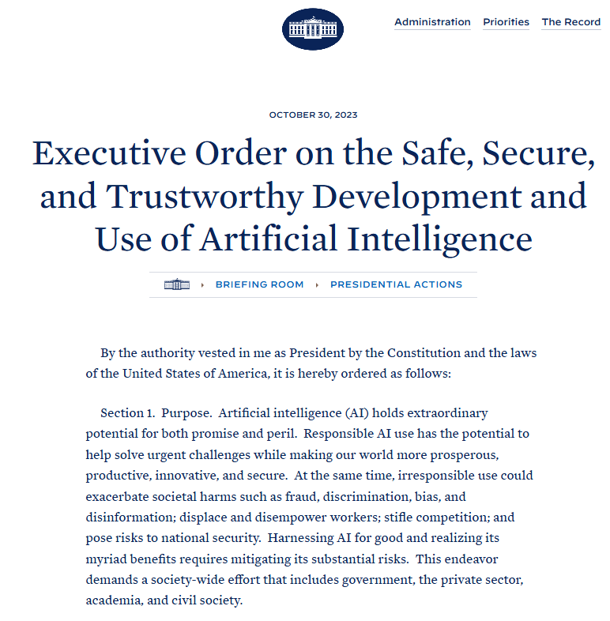
US White House Executive Order 14110
2023
Some important points:
Artificial Intelligence must be safe and secure.
Promoting responsible innovation, competition, and collaboration
Americans’ privacy, civil liberties and labor rights must be protected.

Slide 42
Algorithmic Bias
“Algorithmic bias describes systematic and repeatable errors in a computer system that create unfair outcomes, such as privileging one arbitrary group of users over others.” [Wikipedia]
Pre-existing bias
Social and institutional norms influence design and training data choices.
Technical bias
Limitations of a program or computational power.
Emergent bias
Use and reliance on algorithms across new or unanticipated contexts.
Example: Evaluate job applicants for a job which is historically almost exclusively held by males.
Example: instead of a random sample, the program uses the first n data points.
Example: Use of an algorithm for an unanticipated application that would require retraining.

Slide 43
Types of AI Safety
AI Testing
Adversarial robustness
Monitoring AI
“Prevent accidents, misuse, or other harmful consequences of AI.”
How should this be ensured?
Corporate self-regulation
Government action

Slide 44
AI Safety and Optimizers
Intelligent Agents are “optimizers!”
Goal/reward alignment: How do we specify a robust objective function?
Reward hacking creates unintended side effects. AI needs to follow social norms.
Instrumental convergence: All intelligent agents will pursue common subgoals like the need for more power.
Alignment?
Goals
Objectives and Rules
Intelligent Agent
User
Side effect
Action
Alignment?
program
train
Goals
select
Data
Developers / Owners
Credit: Terminator 3: Rise of the Machines. Warner Bros.

Slide 45
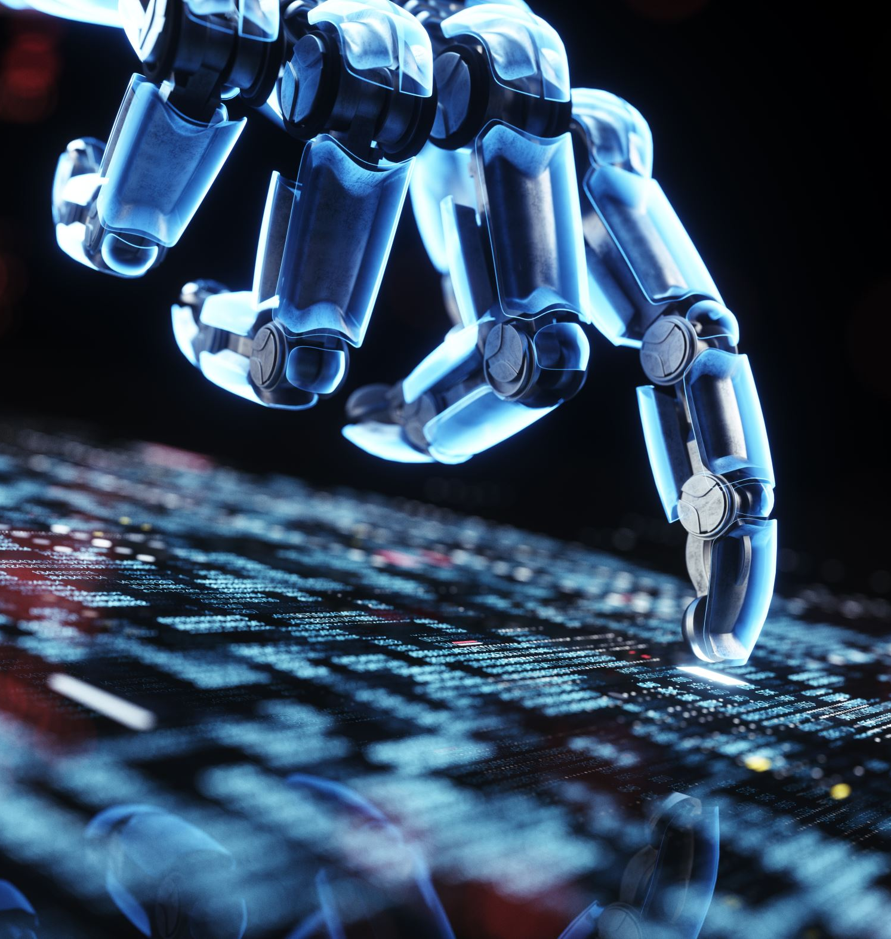
Outlook
AI is a technology that is on the verge of significant leaps…
New technologies always had a profound impacted on the way we live and work (e.g., electricity, the internet, mobile communication).
We can expect unprecedented gains in productivity from better narrow AI.
New technologies always also present dangers and need to be regulated.
This course will introduce simple techniques to create intelligent agents.

