Slide 1
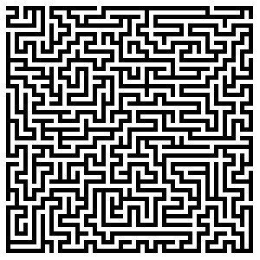
CS 5/7320 Artificial Intelligence Solving problems by searching AIMA Chapter 3
Slides by Michael Hahsler based on slides by Svetlana Lazepnik with figures from the AIMA textbook.
This work is licensed under a Creative Commons Attribution-ShareAlike 4.0 International License.
Online Material

Slide 2
Contents
What are search problems?
Tree search
Uninformed search
Informed search
Search Space

Slide 3
Contents
What are search problems?
Tree search
Uninformed search
Informed search
Search Space

Slide 4
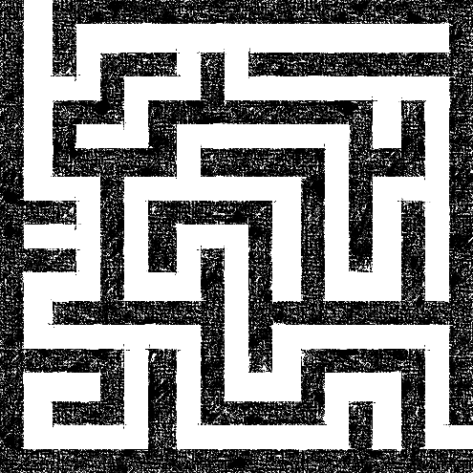
What are Search Problems?
We will consider the problem of designing goal-based agents in known, fully observable, and deterministic environments.
Example environment:
Start
Exit

Slide 5
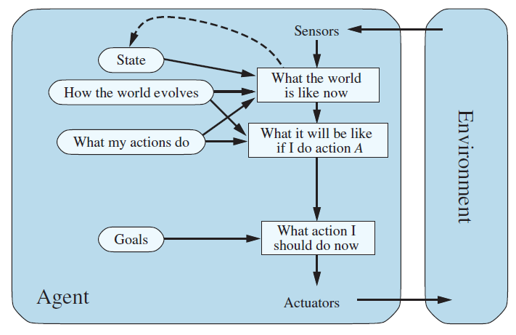
Remember: Goal-based Agent
The agent has the task to reach a defined goal state.
The performance measure is typically the cost to reach the goal.
We will discuss a special type of goal-based agents called planning agents which use search algorithms to plan a sequence of actions that lead to the goal.
Agent’s location
Maze
Map of the maze
Search for a plan
Exit location
$$a_{s}={argmin}_{a∈A}{[cost\left(s, s_{1},s_{2},…,s_{n} | s_{n}∈S^{goal}\right)]}$$

Slide 6
Planning for Search Problems
For now, we consider only a discrete environment using an atomic state representation (states are just labeled 1, 2, 3, …).
The state space is the set of all possible states of the environment and some states are marked as goal states.
The optimal solution is the sequence of actions (or equivalently a sequence of states) that gives the lowest path cost for reaching the goal.
Initial state
1
Goal state
z
Phases:
Search/Planning: the process of looking for the sequence of actions that reaches a goal state. Requires that the agent knows what happens when it moves!
Execution: Once the agent begins executing the search solution in a deterministic, known environment, it can ignore its percepts (open-loop system).

Slide 7
Definition of a Search Problem
Initial state
Actions: {N, E, S, W}
Transitions
Initial state: state description
Actions: set of possible actions $A$
Transition model: a function that defines the new state resulting from performing an action in the current state
Goal state: state description
Path cost: the sum of step costs
1
g
i
4
a
Goal state
z
Discretization grid
Important: The state space is typically too large to be enumerated, or it is continuous. Therefore, the problem is defined by initial state, actions and the transition model and not the set of all possible states.

Slide 8
Transition Function and Available Actions
As an action schema:
$$Action\left(go\left(dir\right)\right)$$ PRECOND: no wall in direction $dir$ EFFECT: change the agent’s location according to $dir$
As a function: $f:S×A →S$or $s^{′}=result(a, s)$
Function implemented as a table representing the state space as a graph.
Available actions in a state come from the transition function. E.g.,
$$actions(4) = \{E, S, N\}$$
Original Description
Initial state
Actions: {N, E, S, W}
Transitions
1
g
$$s$$ | $$a$$ | $$s′$$
1 | S | 2
2 | N | 1
2 | S | 3
… | … | …
4 | E | a
4 | S | 5
4 | N | 3
… | … | …
2
i
3
4
a
5
z
Discretization grid
Goal state
Note: Known and deterministic is a property of the transition function!

Slide 9
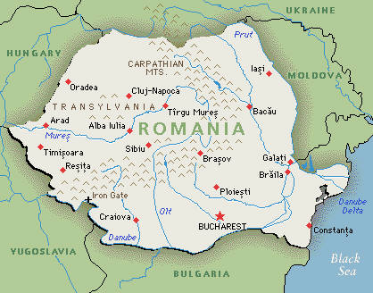
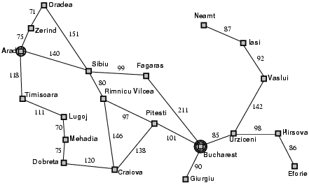
Example: Romania Vacation
Original Description
On vacation in Romania; currently in Arad
Flight leaves tomorrow from Bucharest
Initial state: Arad
Actions: Drive from one city to another.
Transition model and states: If you go from city A to city B, you end up in city B.
Goal state: Bucharest
Path cost: Sum of edge costs.
State Space/Transition model
Defined as a graph
Distance in miles

Slide 10
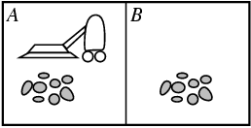
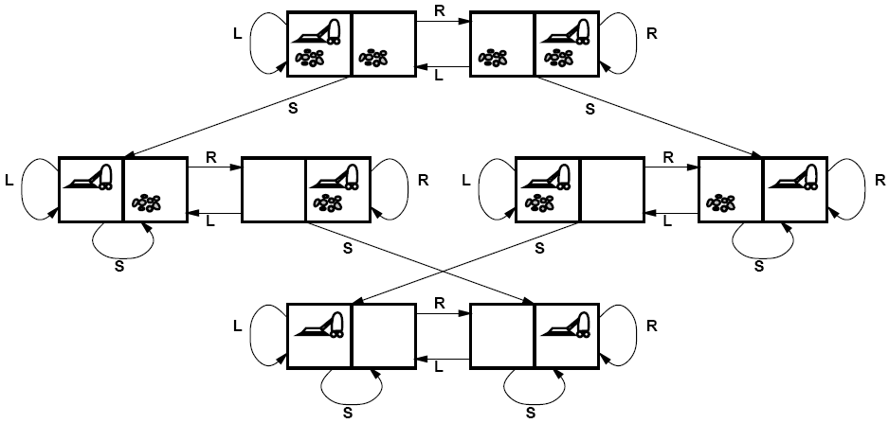
Example: Vacuum world
State Space
Goal states
Initial State: Defined by agent location and dirt location.
Actions: Left, right, suck
Transition model: Clean a location or move.
Goal state: All locations are clean.
Path cost: E.g., number if actions
There are 8 possible atomic states of the system.
Why is the number of states for n possible locations $n\left(2^{n}\right)$?

Slide 11
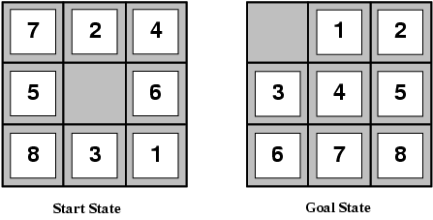
Example: Sliding-tile Puzzle
Initial State: A given configuration.
Actions: Move blank left, right, up, down
Transition model: Move a tile
Goal state: Tiles are arranged empty and 1-8 in order
Path cost: 1 per tile move.
State space size
Each state describes the location of each tile (including the empty one). ½ of the permutations are unreachable.
8-puzzle: $9!/2=181,440$states
15-puzzle: $16!/2 ≈ {10}^{13}$ states
24-puzzle: $25!/2 ≈ 1025$states

Slide 12
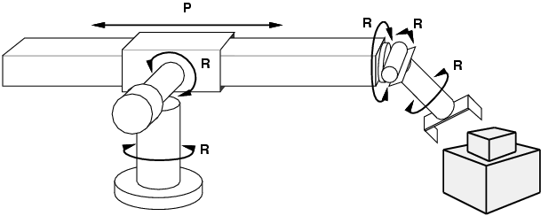
Example: Robot Motion Planning
Initial State: Current arm position.
States: Real-valued coordinates of robot joint angles.
Actions: Continuous motions of robot joints.
Goal state: Desired final configuration (e.g., object is grasped).
Path cost: Time to execute, smoothness of path, etc.

Slide 13
Contents
What are search problems?
Tree search
Uninformed search
Informed search
Search Space

Slide 14
Solving Search Problems
Given a search problem definition
Initial state
Actions
Transition model
Goal state
Path cost
How do we find the optimal solution (sequence of actions/states)?
Construct a search tree for the state space graph!
Initial state
State space
Goal states

Slide 15
Issue: Transition Model is Not a Tree! It can have Redundant Paths
Cycles
Return to the same state. The search tree will create a new node!
Initial state
Non-cycle redundant paths
Multiple paths to get to the same state
Goal states
Initial state
Path 1
Path 2
Goal states

Slide 16
Search Tree
Superimpose a “what if” tree of possible actions and outcomes (states) on the state space graph.
The Root node represents the initial stare.
An action child node is reached by an edge representing an action. The corresponding state is defined by the transition model.
Trees cannot have cycles (loops) or multiple paths to the same state. These are called redundant paths. Cycles in the search space must be broken to prevent infinite loops. Removing other redundant paths improves search efficiency.
A path through the tree corresponds to a sequence of actions (states).
A solution is a path ending in a node representing a goal state.
Nodes vs. states: Each tree node represents a state of the system. If redundant path cannot be prevented then state can be represented by multiple nodes.
Root node = Initial state
a
Edge = Action
Child node
Non-cycle redundant
path
b
c
d
e
e
Cycle
…
…
…
b
Solution path
Node representing a Goal state
f

Slide 17
Differences Between Typical Tree Search and AI Search
Typical tree search
Assumes a given tree that fits in memory.
Trees have by construction no cycles or redundant paths.
AI tree/graph search
The search tree is too large to fit into memory.
Builds parts of the tree from the initial state using the transition function representing the graph.
Memory management is very important.
The search space is typically a very large and complicated graph. Memory-efficient cycle checking is very important to avoid infinite loops or minimize searching parts of the search space multiple times.
Checking redundant paths often requires too much memory and we accept searching the same part multiple times.

Slide 18
Tree Search Algorithm Outline
Initialize the frontier (set of unexplored know nodes) using the starting state/root node.
While the frontier is not empty:
Choose next frontier node to expand according to search strategy.
If the node represents a goal state, return it as the solution.
Else expand the node (i.e., apply all possible actions to the transition model) and add its children nodes representing the newly reached states to the frontier.

Slide 19
Tree Search Example
Frontier
Transition model

Slide 20
Tree Search Example
1. Expand Arad
Frontier
Transition model

Slide 21
Tree Search Example
Frontier
2. Expand Sibiu
Transition model
Example of a cycle
We could have also expanded Timisoara or Zerind!

Slide 22
Search Strategies: Properties
A search strategy is defined by picking the order of node expansion.
Strategies are evaluated along the following dimensions:
Completeness: does it always find a solution if one exists?
Optimality: does it always find a least-cost solution?
Time complexity: how long does it take?
Space complexity: how much memory does it need?

Slide 23
Search Strategies: Time and Space Complexity
A search strategy is defined by picking the order of node expansion.
Worst case time and space complexity are measured in terms of the size of the state space n (= number of nodes in the search tree). $O(n)$
Often used metrics if the state space is only implicitly defined by initial state, actions and a transition function are:
$b$: maximum branching factor of the search tree (number of available actions).
$m$: length of the longest path (loops need to be removed).
$d$: depth of the optimal solution. $n=f\left(d,m,b\right)⇒O(f(d,m,b))$

Slide 24
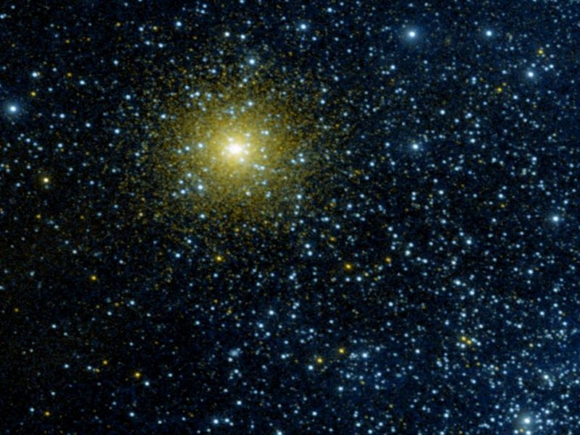
State Space for Search

Slide 25
State Space
Number of different states the agent and environment can be in.
Reachable states are defined by the initial state and the transition model. Not all states may be reachable from the initial state.
Search tree spans the state space. Note that a single state can be represented by several search tree nodes if we have redundant paths.
State space size is an indication of problem size.
State Space Size Estimation
Even if the used algorithm represents the state space using atomic states, we may know that internally they have a factored representation that can be used to estimate the problem size.
The basic rule to calculate (estimate) the state space size for factored state representation with $l$ fluents (variables) is: $n=\left|X_{1}\right|×\left|X_{2}\right|×⋯× \left|X_{l}\right|$ where $\left|⋅\right|$ is the number of possible values.
State representation
$$x_{1}$$
$$x_{2}$$
…
The state consists of variables called fluents that represent conditions that can change over time.

Slide 26
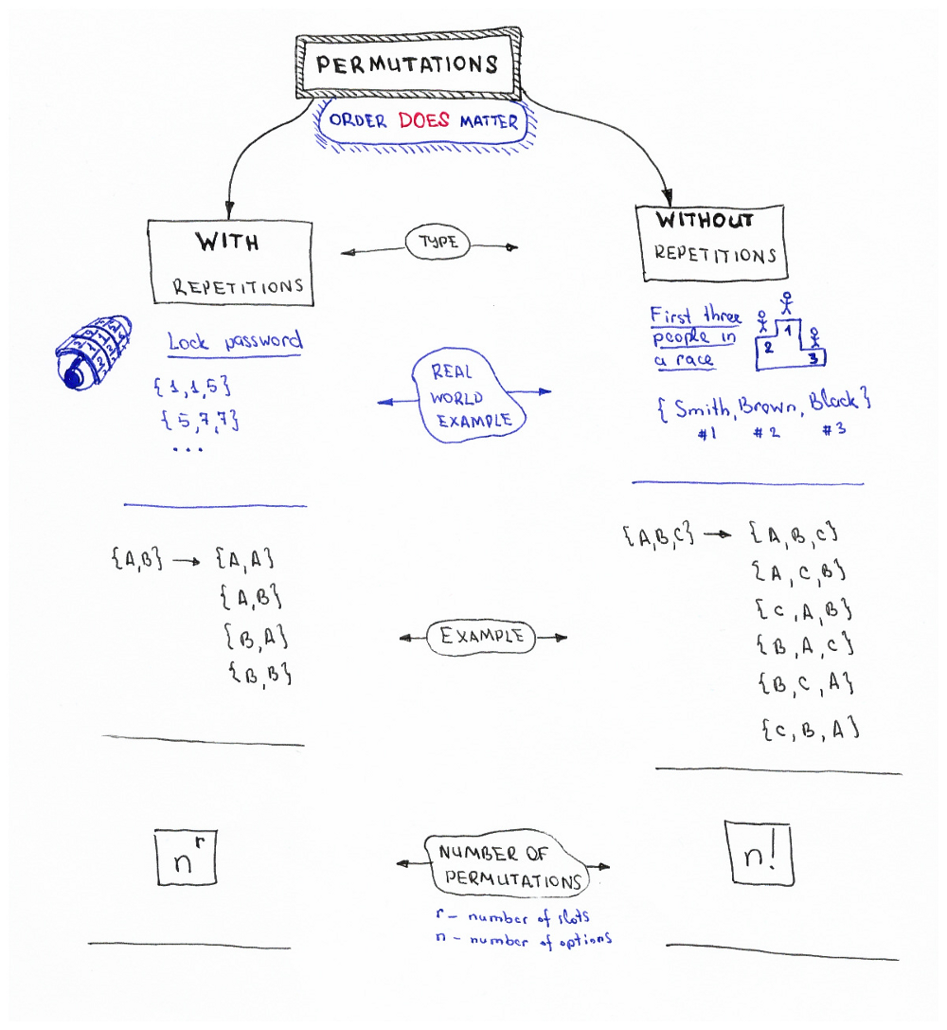
Permutations
In how many ways can we order/arrange n objects?
$$2×2=2^{2}=4$$
$$3×2×1=6$$
Factorial: $n!=n×\left(n−1\right)×…×2×1$
#Python
import math
print (math.factorial(23))
Source: Permutations/Combinations Cheat Sheets by Oleksii Trekhleb https://itnext.io/permutations-combinations-algorithms-cheat-sheet-68c14879aba5

Slide 27
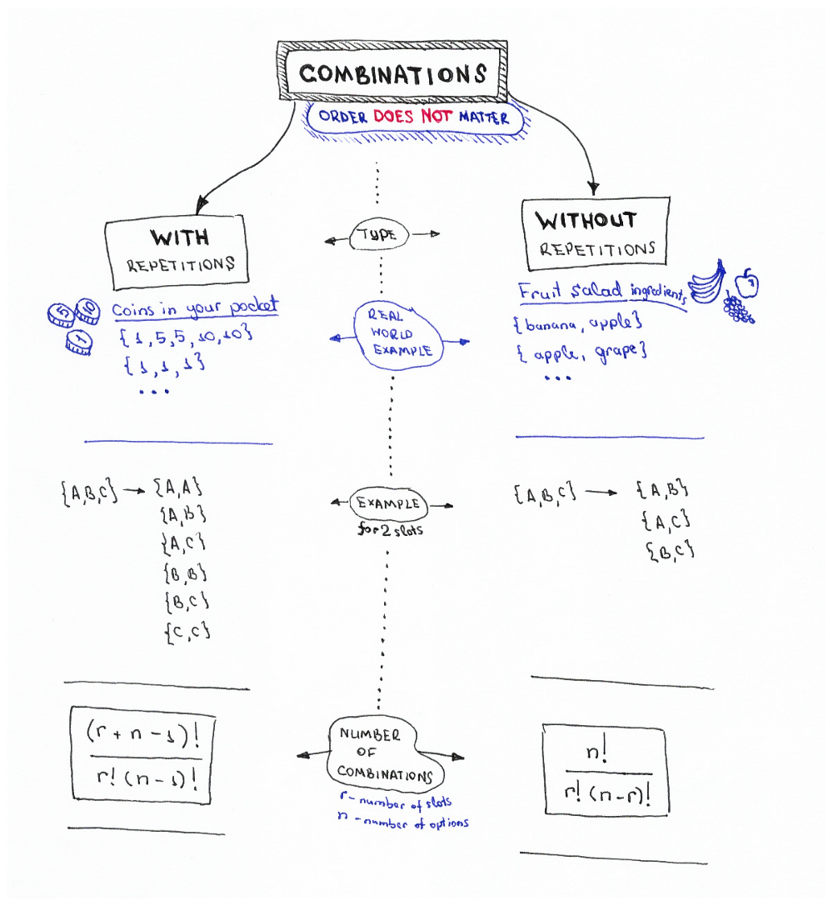
Combinations
Binomial Coefficient: $\left(\begin{matrix}n \\ r\end{matrix}\right)=C\left(n,r\right)={{}_{n}C}_{r}$
Read as “n choose r” because it is the number of ways can we choose $r$ out of $n$ objects?
Special case for $r = 2$: $\left(\begin{matrix}n \\ 2\end{matrix}\right)=\frac{n(n−1)}{2}$
$$\left(\begin{matrix}3 \\ 2\end{matrix}\right)=3$$
#Python
import scipy.special
# the two give the same results
scipy.special.binom(10, 5)
scipy.special.comb(10, 5)
Source: Permutations/Combinations Cheat Sheets by Oleksii Trekhleb https://itnext.io/permutations-combinations-algorithms-cheat-sheet-68c14879aba5

Slide 28
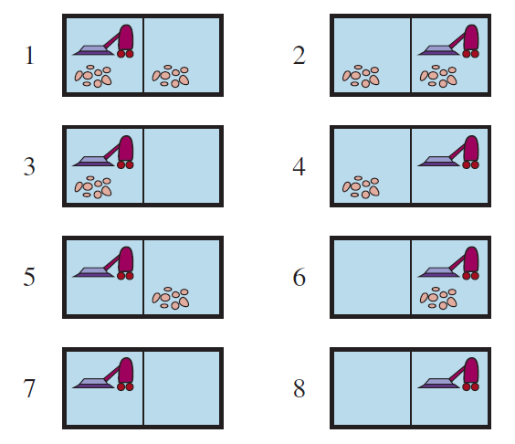
Example: What is the State Space Size?
Dirt
Permutation: A and B are different rooms, order does matter!
With repetition: Dirt can be in both rooms.
There are $2$ options (clean/dirty)
$${→2}^{2}$$
Robot location
Can be in 1 out of 2 rooms.
$$→2$$
Total: $n=2{×2}^{2}=2^{3}=8$
r … # of rooms n … options

Slide 29
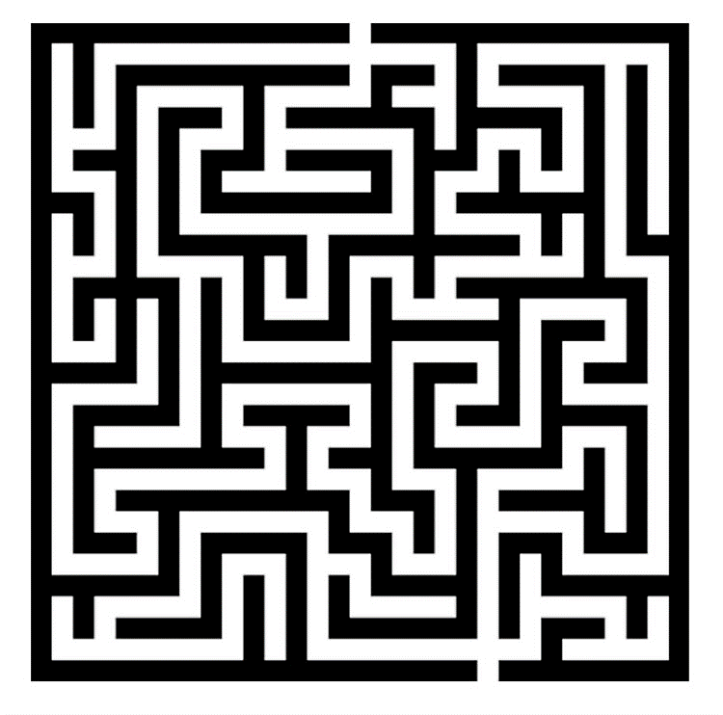
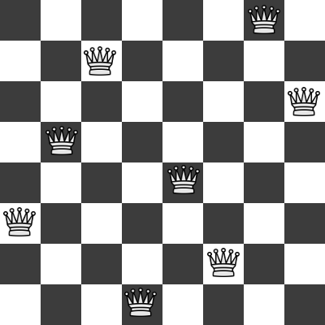
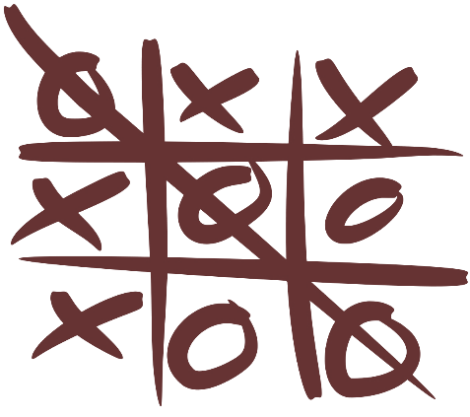
Examples: What is the State Space Size?
Often a rough upper limit is sufficient to determine how hard the search problem is.
Maze
8-queens problem
8-puzzle problem
Tic-tac-toe

Slide 30
Examples: What is the State Space Size?
Often a rough upper limit is sufficient to determine how hard the search problem is.
Maze
8-queens problem
8-puzzle problem
Tic-tac-toe
Positions the agent can be in.
n = Number of white squares.
All arrangements with 8 queens on the board.
$n <2^{64}≈1.8×{10}^{19}$
We can only have 8 queens: $n= \left({64 \atop 8}\right)≈4.4×{10}^{9}$
All arrangements of 9 elements.
$$n≤9!$$
Half is unreachable: $$n=\frac{9!}{2}=181,440$$
All possible boards.
$$n<3^{9}=19,683$$
Many boards are not legal (e.g., all x’s)
The actual number can be obtained by a depth-first traversal of the game tree.

Slide 31
Example: What is the Search Complexity?
$b$: maximum branching factor = number of available actions?
3
$m$: the number of actions in any path? Without loops!
4
$d$: depth of the optimal solution?
3
State Space with Transition Model
Initial state
Goal states

Slide 32
Examples: What is the Search Complexity?
$b$: maximum branching factor
$m$: max. depth of tree
$d$: depth of the optimal solution
Often a rough upper limit is sufficient to determine how hard the search problem is.
Maze
8-queens problem
8-puzzle problem
Tic-tac-toe
$$b =$$
$$m=$$
$$d =$$

Slide 33
Examples: What is the Search Complexity?
$b$: maximum branching factor
$m$: max. depth of tree
$d$: depth of the optimal solution
Often a rough upper limit is sufficient to determine how hard the search problem is.
Maze
8-queens problem
8-puzzle problem
Tic-tac-toe
$b =4$ actions
$m=$ longest path to the goal or a dead end (bounded by $x×y$)
$d =$ shortest path to the goal (bounded by $x×y$)
$b =$ ? What are the actions? Moving one Queen: $64−7=57$
$m=$ We may have to try all: $\left({64 \atop 8}\right)≈4.4×{10}^{9}$
$d =$ move each queen in the right spot = 8
$b =4$ actions to move the empty tile.
$m=$ Try all $O(9!)$
$d =$ ???
$b =9$ actions for the first move.
$$m=9$$
$d =9$ (if both play optimal)

Slide 34
Uninformed Search

Slide 35
Uninformed Search Strategies
The search algorithm/agent is not provided information about how close a state is to the goal state. It just has the labels of the atomic states and the transition function.
It blindly searches following a simple strategy until it finds the goal state by chance.
Search strategies we will discuss:
Breadth-first search
Uniform-cost search
Depth-first search
Iterative deepening search

Slide 36
Breadth-First Search (BFS)
Expansion rule: Expand shallowest unexpanded node in the frontier (=FIFO).
Data Structures
Frontier data structure: holds references to the green nodes (green) and is implemented as a FIFO queue.
Reached data structure: holds references to all visited nodes (gray and green) and is used to prevent visiting nodes more than once (redundant path checking).
Builds a tree with links between parent and child.

Slide 37
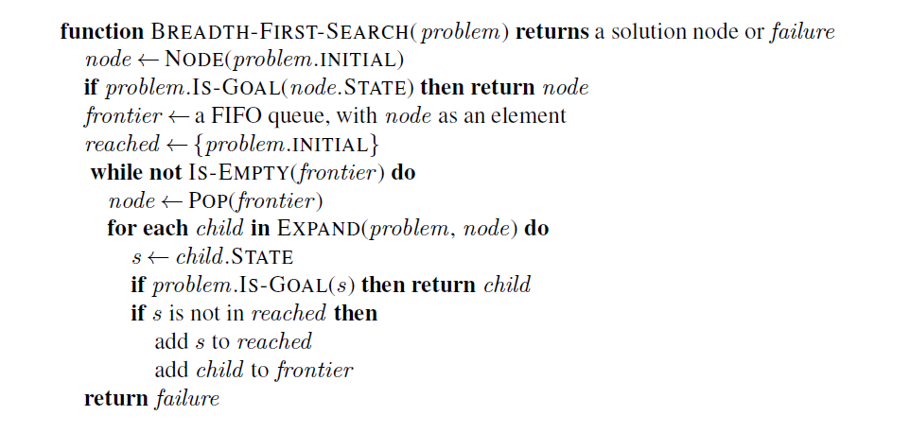
Implementation: BFS
Expand adds the next level below node to the frontier.
reached makes sure we do not visit nodes twice (e.g., in a cycle or other redundant path). Fast lookup is important.

Slide 38
Implementation: Expanding the Search Tree
AI tree search creates the search tree while searching.
The EXPAND function tries all available actions in the current node using the transition function (RESULTS). It returns a list of new nodes for the frontier.
Node structure for the search tree. Yield can also be implemented by returning a list of Nodes.
Transition function

Slide 39
Time and Space Complexity Breadth-First Search
d: depth of the optimal solution
m: max. depth of tree
b: maximum branching factor
A
expanded
b = 2
d = 1
m = 3
Goal
B
C
D
E
F
G
E
C
Goal
All paths to the depth of the goal are expanded:
$$1 +b+b^{2}+ …+b^{d}⇒O\left(b^{d}\right)$$

Slide 40
Properties of Breadth-First Search
d: depth of the optimal solution
m: max. depth of tree
b: maximum branching factor
Complete?
Yes
Optimal?
Yes – if cost is the same per step (action). Otherwise: Use uniform-cost search.
Time?
Number of nodes created: $O(b^{d})$
Space?
Stored nodes: $O(b^{d})$
Note:
The large space complexity is usually a bigger problem than time!

Slide 41
Uniform-cost Search (= Dijkstra’s Shortest Path Algorithm)
Expansion rule: Expand node in the frontier with the least path cost from the initial state.
Implementation: best-first search where the frontier is a priority queue ordered by lower $f(n)$ = path cost (cost of all actions starting from the initial state).
Breadth-first search is a special case when all step costs being equal, i.e., each action costs the same!
Complete?
Yes, if all step cost is greater than some small positive constant ε > 0
Optimal?
Yes – nodes expanded in increasing order of path cost
Time?
Number of nodes with path cost ≤ cost of optimal solution (C*) is O(b^{1+C*/ ε}).
This can be greater than O(b^{d}): the search can explore long paths consisting of small steps before exploring shorter paths consisting of larger steps
Space?
O(b^{1+C*/ ε})
See Dijkstra's algorithm on Wikipedia
d: depth of the optimal solution
m: max. depth of tree
b: maximum branching factor

Slide 42
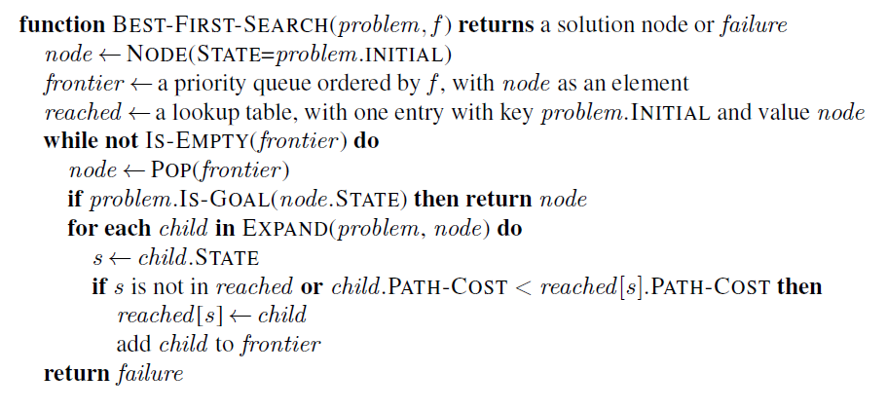
Implementation: Best-First Search Strategy
The order for expanding the frontier is determined by f(n) = path cost from the initial state to node n.
This check is the difference to BFS! It visits a node again if it can be reached by a better (cheaper) path.
See BFS for function EXPAND.

Slide 43
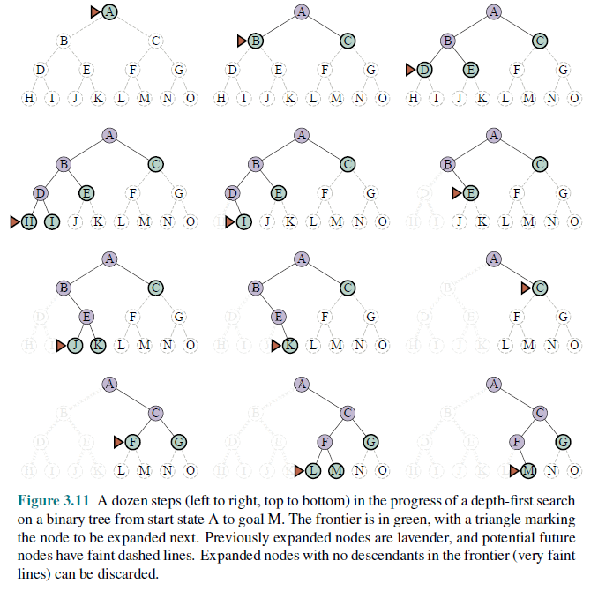
Depth-First Search (DFS)
Expansion rule: Expand deepest unexpanded node in the frontier (last added).
Frontier: stack (LIFO)
No reached data structure! Cycle checking checks only the current path. Redundant paths can not be identified and lead to replicated work.

Slide 44
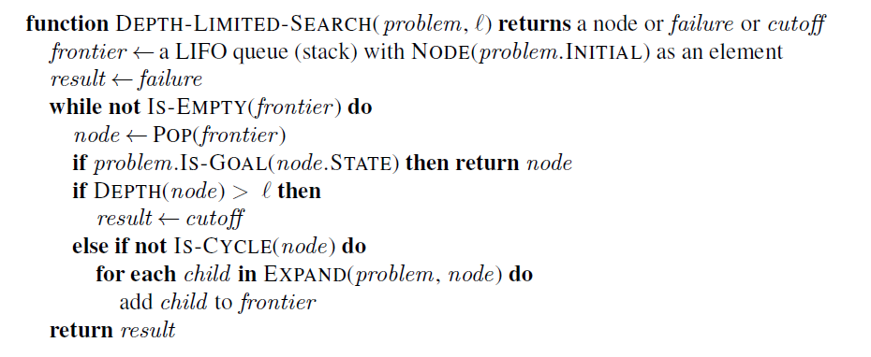
Implementation: DFS
DFS could be implemented like BFS/Best-first search and just taking the last element from the frontier (LIFO).
However, to reduce the space complexity to $O(bm)$, the reached data structure needs to be removed! Options:
Recursive implementation (cycle checking is a problem leading to infinite loops)
Iterative implementation: Build tree and abandoned branches are removed from memory. Cycle checking is only done against the current path. This is similar to Backtracking search.
DFS uses ℓ $=∞$
If we only keep the current path from the root to the current node in memory, then we can only check against that path to prevent cycles, but we cannot prevent other redundant paths. We also need to make sure the frontier does not contain the same state more then once!
See BFS for function EXPAND.

Slide 45
Time and Space Complexity Depth-First Search
d: depth of the optimal solution
m: max. depth of tree
b: maximum branching factor
A
b = 2
d = 1
C
B
Goal
m = 3
E
D
H
I
Goal
DFS finds this goal first ⬄ Not optimal!
Time: $O(bm)$ – worst case is expanding all paths.
Space: $O(bm)$ - if it only stores the frontier nodes and the current path.

Slide 46
Properties of Depth-First Search
Complete?
Only in finite search spaces. Cycles can be avoided by checking for repeated states along the path.
Incomplete in infinite search spaces (e.g., with cycles).
Optimal?
No – returns the first solution it finds.
Time?
The worst case is to reach a solution at maximum depth m in the last path: $O\left(bm\right)$ Terrible compared to BFS if $m≫d.$
Space?
$O\left(bm\right)$ is linear in max. tree depth $m$ which is very good but only achieved if no reached data structure and memory management (forget old branches) is used! Cycles can be broken but redundant paths cannot be checked.
d: depth of the optimal solution
m: max. depth of tree
b: maximum branching factor

Slide 47
Iterative Deepening Search (IDS)
Can we
get DFS’s good memory footprint,
avoid infinite cycles, and
preserve BFS’s optimality guaranty?
Use depth-restricted DFS and gradually increase the depth.
Check if the root node is the goal.
Do a DFS searching for a path of length 1
If goal not found, do a DFS searching for a path of length 2
If goal not found, do a DFS searching for a path of length 3
…

Slide 48
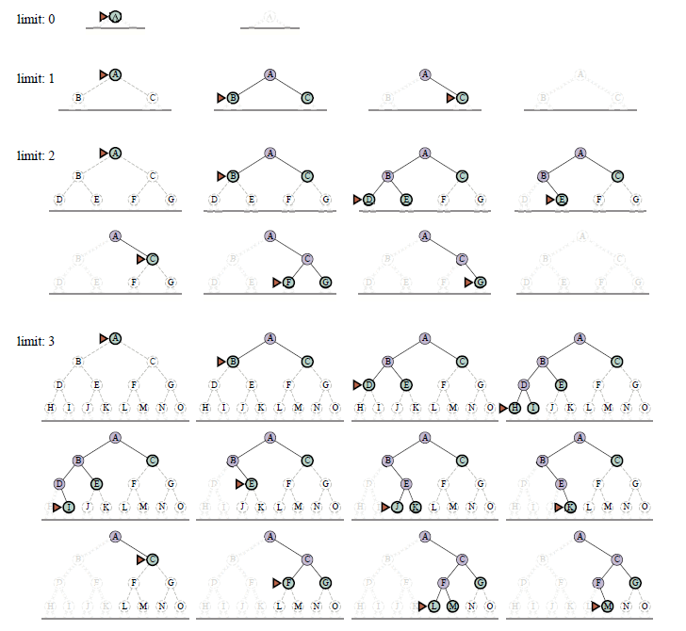
Iterative Deepening Search (IDS)

Slide 49
Implementation: IDS
See BFS for function EXPAND.

Slide 50
Properties of Iterative Deepening Search
Complete?
Yes
Optimal?
Yes, if step cost = 1 (like BFS)
Time?
Consists of rebuilding trees up to $d$ times
$db + (d−1)b2 + … + {1b}^{d} = O(b^{d})$⬄ Slower than BFS, but the same complexity class!
Space?
O(bd) ⬄ linear space. Even less than DFS since $m≤d$. Cycles need to be handled by the depth-limited DFS implementation.
Note: IDS produces the same result as BFS but trades better space complexity for worse run time.
d: depth of the optimal solution
m: max. depth of tree
b: maximum branching factor
This makes IDS/DFS the workhorse of AI.

Slide 51
Informed Search

Slide 52
Informed Search
AI search problems typically have a very large search space. We would like to improve efficiency by expanding as few nodes as possible.
The agent can use additional information in the form of “hints” about what promising states are to explore first. These hints are derived from
information the agent has (e.g., a map with the goal location marked) or
percepts coming from a sensor (e.g., a GPS sensor and coordinates of the goal).
The agent uses a heuristic function $h(n)$ to rank nodes in the frontier and always select the most promising node in the frontier for expansion using the best-first search strategy.
Algorithms:
Greedy best-first search
A* search

Slide 53
Heuristic Function
Heuristic function $h(n)$estimates the cost of reaching a node representing the goal state from the current node $n$.
Examples:
Euclidean distance
Manhattan distance
Start state
Start state
Goal state
Goal state

Slide 54
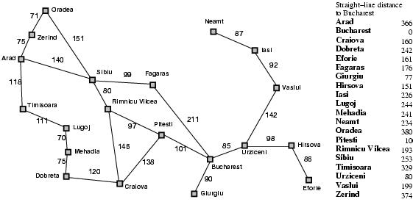
Heuristic for the Romania Problem
Estimate the driving distance from Arad to Bucharest using a straight-line distance.
h(n)
366

Slide 55
Greedy Best-First Search Example
Expansion rule: Expand the node that has the lowest value of the heuristic function h(n)
h(n)=

Slide 56
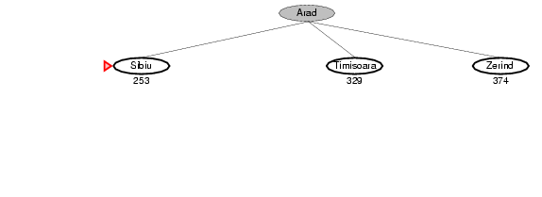
Greedy Best-First Search Example

Slide 57
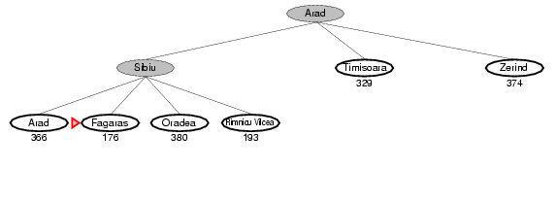
Greedy Best-First Search Example

Slide 58
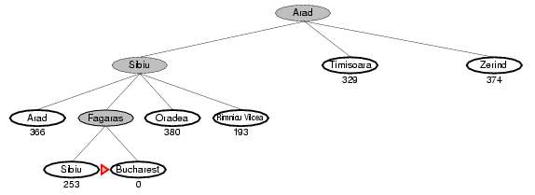
Greedy Best-First Search Example
Total:
140 + 99 + 211 = 450 miles

Slide 59
Properties of Greedy Best-First Search
Complete?
Yes – Best-first search if complete in finite spaces.
Optimal?
No
Total:
140 + 99 + 211 = 450 miles
Alternative through Rimnicu Vilcea:
140 + 80 + 97 + 101 = 418 miles

Slide 60
Implementation of Greedy Best-First search
Best-First Search
Expand the frontier using $$f\left(n\right)=h(n)$$
Expand the frontier using 𝑓(𝑛)=ℎ(𝑛)

Slide 61
Implementation of Greedy Best-First Search
Heuristic $h(n)$ so we expand the node with the lowest estimated cost
The order for expanding the frontier is determined by f(n)
This check is the different to BFS! It visits a node again if it can be reached by a better (cheaper) path.
See BFS for function EXPAND.

Slide 62
Properties of Greedy Best-First Search
Complete?
Yes – Best-first search if complete in finite spaces.
Optimal?
No
Time?
Worst case: O(b^{m}) ⬄ like DFS
Best case: O(bm) – If $h(n)$ is 100% accurate we only expand a single path.
Space?
Same as time complexity.
d: depth of the optimal solution
m: max. depth of tree
b: maximum branching factor

Slide 63
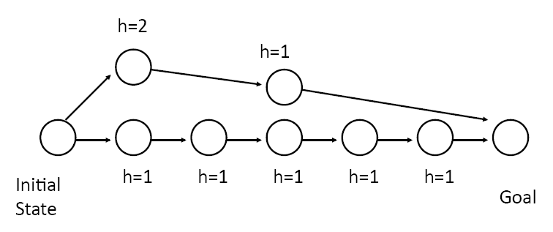
The Optimality Problem of Greedy Best-First search
Greedy best-first search only considers the estimated cost to the goal.
$h=1$ is always better than $h=2$. Greedy best-first will go this way and never reconsider!

Slide 64
A* Search
$f\left(n′\right)=3$
n’
$g(n)$ = 3
$f\left(n\right)=4$
n
Idea: Take the cost of the path to $n$ called $g(n)$ into account to avoid expanding paths that are already very expensive.
The evaluation function $f(n)$ is the estimated total cost of the path through node $n$ to the goal:
$$f(n) = g(n) + h(n)$$
$g(n)$: cost so far to reach n (path cost)
$h(n)$: estimated cost from n to goal (heuristic)
The agent in the example above will stop at n with $f\left(n\right)=3+1=4$and chose the path up with a better $f\left(n’\right)=1+2=3.$
Note: For greedy best-first search we just used $f(n) = h(n).$
Notes:
Dates back to 1968

Slide 65
A* Search Example
Expansion rule: Expand the node with the smallest f(n)
$$f\left(n\right)=g(n)+h(n)=$$
$$h(n)$$

Slide 66
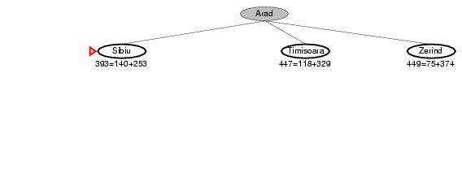
A* Search Example
$$f\left(n\right)=g\left(n\right)+h(n)$$
$$h(n)$$

Slide 67
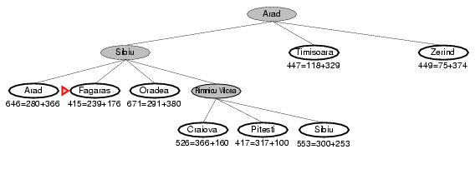
A* Search Example
$$f\left(n\right)=g\left(n\right)+h(n)$$
$$h(n)$$

Slide 68
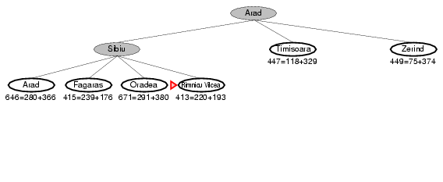
A* Search Example
$$f\left(n\right)=g\left(n\right)+h(n)$$
$$h(n)$$

Slide 69
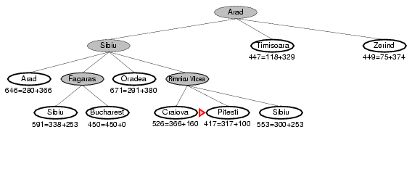
A* Search Example
$$f\left(n\right)=g\left(n\right)+h(n)$$
$$h(n)$$

Slide 70
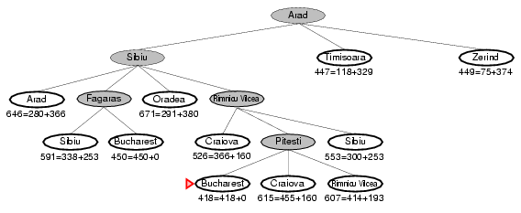
A* Search Example
$$f\left(n\right)=g\left(n\right)+h(n)$$
$$h(n)$$

Slide 71
BFS vs. A* Search
BFS
A*
A*
Source: Wikipedia

Slide 72
Implementation of A* Search
Path cost to $n$ + heuristic from $n$ to goal = estimate of the total cost $$g\left(n\right)+h(n)$$
The order for expanding the frontier is determined by $f(n)$
This check is different to BFS! It visits a node again if it can be reached by a better (cheaper) redundant path.
See BFS for function EXPAND.

Slide 73
Optimality: Admissible Heuristics
Definition: A heuristic $h$ is admissible if for every node $n$, $h\left(n\right)≤ h^{∗}(n)$, where $h^{∗}(n)$ is the true cost to reach the goal state from $n$.
I.e., an admissible heuristic is a lower bound and never overestimates the true cost to reach the goal.
Example: straight line distance never overestimates the actual road distance.
Theorem: If $h$ is admissible, A* is optimal.

Slide 74
Proof of Optimality of A*
$$f(n) = g(n) + h(n)$$
For goal states:
$$f(n^{∗}) = g(n) +0$$
n* (goal)
Any unexplored node $n$ has:
$$C^{∗}=f(n^{∗}) = g(n^{∗}) + 0$$
n
$$f\left(n\right)≥ f(n^{∗})$$
n’ (other goal)
$$g\left(n^{′}\right)≥ f\left(n\right)⟺g\left(n^{′}\right)≥ C^{∗}$$
Suppose A* terminates its search at goal $n^{∗}$ at a cost of $C^{∗}=f\left(n^{∗}\right)$.
All unexplored nodes $n$ have $f\left(n\right)≥ f(n^{∗})$or they would have been explored before $n^{∗}.$
Since $f(n)$ is an optimistic estimate, it is impossible for $n$ to have a successor goal state $n’$ with $C′< C^{∗}$.
This proofs that $n^{∗}$ must be an optimal solution.

Slide 75
Guarantees of A*
A* is optimally efficient
No other tree-based search algorithm that uses the same heuristic can expand fewer nodes and still be guaranteed to find the optimal solution.
Any algorithm that does not expand all nodes with$f(n) < C^{∗}$(the lowest cost of going to a goal node) cannot be optimal. It risks missing the optimal solution.

Slide 76
Properties of A*
Complete?
Yes
Optimal?
Yes
Time?
Number of nodes for which $f(n) ≤ C^{∗}$(exponential)
Space?
Same as time complexity. This is often too much unless a very good heuristic is know.

Slide 77
Designing Heuristic Functions
Heuristics for the 8-puzzle
$h1(n)$ = number of misplaced tiles
$h2(n)$ = total Manhattan distance (number of squares from desired location of each tile)
$$h1(start) = 8$$
$$h2(start) = 3+1+2+2+2+3+3+2 = 18$$
Are $h1$ and $h2$ admissible?
1 needs to move 3 positions

Slide 78
Heuristics from Relaxed Problems
A problem with fewer restrictions on the actions is called a relaxed problem.
The cost of an optimal solution to a relaxed problem is an admissible heuristic for the original problem. I.e., the true cost is never smaller.
What relaxation is used by $h_{1}$ and $h_{2}$?
$h1$: If the rules of the 8-puzzle are relaxed so that a tile can move anywhere, then $h1(n)$gives the shortest solution.
$h2$: If the rules are relaxed so that a tile can move to any adjacent square, then $h2(n)$gives the shortest solution.
$$h1(start) = 8$$
$$h2(start)= 3+1+2+2+2+3+3+2 = 18$$

Slide 79
Heuristics from Relaxed Problems
What relaxations are used in these two cases?
Euclidean distance
Manhattan distance
Start state
Start state
Goal state
Goal state

Slide 80
Heuristics from Subproblems
Let $h3(n)$ be the cost of getting a subset of tiles (say, 1,2,3,4) into their correct positions. The final order of the * tiles does not matter.
Small subproblems are often easy to solve.
Can precompute and save the exact solution cost for every or many possible subproblem instances – pattern database.
*
*
*
*
*
*
*
*

Slide 81
Dominance: What Heuristic is Better?
Definition: If $h1$ and $h2$ are both admissible heuristics and $h2(n) ≥ h1(n)$for all $n$, then $h2$ dominates $h1$
Is $h1$or $h2$ better for A* search?
A* search expands every node with $f(n) < C^{∗}$⬄ $h(n) < C^{∗} – g(n)$
$h2$ is never smaller than $h1$. A* search with $h2$ will expand less nodes and is therefore better.

Slide 82
Example: Effect of Information in Search
Typical search costs for the 8-puzzle
Solution at depth $d=12$ IDS = 3,644,035 nodes A*($h1$) = 227 nodes A*($h2$) = 73 nodes
Solution at depth $d=24$ IDS ≈ 54,000,000,000 nodes A*($h1$) = 39,135 nodes A*($h2$) = 1,641 nodes

Slide 83
Combining Heuristics
Suppose we have a collection of admissible heuristics $h1, h2, …, hm,$but none of them dominates the others.
Combining them is easy:
$$h(n) = max⁡\{h1(n), h2(n), …, hm(n)\}$$
That is, always pick for each node the heuristic that is closest to the real cost to the goal $h^{∗}(n)$.

Slide 84
Satisficing Search: Weighted A* Search
Often it is sufficient to find a “good enough” solution if it can be found very quickly or with way less computational resources. I.e., expanding fewer nodes.
We could use inadmissible heuristics in A* search (e.g., by multiplying $h(n)$ with a factor $W$) that sometimes overestimate the optimal cost to the goal slightly.
It potentially reduces the number of expanded nodes significantly.
This will break the algorithm’s optimality guaranty!
$$f\left(n\right)=g\left(n\right)+W×h(n)$$
Weighted A* search: $g\left(n\right)+W×h\left(n\right)$ $(1<W<∞)$
The presented algorithms are special cases:
A* search: $g\left(n\right)+h\left(n\right)$ $(W=1)$
Uniform cost search/BFS: $g\left(n\right)$ $(W=0)$
Greedy best-first search: $h\left(n\right)$ $\left(W=∞\right)$

Slide 85
Example of Weighted A* Search
Reduction in the number of expanded nodes
Breadth-first Search (BFS)
$f\left(n\right)=$# actions to reach n
Exact A* Search $$f\left(n\right)= g(n)+h_{Eucl}(n)$$
Weighted A* Search
$$f(n) = g(n)+5 h_{Eucl}(n)$$
Source and Animation: Wikipedia

Slide 86
Memory-Bounded Search
The memory usage of A* (search tree and frontier) can still be exorbitant.
How can we make A* more memory-efficient while maintaining completeness and optimality?
Iterative deepening A* search.
Recursive best-first search, SMA*: Forget some subtrees but remember the best f-value in these subtrees and regenerate them later if necessary.
Problems: memory-bounded strategies can be complicated to implement and suffer from “memory thrashing” (regenerating forgotten nodes like IDS).

Slide 87
Implementation as Best-First Search
All discussed search strategies can be implemented using Best-first search.
Best-first search expands always the node with the minimum value of an evaluation function $f(n)$.
Important note: Do not implement DFS/IDS using Best-first Search! You will get the poor space complexity and the disadvantages of DFS (not optimal and worse time complexity)
Search Strategy | Evaluation function $f(n)$
BFS (Breadth-first search) | $g(n)$ (=uniform path cost)
Uniform-cost Search | $g(n)$ (=path cost)
DFS/IDS (see note below!) | $$−g(n)$$
Greedy Best-first Search | $$h(n)$$
(weighted) A* Search | $$g\left(n\right)+W×h(n)$$

Slide 88
Summary: Uninformed Search Strategies
Algorithm | Complete? | Optimal? | Time complexity | Space complexity
BFS (Breadth-first search)
Uniform-cost Search
DFS
IDS
Yes
If all step costs are equal
$$O(bd)$$
$$O(bd)$$
Yes
Yes
Number of nodes with $g\left(n\right)≤C^{∗}$
In finite spaces (cycle checking)
No
$$O(bm)$$
$$O(bm)$$
Yes
If all step costs are equal
$$O(bd)$$
$$O(bd)$$
b: maximum branching factor of the search tree
d: depth of the optimal solution
m: maximum length of any path in the state space
C*: cost of optimal solution
Notes:
When is UCS equivalent to BFS?
Can the complexity of UCS exceed the complexity of BFS?
How to make DFS complete?
When is DFS better than BFS?

Slide 89
Summary: All Search Strategies
Algorithm | Complete? | Optimal? | Time complexity | Space complexity
BFS (Breadth-first search)
Uniform-cost Search
DFS
IDS
Greedy best-first Search
A* Search
Yes
If all step costs are equal
$$O(bd)$$
$$O(bd)$$
Yes
Yes
Number of nodes with $g(n) ≤ C^{∗}$
In finite spaces (cycles checking)
No
$$O(bm)$$
$$O(bm)$$
Yes
If all step costs are equal
$$O(bd)$$
$$O(bd)$$
In finite spaces (cycles checking)
Depends on heuristic
Worst case: $O(bm)$
No
Best case: $O(bd)$
Number of nodes with $$g(n)+h(n) ≤ C^{∗}$$
Yes
Yes

Slide 90
Planning vs. Execution Phase
Planning is done by a planning function using search. The result is a plan.
The plan can be executed by a model-based agent function. The used model is the plan + a step counter so the agent function can follow the plan.
Planning function
Execution function at step 2 in the plan
Agent
Step
Plan
…
1
S
S
S
E
…
Agent’s State
(= program counter)
2
3
4
Step 2
…
Note: The agent does not use percepts or the transition function. It blindly follows the plan. Caution: This only works in an environment with deterministic transitions.

Slide 91
Complete Planning Agent for a Maze-Solving Agent
Map = Transition function + initial and goal state
Physical agent
has an event loop:
Read sensors
Call agent function
Execute action in the physical environment
Repeat
Environment
Physical Maze
Planning function
Sensors
Sensor input
Need to plan or replan
percepts
State
Plan
Agent function
action
Follow the plan
Counter in plan
Actuators
Execute action in the physical environment
The event loop calls the agent function for the next action.
The agent function follows the plan or calls the planning function if there is no plan yet or it thinks the current plan does not work based on the percepts (replanning).

Slide 92
Conclusion
Tree search can be used for planning actions for goal-based agents in known, fully observable and deterministic environments.
Issues are:
The large search space typically does not fit into memory. We use a transition function as a compact description of the transition model.
The search tree is built on the fly, and we have to deal with cycles, redundant paths, and memory management.
IDS is a memory efficient method used often in AI for uninformed search.
Informed search uses heuristics based on knowledge or percepts to improve search performance (i.e., A* expand fewer nodes than BFS).

