Slide 1
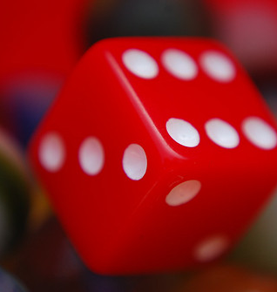

CS 5/7320
Artificial Intelligence
Quantifying Uncertainty: Probabilities
AIMA Chapter 12
Slides by Michael Hahsler
based on slides by Svetlana Lazepnik
with figures from the AIMA textbook
This work is licensed under a Creative Commons Attribution-ShareAlike 4.0 International License.
Cover image: "Dice"
by Steve A Johnson
Online Material

Slide 2
Contents
Making Decisions under Uncertainty
Independence between Events
Bayesian Decision Making
Example: Naïve Bayesian Classifier
Probability Theory and Bayes’ Rule

Slide 3

Example: Catching a Flight with a Logical Agent
Let action A_{t} = leave for airport t minutes before flight
Question: Will A_{t} get me there on time?
Problems:
    Partial observability (road state, other drivers' plans, etc.)
    Noisy sensors (traffic reports)
    Uncertainty in action outcomes (flat tire, etc.)
    Complexity of modeling and predicting traffic
Logical leads to the following conclusions:
    A₂₅ will get me there on time if there is no accident on the bridge and it doesn't rain and my tires remain intact, etc., etc.
    A_{Inf} guarantees to get there in time, but who lives forever?
Logic creates conclusions that are too weak for effective decision making!
Uncertainty is really bad for logical agents!

Slide 4
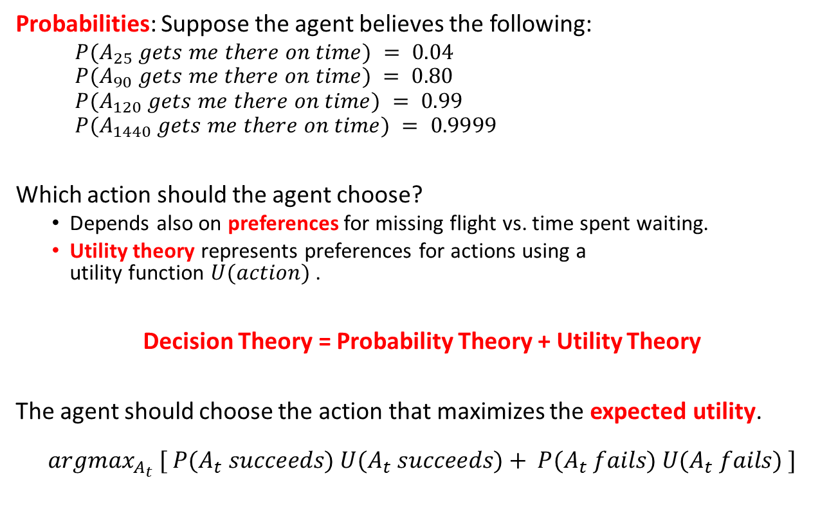
Example: Catching a Flight
Making a Decision Under Uncertainty
Probabilities: Suppose the agent believes the following:
  $P(A_{25} gets me there on time) = 0.04$
  $$P(A_{90} gets me there on time) = 0.80$$
  $$P(A_{120} gets me there on time) = 0.99$$
  $$P(A_{1440} gets me there on time) = 0.9999$$
Which action should the agent choose?
  Depends also on preferences for missing flight vs. time spent waiting.
  Utility theory represents preferences for actions using a
  utility function $U(action)$ .
Decision Theory = Probability Theory + Utility Theory
The agent should choose the action that maximizes the expected utility.
$$argmax_{A_{t}} [ P(A_{t} succeeds) U(A_{t} succeeds)+ P(A_{t} fails) U(A_{t} fails) ]$$

Slide 5
Sources of Uncertainty
Probabilistic assertions summarize effects of:
Ignorance
Lack of explicit theories, relevant facts, observability, etc.
Randomness
Intrinsically random behavior
Laziness
Failure to enumerate exceptions, qualifications, etc.
Example: What is the source of uncertainty for a coin toss?

Slide 6
What are Probabilities?
Frequentism (Objective; Positivist)
Probabilities are long-run relative frequencies determined by observation.
For example, if we toss a coin many times$, P(heads)$is estimated as the proportion of the time the coin will come up heads
For example, if we toss a coin many times, 𝑃(ℎ𝑒𝑎𝑑𝑠) is estimated as the proportion of the time the coin will come up heads
But what if we are dealing with events that only happen once? E.g., what is the probability that a Republican will win the presidency in 2024? How do we define comparable elections? Reference class problem.
Bayesian Statistics (Subjective)
Probabilities are degrees of belief based on prior knowledge and updated by evidence.
Assign belief values to statements without evidence
Update our degrees of belief given observations = Learning
Provides tools to:
Good if we have
lots of data
Good for little data
and learning

Slide 7
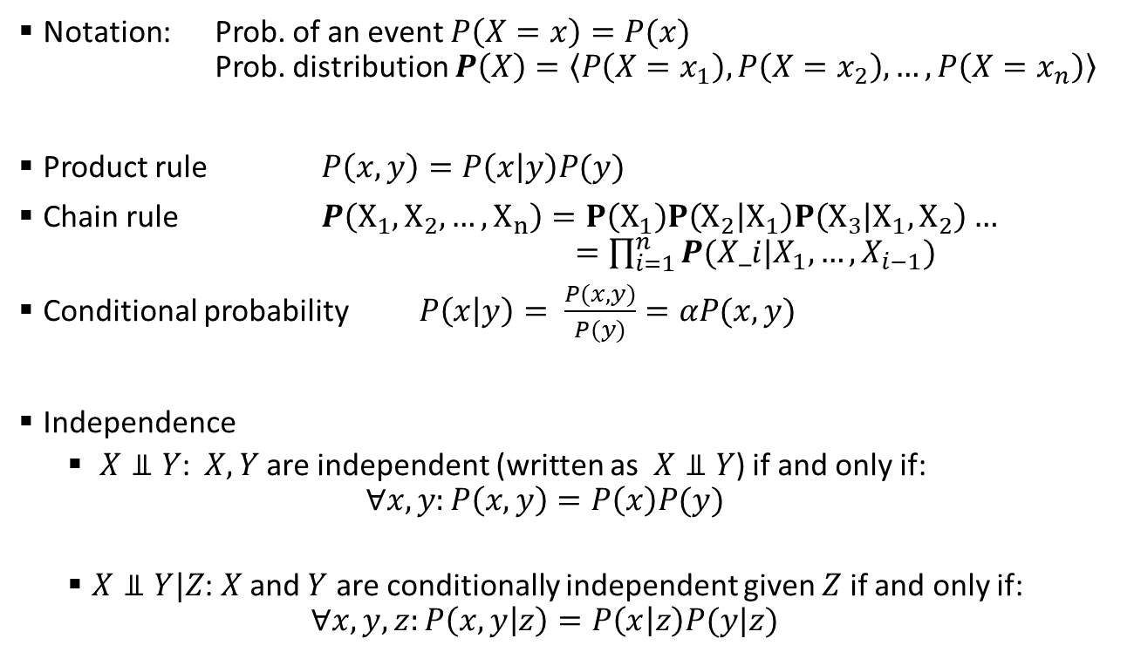
Probability Theory Recap
Notation: Prob. of an event $P\left(X=x\right)=P(x)$
Prob. distribution $P\left(X\right)=\left\langle P\left(X=x_{1}\right), P\left(X=x_{2}\right), …, P\left(X=x_{n}\right)\right\rangle$
Product rule $P\left(x,y\right)=P\left(x | y\right)P(y)$
Chain rule $P\left(X_{1},X_{2},…,X_{n}\right)=P\left(X_{1}\right)P\left(X_{2} | X_{1}\right)P\left(X_{3} | X_{1},X_{2}\right)…$
$=\prod_{i=1}^{n}{P(X_i|X_{1},…,X_{i−1})}$
Conditional probability $P\left(x | y\right)= \frac{P(x,y)}{P(y)}=αP(x,y)$
Independence
  $X⫫Y$: $X, Y$are independent (written as $X⫫Y$) if and only if:
  $∀x,y:P\left(x,y\right)=P\left(x\right)P(y)$
  $X⫫Y|Z$: $X$ and $Y$ are conditionally independent given $Z$ if and only if:
  $∀x,y,z:P\left(x,y | z\right)=P\left(x | z\right)P(y|z)$

Slide 8
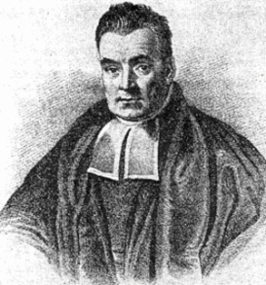
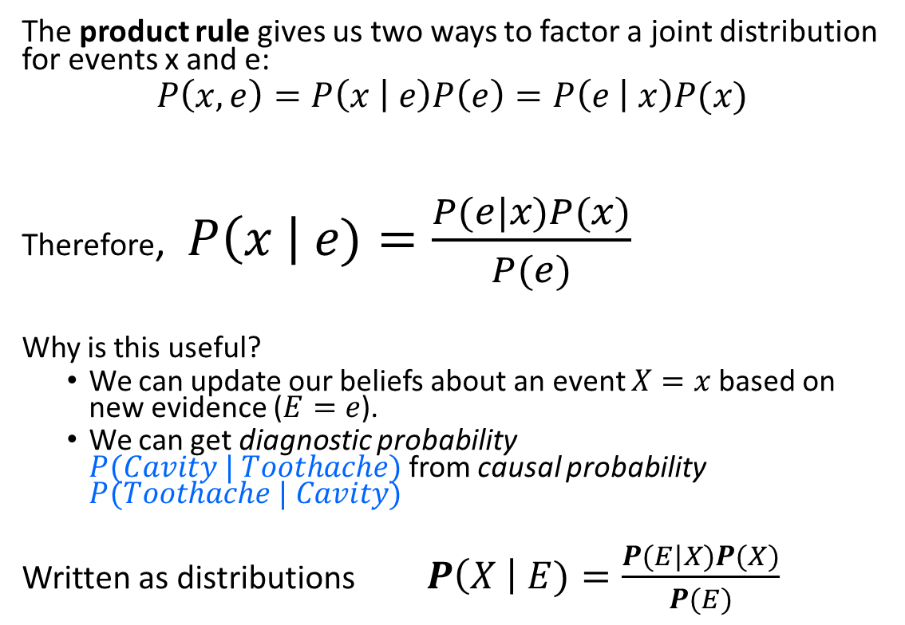
Bayesian Update: Bayes’ Rule
The product rule gives us two ways to factor a joint distribution for events x and e:
$$P\left(x,e\right)=P\left(x | e\right)P\left(e\right)=P\left(e | x\right)P(x)$$
Therefore, $P\left(x \right| e)=\frac{P(e|x)P(x)}{P(e)}$
Why is this useful?
  We can update our beliefs about an event $X=x$ based on new evidence ($E=e$).
  We can get diagnostic probability $P(Cavity | Toothache)$from causal probability $P(Toothache | Cavity)$
Written as distributions $P\left(X \right| E)=\frac{P(E|X)P(X)}{P(E)}$
Posterior Prob.
Prior Prob.
Rev. Thomas Bayes
(1702-1761)

Slide 9
Problem: Getting Married in the Desert
Marie is getting married tomorrow, at an outdoor ceremony in the desert. In recent years, it has rained only 5 days each year (5/365 = 0.014). Unfortunately, the weatherman has predicted rain for tomorrow. When it actually rains, the weatherman correctly forecasts rain 90% of the time. When it doesn't rain, he incorrectly forecasts rain 10% of the time. What is Marie’s belief for the probability that it will rain on her wedding day?

Slide 10
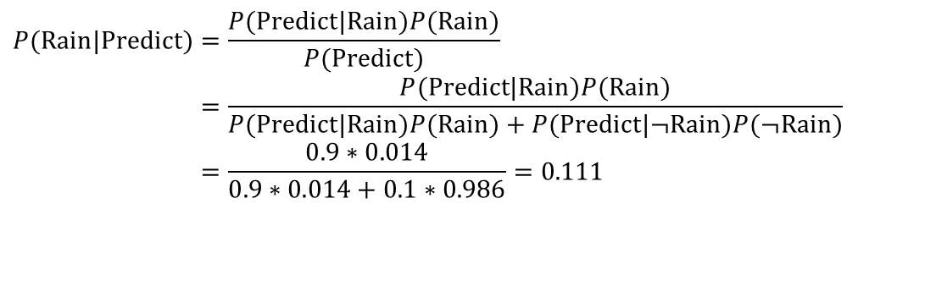
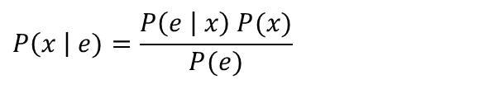
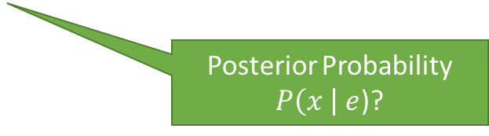

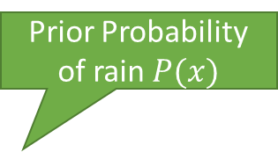
Example: Getting Married in the Desert
New Evidence $e$
Prior Probability of rain $P(x)$
Marie is getting married tomorrow, at an outdoor ceremony in the desert. In recent years, it has rained only 5 days each year (5/365 = 0.014). Unfortunately, the weatherman has predicted rain for tomorrow. When it actually rains, the weatherman correctly forecasts rain 90% of the time. When it doesn't rain, he incorrectly forecasts rain 10% of the time. What is Marie’s belief for the probability that it will rain on her wedding day?
$$P\left(x \right| e)=\frac{P\left(e | x\right) P(x)}{P(e)}$$
Posterior Probability
$P\left(x \right| e$)?
$$P(\text{Rain}|\text{Predict})=\frac{P(\text{Predict}|\text{Rain})P(\text{Rain})}{P(\text{Predict})} \\ =\frac{P(\text{Predict}|\text{Rain})P(\text{Rain})}{P(\text{Predict}|\text{Rain})P(\text{Rain})+P(\text{Predict}|¬\text{Rain})P(¬\text{Rain})} \\ =\frac{0.9∗0.014}{0.9∗0.014+0.1∗0.986}=0.111$$
The weather forecast changes her belief from 0.014 to 0.111. She thinks now that the chance of rain tomorrow is now about 10-times larger!

Slide 11
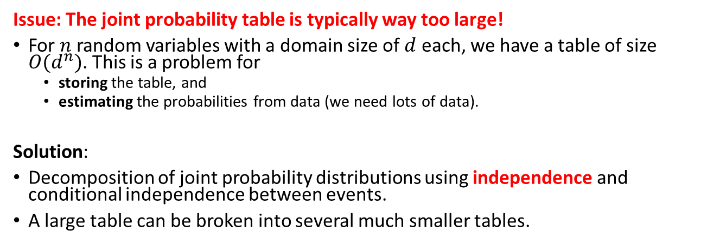
Issue With Applying Bayes’ Theorem
Estimate Joint Probability Distribution
Calculate Marginal and Conditional Probabilities
Apply Bayes’ Theorem
Approach
Issue: The joint probability table is typically way too large!
For $n$ random variables with a domain size of $d$ each, we have a table of size $O(d^{n})$. This is a problem for
  storing the table, and
  estimating the probabilities from data (we need lots of data).
Solution:
Decomposition of joint probability distributions using independence and conditional independence between events.
A large table can be broken into several much smaller tables.

Slide 12
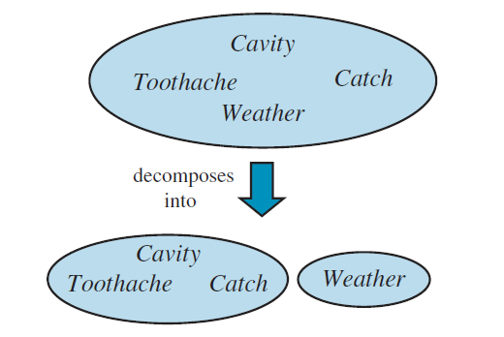
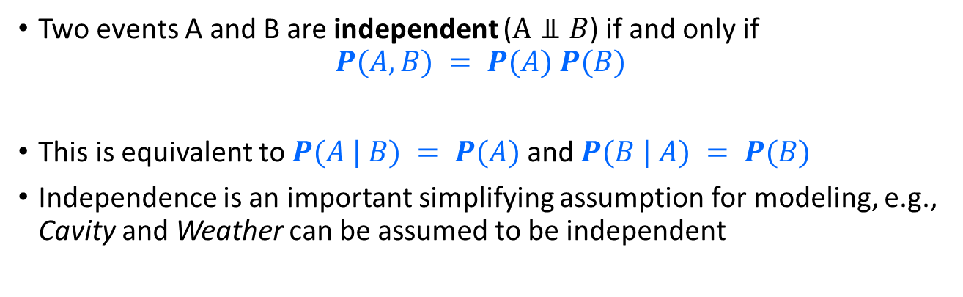
Independence Between Events
Two events A and B are independent ($A⫫B$) if and only if
$$P(A, B) = P(A) P(B)$$
This is equivalent to $P(A | B) = P(A)$and $P(B | A) = P(B)$
Independence is an important simplifying assumption for modeling, e.g., Cavity and Weather can be assumed to be independent
Independence
P(Cavity, Weather) = P(Cavity)P(Weather)
P(Cavity | Weather) = P(Cavity)

Slide 13
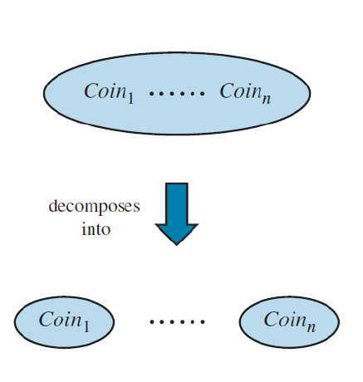
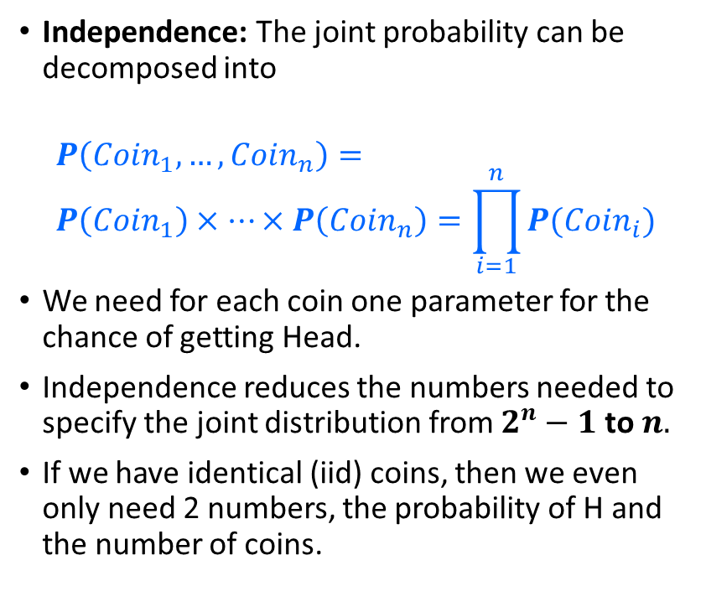


Decomposition of the Joint Probability Distribution With Independence
Independence: The joint probability can be decomposed into
$$P\left(Coin_{1},…,Coin_{n}\right)= \\ P\left(Coin_{1}\right)×…×P\left(Coin_{n}\right)=\prod_{i=1}^{n}{P(Coin_{i})}$$
We need for each coin one parameter for the chance of getting Head.
Independence reduces the numbers needed to specify the joint distribution from $2^{n}−1$ to $n.$
If we have identical (iid) coins, then we even only need 2 numbers, the probability of H and the number of coins.
$2^{n}−1$ entries
$n$ entries

Slide 14
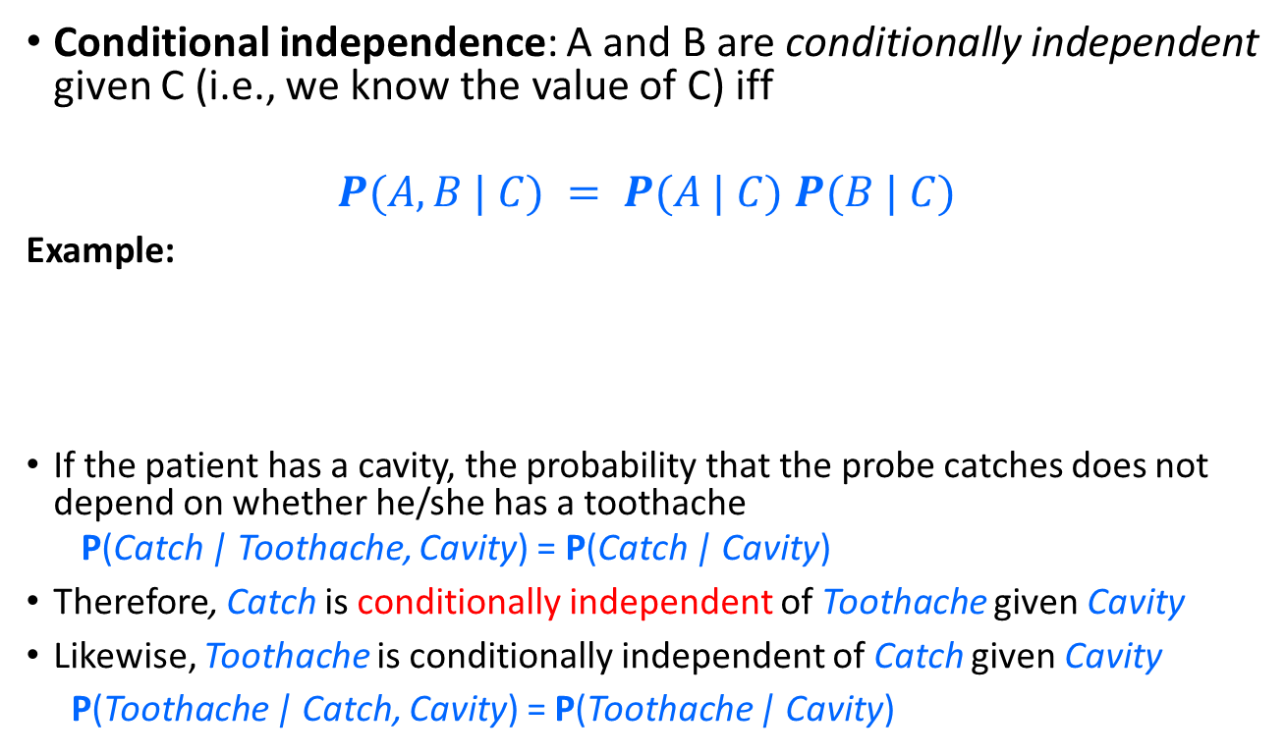
Conditional Independence
Conditional independence: A and B are conditionally independent given C (i.e., we know the value of C) iff
$$P(A, B | C) = P(A | C) P(B | C)$$
Example:
If the patient has a cavity, the probability that the probe catches does not depend on whether he/she has a toothache
  P(Catch | Toothache, Cavity) = P(Catch | Cavity)
Therefore, Catch is conditionally independent of Toothache given Cavity
Likewise, Toothache is conditionally independent of Catch given Cavity
P(Toothache | Catch, Cavity) = P(Toothache | Cavity)
Toothache
Cavity
Catch

Slide 15
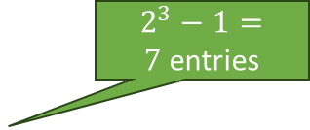
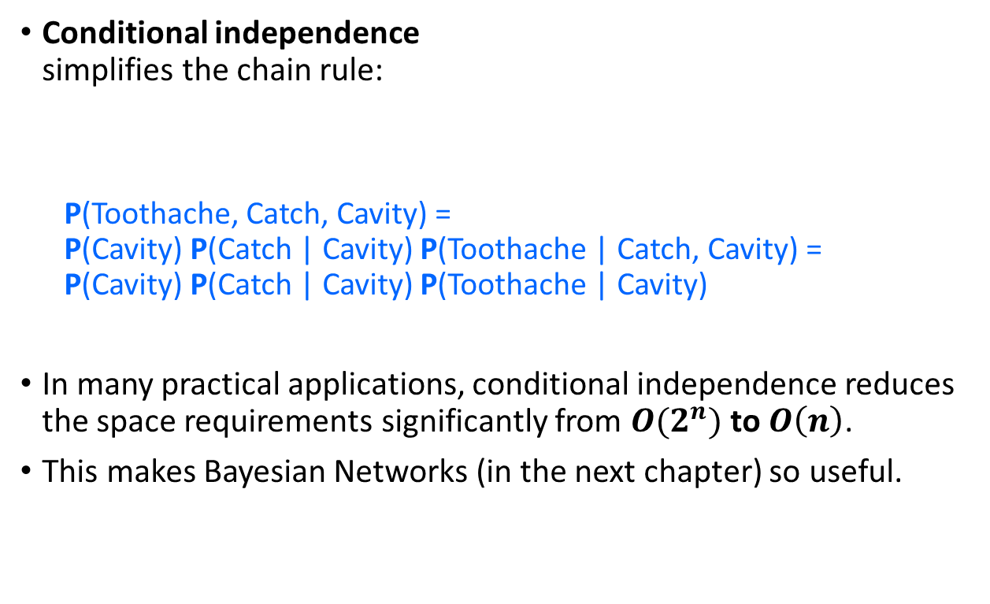
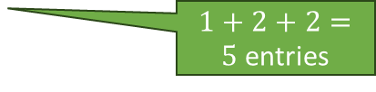
Decomposition of the Joint Probability Distribution With Conditional Independence
Toothache
Cavity
Conditional independence
simplifies the chain rule:
  P(Toothache, Catch, Cavity) =
  P(Cavity) P(Catch | Cavity) P(Toothache | Catch, Cavity) =
  P(Cavity) P(Catch | Cavity) P(Toothache | Cavity)
In many practical applications, conditional independence reduces the space requirements significantly from $O(2^{n})$ to $O\left(n\right)$.
This makes Bayesian Networks (in the next chapter) so useful.
Catch
$2^{3}−1=7$entries
$1+2+2=5$entries

Slide 16
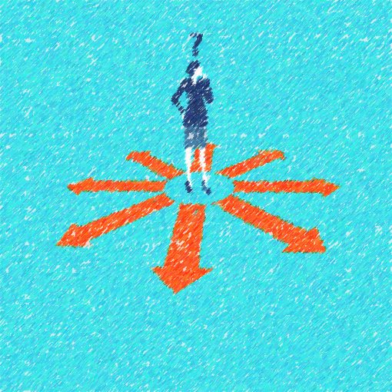
Bayesian Decision Making
Making Decisions Under Uncertainty Based on Evidence

Slide 17




Probabilistic Inference
Suppose the agent must guess the value of an unobserved query variable $X$ given some observed evidence $E = e$and we assume $X$ probabilistically causes $E$.
Example:
  $x∈ \{\text{zebra}\text{, }\text{giraffe}\text{, }\text{hippo}\},$e = image features
What is the best guess $x^{∗}$?
Notation: We use $\hat{x}$ for an estimate and $x^{∗}$ for the best estimate.
Notes:
Expected loss of a decision: P(decision is correct) * 0 + P(decision is wrong) * 1

Slide 18
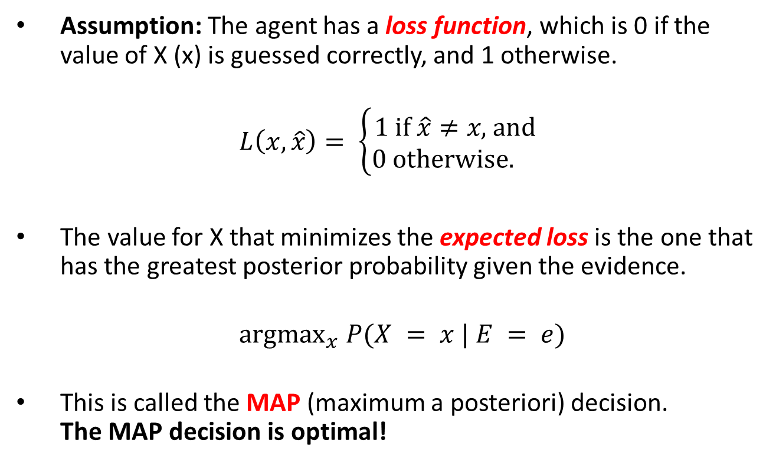
The Optimal Bayes Decision Rule
Assumption: The agent has a loss function, which is 0 if the value of X (x) is guessed correctly, and 1 otherwise.
$$L\left(x, \hat{x}\right)= \left\{\begin{aligned}1 \text{if} \hat{x}≠x\text{, }\text{and} \\ 0 \text{otherwise}\text{. }\end{aligned}\right.$$
The value for X that minimizes the expected loss is the one that has the greatest posterior probability given the evidence.
${ argmax}_{x} P(X = x | E = e)$
This is called the MAP (maximum a posteriori) decision.
The MAP decision is optimal!
Notes:
Expected loss of a decision: P(decision is correct) * 0 + P(decision is wrong) * 1

Slide 19
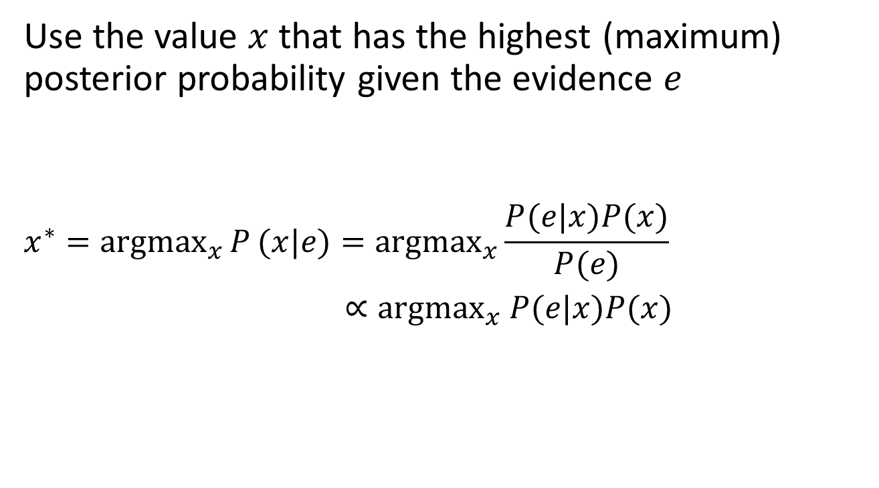

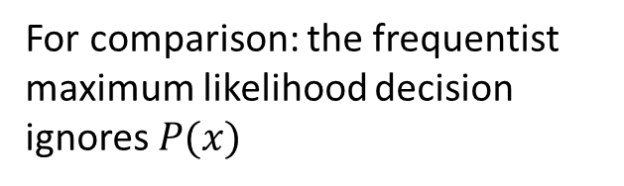
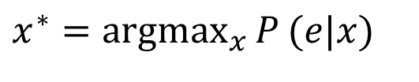
MAP: Maximum A Posteriori Decision
Use the value $x$ that has the highest (maximum) posterior probability given the evidence $e$
$$x^{∗}={argmax}_{x}{P}(x|e)={argmax}_{x}\frac{P(e|x)P(x)}{P(e)}$$
$∝{argmax}_{x} P(e|x)P(x)$
Prior Prob.
Posterior Prob.
$P\left(e\right)$ is fixed for a given example.
For comparison: the frequentist maximum likelihood decision ignores $P(x)$
$$x^{∗}={argmax}_{x}{P}(e|x)$$
likelihood

Slide 20


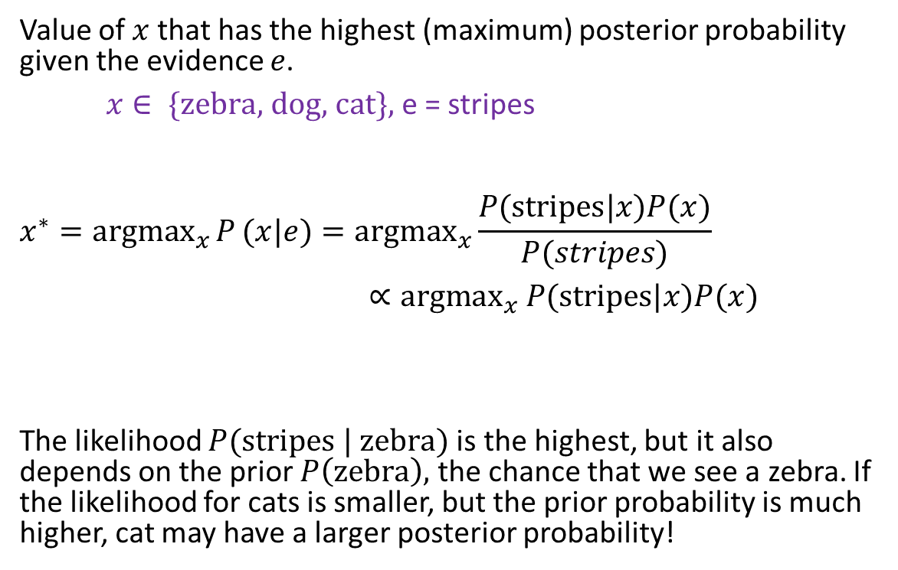
MAP: Example
Value of $x$ that has the highest (maximum) posterior probability given the evidence $e$.
$x∈ \{\text{zebra}\text{, }\text{dog}\text{, }\text{cat}\},$e = stripes
$$x^{∗}={argmax}_{x}{P}(x|e)={argmax}_{x}\frac{P(\text{stripes}|x)P(x)}{P(stripes)}$$
$∝{argmax}_{x} P(\text{stripes}|x)P(x)$
The likelihood $P(\text{stripes} \text{|} \text{zebra})$is the highest, but it also depends on the prior $P\left(\text{zebra}\right),$ the chance that we see a zebra. If the likelihood for cats is smaller, but the prior probability is much higher, cat may have a larger posterior probability!
Posterior Prob.
likelihood
Prior Prob.

Slide 21
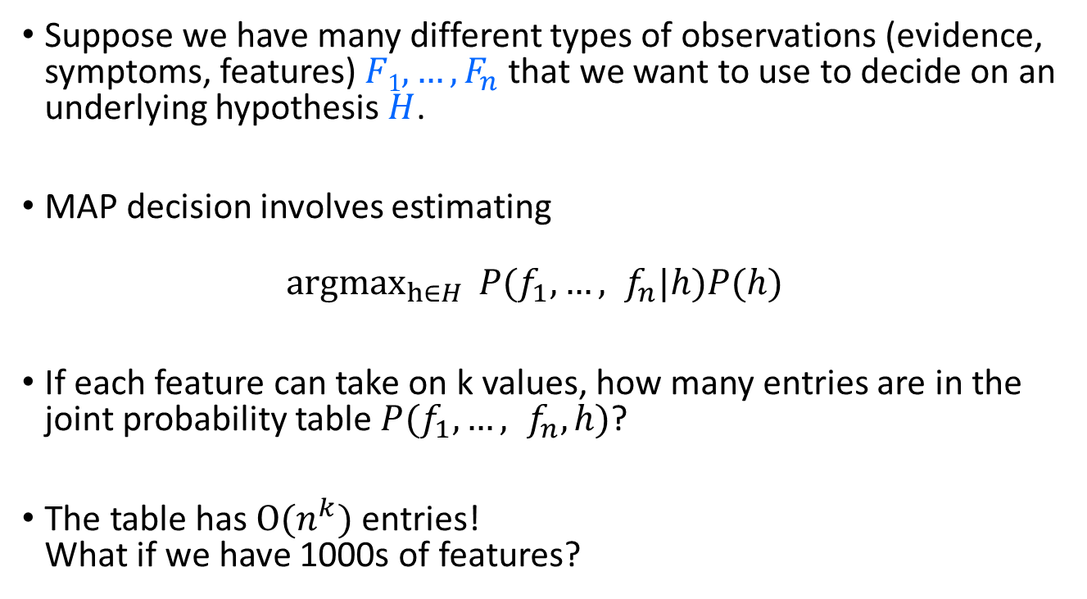
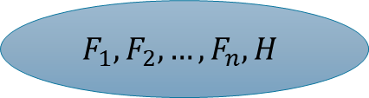
Bayes Classifier
$$F_{1},F_{2},…,F_{n}, H$$
Suppose we have many different types of observations (evidence, symptoms, features) $F1, …, F_{n}$that we want to use to decide on an underlying hypothesis $H$.
MAP decision involves estimating
$${argmax}_{h∈H}{P(f_{1},…, f_{n}|h)P(h) }$$
If each feature can take on k values, how many entries are in the joint probability table $P(f_{1},…, f_{n},h)$?
The table has $O(n^{k})$ entries!
What if we have 1000s of features?

Slide 22
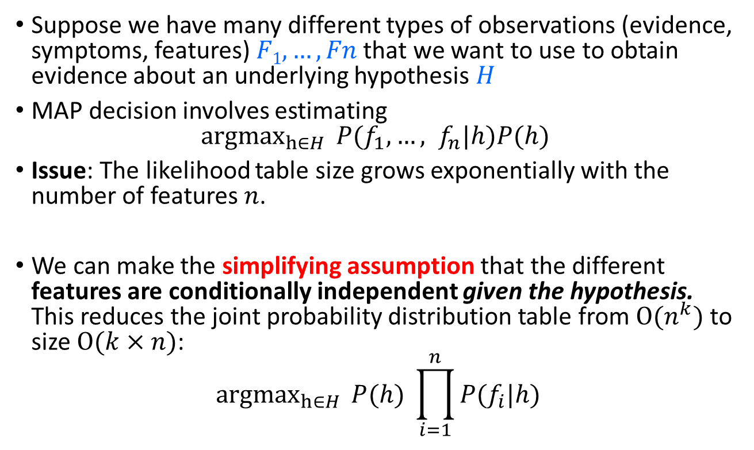




Naïve Bayes Model
$$H$$
…
$$F_{1}$$
$$F_{2}$$
$$F_{n}$$
Suppose we have many different types of observations (evidence, symptoms, features) $F1, …, Fn$that we want to use to obtain evidence about an underlying hypothesis $H$
MAP decision involves estimating
${argmax}_{h∈H}{P(f_{1},…, f_{n}|h)P(h) }$
Issue: The likelihood table size grows exponentially with the number of features $n$.
We can make the simplifying assumption that the different features are conditionally independent given the hypothesis. This reduces the joint probability distribution table from $O(n^{k})$ to size $O(k×n)$:
$${argmax}_{h∈H}{P(h) }\prod_{i=1}^{n}{P(f_{i}|h)}$$

Slide 23


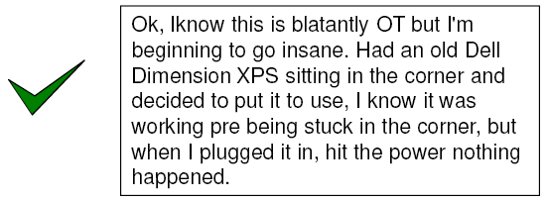
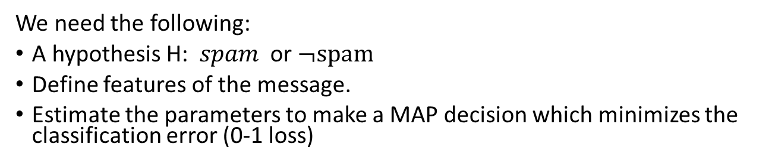
Example: Naïve Bayes Spam Filter
We need the following:
A hypothesis H: $spam$ or $¬\text{spam}$
Define features of the message.
Estimate the parameters to make a MAP decision which minimizes the classification error (0-1 loss)

Slide 24

Message Features:
Bag of Words from NLP
Model a document as a vector of binary random variables $\left(W_{1}, …, W_{n}\right).$
Each random variable represents if a specific word $i$ is present ($W_{i}=w_{i}=1$) or not ($W_{i}=w_{i}=0$) in the message.
Simplifications used by bag-of-words:
  The order of the words in the message is ignored.
  How often a word is repeated is ignored.

Slide 25
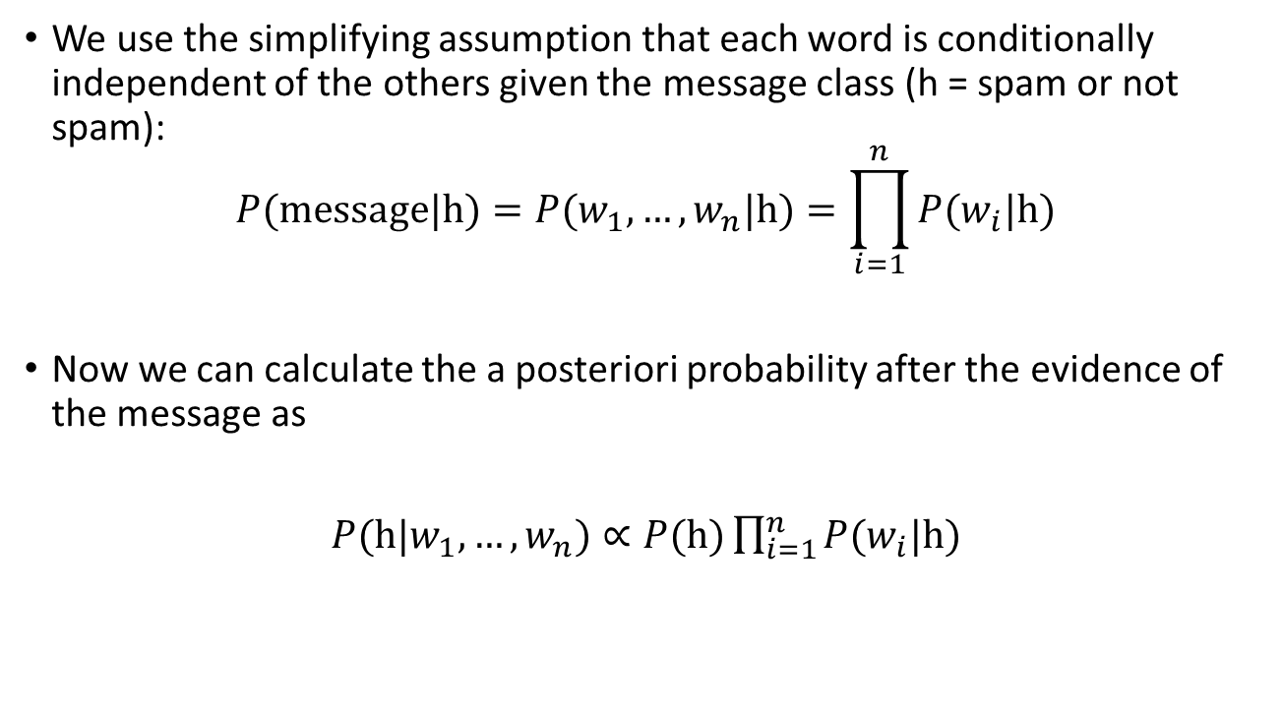

Naïve Bayes Spam Filter Using Words
We use the simplifying assumption that each word is conditionally independent of the others given the message class (h = spam or not spam):
$$P(\text{message}\text{|}\text{h})=P(w_{1},…,w_{n}|\text{h})=\prod_{i=1}^{n}{P(w_{i}|\text{h})}$$
Now we can calculate the a posteriori probability after the evidence of the message as
$P(\text{h}|w_{1},…,w_{n})∝P(\text{h})\prod_{i=1}^{n}{P(w_{i}|\text{h})}$
Note: It is only proportional since we do not divide by $P(w_{1},…,w_{n})$
posterior
prior
likelihoods
(presents and
absence of words)

Slide 26
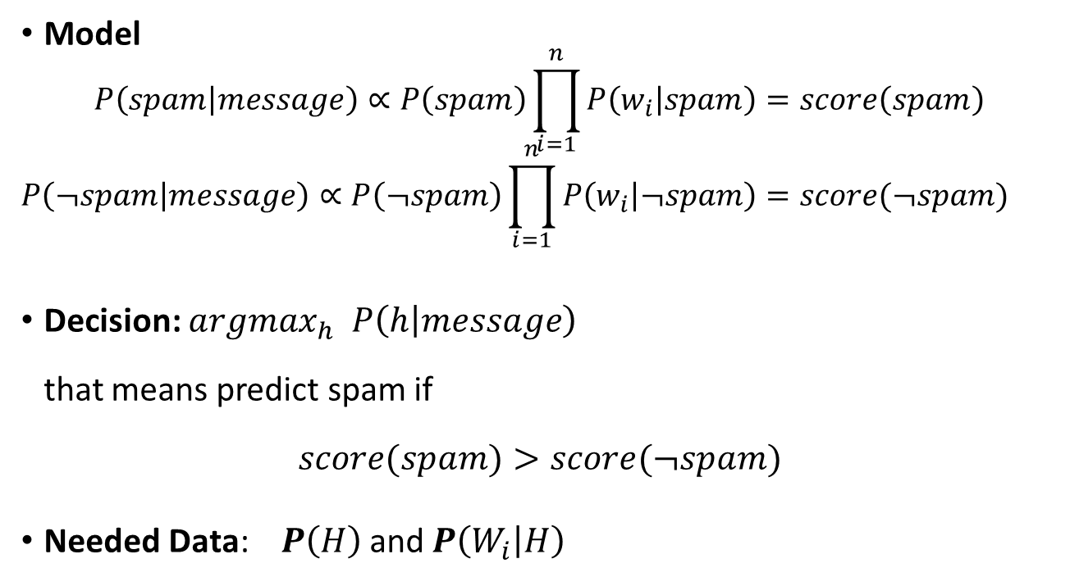
Naïve Bayes Spam Filter:
Model and Decision
Model
$$P\left(spam | message\right)∝P\left(spam\right)\prod_{i=1}^{n}{P\left(w_{i} | spam\right)}=score\left(spam\right)$$
$$P\left(¬spam | message\right)∝P\left(¬spam\right)\prod_{i=1}^{n}{P\left(w_{i} | ¬spam\right)}=score(¬spam)$$
Decision: $argmax_{h} P\left(h | message\right)$
that means predict spam if
$score(spam)>score(¬spam)$
Needed Data: $P\left(H\right)$ and $P\left(W_{i} | H\right)$

Slide 27
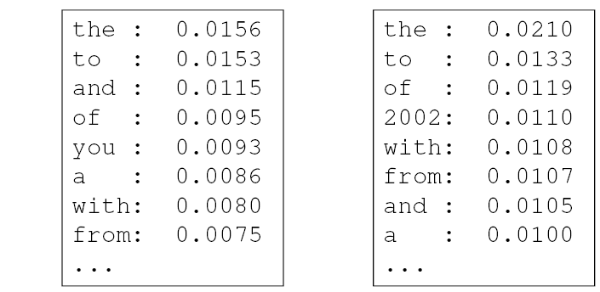



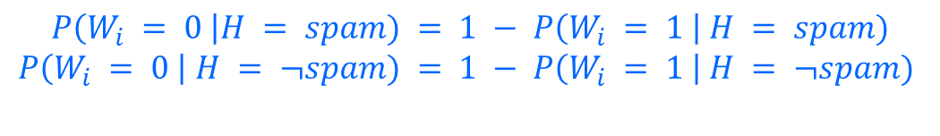

Naïve Bayes Spam Filter:
Parameter Estimation
Count in training data:
Smoothing for low counts.
$$P\left(H=spam\right)=\frac{\# of spam messages+1}{total \# of messages+\# of classes}$$
$$P\left(w_{i}=1 | H=spam\right)=\frac{\# of spam messages that contain the word+1}{total \# of spam messages+\# of classes}$$
Prior $P(H)$
$$P(W_{i} = 1 | H= spam)$$
$$P(W_{i} = 1 | H = ¬spam)$$
spam: 0.33
¬spam: 0.67
+ likelihoods for the absence of words:
$$P\left(W_{i} = 0 \right|H = spam) = 1 − P\left(W_{i} = 1 \right| H = spam)$$
$$P\left(W_{i} = 0 \right| H = ¬spam) = 1 − P\left(W_{i} = 1 \right| H = ¬spam)$$

Slide 28
Summary
Decision theory
To make decisions under uncertainty requires:
  Estimating probabilities of outcomes for different actions.
  Assign utility to outcomes.
  Choose the action with the larges expected utility.
Bayes decision rule
Choose the most likely outcome by minimizing expected 0-1 loss. Required steps:
  Estimate prior probabilities of outcomes and the likelihood of seeing evidence given different outcomes.
  Use the evidence to update the probability of the outcome.
  Apply the MAP decision rule to determine the most likely outcome.
A general framework for learning functions and decision rules from data is the goal of Machine Learning.
Issue is that we need to define/learn the complete joint probability distribution! Much of ML is about overcoming this issue.

Slide 29
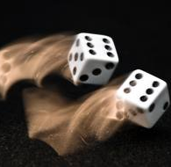
Appendix: A Quick Review of Probability Theory
Random variables
Events
Joint probabilities
Marginal probabilities
Conditional probabilities
Bayes’ Rule
Independence

Slide 30
Random Variables
Random Variable
Random variables are denoted by capital letters.
R: Is it raining?
W: What’s the weather?
Die: What is the outcome of rolling two dice?
V: What is the speed of my car (in MPH)?
Domain
Domain values must be mutually exclusive and exhaustive.
R $∈${True, False}
R ∈ {True, False}
W $∈$ {Sunny, Cloudy, Rainy, Snow}
W ∈ {Sunny, Cloudy, Rainy, Snow}
Die $∈$ {(1,1), (1,2), … (6,6)}
Die ∈ {(1,1), (1,2), … (6,6)}
V $∈$ [0, 200]
V ∈ [0, 200]
We describe the (uncertain) state of the world using random variables.
Random variables take on values in a domain D.

Slide 31
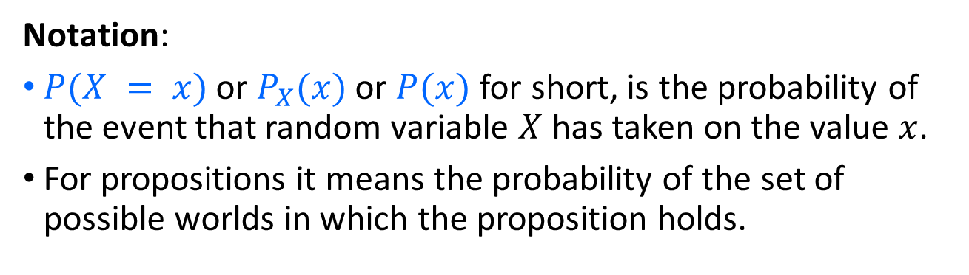
Events and Propositions
Probabilistic statements are defined over events, world states or sets of states
“It is raining”
“The weather is either cloudy or snowy”
“The sum of the two dice rolls is 11”
“My car is going between 30 and 50 miles per hour”
Events are described using propositions:
R = True
W = “Cloudy” ∨ W = “Snowy”
D ∈ {(5,6), (6,5)}
30 ≤ S ≤ 50
Notation:
$P(X = x)$or $P_{X}(x)$ or $P(x)$ for short, is the probability of the event that random variable $X$ has taken on the value $x$.
For propositions it means the probability of the set of possible worlds in which the proposition holds.

Slide 32
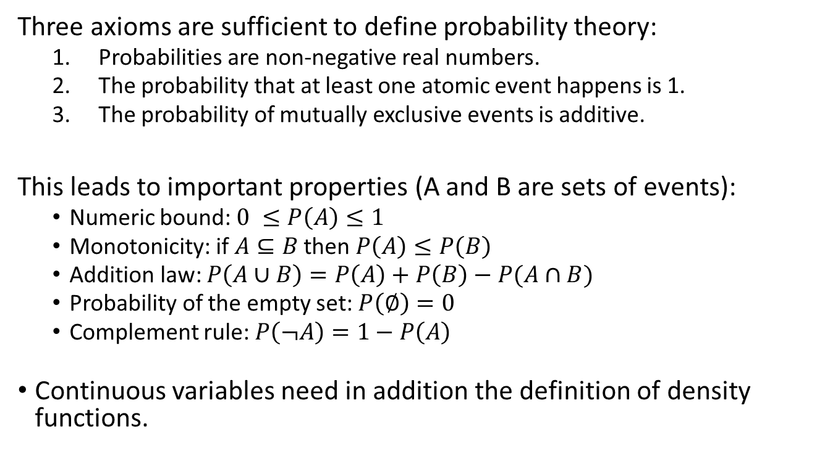
Kolmogorov’s 3 Axioms of Probability
Three axioms are sufficient to define probability theory:
  Probabilities are non-negative real numbers.
  The probability that at least one atomic event happens is 1.
  The probability of mutually exclusive events is additive.
This leads to important properties (A and B are sets of events):
  Numeric bound: $0 ≤P\left(A\right)≤1$
  Monotonicity: if $A⊆B$ then $P\left(A\right)≤P\left(B\right)$
  Addition law: $P\left(A∪B\right)=P\left(A\right)+P\left(B\right)−P(A∩B)$
  Probability of the empty set: $P\left(∅\right)=0$
  Complement rule: $P\left(¬A\right)=1−P\left(A\right)$
Continuous variables need in addition the definition of density functions.

Slide 33
Atomic Events
Atomic event: a complete specification of the state of the world, or a complete assignment of domain values to all random variables.
Atomic events are mutually exclusive and exhaustive.
E.g., if the world consists of only two Boolean variables Cavity and Toothache, then there are 4 distinct atomic events:
Cavity = false ∧Toothache = false
Cavity = false ∧ Toothache = true
Cavity = true ∧ Toothache = false
Cavity = true ∧ Toothache = true

Slide 34

Joint Probability Distributions
A joint distribution is an assignment of probabilities to every possible atomic event.
Notation:
  $P(x), P(X=x)$is the probability that random variable X takes on value x
  $P(X)$is the distribution of probabilities for all possible values of X. Often we are lazy or forget to make P bold.
Atomic event | P
Cavity = false ∧Toothache = false | 0.8
Cavity = false ∧ Toothache = true | 0.1
Cavity = true ∧ Toothache = false | 0.05
Cavity = true ∧ Toothache = true | 0.05
Sum: 1.00

Slide 35

Marginal Probability Distributions
Sometimes we are only interested in one variable. This is called the marginal distribution $P(Y)$
P(Cavity, Toothache)
Cavity = false ∧Toothache = false | 0.8
Cavity = false ∧ Toothache = true | 0.1
Cavity = true ∧ Toothache = false | 0.05
Cavity = true ∧ Toothache = true | 0.05
P(Cavity)
Cavity = false | ?
Cavity = true | ?
P(Toothache)
Toothache = false | ?
Toothache = true | ?
Marginal Prob. Distr.

Slide 36

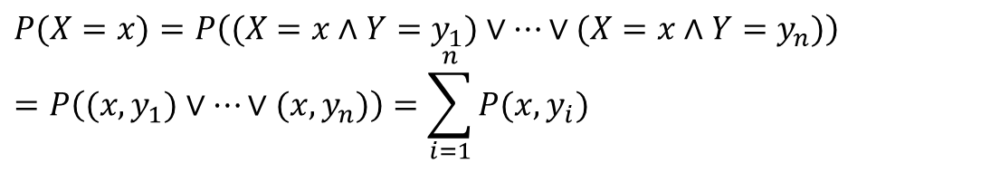
Marginal Probability Distributions 2
Suppose we have the joint distribution $P(X,Y)$ and we want to find the marginal distribution $P(Y)$
General rule: to find $P(X = x),$sum the probabilities of all atomic events where $X = x$. This is called “summing out” or marginalization.
$$P(X=x)=P\left((X=x∧Y=y_{1})∨…∨(X=x∧Y=y_{n})\right) \\ =P\left((x,y_{1})∨…∨(x,y_{n})\right)=\sum_{i=1}^{n}{P(x,y_{i})}$$

Slide 37
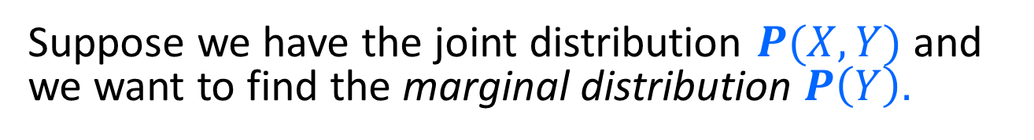
Marginal Probability Distributions 3
Suppose we have the joint distribution $P(X,Y)$ and we want to find the marginal distribution $P\left(Y\right).$
P(Cavity, Toothache)
Cavity = false ∧Toothache = false | 0.8
Cavity = false ∧ Toothache = true | 0.1
Cavity = true ∧ Toothache = false | 0.05
Cavity = true ∧ Toothache = true | 0.05
P(Cavity)
Cavity = false | 0.8+0.1 = 0.9
Cavity = true | 0.05+0.05=0.1
P(Toothache)
Toothache = false | 0.8+0.0.5= 0.85
Toothache = true | 0.1+0.05= 0.15
Marginal Prob. Distr.

Slide 38
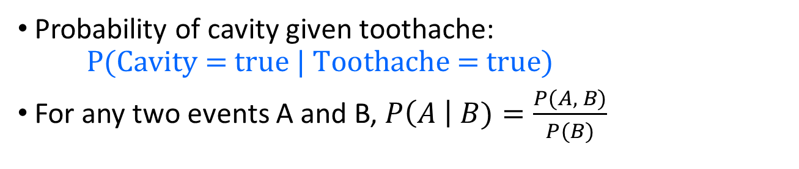



Conditional Probability
Probability of cavity given toothache:
$\text{P}\text{(}\text{Cavity}\text{ = }\text{true}\text{ | }\text{Toothache}\text{ = }\text{true}\text{)}$
For any two events A and B, $P\left(A \right| B)=\frac{P(A, B)}{P(B)}$
$$P(A,B)$$
$$P(A)$$
$$P(B)$$

Slide 39

Conditional Probability 2
$$P\left(A \right| B)=\frac{P(A,B)}{P(B)}$$
P(Cavity, Toothache)
Cavity = false ∧Toothache = false | 0.8
Cavity = false ∧ Toothache = true | 0.1
Cavity = true ∧ Toothache = false | 0.05
Cavity = true ∧ Toothache = true | 0.05
Joint Prob. Distr.
P(Cavity)
Cavity = false | 0.9
Cavity = true | 0.1
P(Toothache)
Toothache = false | 0.85
Toothache = true | 0.15
Marginal Prob. Distr.
What is P(Cavity = true | Toothache = false)?
  0.05 / 0.85 = 0.059
What is P(Cavity = false | Toothache = true)?
  0.1 / 0.15 = 0.667

Slide 40
Conditional Distributions
$$P\left(A \right| B)=\frac{P(A,B)}{P(B)}$$
P(Cavity, Toothache)
Cavity = false ∧Toothache = false | 0.8
Cavity = false ∧ Toothache = true | 0.1
Cavity = true ∧ Toothache = false | 0.05
Cavity = true ∧ Toothache = true | 0.05
A conditional distribution is a distribution over the values of one variable given fixed values of other variables
P(Cavity | Toothache = true)
Cavity = false | 0.667
Cavity = true | 0.333
P(Cavity | Toothache = false)
Cavity = false | 0.941
Cavity = true | 0.059
P(Toothache | Cavity = true)
Toothache= false | 0.5
Toothache = true | 0.5
P(Toothache | Cavity = false)
Toothache= false | 0.889
Toothache = true | 0.111

Slide 41


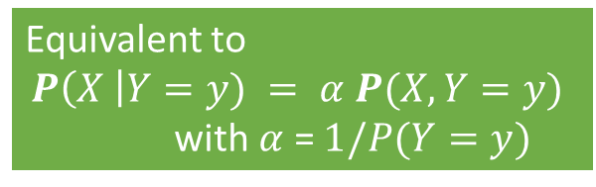

Normalization Trick
To get the whole conditional distribution $P(X | Y = y)$at once, select all entries in the joint distribution matching $Y = y$and renormalize them to sum to one.
P(Cavity, Toothache)
Cavity = false ∧Toothache = false | 0.8
Cavity = false ∧ Toothache = true | 0.1
Cavity = true ∧ Toothache = false | 0.05
Cavity = true ∧ Toothache = true | 0.05
Select P(X, Y = y)
Toothache, Cavity = false
Toothache= false | 0.8
Toothache = true | 0.1
Sum is $P\left(Y=y\right)=0.9$
Renormalize sum to 1 (= divide by $P(Y=y)$)
P(Toothache | Cavity = false)
Toothache= false | 0.889
Toothache = true | 0.111
Equivalent to
$$P\left(X \right|Y=y) = α P(X, Y=y)$$
with $α$ = $1/P(Y=y)$

