Slide 1
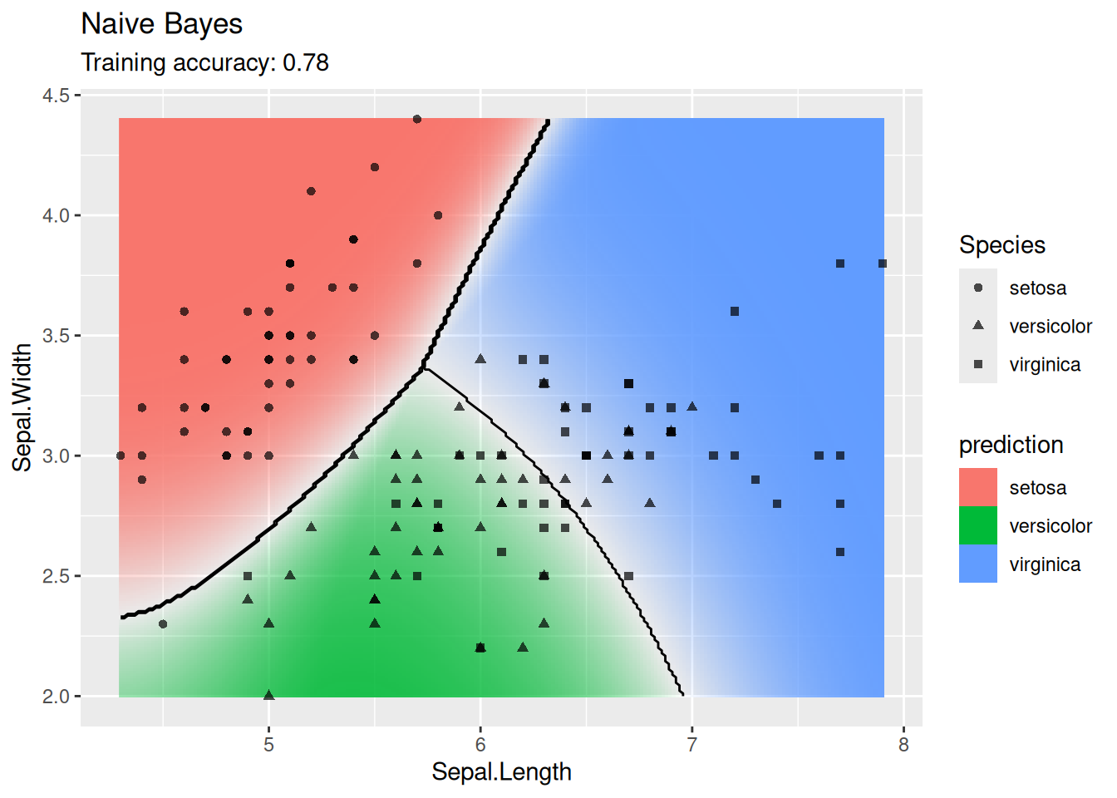

CS 5/7320
Artificial Intelligence
Learning from Examples
AIMA Chapter 19
Slides by Michael Hahsler
Based on slides by Dan Klein, Pieter Abbeel, Sergey Levine and A. Farhadi (http://ai.berkeley.edu) with figures from the AIMA textbook.
This work is licensed under a Creative Commons Attribution-ShareAlike 4.0 International License.
Online Material
Notes:
Please retain proper attribution, including the reference to ai.berkeley.edu. Thanks!

Slide 2
Topics
Supervised Learning
Data
Training & Testing
Types of supervised ML Models
Use in AI
ML & Agents

Slide 3
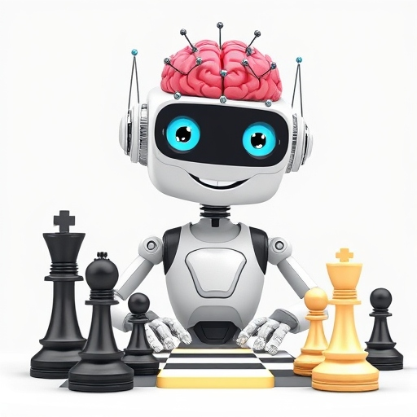
ML and Agents
DeepAi.org with prompt: “A happy cartoon robot with an artificial neural network for a brain on white background learning to play chess”

Slide 4
Learning from Examples: Machine Learning
Up until now in this course:
  Hand-craft algorithms to make rational/optimal or at least good decisions.
  Examples: Search strategies, heuristics.
Issues
  Designer cannot anticipate all possible future situations.
  Designer may have examples but does not know how to program a solution.
Machine Learning
Learning = Improve performance after making observations about the world. That is, learn what works and what doesn’t.
We learn a model that decides on the actions to take. This is called the “performance element.”
The goal is to get closer to optimal decisions. I.e., it is an optimization problem.

Slide 5
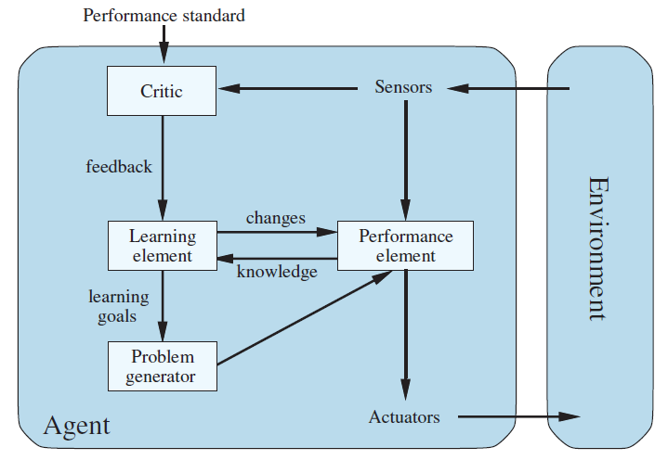
From Chapter 2: Agents that Learn
The learning element modifies the performance element to improve its performance.
Critic: How is the agent currently performing?
Learning Element: Update the performance element and changes how it selects actions.
E.g., adding rules, changing weights
Problem generators: Explore actions that lead to better information

Slide 6
Types of Using Machine Learning
  What component of the performance element is learned?
  E.g., how to select action, estimate the utility of a state, …
  What representation (model) is used in the component?
  Linear regression, rules, trees, neural nets,…
  What feedback is available for learning?
    Unsupervised Learning: No feedback, just organize data (e.g., clustering, embedding)
    Supervised Learning: Uses a data set with correct answers. Learn a function (model) to map an input (e.g., state) to an output (e.g., action or utility).
    Examples:
      Use a naïve Bayesian classifier to distinguish between spam/no spam
      Learn a playout policy to simulate games (current board -> good move)
    Reinforcement Learning: Learn from rewards/punishment (e.g., winning a game) obtained via interaction with the environment over time.
We focus here on supervised learning

Slide 7

Supervised Learning
1+1=2

Slide 8



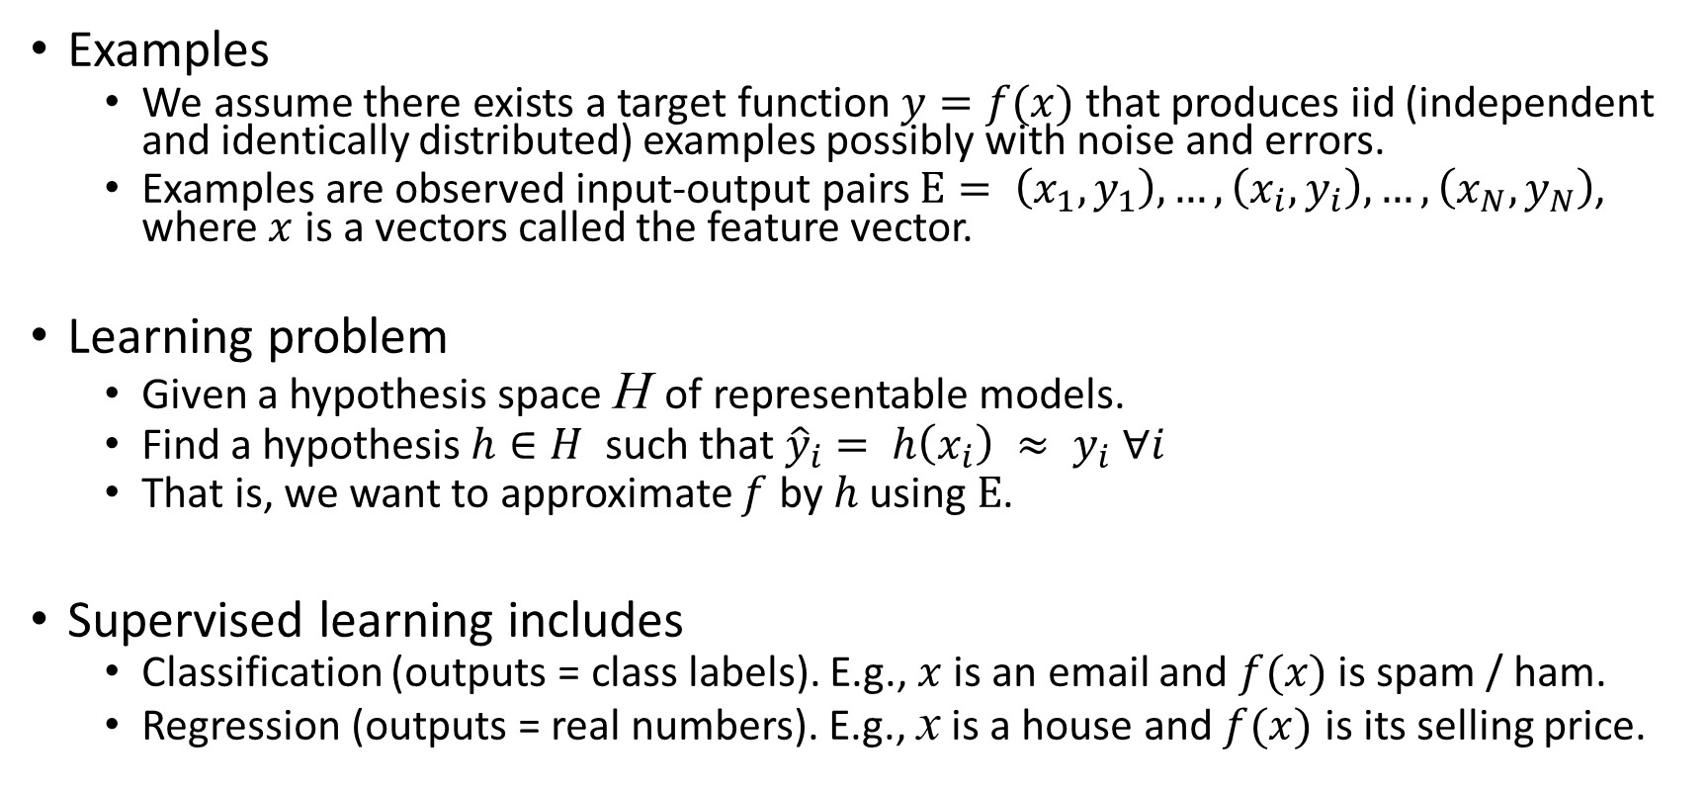
Supervised Learning As Function Approximation
Examples
  We assume there exists a target function $y=f(x)$ that produces iid (independent and identically distributed) examples possibly with noise and errors.
  Examples are observed input-output pairs $E= \left(x_{1},y_{1}\right),…, \left(x_{i}, y_{i}\right),…,\left(x_{N},y_{N}\right)$, where $x$ is a vectors called the feature vector.
Learning problem
  Given a hypothesis space H of representable models.
  Find a hypothesis $h∈H$ such that ${\hat{y}}_{i}= h\left(x_{i}\right) ≈ y_{i} ∀i$
  That is, we want to approximate $f$ by $h$ using $E$.
Supervised learning includes
  Classification (outputs = class labels). E.g., $x$ is an email and $f(x)$ is spam / ham.
  Regression (outputs = real numbers). E.g., x is a house and $f(x)$ is its selling price.
$$f$$
Set of all functions

Slide 9
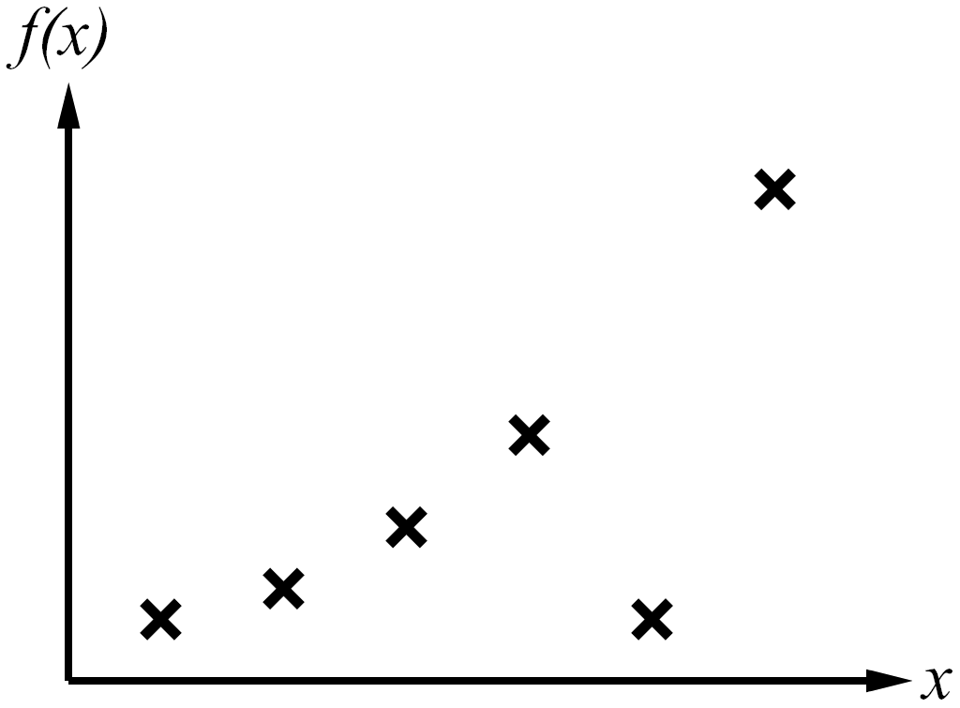
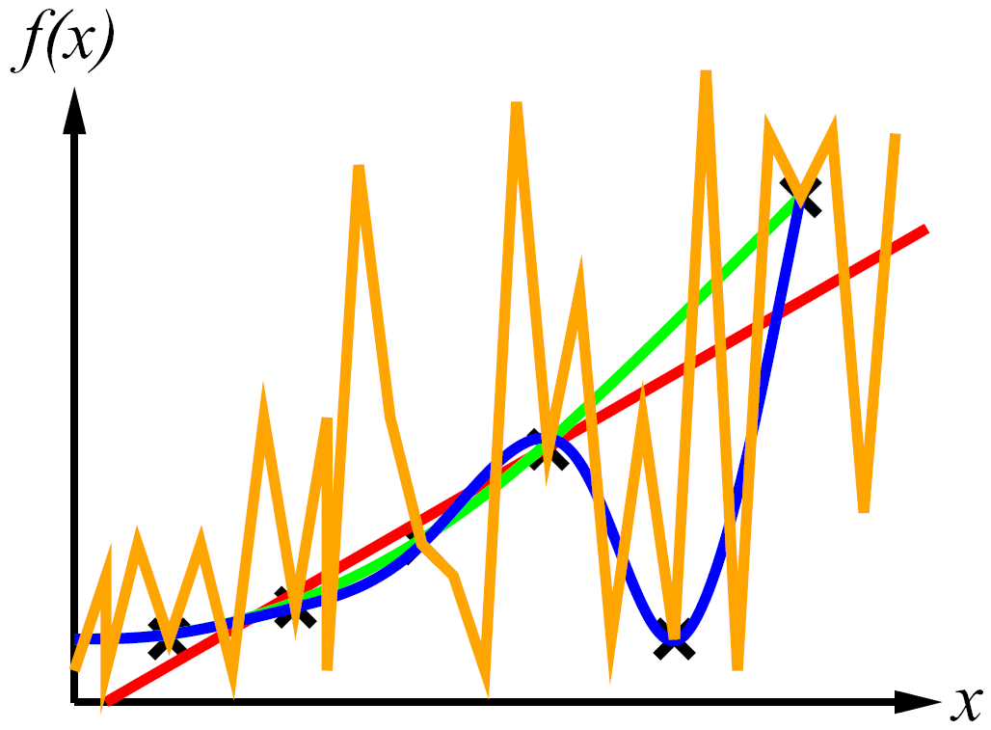
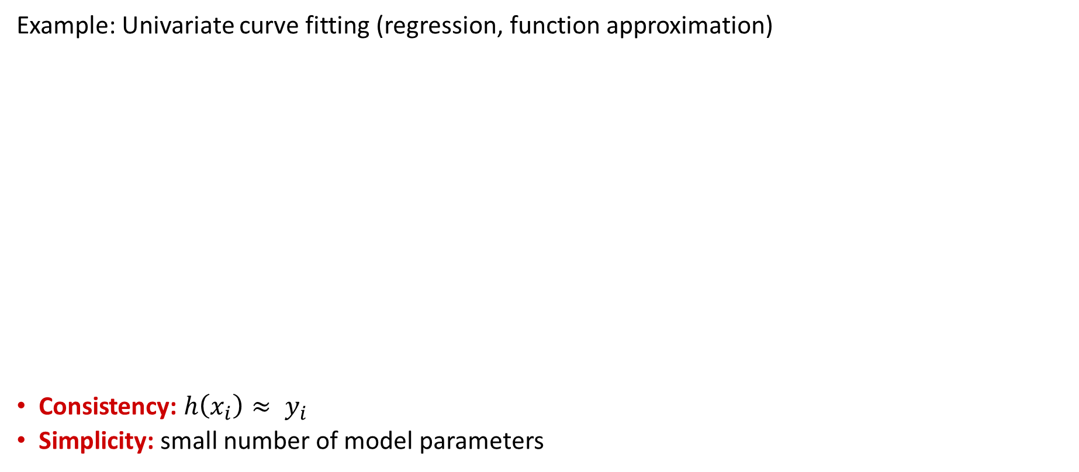
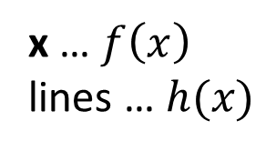
Consistency vs. Simplicity
Example: Univariate curve fitting (regression, function approximation)
Consistency: $h\left(x_{i}\right)≈ y_{i}$
Simplicity: small number of model parameters
y
Examples
y
Learned Models
x … $f\left(x\right)$
lines … $h(x)$
Very simple, but not very consistent with the data!

Slide 10
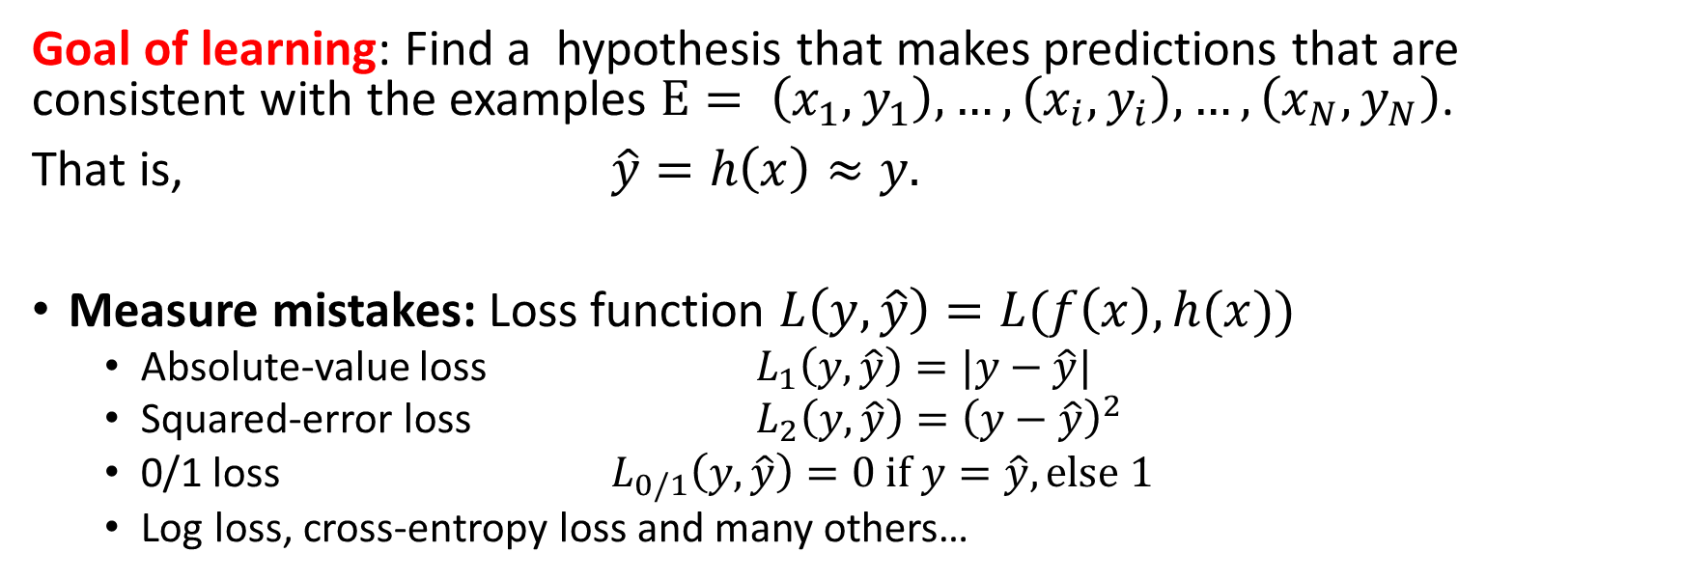


Measuring Consistency using Loss
Goal of learning: Find a hypothesis that makes predictions that are consistent with the examples $E= \left(x_{1},y_{1}\right),…, \left(x_{i}, y_{i}\right),…,\left(x_{N},y_{N}\right)$.
That is, $\hat{y}=h\left(x\right)≈y.$
Measure mistakes: Loss function $L\left(y, \hat{y}\right)=L(f\left(x\right), h(x))$
  Absolute-value loss $L_{1}\left(y, \hat{y}\right)=|y−\hat{y}|$
  Squared-error loss $L_{2}\left(y, \hat{y}\right)={\left(y−\hat{y}\right)}^{2}$
  0/1 loss $L_{0/1}\left(y, \hat{y}\right)=0 if y=\hat{y}, else 1$
  Log loss, cross-entropy loss and many others…
For Regression
For Classification
Loss
$$f$$
$$h^{∗}$$

Slide 11
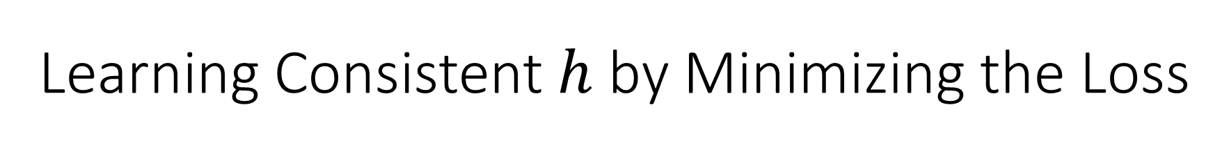
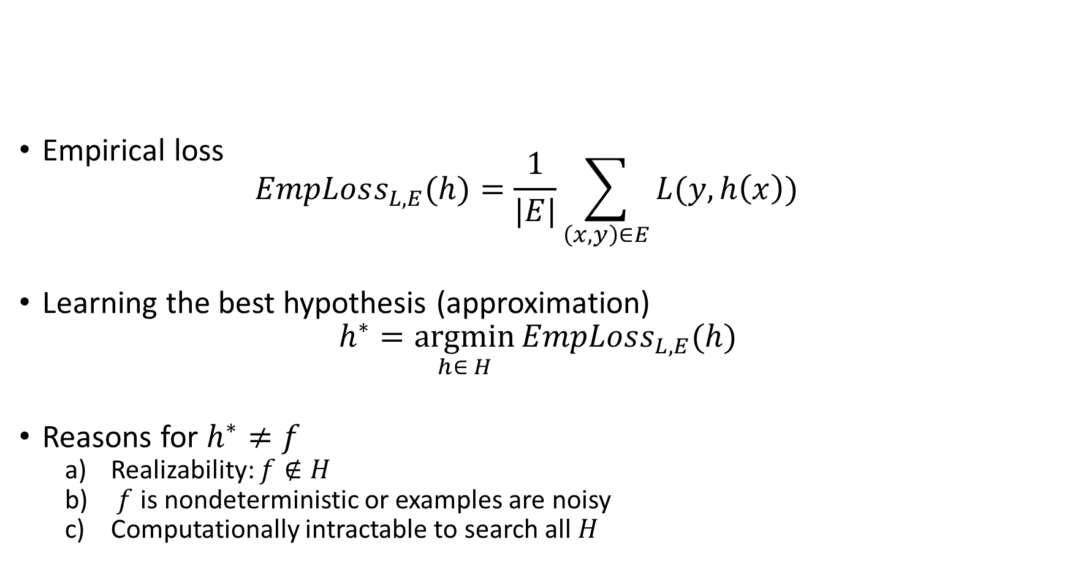
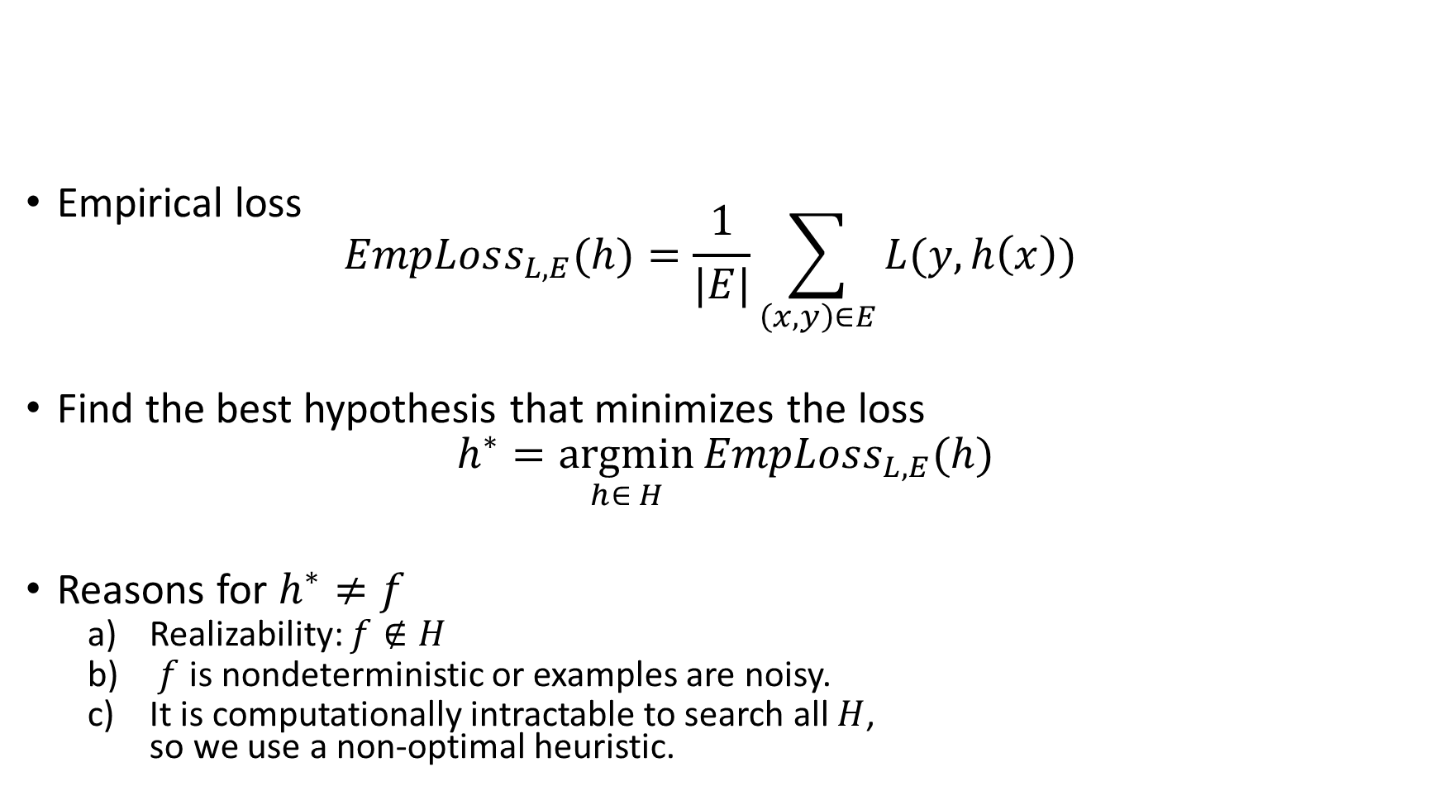
Learning Consistent $h$ by Minimizing the Loss
Empirical loss
$EmpLoss_{L,E}(h)=\frac{1}{|E|}\sum_{\left(x,y\right)∈E}{L(y, h\left(x\right))}$
Find the best hypothesis that minimizes the loss
$$h^{∗}=\underset{h∈ H}{argmin}{EmpLoss_{L,E}(h)}$$
Reasons for $h^{∗}≠f$
  Realizability: $f∉H$
  $f$ is nondeterministic or examples are noisy.
  It is computationally intractable to search all $H$,
  so we use a non-optimal heuristic.
Loss
$$f$$
$$h^{∗}$$

Slide 12
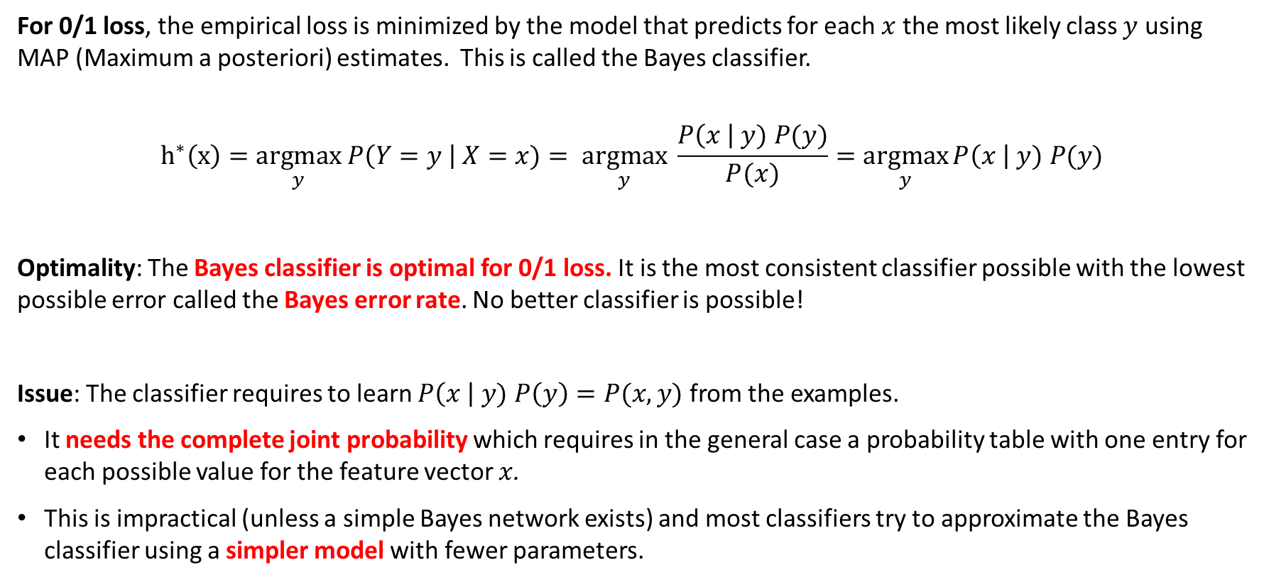
The Most Consistent Classifier
The Bayes Classifier
For 0/1 loss, the empirical loss is minimized by the model that predicts for each $x$ the most likely class $y$ using MAP (Maximum a posteriori) estimates. This is called the Bayes classifier.
$$h^{∗}\left(x\right)=\underset{y}{argmax} P\left(Y=y \right| X=x)= \underset{y}{argmax} \frac{P\left(x \right| y) P(y)}{P(x)}=\underset{y}{argmax}{P\left(x \right| y) P(y)}$$
Optimality: The Bayes classifier is optimal for 0/1 loss. It is the most consistent classifier possible with the lowest possible error called the Bayes error rate. No better classifier is possible!
Issue: The classifier requires to learn $P\left(x \right| y) P\left(y\right)=P(x,y)$ from the examples.
It needs the complete joint probability which requires in the general case a probability table with one entry for each possible value for the feature vector $x$.
This is impractical (unless a simple Bayes network exists) and most classifiers try to approximate the Bayes classifier using a simpler model with fewer parameters.

Slide 13
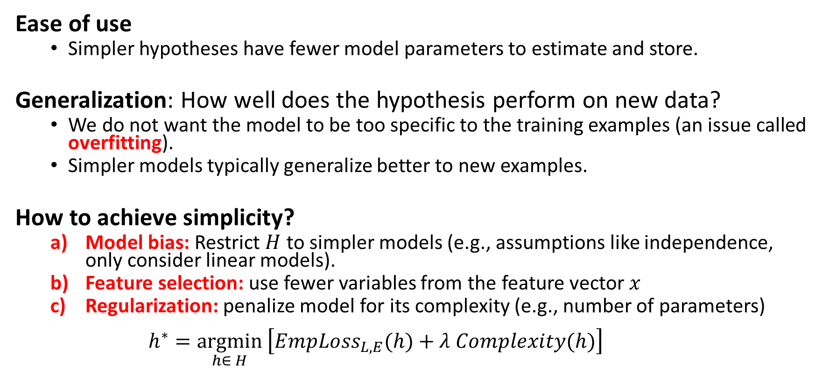
Simplicity
Ease of use
  Simpler hypotheses have fewer model parameters to estimate and store.
Generalization: How well does the hypothesis perform on new data?
  We do not want the model to be too specific to the training examples (an issue called overfitting).
  Simpler models typically generalize better to new examples.
How to achieve simplicity?
  Model bias: Restrict $H$ to simpler models (e.g., assumptions like independence, only consider linear models).
  Feature selection: use fewer variables from the feature vector $x$
  Regularization: penalize model for its complexity (e.g., number of parameters)
  $h^{∗}=\underset{h∈ H}{argmin}\left[EmpLoss_{L,E}(h)+λ Complexity(h)\right]$
Penalty term

Slide 14
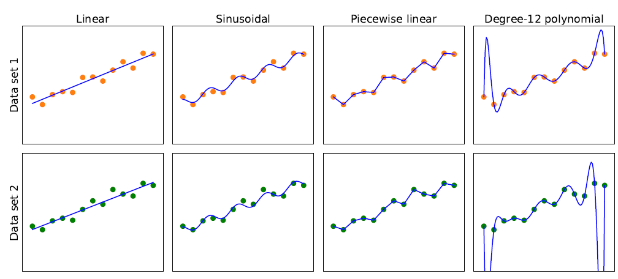
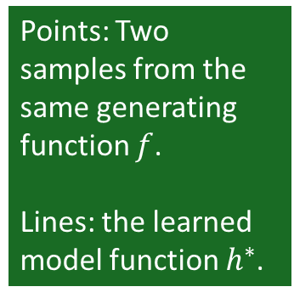
Model Selection: Bias vs. Variance
Overfitting
Simpler
More consistent
Points: Two samples from the same generating function $f$.
Lines: the learned model function $h^{∗}$.
High Bias: restrictions by the model class Low
Low Variance: difference in the model due to slightly different data. high
This is a tradeoff

Slide 15
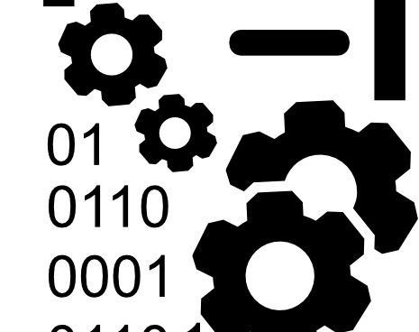
Data

Slide 16
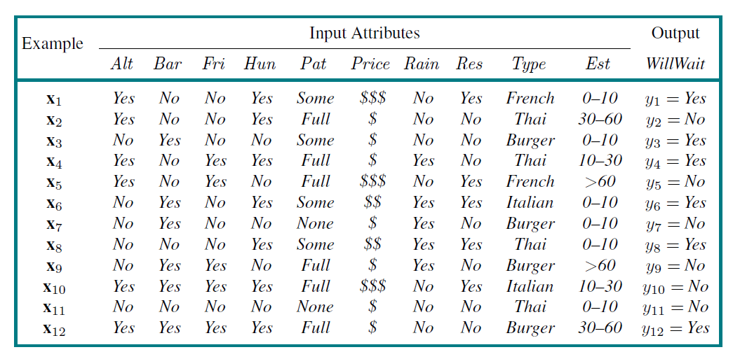
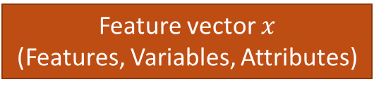
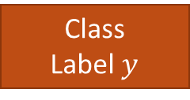
The Dataset
Feature vector $x$
(Features, Variables, Attributes)
Class
Label $y$
Examples
(Instances,
Observation)
Alternative
Hungry
Patrons
Reservation
Wait time
Find a hypothesis (called “model”) to predict the class given the features.

Slide 17
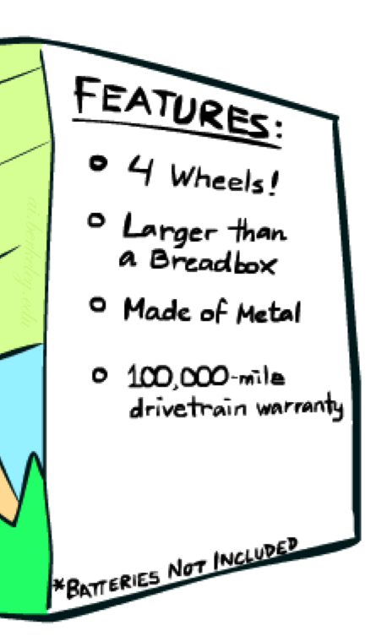

Feature Engineering
Add information sources as new variables to the model.
Add derived features that help the classifier (e.g., $x_{1}x_{2}$, $x_{1}^{2}$).
Embedding: E.g., convert words to vectors where vector similarity between vectors reflects semantic similarity.
Example for Spam detection: In addition to words
  Have you emailed the sender before?
  Have 1000+ other people just gotten the same email?
  Is the email in ALL CAPS?
Feature Selection: Which features should be used in the model is a model selection problem (choose between models with different features).

Slide 18

Data in AI
Data in AI can come from many sources
  Observation: Record video of a task being performed.
  Existing Data: Download documents from the internet to train Large Language Models.
  Simulation: E.g., simulated games using a playout strategy.
  Expert feedback on how well a task was performed.

Slide 19

Training and
Testing

Slide 20
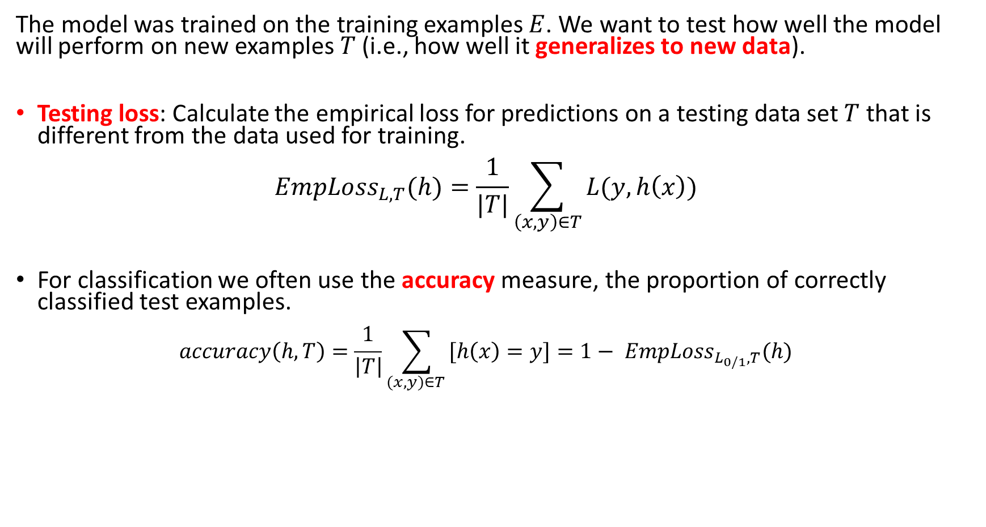
Model Evaluation (Testing)
The model was trained on the training examples $E$. We want to test how well the model will perform on new examples $T$ (i.e., how well it generalizes to new data).
Testing loss: Calculate the empirical loss for predictions on a testing data set $T$ that is different from the data used for training.
$EmpLoss_{L,T}(h)=\frac{1}{|T|}\sum_{\left(x,y\right)∈T}{L(y, h\left(x\right))}$
For classification we often use the accuracy measure, the proportion of correctly classified test examples.
$accuracy\left(h, T\right)=\frac{1}{\left|T\right|}\sum_{(x,y)∈T }{[h\left(x\right)=y]}=1− EmpLoss_{L_{0/1},T}(h)$
$\left[c\right]$ is an indicator function returning 1 if $c = True$and otherwise 0

Slide 21

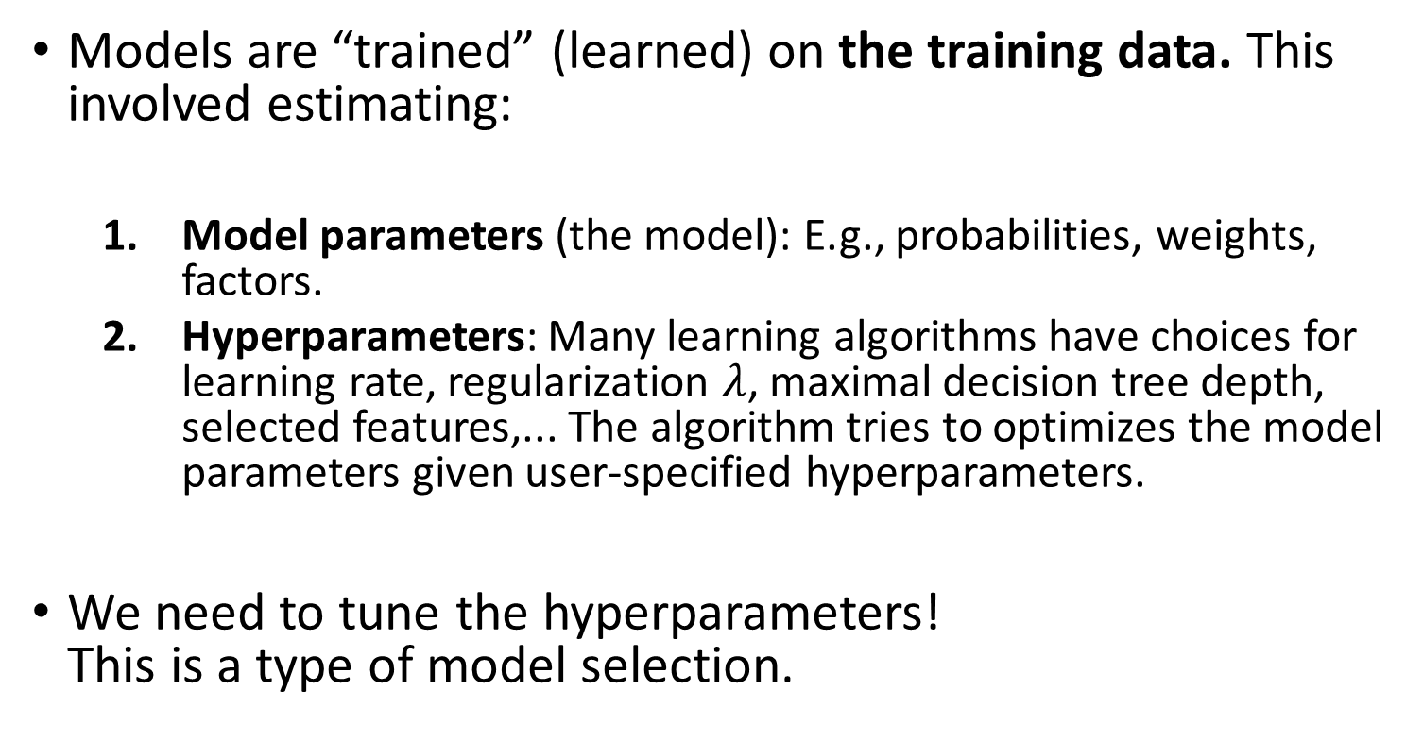
Training a Model
Training
Data
Models are “trained” (learned) on the training data. This involved estimating:
  Model parameters (the model): E.g., probabilities, weights, factors.
  Hyperparameters: Many learning algorithms have choices for learning rate, regularization $λ$, maximal decision tree depth, selected features,... The algorithm tries to optimizes the model parameters given user-specified hyperparameters.
We need to tune the hyperparameters!
This is a type of model selection.
Test
Data

Slide 22
Hyperparameter Tuning/Model Selection
Hold a validation data set back from the training data.
Learn models using the training set with different hyperparameters. Often a grid of possible hyperparameter combinations or some greedy search is used.
Evaluate the models using the validation data and choose the model with the best accuracy. Selecting the right type of model, hyperparameters and features is called model selection.
Learn the final model with the chosen hyperparameters using all training (including validation data).
Notes:
  The validation set was not used for training with different hyperparameters, so we get generalization accuracy for comparing different hyperparameter settings.
  If no model selection is necessary, then no validation set is used.
Training
Data
Training
Data
Validation
Data
Test
Data

Slide 23

Testing a Model
Training
Data
After the model is selected, the final model is evaluated against the test set to estimate the final model accuracy and see how well it generalizes.
Very important: never contaminate your training set with test data or “peek” at the test set during training!
Test
Data

Slide 24
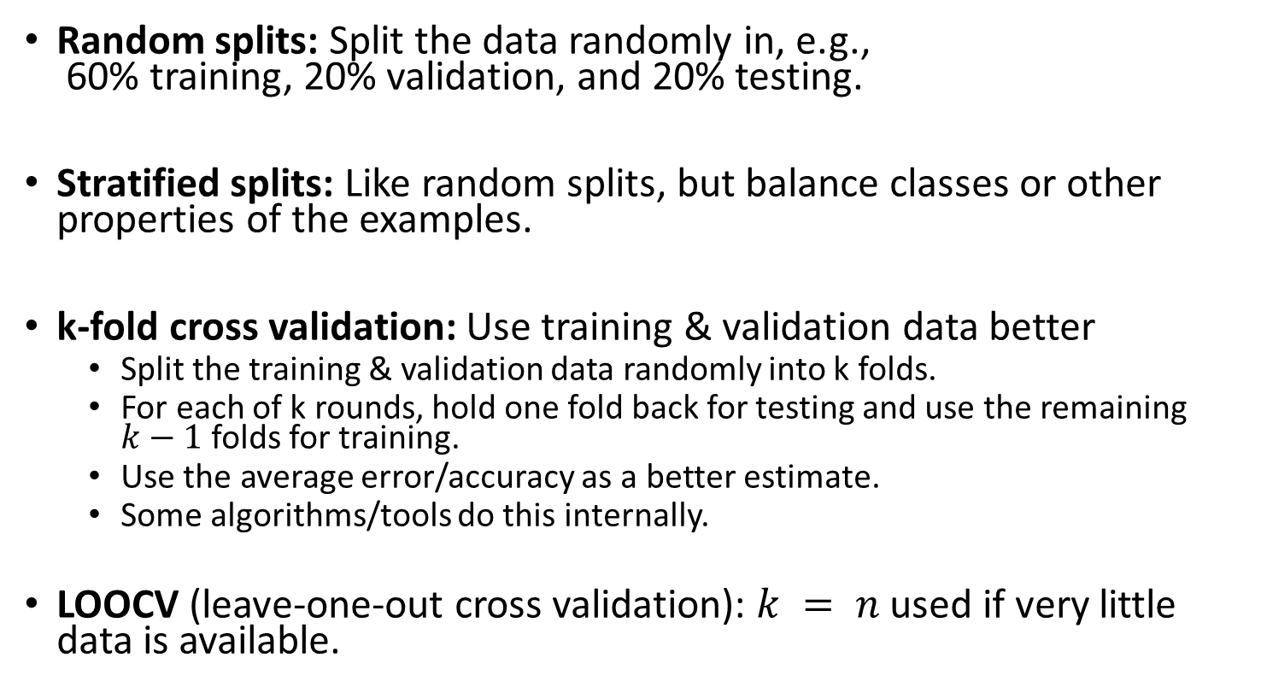
How to Split the Dataset
Random splits: Split the data randomly in, e.g.,
60% training, 20% validation, and 20% testing.
Stratified splits: Like random splits, but balance classes or other properties of the examples.
k-fold cross validation: Use training & validation data better
  Split the training & validation data randomly into k folds.
  For each of k rounds, hold one fold back for testing and use the remaining $k−1$ folds for training.
  Use the average error/accuracy as a better estimate.
  Some algorithms/tools do this internally.
LOOCV (leave-one-out cross validation): $k = n$used if very little data is available.
Training
Data
Training
Data
Validation
Data
Test
Data

Slide 25
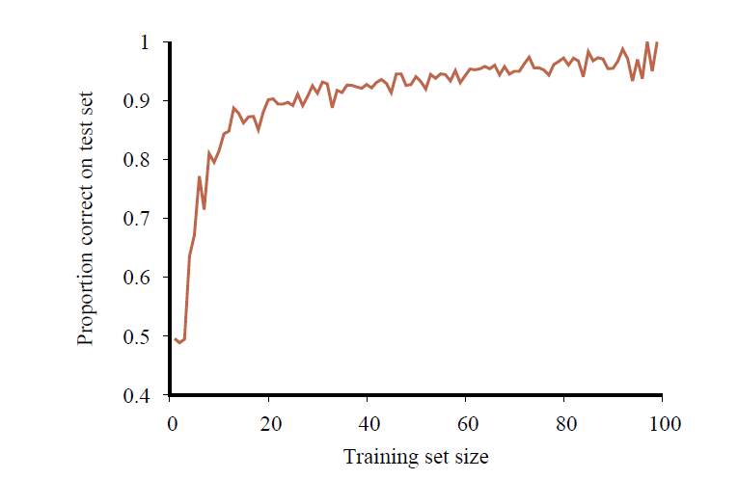
Learning Curve:
The Effect the Training Data Size
Accuracy of a classifier when the amount of available training data increases.
More data is better!
At some point the learning curve flattens out and more data does not contribute much!
Accuracy

Slide 26

Comparing to a Baselines
First step: get a baseline
  Baselines are very simple straw man model.
  Helps to determine how hard the task is.
  Helps to find out what a good accuracy is.
Weak baseline: The most frequent label classifier
  Gives all test instances whatever label was most common in the training set.
    Example: For spam filtering, give every message the label “ham.”
  Accuracy might be very high if the problem is skewed (called class imbalance).
    Example: If calling everything “ham” gets already 66% right, so a classifier that gets 70% isn’t very good…
Strong baseline: For research, we typically compare to previous published state-of-the-art as a baseline.

Slide 27

Types of
ML Models
Regression: Predict a number
Classification: Predict a label

Slide 28
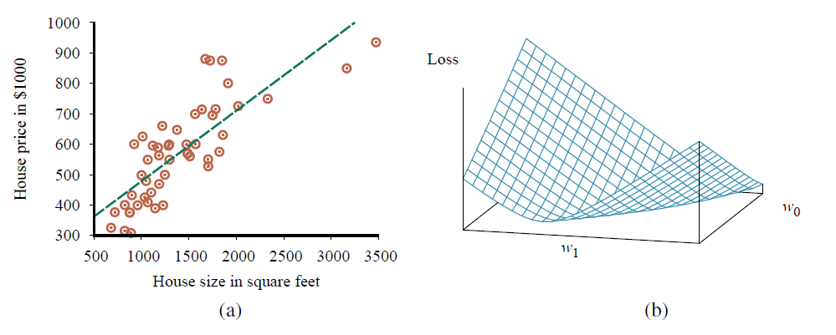
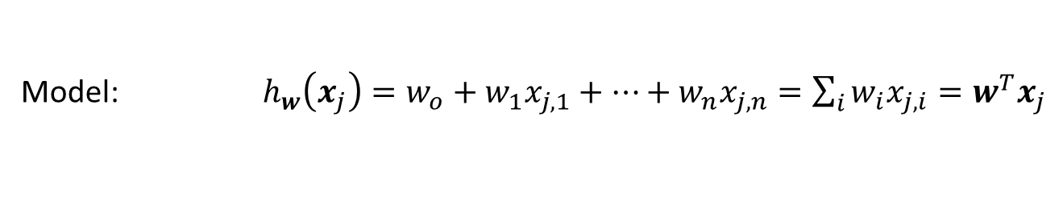

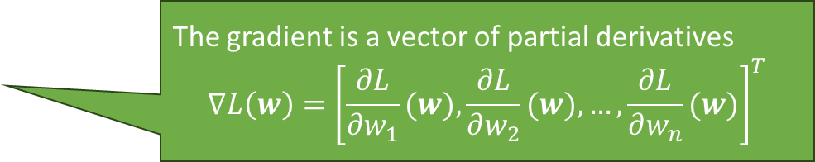
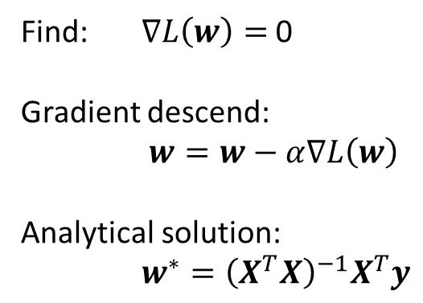



Regression: Linear Regression
Model: $h_{w}\left(x_{j}\right)=w_{o}+w_{1}x_{j,1}+…+w_{n}x_{j,n}=\sum_{i}{w_{i}x_{j,i}}=w^{T}x_{j}$
Squared error loss over the whole data matrix $X$
Empirical Loss: $L\left(w\right)={\left\|Xw−y\right\|}^{2}$
The gradient is a vector of partial derivatives
$$∇L\left(w\right)={\left[\frac{∂L}{∂w_{1}}(w),\frac{∂L}{∂w_{2}}(w),…,\frac{∂L}{∂w_{n}}(w)\right]}^{T}$$
Gradient: $∇L\left(w\right)=2X^{T}\left(Xw−y\right)$
Find: $∇L\left(w\right)=$ 0
Gradient descend:
$w=w−α∇L\left(w\right)$
Analytical solution:
$w^{∗}={\left(X^{T}X\right)}^{−1}X^{T}y$
$$∇L\left(w\right)$$
$$w$$
Pseudo inverse

Slide 29
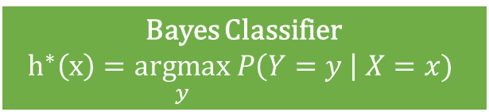
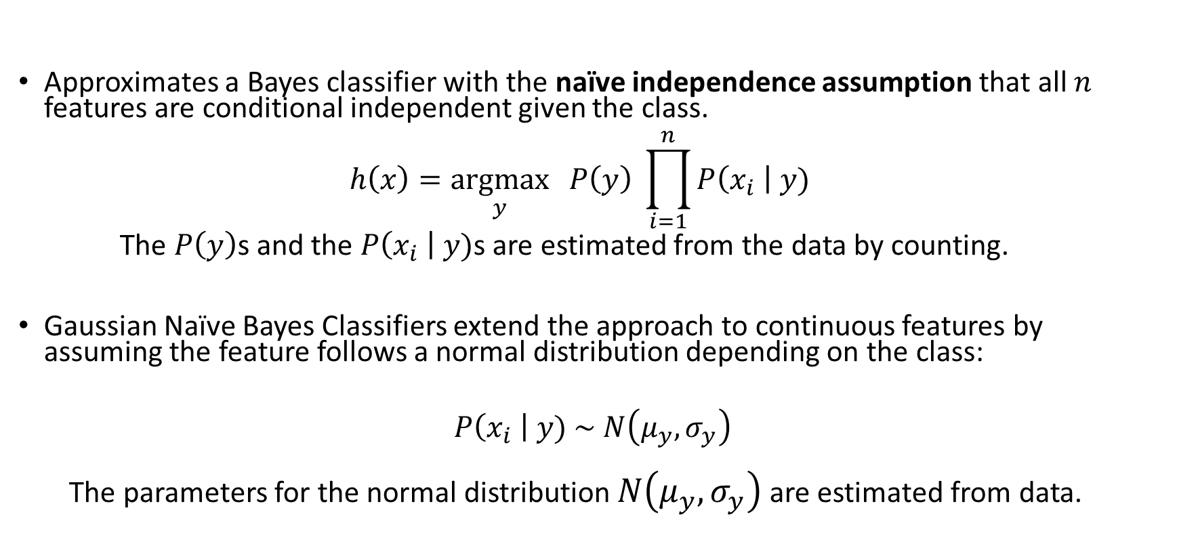
Naïve Bayes Classifier
Bayes Classifier
$$h^{∗}\left(x\right)=\underset{y}{argmax} P\left(Y=y \right| X=x)$$
Approximates a Bayes classifier with the naïve independence assumption that all $n$ features are conditional independent given the class.
$h\left(x\right)=\underset{y}{argmax}{ P\left(y\right) \prod_{i=1}^{n}{P\left(x_{i} \right| y)}}$
The $P\left(y\right)$s and the $P\left(x_{i} \right| y)$s are estimated from the data by counting.
Gaussian Naïve Bayes Classifiers extend the approach to continuous features by assuming the feature follows a normal distribution depending on the class:
$$P\left(x_{i} \right| y) \sim N\left(μ_{y},σ_{y}\right)$$
  The parameters for the normal distribution $N\left(μ_{y},σ_{y}\right)$ are estimated from data.

Slide 30
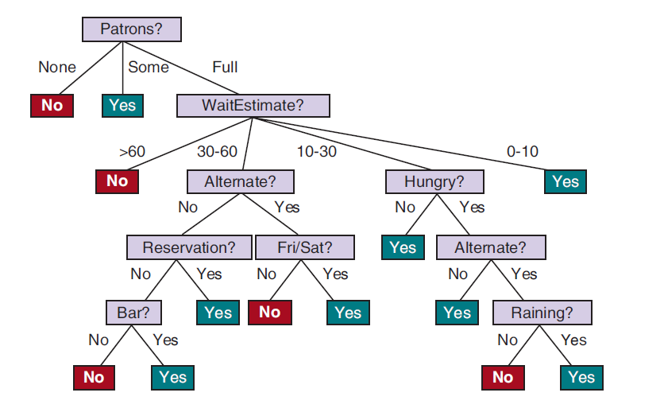
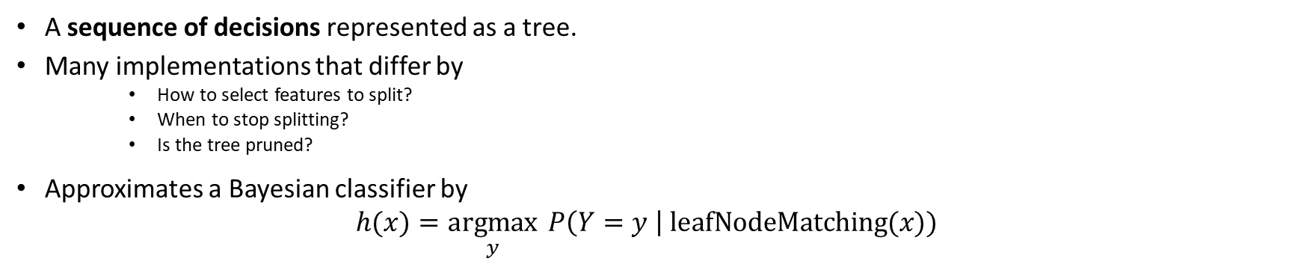
Decision Trees
Bayes Classifier
$$h^{∗}\left(x\right)=\underset{y}{argmax} P\left(Y=y \right| X=x)$$
A sequence of decisions represented as a tree.
Many implementations that differ by
    How to select features to split?
    When to stop splitting?
    Is the tree pruned?
Approximates a Bayesian classifier by
$h(x)=\underset{y}{argmax}{ P\left(Y=y \right| \text{leafNodeMatching}(x)) }$

Slide 31
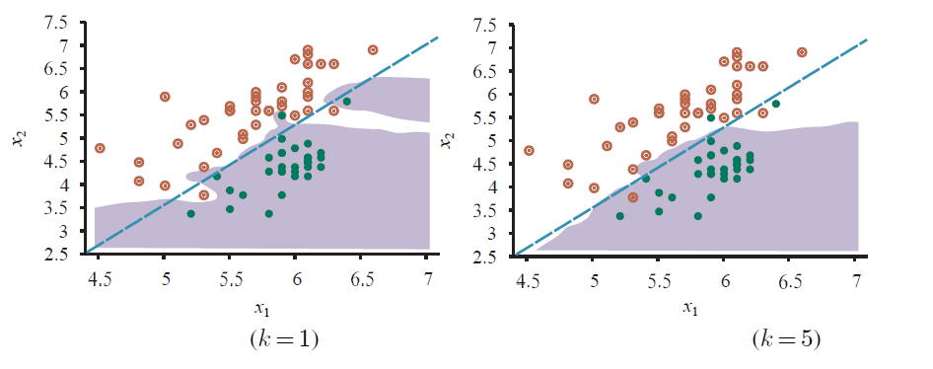
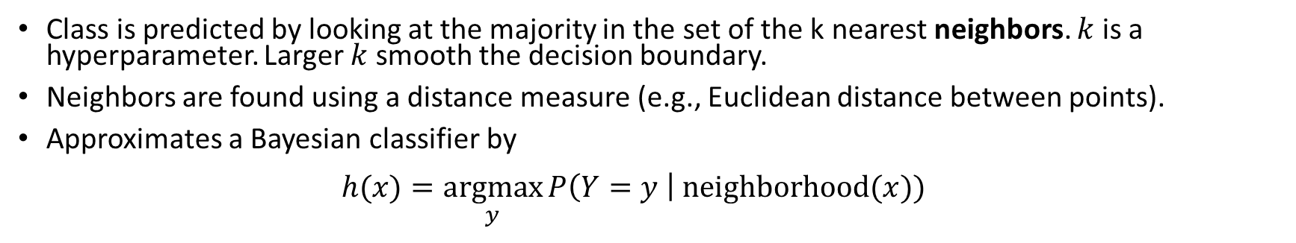
K-Nearest Neighbors Classifier
Bayes Classifier
$$h^{∗}\left(x\right)=\underset{y}{argmax} P\left(Y=y \right| X=x)$$
Class is predicted by looking at the majority in the set of the k nearest neighbors. $k$ is a hyperparameter. Larger $k$ smooth the decision boundary.
Neighbors are found using a distance measure (e.g., Euclidean distance between points).
Approximates a Bayesian classifier by
$h(x)=\underset{y}{argmax}{P\left(Y=y \right| \text{neighborhood}(x)) }$

Slide 32
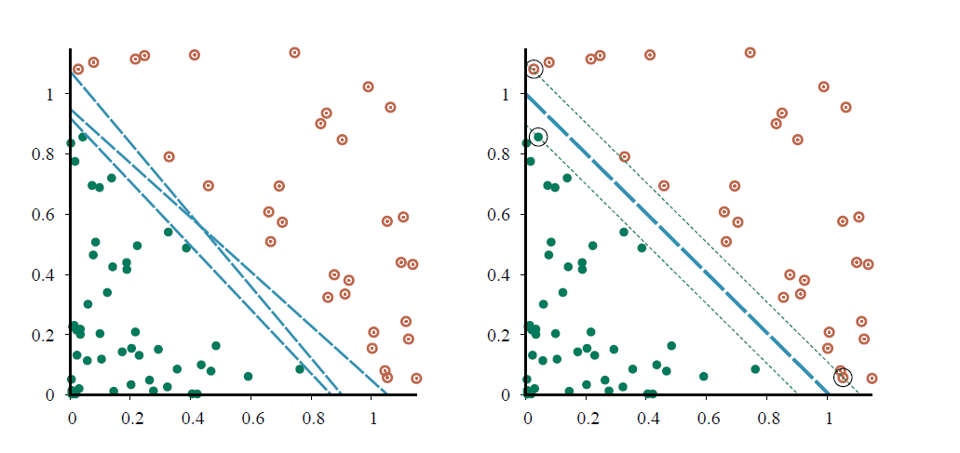
Support Vector Machine (SVM)
Margin
Decision boundary
Linear classifier that finds the maximum margin separator using only the points that are “support vectors” and quadratic optimization.
The kernel trick can be used to learn non-linear decision boundaries.

Slide 33
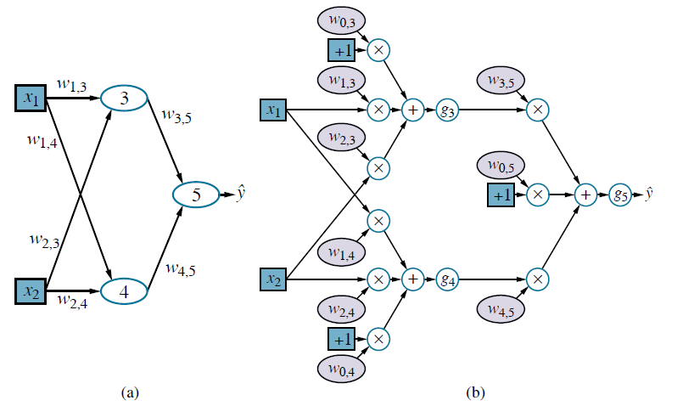
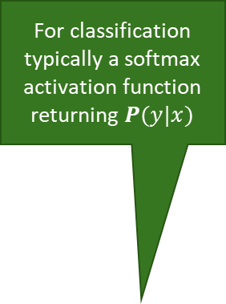
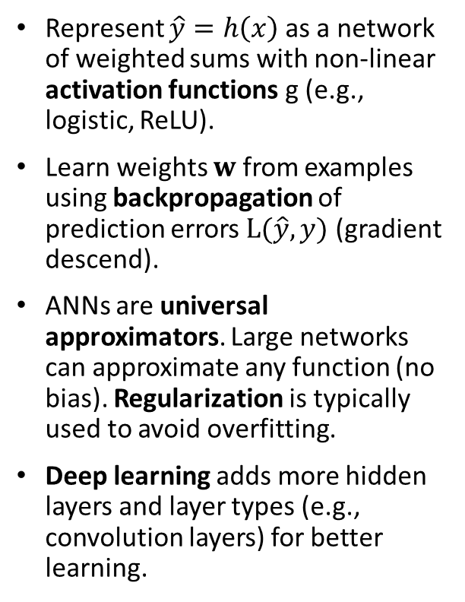
Artificial Neural Networks/Deep Learning
Computational graph
Hidden Layer
For classification typically a softmax activation function returning $P(y|x)$
Represent $\hat{y}=h\left(x\right)$ as a network of weighted sums with non-linear activation functions g (e.g., logistic, ReLU).
Learn weights $w$ from examples using backpropagation of prediction errors $L(\hat{y}, y)$ (gradient descend).
ANNs are universal approximators. Large networks can approximate any function (no bias). Regularization is typically used to avoid overfitting.
Deep learning adds more hidden layers and layer types (e.g., convolution layers) for better learning.
Perceptron
Bias term
Non-linear activation function

Slide 34
Other Popular Models and Methods
Many other models exist
Generalized linear model (GLM): This important model family includes linear regression and the classification method logistic regression.
Often used methods
Regularization: enforce simplicity and reduces overfitting by using a penalty for complexity.
Kernel trick: Let a linear classifier learn non-linear decision boundaries ( = a linear boundary in a high dimensional space).
Ensemble Learning: Use many models and combine the results (e.g., random forest, boosting).
Embedding and Dimensionality Reduction: Learn how to represent data in a simpler way (e.g., PCA, text embeddings).

Slide 35
Some Use Cases of ML for Intelligent Agents
Learn Actions
Learn Heuristics
Perception
Natural language processing: Use deep learning / word embeddings / language models to understand concepts, translate between languages, or generate text.
Speech recognition: Identify the most likely sequence of words.
Vision: Object recognition in images/videos. Generate images/video.
Learn evaluation functions for states.
Directly learn the best action from examples.
$$action=h(state)$$
𝑎𝑐𝑡𝑖𝑜𝑛=ℎ(𝑠𝑡𝑎𝑡𝑒)
$$eval=h(state)$$
𝑒𝑣𝑎𝑙=ℎ(𝑠𝑡𝑎𝑡𝑒)
This model can also be used as a playout policy for Monte Carlo tree search with data from self-play.
Can learn a heuristic for minimax search from examples.
Compressing Tables
Neural networks can be used as a compact representation of tables that do not fit in memory. E.g.,
Joint and conditional probability tables
State utility tables
The tables can be learned form data.
Bottom line: Learning a function is often more effective than hard-coding it
However, we do not always know how it performs in very rare cases!

