Slide 1
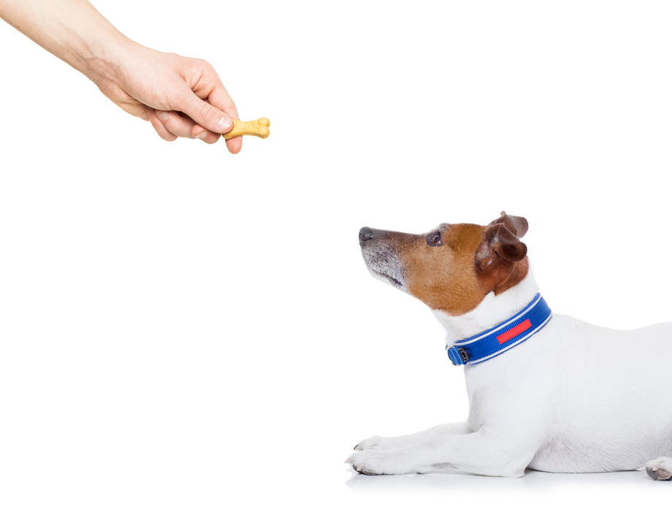

CS 5/7320
Artificial Intelligence
Reinforcement Learning
AIMA Chapter 17+22
Slides by Michael Hahsler
with figures from the AIMA textbook.
This work is licensed under a Creative Commons Attribution-ShareAlike 4.0 International License.
Online Material

Slide 2





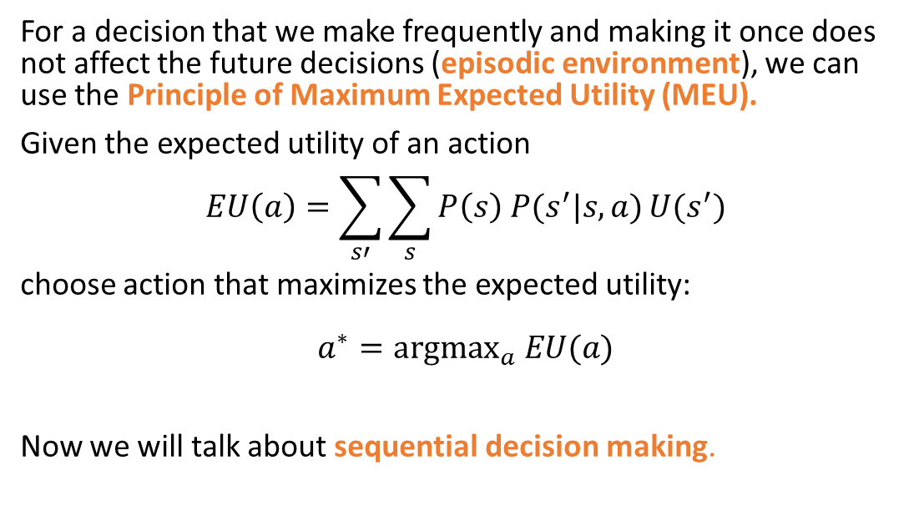


Remember Chapter 16:
Making Simple Decisions
Currentstate $s$
Action $a$
Future state $s′$
$$U(s’)$$
Action
For a decision that we make frequently and making it once does not affect the future decisions (episodic environment), we can use the Principle of Maximum Expected Utility (MEU).
Given the expected utility of an action
$$EU\left(a\right)=\sum_{s′}{\sum_{s}{P\left(s\right) P(s^{′}|s,a)}U(s^{′})}$$
choose action that maximizes the expected utility:
$$a^{∗}={argmax}_{a} EU(a)$$
Now we will talk about sequential decision making.

Slide 3
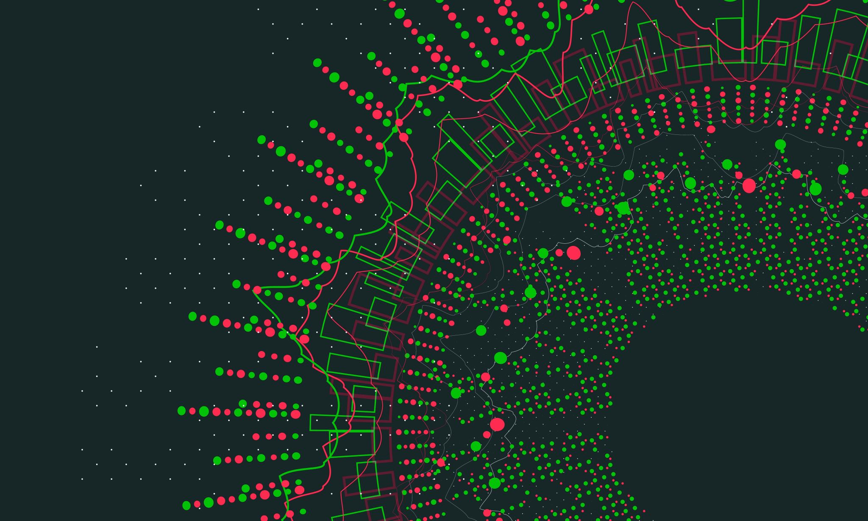
Making Complex Decisions:
Sequential Decision Making
AIMA Chapter 17

Slide 4




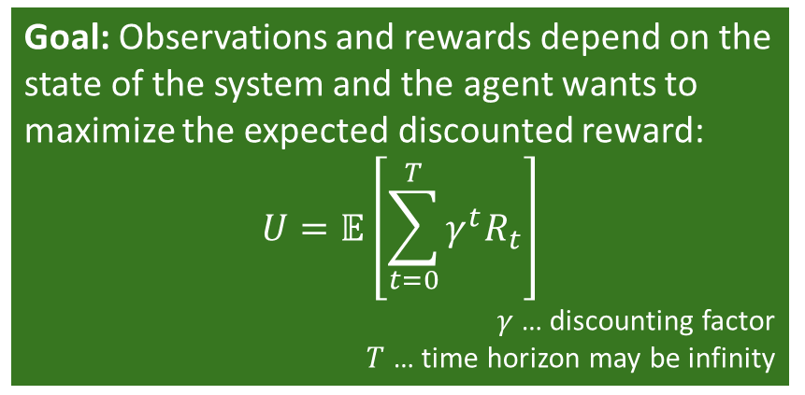


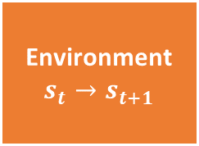




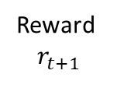



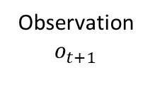


Sequential Decision Problems
$$a_{0}$$
$$U(s_{1})$$
…
$$U(s_{T−1})$$
$$U(s_{T})$$
Currentstate $s_{0}$
$$s_{1}$$
$$s_{T−1}$$
$$s_{T}$$
$$a_{1}$$
$$a_{T−1}$$
Utility-based agent: The agent’s utility depends on a sequence of decisions that depend on each other.
Sequential decision problems incorporate utilities (called reward), uncertainty, and sensing.
$$s_{0}$$
$$s_{1}$$
$$s_{2}$$
Action
$a_{t}$
Sequence: ${{(o}_{0},r}_{0}), a_{0}, {(o_{1},r}_{1}), a_{1},(o_{2},r_{2}), a_{2}, …$
Agent
Goal: Observations and rewards depend on the state of the system and the agent wants to maximize the expected discounted reward:
$$U=𝔼\left[\sum_{t=0}^{T}{γ^{t}R_{t}}\right]$$
$γ$ … discounting factor
$T$ … time horizon may be infinity
Observation
$$o_{t+1}$$
Reward
$$r_{t+1}$$
Environment
$$s_{t}→s_{t+1}$$

Slide 5

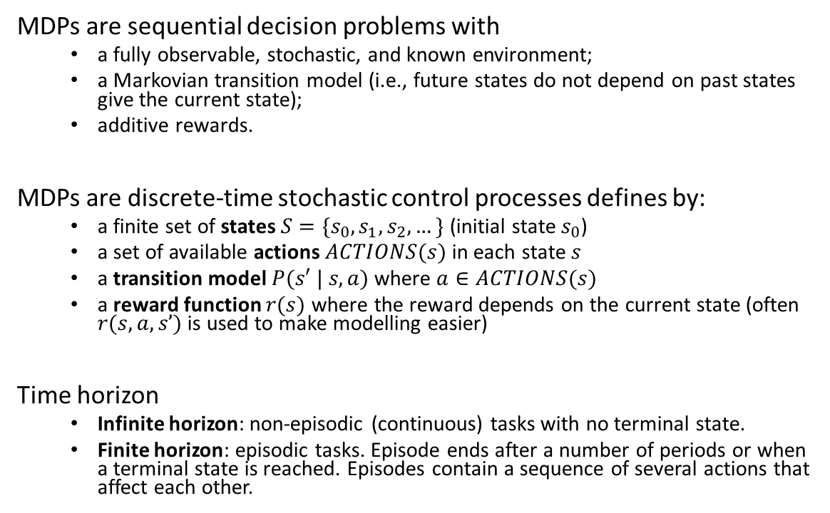

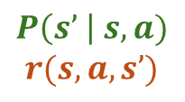






Definition: Markov Decision Process (MDP)
MDPs are sequential decision problems with
  a fully observable, stochastic, and known environment;
  a Markovian transition model (i.e., future states do not depend on past states give the current state);
  additive rewards.
MDPs are discrete-time stochastic control processes defines by:
  a finite set of states $S=\{s_{0}, s_{1},s_{2}, …\}$ (initial state $s_{0}$)
  a set of available actions $ACTIONS(s)$ in each state $s$
  a transition model $P(s′ | s, a)$ where $a∈ACTIONS(s)$
  a reward function $r(s)$ where the reward depends on the current state (often $r(s,a,s’)$is used to make modelling easier)
Time horizon
  Infinite horizon: non-episodic (continuous) tasks with no terminal state.
  Finite horizon: episodic tasks. Episode ends after a number of periods or when a terminal state is reached. Episodes contain a sequence of several actions that affect each other.
$$P\left(s’ \right| s,a)$$
$$r(s,a,s’)$$
1
$$a_{1}$$
.5
10
$$s_{0}$$
$$s_{1}$$
$$a_{2}$$
-5
10
$$a_{2}$$
.5
1
$$a_{1}$$
100
$$s_{2}$$
$$a_{1},a_{2}$$
0
This is different from the previous definition of an episodic environment!

Slide 6
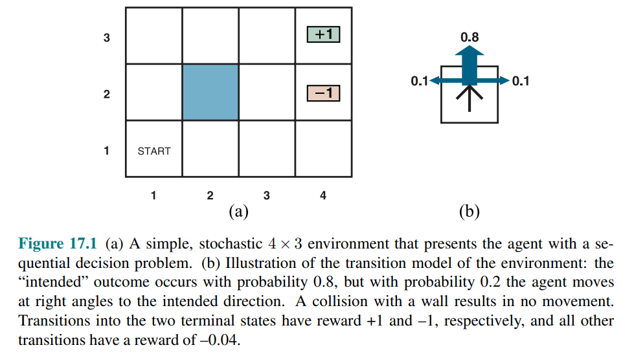
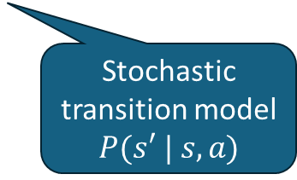
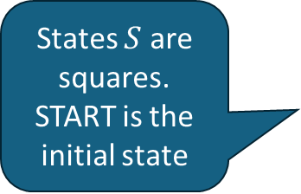
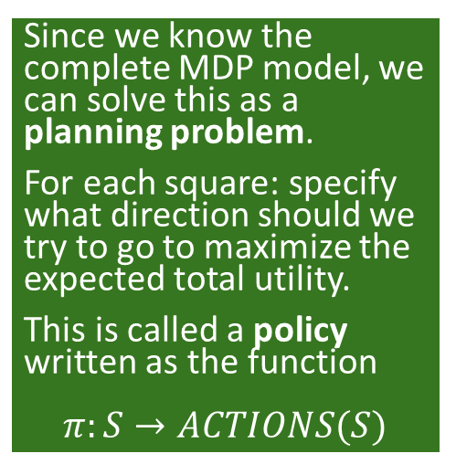
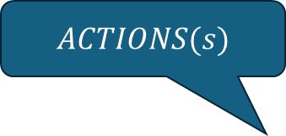
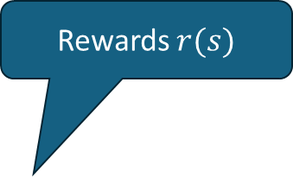
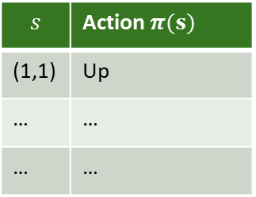
Example: 4x3 Grid World
Since we know the complete MDP model, we can solve this as a planning problem.
For each square: specify what direction should we try to go to maximize the expected total utility.
This is called a policy written as the function
$$π:S→ACTIONS(S)$$
Rewards $r(s)$
$ACTIONS(s)$
-0.04
-0.04
-0.04
States $S$ are squares. START is the initial state
-0.04
-0.04
-0.04
-0.04
-0.04
Stochastic transition model
$P(s′ | s, a)$
-0.04
Policy
$$s$$ | Action $π(s)$
(1,1) | Up
… | …
… | …

Slide 7
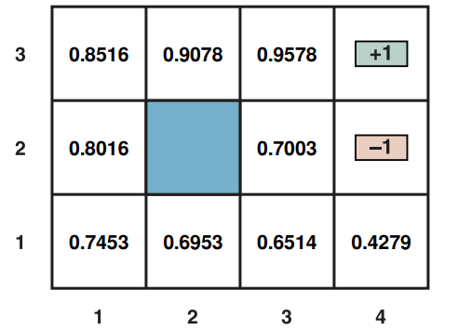
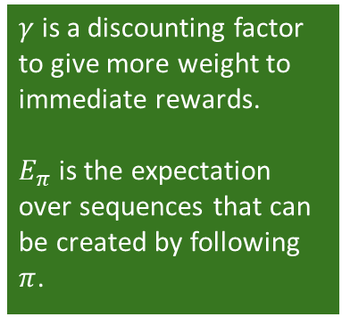
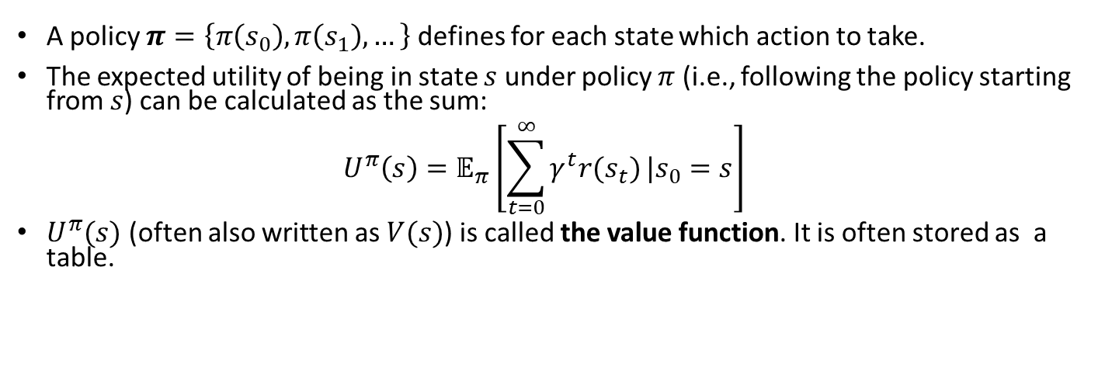
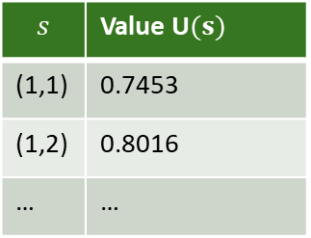
Value Function
A policy $π=\left\{π\left(s_{0}\right), π\left(s_{1}\right), …\right\}$ defines for each state which action to take.
The expected utility of being in state $s$ under policy $π$ (i.e., following the policy starting from $s$) can be calculated as the sum:
$U^{π}\left(s\right)=𝔼_{π}\left[\sum_{t=0}^{∞}{γ^{t}r(s_{t})}|s_{0}=s\right]$
$U^{π}(s)$ (often also written as $V(s)$) is called the value function. It is often stored as a table.
$γ$ is a discounting factor to give more weight to immediate rewards.
$E_{π}$ is the expectation over sequences that can be created by following $π$.
Value Function
Value Function
$$s$$ | Value U$(s)$
(1,1) | 0.7453
(1,2) | 0.8016
… | …

Slide 8
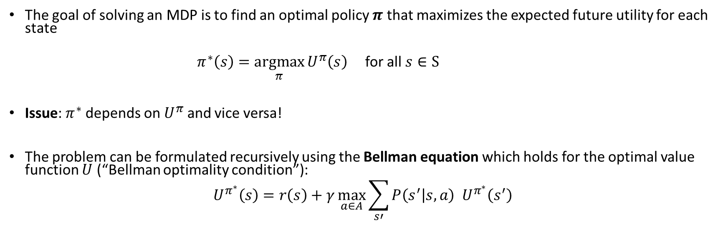
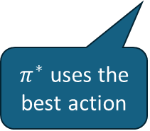
Planning: Finding the Optimal Policy
The goal of solving an MDP is to find an optimal policy $π$ that maximizes the expected future utility for each state
$π^{∗}\left(s\right)=\underset{π}{argmax}{U^{π}\left(s\right)}$ for all $s∈S$
Issue: $π^{∗}$ depends on $U^{π}$ and vice versa!
The problem can be formulated recursively using the Bellman equation which holds for the optimal value function $U$ (“Bellman optimality condition”):
$$U^{π^{∗}}\left(s\right)=r\left(s\right)+γ\max_{a∈A}{\sum_{s′}{P\left(s^{′} | s,a\right){ U}^{π^{∗}}\left(s^{′}\right)}}$$
Immediate Reward
$π^{∗}$ uses the best action
Expectation
Utility of the next state

Slide 9
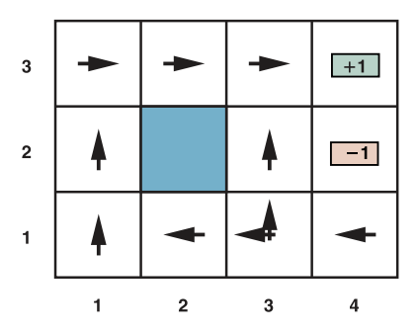
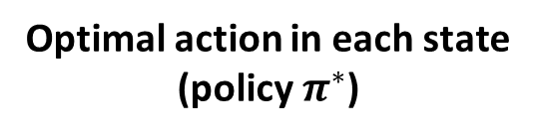

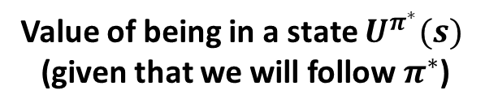
Solution: 4x3 Grid World
Optimal action in each state
(policy $π^{∗}$)
Value of being in a state $U^{π^{∗}}(s)$
(given that we will follow $π^{∗}$)
Greedy policy:
Always pick the action leading to the state with the highest expected utility.
$$γ=1$$
It is optimal to walk away from the +1 square!
How to we find the optimal value function/optimal policy?
Policy Iteration
Value Iteration

Slide 10
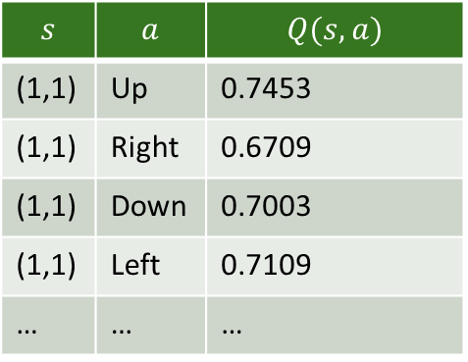
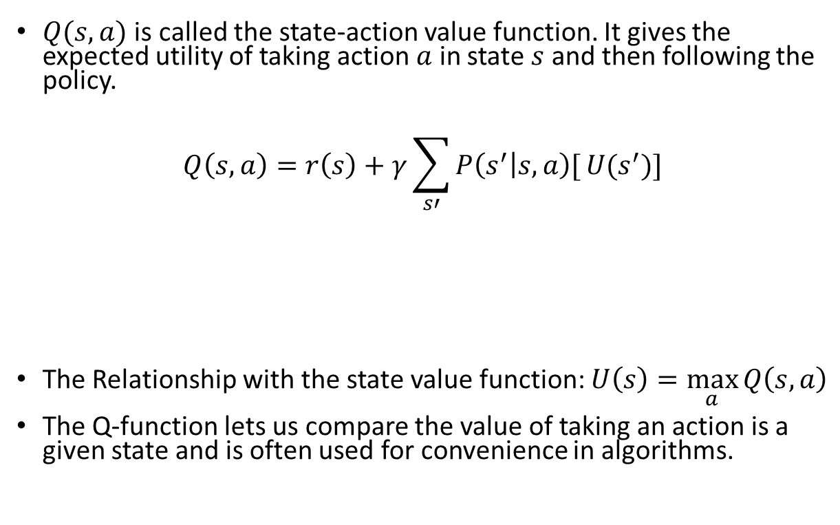
Q-Function
Value Function
$Q(s,a)$ is called the state-action value function. It gives the expected utility of taking action $a$ in state $s$ and then following the policy.
$$Q\left(s,a\right)=r\left(s\right)+γ\sum_{s′}{P\left(s^{′} | s,a\right)[}U(s^{′})]$$
The Relationship with the state value function: $U\left(s\right)=\max_{a}{Q\left(s, a\right)}$
The Q-function lets us compare the value of taking an action is a given state and is often used for convenience in algorithms.
Immediate Reward
Expected utility of the next state
Q-Table
$$s$$ | $$a$$ | $$Q(s,a)$$
(1,1) | Up | 0.7453
(1,1) | Right | 0.6709
(1,1) | Down | 0.7003
(1,1) | Left | 0.7109
… | … | …

Slide 11
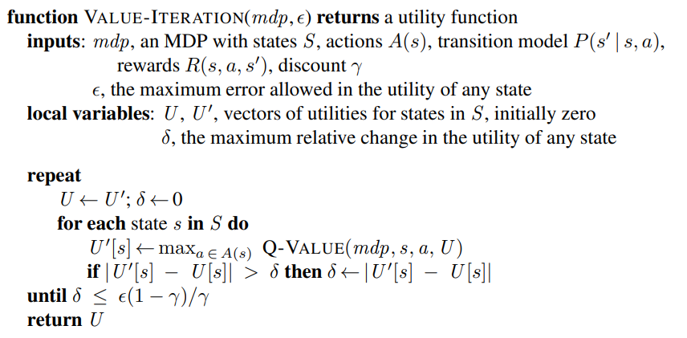


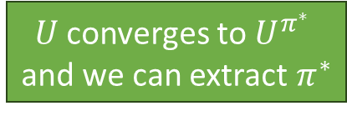
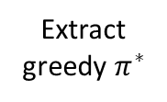


Value Iteration: Estimate the Optimal Value Function $U^{π^{∗}}$
Algorithm: Start with a $U$ vector of 0 for all states and then update (Bellman update) the vector iteratively until it converges to the unique optimal solution $U^{π^{∗}}$.
Bellman update
$$U$$
$$U′$$
$$U^{π^{∗}}$$
Extract
greedy $π^{∗}$
Update with the value of the best action in state s.
Uses a proxy for policy loss ${\left\|U^{π}−U\right\|}_{∞}$ as the stopping criterion
$U$ converges to $U^{π^{∗}}$
and we can extract $π^{∗}$

Slide 12
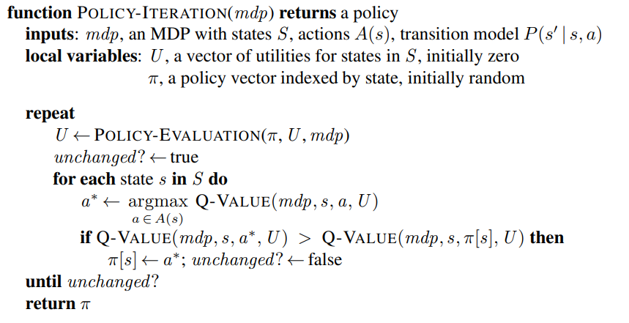


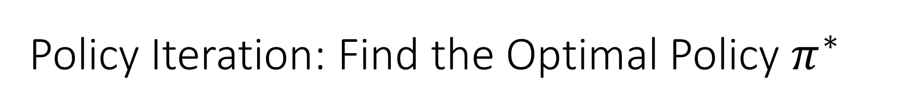


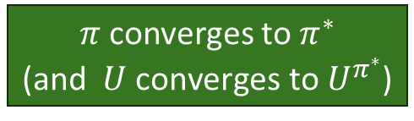
Policy Iteration: Find the Optimal Policy $π^{∗}$
Policy iteration tries to directly find the optimal policy by iterating policy evaluation and improvement.
$$U$$
$$U^{π^{∗}}$$
Calculate U given current policy (either solve an LP or value iteration with fixed policy)
P. improvement
Policy evaluation
$$π^{∗}$$
$$π$$
Greedy policy
Improvement
$π$ converges to $π^{∗}$
(and $U \text{converges} \text{to} U^{π^{∗}}$)

Slide 13
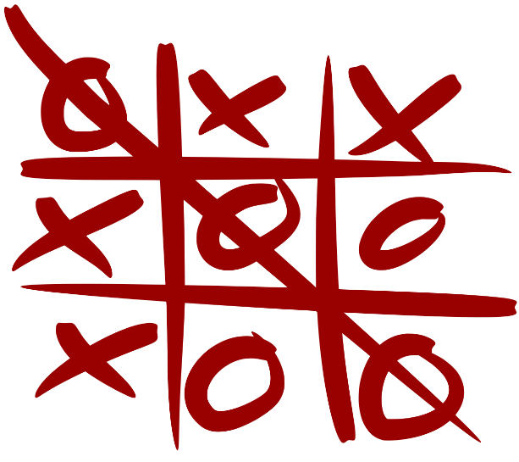



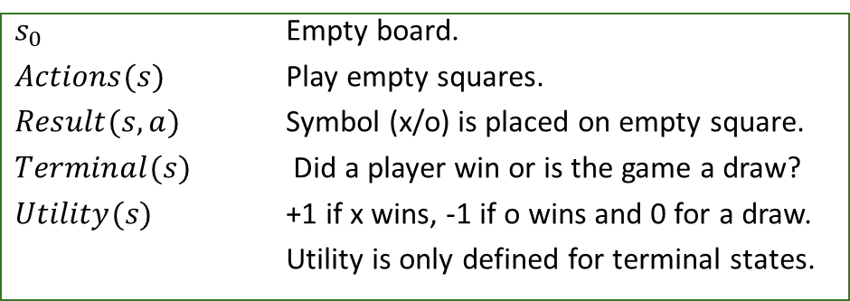
Playing a Game as a Sequential Decision Problem: Tic-Tac-Toe
Definitions from the Chapter 5 on Games for a goal-based agent:
We can set up an MDP to find the optimal policy $π^{∗}\left(s\right)$, but it will be hard to solve since:
  There are many states, so the table $U\left(s\right)$has many entries.
  $P\left(s^{′} | s,a\right)$ depends on the other player so it would need to be learned. The table is also very large.
  All the reward is delayed. Immediate regards are always 0 until the end of the game.
This makes learning hard! A solution is model-free reinforcement learning.
$s_{0}$ Empty board.
$Actions(s)$ Play empty squares.
$Result(s,a)$ Symbol (x/o) is placed on empty square.
$Terminal(s)$ Did a player win or is the game a draw?
$Utility(s)$ +1 if x wins, -1 if o wins and 0 for a draw.
Utility is only defined for terminal states.
Stochastic transition model $P\left(s^{′} | s,a\right)$
Reward function $r(s)$

Slide 14



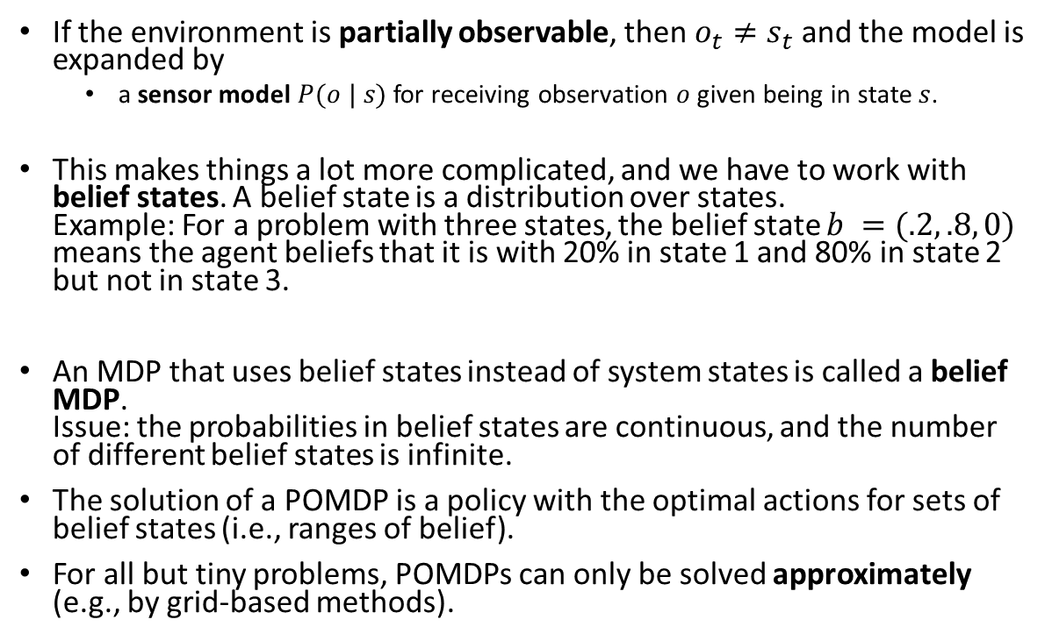






Partially Observable Markov Decision Process (POMDP)
If the environment is partially observable, then $o_{t}≠s_{t}$ and the model is expanded by
  a sensor model $P(o | s)$ for receiving observation $o$ given being in state $s$.
This makes things a lot more complicated, and we have to work with belief states. A belief state is a distribution over states.
Example: For a problem with three states, the belief state $b =(.2, .8, 0)$ means the agent beliefs that it is with 20% in state 1 and 80% in state 2 but not in state 3.
An MDP that uses belief states instead of system states is called a belief MDP.
Issue: the probabilities in belief states are continuous, and the number of different belief states is infinite.
The solution of a POMDP is a policy with the optimal actions for sets of belief states (i.e., ranges of belief).
For all but tiny problems, POMDPs can only be solved approximately (e.g., by grid-based methods).
$${ o}_{1}$$
$${ o}_{2}$$
$${ o}_{3}$$
$$P\left(o \right|s)$$
1
$$a_{1}$$
.5
10
10
$$s_{0}$$
$$s_{1}$$
$$a_{2}$$
-5
$$a_{2}$$
.5

Slide 15

Reinforcement Learning
AIMA Chapter 22

Slide 16
Reinforcement Learning (RL)
RL assumes that the problem can be modeled as an MDP.
However, we do not know the transition or the reward model. This means we have an unknown environment.
We cannot use offline planning in unknown environments. The agent needs to interact with the environment (try actions) and use the reward signal to update its estimate of the utility of states and actions. This is a learning process where the reward provides positive reinforcement.
A popular algorithm is Q-Learning which tries to learn the state-action value function of important states.
Notes:
Reward may be sparse. Need for credit assignment.
Reward shaping creates pseudo rewards that advance learning (e.g., ball possession or distance to the goal in soccer).
Hierarchical RL: Break the task into smaller sub-tasks so we can learn the succession of sub-task efficiently.

Slide 17
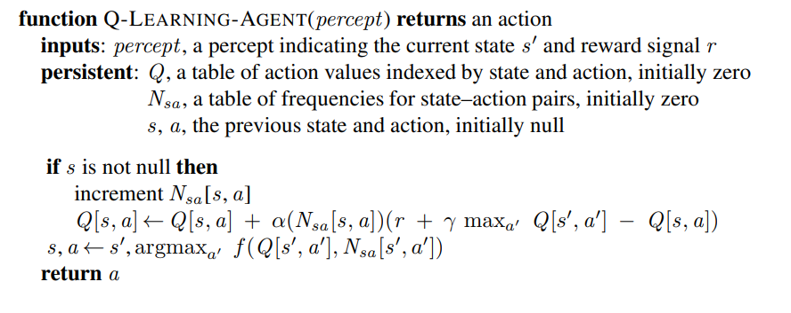
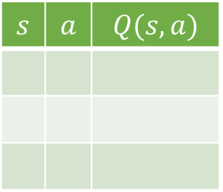
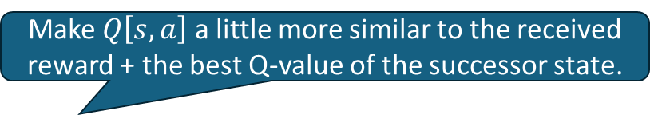
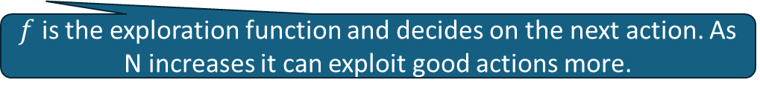
Q-Learning
Q-Table
$$s$$ | $$a$$ | $$Q(s,a)$$
Q-Learning learns the state-action value function as a table from interactions with the environment.
New episode has no s.
Learning rate
Make $Q\left[s,a\right]$ a little more similar to the received reward + the best Q-value of the successor state.
$f$ is the exploration function and decides on the next action. As N increases it can exploit good actions more.

Slide 18
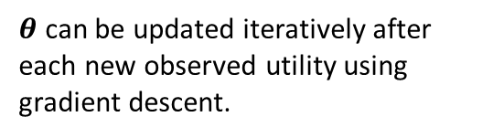

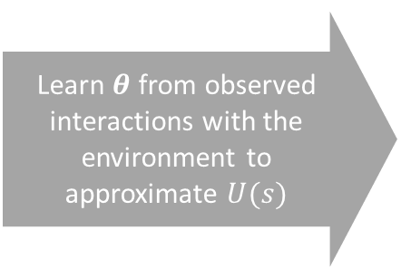


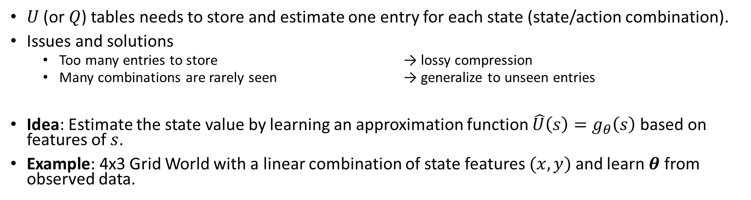

Value Function Approximation
$U$ (or $Q$) tables needs to store and estimate one entry for each state (state/action combination).
Issues and solutions
  Too many entries to store → lossy compression
  Many combinations are rarely seen → generalize to unseen entries
Idea: Estimate the state value by learning an approximation function $\hat{U}\left(s\right)=g_{θ}\left(s\right)$ based on features of $s$.
Example: 4x3 Grid World with a linear combination of state features $(x, y)$ and learn $θ$ from observed data.
$$y$$
Value function $U(s)$
Learn $θ$ from observed interactions with the environment to approximate $U(s)$
$${\hat{U}}_{θ}\left(x,y\right)=θ_{0}+θ_{1}x+θ_{2}y$$
$θ$ can be updated iteratively after each new observed utility using gradient descent.
$$x$$
Notes:
Deep RL is still somewhat unpredictable since the deep ANN has many parameters…

Slide 19



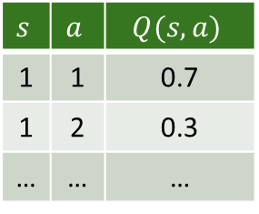



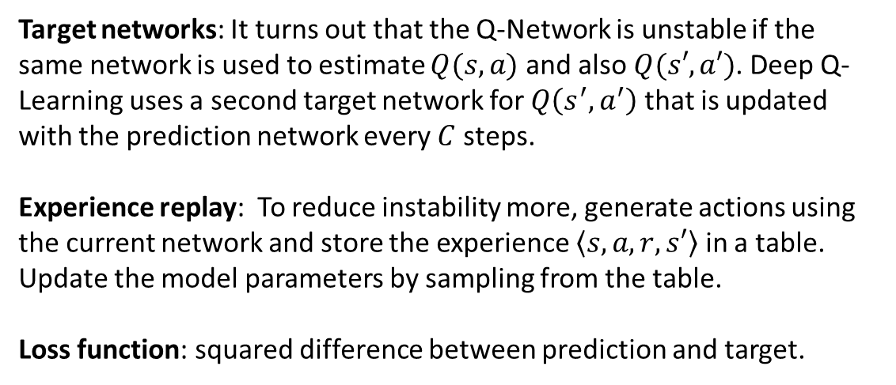
Deep Q-Learning
Traditional Q-Learning
$$s$$ | $$a$$ | $$Q(s,a)$$
1 | 1 | 0.7
1 | 2 | 0.3
… | … | …
$$s$$
$$Q(s, a)$$
target
prediction
Q-Table
Target networks: It turns out that the Q-Network is unstable if the same network is used to estimate $Q(s, a)$ and also $Q(s′, a′)$. Deep Q-Learning uses a second target network for $Q\left(s^{′}, a^{′}\right)$ that is updated with the prediction network every $C$ steps.
Experience replay: To reduce instability more, generate actions using the current network and store the experience $\left\langle s, a, r, s′\right\rangle$ in a table. Update the model parameters by sampling from the table.
Loss function: squared difference between prediction and target.
$$S$$
$$A$$
$$s$$
$$Q(s, a)$$
Deep Q-Network
(DQN)
Volodymyr Mni et al., Playing Atari with Deep Reinforcement Learning, NIPS Deep Learning Workshop 2013.

Slide 20

Summary
Agents can learn the value of being in a state from reward signals.
Rewards can be delayed (e.g., at the end of a game).
Not being able to fully observe the state makes the problem more difficult (POMDP).
Unknown transition models lead to the need of exploration by trying actions (model free methods like Q-Learning).
All these problems are computationally very expensive and often can only be solved by approximation. State of the art is to use deep artificial neural networks for function approximation.

