Slide 1



CS 5/7320 Artificial Intelligence Quantifying Uncertainty: Probabilities & Bayesian Decision Making AIMA Chapter 12
Slides by Michael Hahsler based on slides by Svetlana Lazepnik with figures from the AIMA textbook
This work is licensed under a Creative Commons Attribution-ShareAlike 4.0 International License.
Cover image: "Dice" by Steve A Johnson
Online Material

Slide 2

Example: Catching a Flight with a Logical Agent
Let action A_{t} = leave for airport t minutes before flight
Question: What action A_{t} get me there on time?
Problems:
Partial observability (road state, other drivers' plans, etc.)
Noisy sensors (traffic reports)
Uncertainty in action outcomes (flat tire, etc.)
Complexity of modeling and predicting traffic
Logic leads to the following conclusions:
A₂₅ will get me there on time if there is no accident on the bridge and it doesn't rain and my tires remain intact, etc., etc.
A_{Inf} guarantees to get there in time, but who lives forever?
Logic often creates conclusions that are too weak for effective decision-making. Uncertainty is a problem for logical agents!

Slide 3
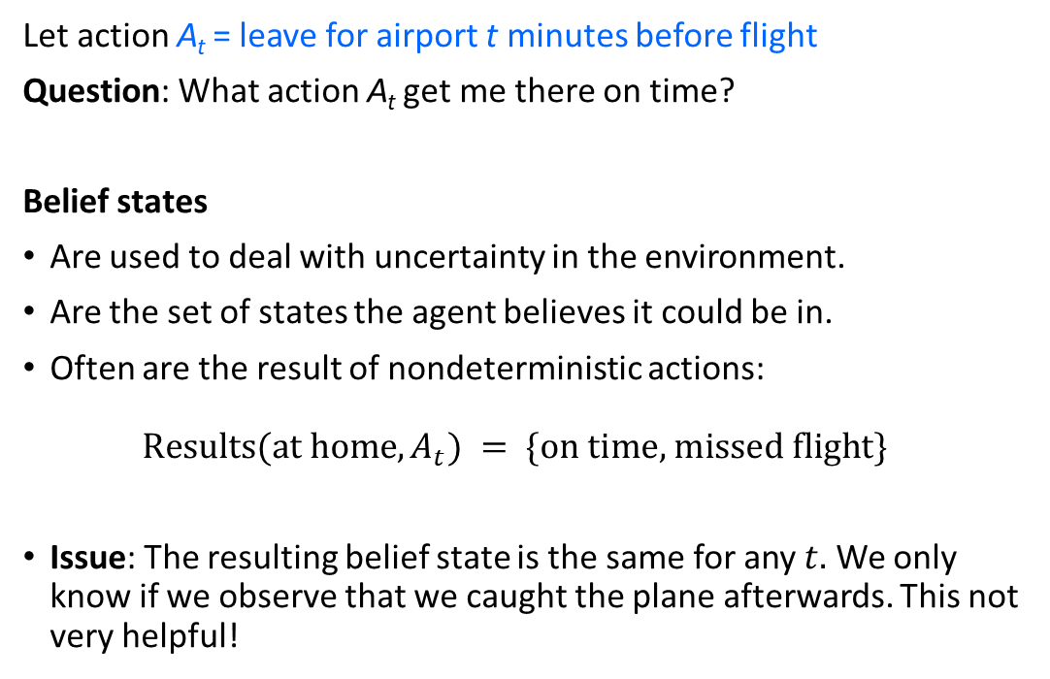
Example: Catching a Flight with Belief States
Let action A_{t} = leave for airport t minutes before flight
Question: What action A_{t} get me there on time?
Belief states
Are used to deal with uncertainty in the environment.
Are the set of states the agent believes it could be in.
Often are the result of nondeterministic actions: $\text{Results}(\text{at} \text{home}, A_{t}) = \{\text{on} \text{time}\text{, }\text{missed} \text{flight}\}$
Issue: The resulting belief state is the same for any $t.$ We only know if we observe that we caught the plane afterwards. This not very helpful!
We need a way to specify how likely it is that we will end up at the airport after the action!

Slide 4
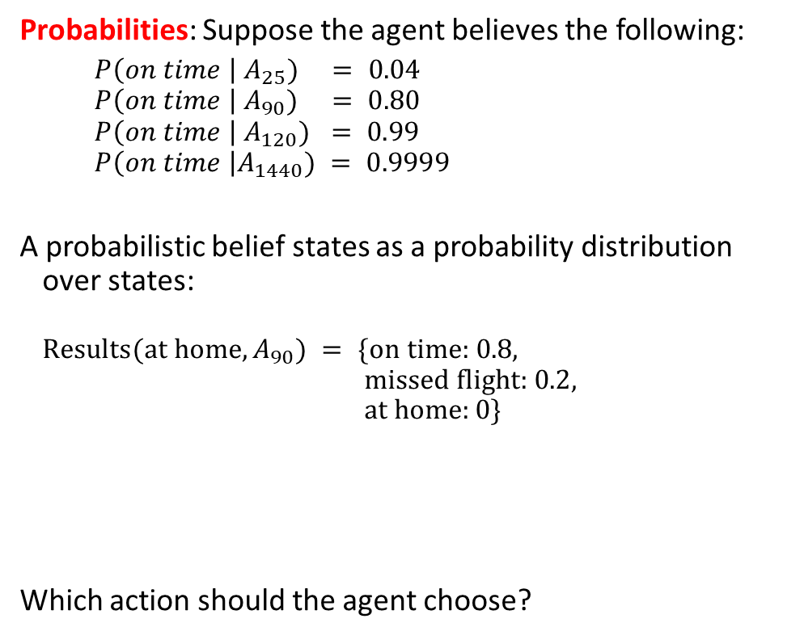
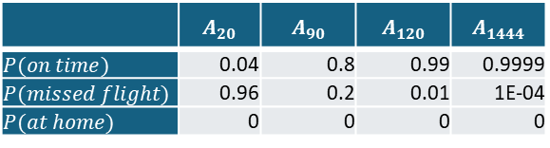
Example: Catching a Flight with Probabilities
Probabilities: Suppose the agent believes the following:
$P\left(on time \right| A_{25}) = 0.04$
$$P\left(on time \right|{ A}_{90}) = 0.80$$
$$P\left(on time \right|{ A}_{120}) = 0.99$$
$$P\left(on time \right|A_{1440}) = 0.9999$$
A probabilistic belief states as a probability distribution over states: $$\text{Results}(\text{at} \text{home}, A_{90}) = \{\text{on} \text{time}\text{: 0.8, }$$ $\text{missed} \text{flight}\text{: 0.2},$ $\text{at} \text{home}:0\}$
Which action should the agent choose?
 | $$A_{20}$$ | $$A_{90}$$ | $$A_{120}$$ | $$A_{1444}$$
$$P(on time)$$ | 0.04 | 0.8 | 0.99 | 0.9999
$$P(missed flight)$$ | 0.96 | 0.2 | 0.01 | 1E-04
$$P(at home)$$ | 0 | 0 | 0 | 0
Belief states

Slide 5
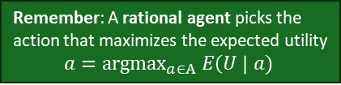
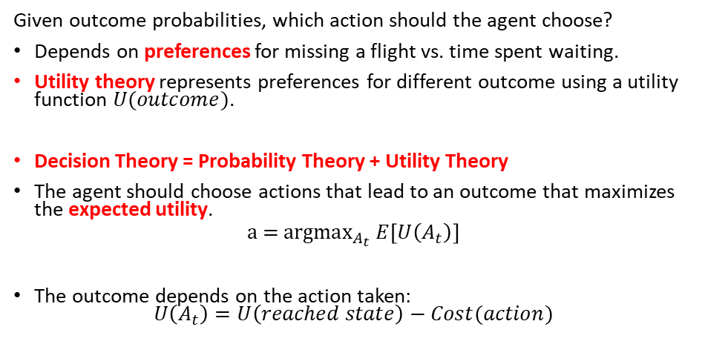
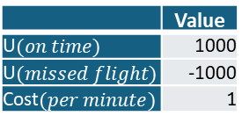
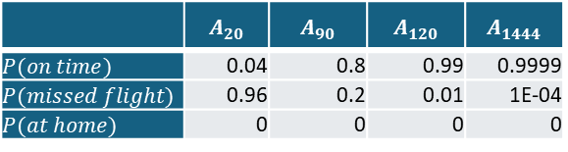
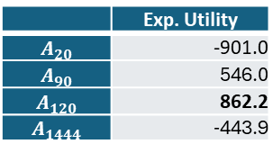
Making a Decision Under Uncertainty
Given outcome probabilities, which action should the agent choose?
Depends on preferences for missing a flight vs. time spent waiting.
Utility theory represents preferences for different outcome using a utility function $U(outcome)$.
Decision Theory = Probability Theory + Utility Theory
The agent should choose actions that lead to an outcome that maximizes the expected utility.
$$\text{a}\text{ = }\text{argma}{\text{x}}_{A_{t}} E\left[U\left(A_{t}\right)\right]$$
The outcome depends on the action taken: $U\left(A_{t}\right)=U\left(reached state\right)−Cost(action)$
Remember: A rational agent picks the action that maximizes the expected utility
$$a={\text{argmax}}_{a∈A} E\left(U \right| a)$$
Example:
Belief states with probabilities
Utility structure
 | $$A_{20}$$ | $$A_{90}$$ | $$A_{120}$$ | $$A_{1444}$$
$$P(on time)$$ | 0.04 | 0.8 | 0.99 | 0.9999
$$P(missed flight)$$ | 0.96 | 0.2 | 0.01 | 1E-04
$$P(at home)$$ | 0 | 0 | 0 | 0
+
=
 | Exp. Utility
$$A_{20}$$ | -901.0
$$A_{90}$$ | 546.0
$$A_{120}$$ | 862.2
$$A_{1444}$$ | -443.9
 | Value
U$(on time)$ | 1000
U$(missed flight)$ | -1000
Cost$(per minute)$ | 1
$$E\left[U\left(A_{t}\right)\right] =P\left(on time | A_{t}\right) U\left(on time \right| A_{t})+P\left(missed flight | A_{t}\right)U\left(missed flight \right|A_{t})$$
$$E\left[U\left(A_{120}\right)\right]=0.99×\left(1000−120×1\right)+0.01×\left(−1000−120×1\right)=862.4$$

Slide 6
Contents of this Module
Randomness and Probability Theory
Independence between Events
Bayesian Decision Making
Example: Naïve Bayesian Classifier
Bayes’ Update Rule

Slide 7
Randomness and Probability Theory

Slide 8
Sources of Uncertainty
Probabilistic assertions summarize effects of:
Ignorance
Lack of knowledge: partial observability, stochastic transitions, etc.
Randomness
Intrinsically random behavior: no patterns (not very common)
Laziness
Convenience: It is too hard to calculate the exact answer.
Example: What is the source of uncertainty for a coin toss?

Slide 9
What are Probabilities?
Frequentism (Objective; Positivist)
Probabilities are long-run relative frequencies determined by observation.
For example, if we toss a coin many times$, P(heads)$is estimated as the proportion of the time the coin will come up heads.
For example, if we toss a coin many times, 𝑃(ℎ𝑒𝑎𝑑𝑠) is estimated as the proportion of the time the coin will come up heads.
But what if we are dealing with events that only happen once? E.g., what is the probability that a Republican will win the presidency in 2024? How do we define comparable elections? Reference class problem.
Bayesian Statistics (Subjective)
Probabilities are degrees of belief based on prior knowledge and updated by evidence.
Assign belief values to statements without evidence
Update our degrees of belief given observations = Learning
Provides tools to:
For lots of data
Limited data and learning
Both concepts are often used together.

Slide 10
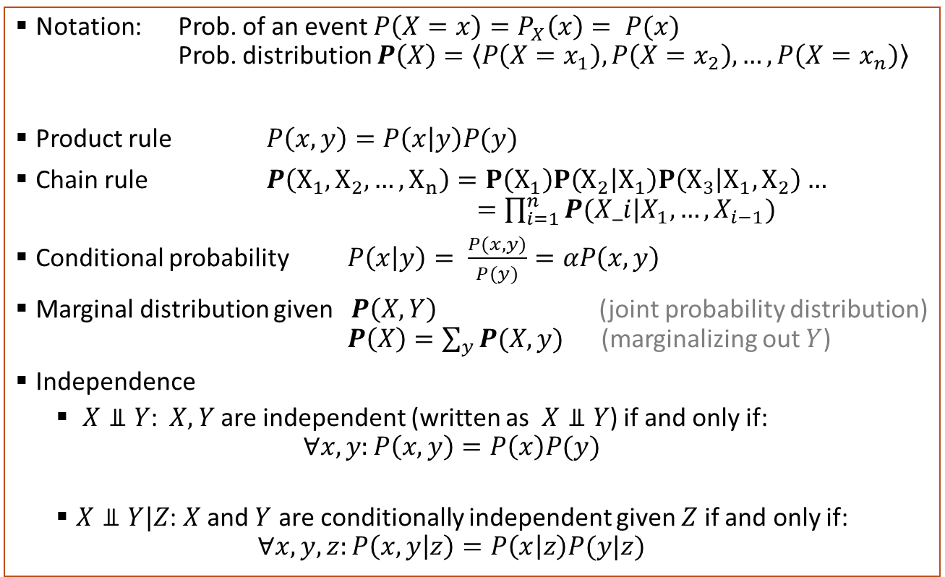
Probability Theory Recap
Notation: Prob. of an event $P\left(X=x\right)=P_{X}\left(x\right)= P(x)$ Prob. distribution $P\left(X\right)=\left\langle P\left(X=x_{1}\right), P\left(X=x_{2}\right), …, P\left(X=x_{n}\right)\right\rangle$
Product rule $P\left(x,y\right)=P\left(x | y\right)P(y)$
Chain rule $P\left(X_{1},X_{2},…,X_{n}\right)=P\left(X_{1}\right)P\left(X_{2} | X_{1}\right)P\left(X_{3} | X_{1},X_{2}\right)…$ $=\prod_{i=1}^{n}{P(X_i|X_{1},…,X_{i−1})}$
Conditional probability $P\left(x | y\right)= \frac{P(x,y)}{P(y)}=αP\left(x,y\right)$
Marginal distribution given $P\left(X,Y\right)$ (joint probability distribution) $P\left(X\right)=\sum_{y}{P(X,y)}$ (marginalizing out $Y$)
Independence
$X⫫Y$: $X, Y$are independent (written as $X⫫Y$) if and only if: $∀x,y:P\left(x,y\right)=P\left(x\right)P(y)$
$X⫫Y|Z$: $X$ and $Y$ are conditionally independent given $Z$ if and only if: $∀x,y,z:P\left(x,y | z\right)=P\left(x | z\right)P(y|z)$

Slide 11
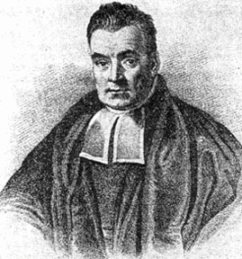
Bayesian Updates
Learning from Evidence
Rev. Thomas Bayes (1702-1761)

Slide 12
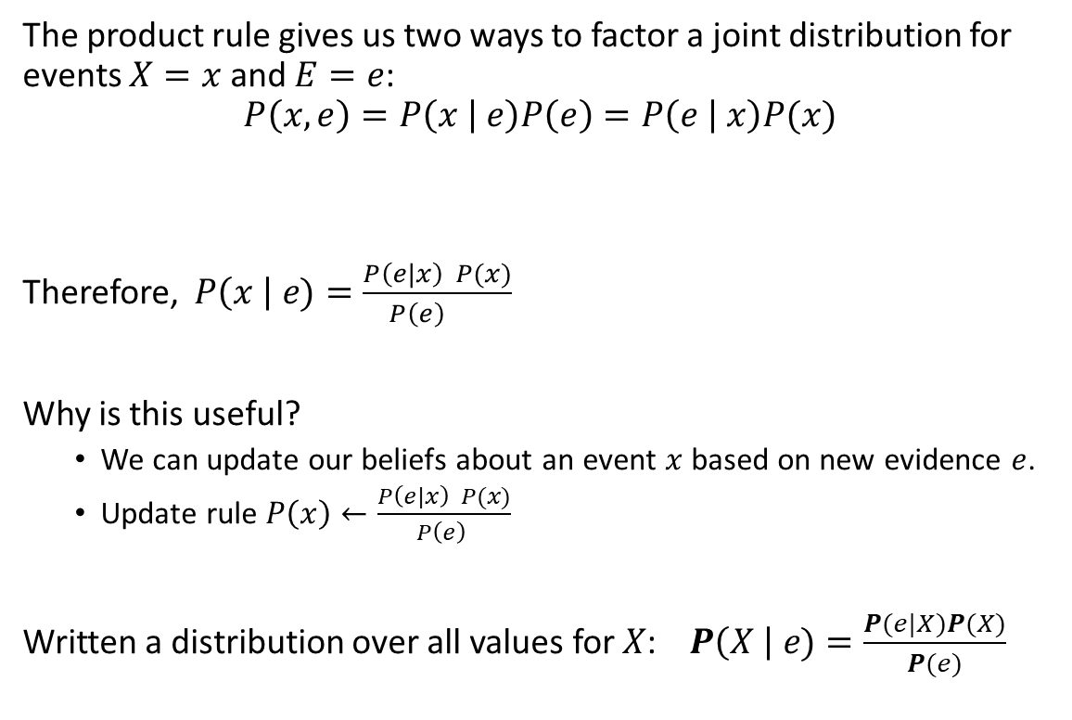
Bayes’ Theorem: The Bayesian Update Rule
The product rule gives us two ways to factor a joint distribution for events $X=x$ and $E=e$:
$$P\left(x,e\right)=P\left(x | e\right)P\left(e\right)=P\left(e | x\right)P(x)$$
Therefore, $P\left(x \right| e)=\frac{P\left(e|x\right) P(x)}{P\left(e\right) }$
Why is this useful?
We can update our beliefs about an event $x$ based on new evidence $e$.
Update rule $P\left(x\right)←\frac{P\left(e|x\right) P(x)}{P\left(e\right) }$
Written a distribution over all values for $X$: $P\left(X \right| e)=\frac{P(e|X)P(X)}{P(e)}$
Posterior Prob.
Prior Prob.
Add evidence

Slide 13
Problem: Getting Married in the Desert
Marie is getting married tomorrow, at an outdoor ceremony in the desert. In recent years, it has rained only 5 days each year. Unfortunately, the weatherman has predicted rain for tomorrow. When it actually rains, the weatherman correctly forecasts rain 90% of the time. When it doesn't rain, he incorrectly forecasts rain 10% of the time. What is Marie’s belief for the probability that it will rain on her wedding day?

Slide 14
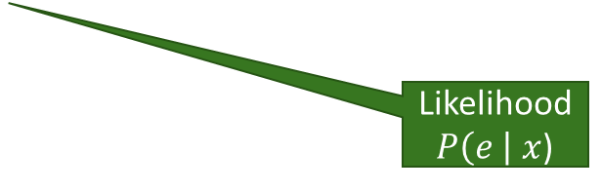
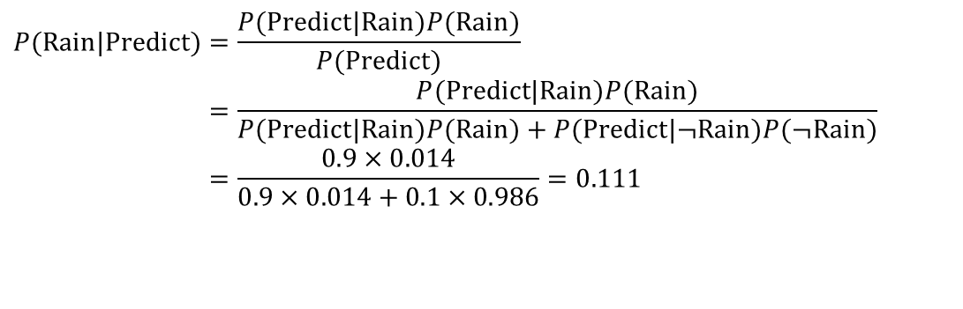
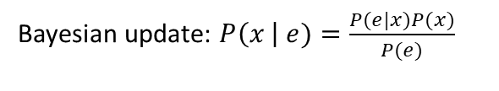


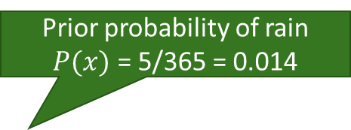
Example: Getting Married in the Desert
New Evidence $e$
Prior probability of rain $P(x)$ = 5/365 = 0.014
Marie is getting married tomorrow at an outdoor ceremony in the desert. In recent years, it has rained only 5 days each year. Unfortunately, the weatherman has predicted rain for tomorrow. When it actually rains, the weatherman correctly forecasts rain 90% of the time. When it doesn't rain, he incorrectly forecasts rain 10% of the time. What is Marie’s belief for the probability that it will rain on her wedding day?
Likelihood $P\left(e \right| x$)
Bayesian update: $P\left(x \right| e)=\frac{P(e|x)P(x)}{P(e)}$
Posterior Probability $P\left(x \right| e$)?
$$P(\text{Rain}|\text{Predict})=\frac{P(\text{Predict}|\text{Rain})P(\text{Rain})}{P(\text{Predict})} \\ =\frac{P(\text{Predict}|\text{Rain})P(\text{Rain})}{P(\text{Predict}|\text{Rain})P(\text{Rain})+P(\text{Predict}|¬\text{Rain})P(¬\text{Rain})} \\ =\frac{0.9×0.014}{0.9×0.014+0.1×0.986}=0.111$$
The weather forecast changes her belief from 0.014 to 0.111. She thinks that the chance of rain tomorrow is now about 10 times larger!
The decision depends on the utility: How much does Marie value no rain on her wedding day vs. moving the venue?

Slide 15
Bayesian Intelligent Agents
This is a type of utility-based agent is also called a decision-theoretic agent.
Approach
Agent function
Estimate prior probabilities
Update belief using Bayes’ rule with new evidence
+Utility
Decision
Estimate Likelihoods
Agent’s knowledge. We typically use frequentist estimates (e.g., counting) and store them as a model.
Predict the belief states given different actions + Use utility information to calculate expected utilities.
Choose the action that maximizes the expected utility.

Slide 16

Independence between Events

Slide 17
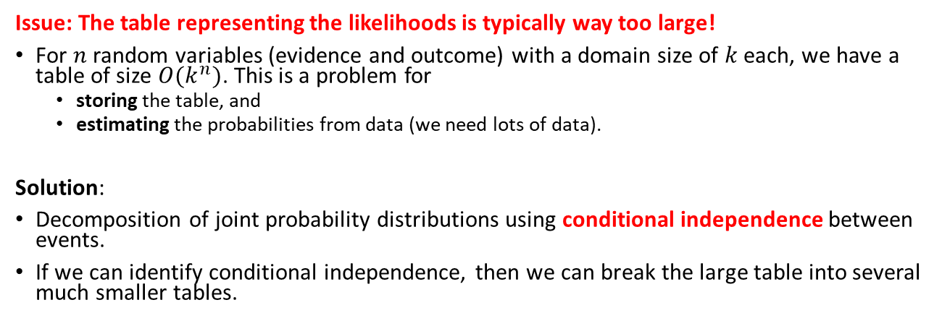
Issues with Making Decisions using Bayes’ Rule
Approach
Estimate prior probabilities
Update belief using Bayes’ rule with new evidence
+Utility
Decision
Estimate Likelihoods
Issue: The table representing the likelihoods is typically way too large!
For $n$ random variables (evidence and outcome) with a domain size of $k$ each, we have a table of size $O(k^{n})$. This is a problem for
storing the table, and
estimating the probabilities from data (we need lots of data).
Solution:
Decomposition of joint probability distributions using conditional independence between events.
If we can identify conditional independence, then we can break the large table into several much smaller tables.

Slide 18
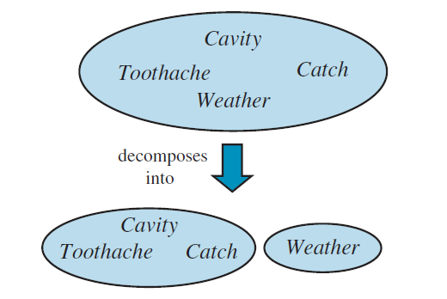
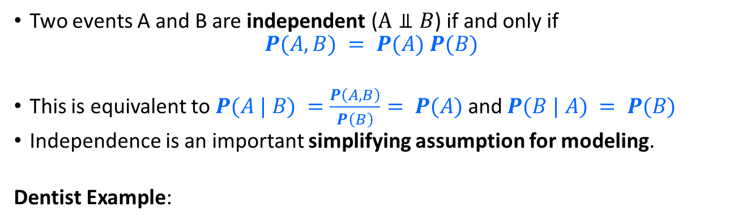
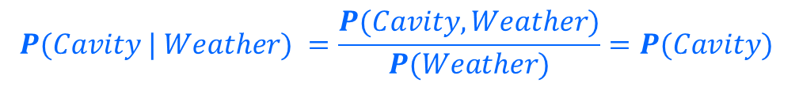
Independence Between Events
Two events A and B are independent ($A⫫B$) if and only if
$$P(A, B) = P(A) P(B)$$
This is equivalent to $P(A | B) =\frac{P\left(A,B\right)}{P\left(B\right)}= P(A)$and $P(B | A) = P(B)$
Independence is an important simplifying assumption for modeling.
Dentist Example:
Weather is not related to the other variables!
Independence
$$P(Cavity, Weather) = P(Cavity)P(Weather)$$
$$P(Cavity | Weather) =\frac{P(Cavity, Weather)}{P(Weather)}=P(Cavity)$$

Slide 19
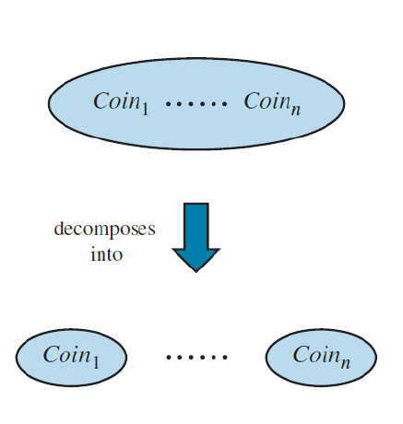
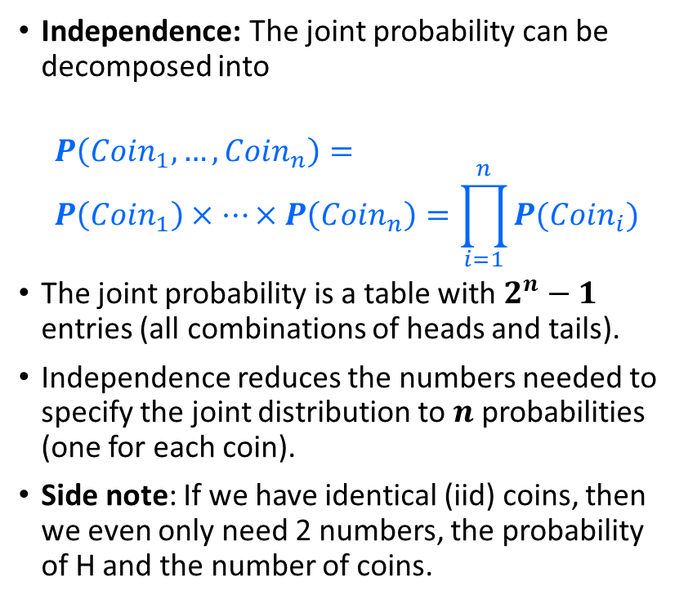



Decomposition of the Joint Probability Distribution With Independence
Independence: The joint probability can be decomposed into
$$P\left(Coin_{1},…,Coin_{n}\right)= \\ P\left(Coin_{1}\right)×…×P\left(Coin_{n}\right)=\prod_{i=1}^{n}{P(Coin_{i})}$$
The joint probability is a table with $2^{n}−1$ entries (all combinations of heads and tails).
Independence reduces the numbers needed to specify the joint distribution to $n$ probabilities (one for each coin).
Side note: If we have identical (iid) coins, then we even only need 2 numbers, the probability of H and the number of coins.
$2^{n}−1$ entries
$n$ entries
$$O\left(2^{n}\right)→O(n)$$

Slide 20
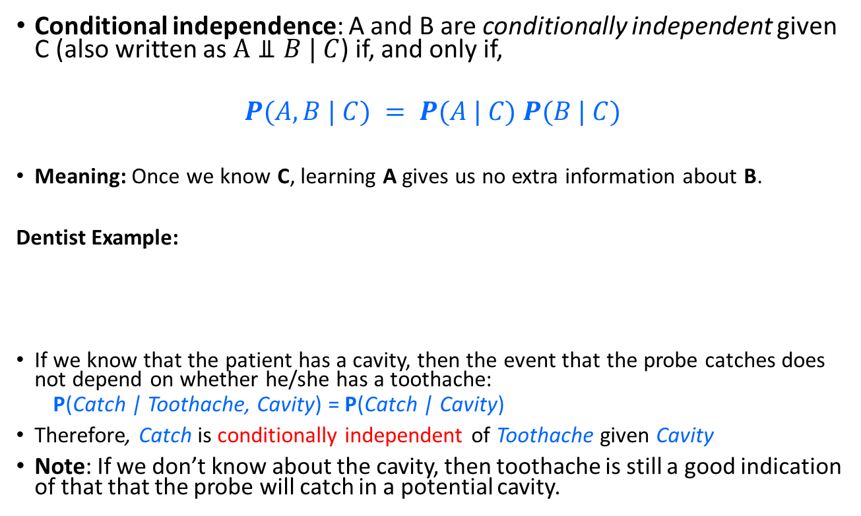
Conditional Independence
Conditional independence: A and B are conditionally independent given C (also written as $A⫫B | C$) if, and only if,
$$P(A, B | C) = P(A | C) P(B | C)$$
Meaning: Once we know C, learning A gives us no extra information about B.
Dentist Example:
If we know that the patient has a cavity, then the event that the probe catches does not depend on whether he/she has a toothache:
P(Catch | Toothache, Cavity) = P(Catch | Cavity)
Therefore, Catch is conditionally independent of Toothache given Cavity
Note: If we don’t know about the cavity, then toothache is still a good indication of that that the probe will catch in a potential cavity.
Toothache
Cavity
Catch

Slide 21
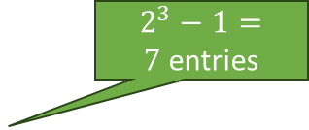



Decomposition of the Joint Probability Distribution With Conditional Independence
Toothache
Cavity
Conditional independence simplifies the chain rule:
$$P(Toothache, Catch, Cavity) = \\ P(Cavity) P(Catch | Cavity) P(Toothache | Catch, Cavity) = \\ P(Cavity) P(Catch | Cavity) P(Toothache | Cavity)$$
Catch
$2^{3}−1=7$entries
$1+2+2=5$entries
If each variable only depends on a small number of other variables:
$$O\left(2^{n}\right)→O(n)$$

Slide 22
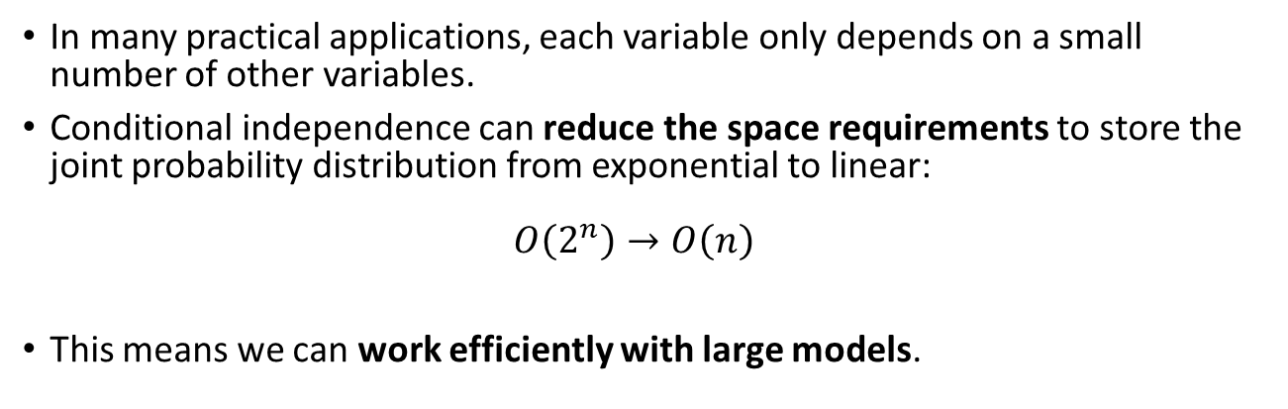
Bayesian Networks
Bayesian networks are a graphical method to specify dependence between random variables. This very useful technique will be discussed in detail later in this course.
Toothache
Cavity
Catch
In many practical applications, each variable only depends on a small number of other variables.
Conditional independence can reduce the space requirements to store the joint probability distribution from exponential to linear: $O\left(2^{n}\right)→O\left(n\right)$
This means we can work efficiently with large models.

Slide 23
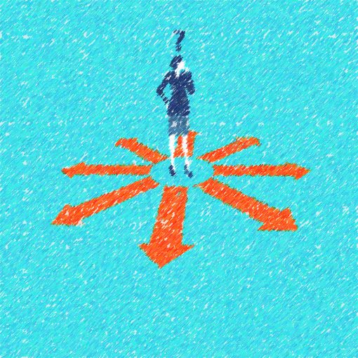
Bayesian Decision Making Making Simple Decisions Under Uncertainty

Slide 24




Probabilistic Inference
Suppose the agent must repeatedly guess the value of an unobserved query variable $X$ given some observed evidence $E = e$and we assume $X$ probabilistically causes $E$.
Example:
$x∈ \{\text{dog}\text{, }\text{zebra}\text{, }cat\},$e = image features
What is the best guess $\hat{x}$?
Notation: We use $\hat{x}$ for an estimate and $x^{∗}$ for the optimal estimate.
Notes:
Expected loss of a decision: P(decision is correct) * 0 + P(decision is wrong) * 1

Slide 25
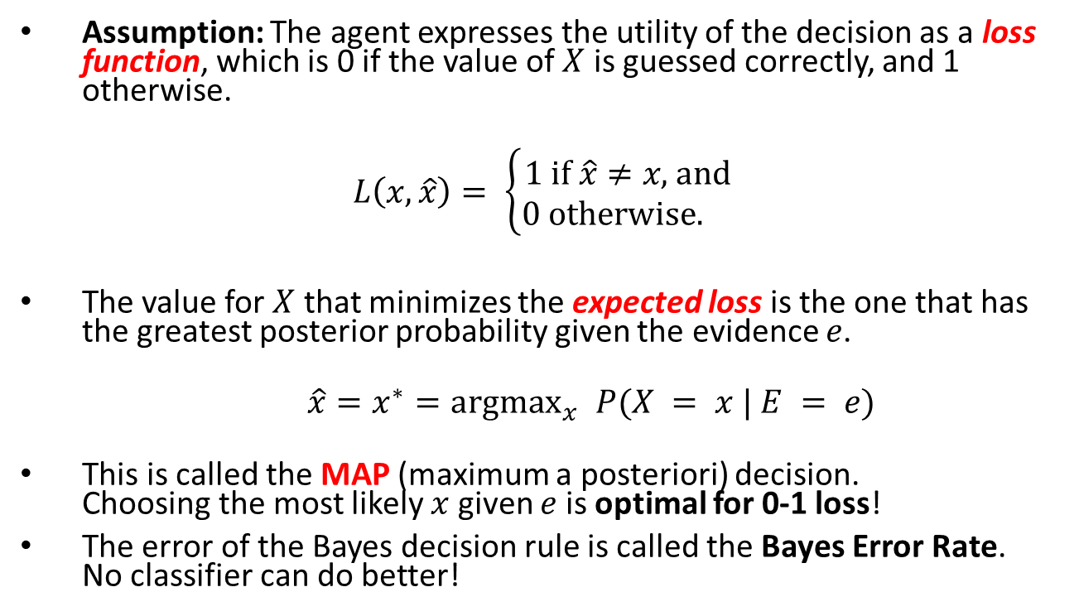
The Optimal Decision Rule: MAP
Assumption: The agent expresses the utility of the decision as a loss function, which is 0 if the value of $X$ is guessed correctly, and 1 otherwise.
$$L\left(x, \hat{x}\right)= \left\{\begin{aligned}1 \text{if} \hat{x}≠x\text{, }\text{and} \\ 0 \text{otherwise}\text{. }\end{aligned}\right.$$
The value for $X$ that minimizes the expected loss is the one that has the greatest posterior probability given the evidence $e$.
$\hat{x}=x^{∗}{=argmax}_{x} P(X = x | E = e)$
This is called the MAP (maximum a posteriori) decision. Choosing the most likely $x$ given $e$ is optimal for 0-1 loss!
The error of the Bayes decision rule is called the Bayes Error Rate. No classifier can do better!
Notes:
Expected loss of a decision: P(decision is correct) * 0 + P(decision is wrong) * 1

Slide 26
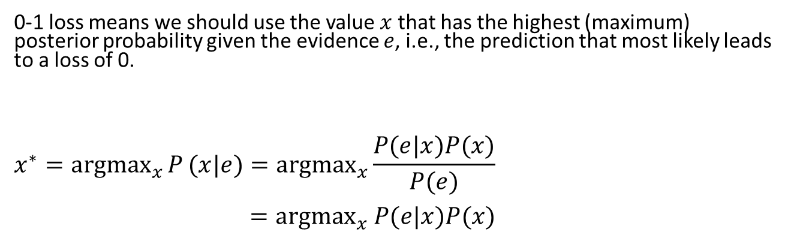


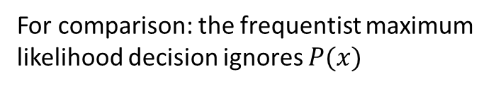
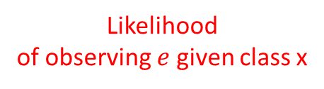
MAP: Maximum A Posteriori Decision
Estimate prior probabilities
+Utility (Loss)
Update belief using Bayes’ rule with new evidence
Decision
Estimate Likelihoods
0-1 loss means we should use the value $x$ that has the highest (maximum) posterior probability given the evidence $e$, i.e., the prediction that most likely leads to a loss of 0.
$$x^{∗}={argmax}_{x}{P}(x|e)={argmax}_{x}\frac{P(e|x)P(x)}{P(e)}$$ $={argmax}_{x} P(e|x)P(x)$
Prior Prob.
Posterior Prob.
$P\left(e\right)$ is fixed for a given evidence.
For comparison: the frequentist maximum likelihood decision ignores $P(x)$
$$x^{∗}={argmax}_{x}{P(e|x)}$$
Likelihood of observing $e$ given class x

Slide 27
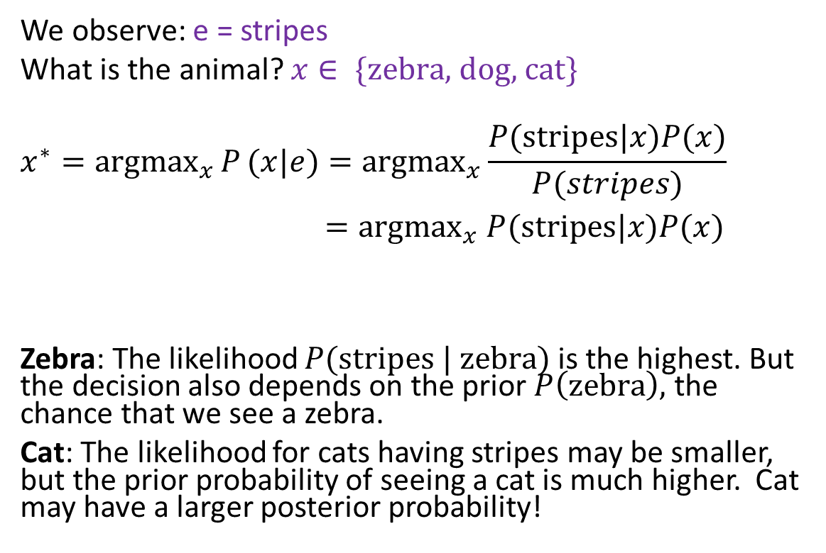
MAP: Example
We observe: e = stripes
What is the animal? $x∈ \{\text{zebra}\text{, }\text{dog}\text{, }\text{cat}\}$
$$x^{∗}={argmax}_{x}{P}(x|e)={argmax}_{x}\frac{P(\text{stripes}|x)P(x)}{P(stripes)}$$ $={argmax}_{x} P(\text{stripes}|x)P(x)$
Zebra: The likelihood $P(\text{stripes} \text{|} \text{zebra})$is the highest. But the decision also depends on the prior $P\left(\text{zebra}\right),$ the chance that we see a zebra.
Cat: The likelihood for cats having stripes may be smaller, but the prior probability of seeing a cat is much higher. Cat may have a larger posterior probability!
Posterior Prob.
likelihood
Prior Prob.

Slide 28
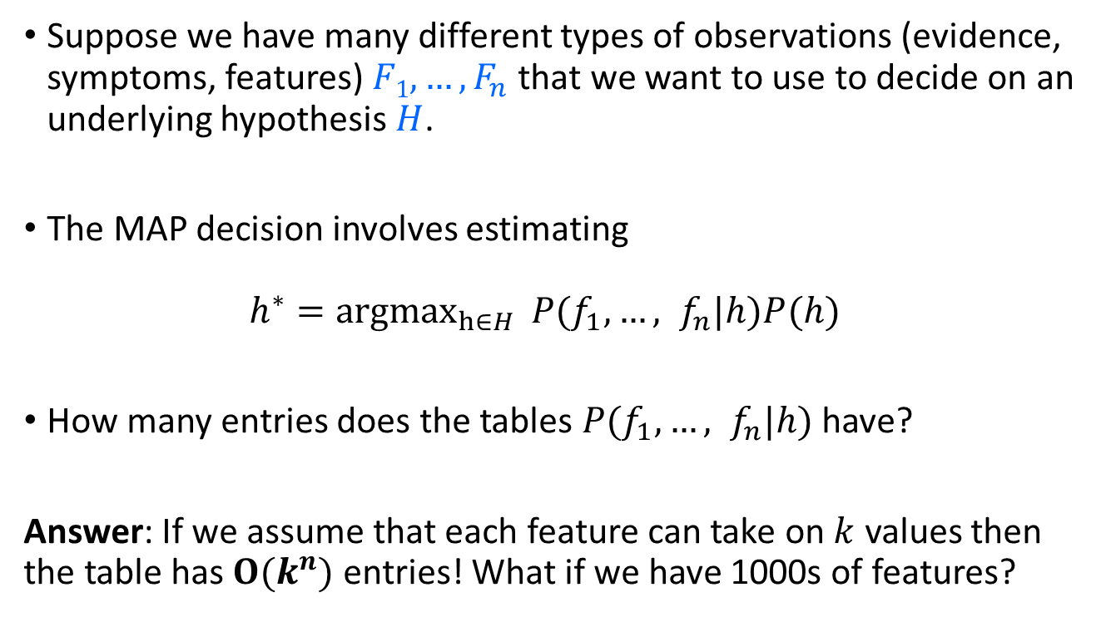
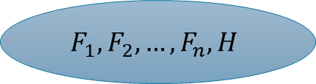
Bayes Classifier
$$F_{1},F_{2},…,F_{n}, H$$
Suppose we have many different types of observations (evidence, symptoms, features) $F1, …, F_{n}$that we want to use to decide on an underlying hypothesis $H$.
The MAP decision involves estimating
$$h^{∗}={argmax}_{h∈H}{P(f_{1},…, f_{n}|h)P(h) }$$
How many entries does the tables $P(f_{1},…, f_{n}|h)$ have?
Answer: If we assume that each feature can take on $k$ values then the table has $O(k^{n})$ entries! What if we have 1000s of features?

Slide 29
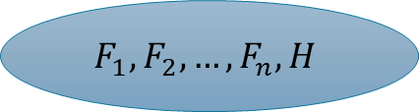
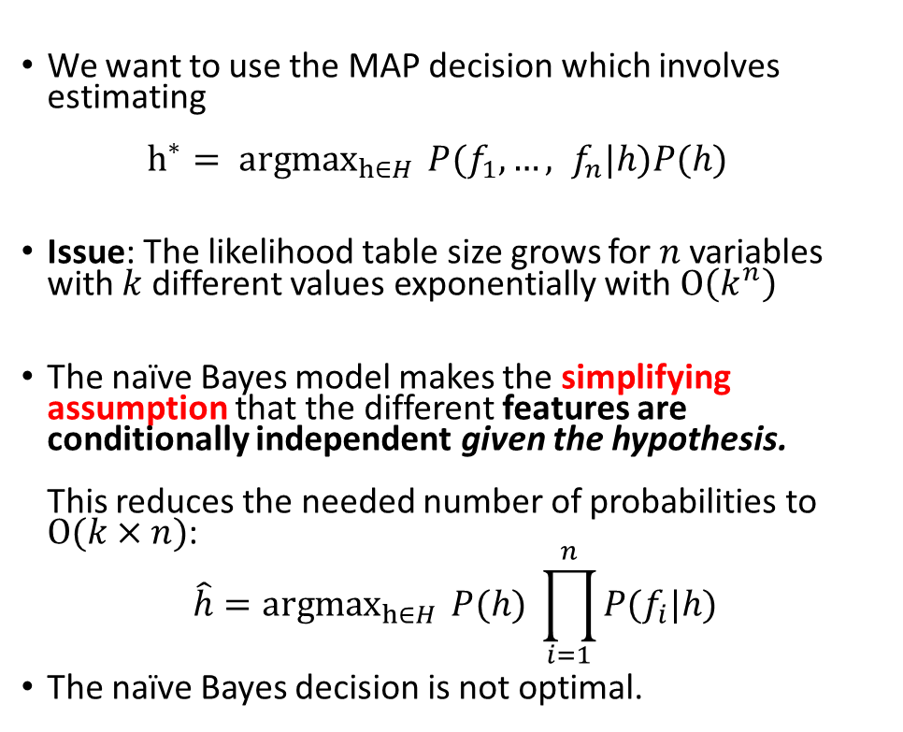






Naïve Bayes Model
We want to use the MAP decision which involves estimating ${h^{∗}= argmax}_{h∈H}{P(f_{1},…, f_{n}|h)P(h) }$
Issue: The likelihood table size grows for $n$ variables with $k$ different values exponentially with $O\left(k^{n}\right)$
The naïve Bayes model makes the simplifying assumption that the different features are conditionally independent given the hypothesis. This reduces the needed number of probabilities to $O(k×n)$:
$${\hat{h}=argmax}_{h∈H}{P(h) }\prod_{i=1}^{n}{P(f_{i}|h)}$$
The naïve Bayes decision is not optimal.
$$O\left(2^{n}\right)$$
$$F_{1},F_{2},…,F_{n}, H$$
$$H$$
$$O\left(n\right)$$
…
$$F_{1}$$
$$F_{2}$$
$$F_{n}$$

Slide 30


Example: Naïve Bayesian Spam Filter

Slide 31


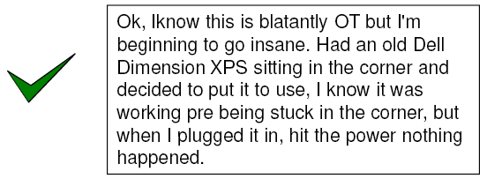
Example: Naïve Bayes Spam Filter
Approach
Estimate prior probabilities
+Utility (Loss)
Update belief using Bayes’ rule with new evidence
Decision
Estimate Likelihoods
To make decisions, we need to:
Define random variables so we can estimate prior probabilities and likelihoods.
Class: spam no spam
Evidence: features of the message.
Define utility/loss

Slide 32
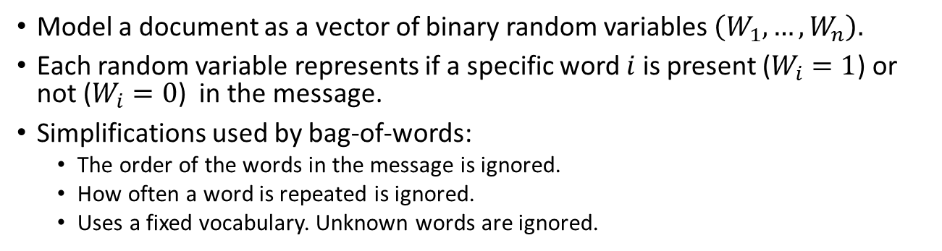
Message Features: Bag of Words from Natural Language Processing (NLP)
Model a document as a vector of binary random variables $\left(W_{1}, …, W_{n}\right).$
Each random variable represents if a specific word $i$ is present ($W_{i}=1$) or not ($W_{i}=0$) in the message.
Simplifications used by bag-of-words:
The order of the words in the message is ignored.
How often a word is repeated is ignored.
Uses a fixed vocabulary. Unknown words are ignored.

Slide 33
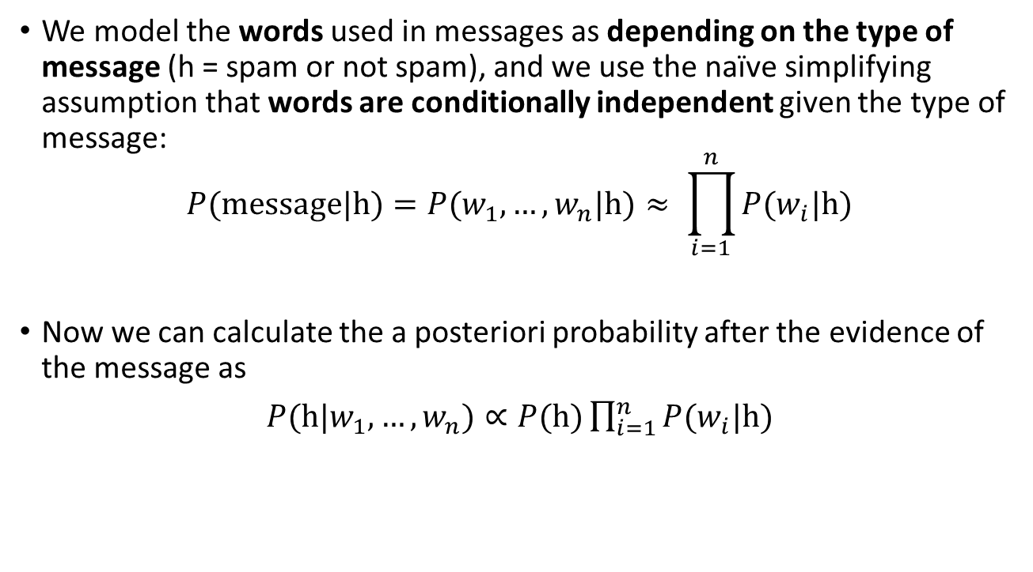

Naïve Bayes Spam Filter Using Words
We model the words used in messages as depending on the type of message (h = spam or not spam), and we use the naïve simplifying assumption that words are conditionally independent given the type of message:
$$P(\text{message}\text{|}\text{h})=P(w_{1},…,w_{n}|\text{h})≈ \prod_{i=1}^{n}{P(w_{i}|\text{h})}$$
Now we can calculate the a posteriori probability after the evidence of the message as
$P(\text{h}|w_{1},…,w_{n})∝P(\text{h})\prod_{i=1}^{n}{P(w_{i}|\text{h})}$
Note: It is only proportional since we do not divide by $P(w_{1},…,w_{n})$
posterior
prior
likelihoods (presents and absence of words)

Slide 34
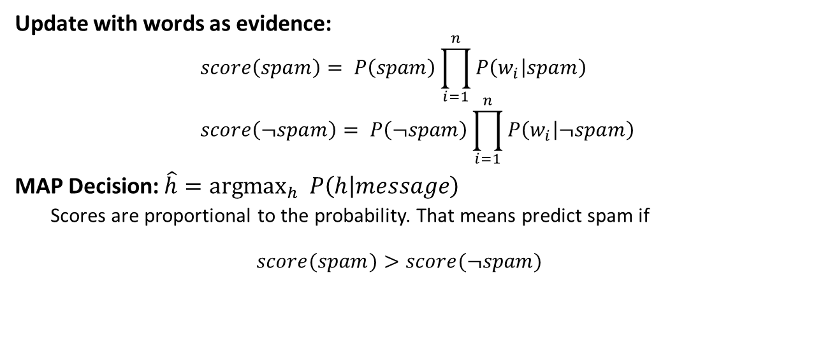
Naïve Bayes Spam Filter: Decision Making
Estimate prior probabilities
+Utility (Loss)
Decision
Update belief using Bayes’ rule with new evidence
Estimate Likelihoods
A posteriori probabilities are simplified to proportional scores that can be compared
Update with words as evidence: $$score\left(spam\right)= P\left(spam\right)\prod_{i=1}^{n}{P\left(w_{i} | spam\right)} \\ score\left(¬spam\right)= P\left(¬spam\right)\prod_{i=1}^{n}{P\left(w_{i} | ¬spam\right)}$$
MAP Decision: $\hat{h}=\text{a}\text{rgma}{\text{x}}_{h} P\left(h | message\right)$
Scores are proportional to the probability. That means predict spam if $$score(spam)>score(¬spam)$$
Minimizes 0-1 Loss (number of mistakes)

Slide 35
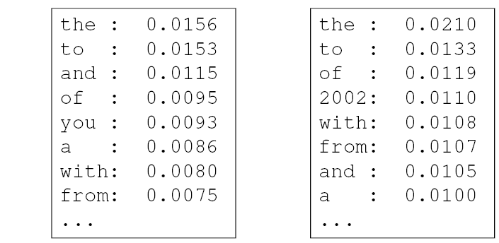

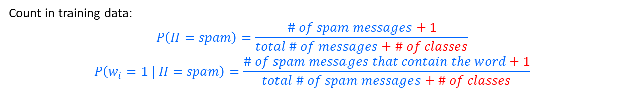


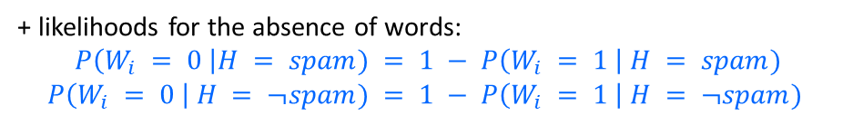

Naïve Bayes Spam Filter: Parameter Estimation
Estimate prior probabilities
+Utility (Loss)
Decision
Update belief using Bayes’ rule with new evidence
Estimate Likelihoods
Smoothing for low counts.
Count in training data:
$$P\left(H=spam\right)=\frac{\# of spam messages+1}{total \# of messages+\# of classes}$$
$$P\left(w_{i}=1 | H=spam\right)=\frac{\# of spam messages that contain the word+1}{total \# of spam messages+\# of classes}$$
$$P(W_{i} = 1 | H= spam)$$
$$P(W_{i} = 1 | H = ¬spam)$$
$$O\left(n\right)$$
Prior $P(H)$
spam: 0.33
¬spam: 0.67
+ likelihoods for the absence of words:
$$P\left(W_{i} = 0 \right|H = spam) = 1 − P\left(W_{i} = 1 \right| H = spam)$$
$$P\left(W_{i} = 0 \right| H = ¬spam) = 1 − P\left(W_{i} = 1 \right| H = ¬spam)$$

Slide 36
Summary
Bayesian Intelligent Agent
Estimate prior probabilities
Update belief using Bayes’ rule with new evidence
+Utility
Decision
Estimate Likelihoods
This is a type of utility-based agent, also known as a decision-theoretic agent.
It combines:
Probability theory to update its belief about outcomes given actions.
Utility theory to represent preference for different outcomes.
Bayes’ Theorem provides a general framework for learning functions and decision rules from data is the goal of Machine Learning.
An issue is that we need to estimate/learn a model consisting of an exponentially large set of all likelihoods. This is essentially the complete joint probability distribution between the evidence and state random variables!
Much of AI and ML is about overcoming this model size issue by using simplifications, such as the naïve Bayes model.

Slide 37
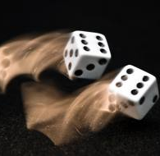
Appendix: A Quick Review of Probability Theory
Random variables
Events
Joint probabilities
Marginal probabilities
Conditional probabilities

Slide 38
Random Variables
Random Variable
Random variables are denoted by capital letters.
R: Is it raining?
W: What’s the weather?
Die: What is the outcome of rolling two dice?
V: What is the speed of my car (in MPH)?
Domain
Domain values must be mutually exclusive and exhaustive.
R $∈${True, False}
R ∈ {True, False}
W $∈$ {Sunny, Cloudy, Rainy, Snow}
W ∈ {Sunny, Cloudy, Rainy, Snow}
Die $∈$ {(1,1), (1,2), … (6,6)}
Die ∈ {(1,1), (1,2), … (6,6)}
V $∈$ [0, 200]
V ∈ [0, 200]
We describe the (uncertain) state of the world using random variables.
Random variables take on values in a domain D.

Slide 39
Events and Propositions
Probabilistic statements are defined over events, world states or sets of states
“It is raining”
“The weather is either cloudy or snowy”
“The sum of the two dice rolls is 11”
“My car is going between 30 and 50 miles per hour”
Events are described using propositions:
R = True
W = “Cloudy” ∨ W = “Snowy”
D ∈ {(5,6), (6,5)}
30 ≤ S ≤ 50

Slide 40
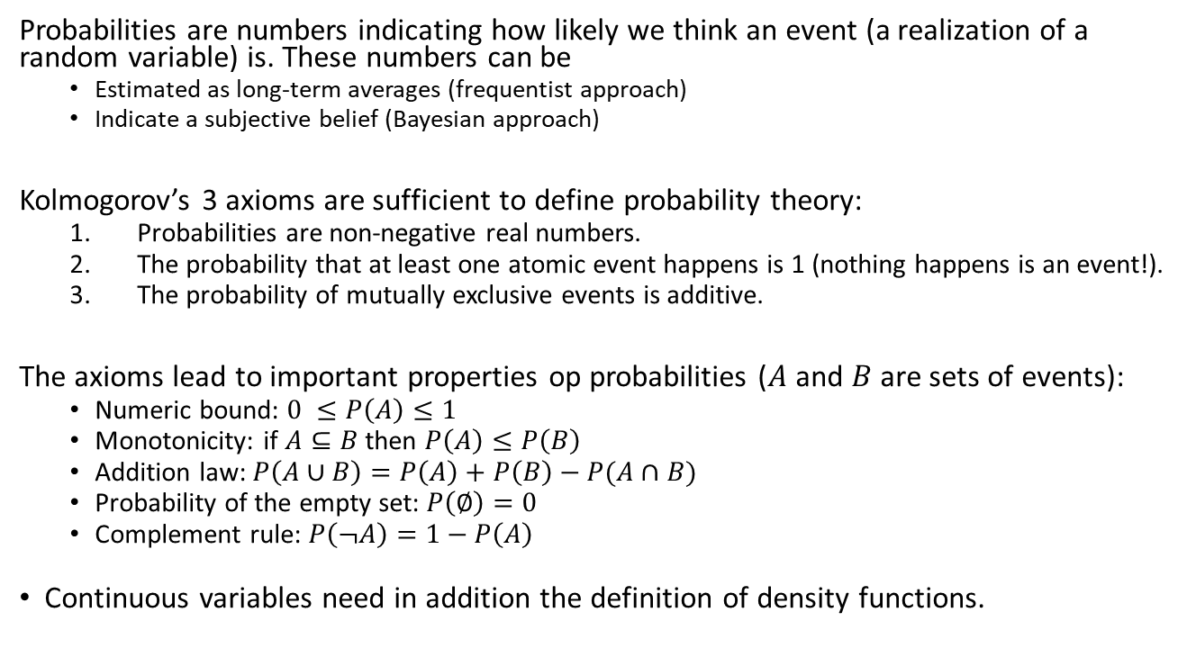
Probabilities
Probabilities are numbers indicating how likely we think an event (a realization of a random variable) is. These numbers can be
Estimated as long-term averages (frequentist approach)
Indicate a subjective belief (Bayesian approach)
Kolmogorov’s 3 axioms are sufficient to define probability theory:
Probabilities are non-negative real numbers.
The probability that at least one atomic event happens is 1 (nothing happens is an event!).
The probability of mutually exclusive events is additive.
The axioms lead to important properties op probabilities ($A$ and $B$ are sets of events):
Numeric bound: $0 ≤P\left(A\right)≤1$
Monotonicity: if $A⊆B$ then $P\left(A\right)≤P\left(B\right)$
Addition law: $P\left(A∪B\right)=P\left(A\right)+P\left(B\right)−P(A∩B)$
Probability of the empty set: $P\left(∅\right)=0$
Complement rule: $P\left(¬A\right)=1−P\left(A\right)$
Continuous variables need in addition the definition of density functions.

Slide 41
Joint Probability Distributions: Atomic Events
Atomic event: a complete assignment of values to all random variables.
For AI: Random variables are the fluents of a factored state description. An atomic event is a complete specification of the state of the world.
Atomic events are mutually exclusive and exhaustive.
Example: if the state consists of only two Boolean variables Cavity and Toothache, then there are 4 distinct atomic events: Cavity = false ∧Toothache = false Cavity = false ∧ Toothache = true Cavity = true ∧ Toothache = false Cavity = true ∧ Toothache = true

Slide 42
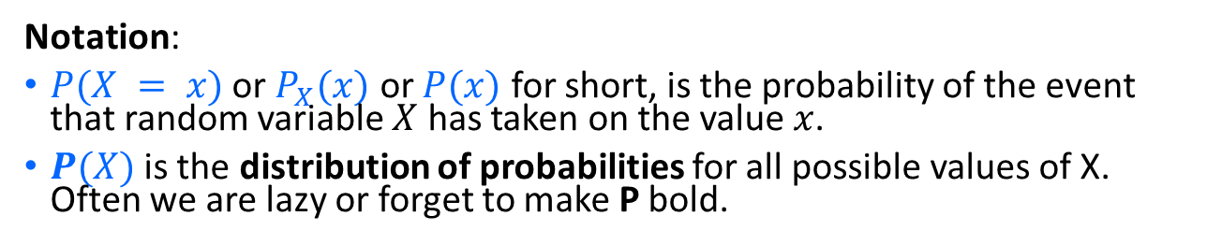
Joint Probability Distributions
A joint distribution is an assignment of probabilities to every possible atomic event (state). The distribution is often stored as a table.
Example: Joint probability distribution for a world with two random variables
Atomic event | P
Cavity = false ∧Toothache = false | 0.8
Cavity = false ∧ Toothache = true | 0.1
Cavity = true ∧ Toothache = false | 0.05
Cavity = true ∧ Toothache = true | 0.05
Cavity | Toothache | P
False | false | 0.8
False | True | 0.1
True | false | 0.05
True | true | 0.05
or
Sum: 1.00
Notation:
$P(X = x)$or $P_{X}(x)$ or $P(x)$ for short, is the probability of the event that random variable $X$ has taken on the value $x$.
$P(X)$is the distribution of probabilities for all possible values of X. Often we are lazy or forget to make P bold.

Slide 43
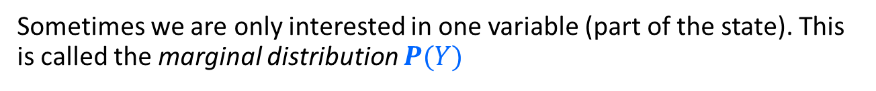
Marginal Probability Distributions
Sometimes we are only interested in one variable (part of the state). This is called the marginal distribution $P(Y)$
Cavity, Toothache | P
Cavity = false ∧Toothache = false | 0.8
Cavity = false ∧ Toothache = true | 0.1
Cavity = true ∧ Toothache = false | 0.05
Cavity = true ∧ Toothache = true | 0.05
Joint Prob. Distr.
Cavity | P
Cavity = false | ?
Cavity = true | ?
Toothache | P
Toothache = false | ?
Toothache = true | ?
Marginal Prob. Distr.

Slide 44

Marginal Probability Distributions 2
Suppose we have the joint distribution $P(X,Y)$ and we want to find the marginal distribution $P(X)$ $$P(X=x)=P\left((X=x∧Y=y_{1})∨…∨(X=x∧Y=y_{n})\right)$$
$$=P\left((x,y_{1})∨…∨(x,y_{n})\right)=\sum_{i=1}^{n}{P(x,y_{i})}$$
Rule: to find $P(X = x),$sum the probabilities of all atomic events where $X = x$. This is called “summing out” or “marginalizing out” the other variables.

Slide 45

Marginal Probability Distributions 3
Suppose we have the joint distribution $P(X,Y)$ and we want to find the marginal distribution $P\left(Y\right)$.
Cavity, Toothache | P
Cavity = false ∧Toothache = false | 0.8
Cavity = false ∧ Toothache = true | 0.1
Cavity = true ∧ Toothache = false | 0.05
Cavity = true ∧ Toothache = true | 0.05
Joint Prob. Distr.
Cavity | P
Cavity = false | 0.8 + 0.1 = 0.9
Cavity = true | 0.05 + 0.05=0.1
Toothache | P
Toothache = false | 0.8 + 0.5= 0.85
Toothache = true | 0.1 + 0.05= 0.15
Marginal Prob. Distr.

Slide 46





Conditional Probability
Probability of event cavity given toothache: $\text{P}\text{(}\text{Cavity}\text{ = }\text{true}\text{ | }\text{Toothache}\text{ = }\text{true}\text{) = }\frac{\text{P}\text{(}\text{Cavity}\text{ = }\text{true} ∧ \text{Toothache}\text{ = }\text{true}\text{)}}{\text{P}\text{(}\text{Toothache}\text{ = }\text{true}\text{) } }$
Conditional distribution of random variable A given B $P\left(A \right| B)=\frac{P(A, B)}{P(B)}$
$$P(A,B)$$
$$P(A)$$
$$P(B)$$
$\frac{P(A, B)}{P(B)}$… fraction of B that is shared with A

Slide 47


Conditional Probability 2
$$P\left(A \right| B)=\frac{P(A,B)}{P(B)}$$
Cavity, Toothache | P
Cavity = false ∧Toothache = false | 0.8
Cavity = false ∧ Toothache = true | 0.1
Cavity = true ∧ Toothache = false | 0.05
Cavity = true ∧ Toothache = true | 0.05
Joint Prob. Distr.
Cavity | P
Cavity = false | 0.9
Cavity = true | 0.1
Toothache | P
Toothache = false | 0.85
Toothache = true | 0.15
Marginal Prob. Distr.
What is P(Cavity = true | Toothache = false)?
$$\frac{P\left(\text{Cavity}\text{ = }\text{true} ∧ \text{Toothache}\text{ = }\text{false}\right)}{P\left(\text{Toothache}\text{ = }\text{false}\right)}=0.05 / 0.85 = 0.059$$
What is P(Cavity = false | Toothache = true)?
$$\frac{P\left(\text{Cavity}\text{ = }\text{false} ∧ \text{Toothache}\text{ = }\text{true}\right)}{P\left(\text{Toothache}\text{ = }\text{tru}\text{e}\right)}= 0.1 / 0.15 = 0.667$$

Slide 48
Conditional Distributions
$$P\left(A \right| B)=\frac{P(A,B)}{P(B)}$$
Cavity, Toothache | P
Cavity = false ∧Toothache = false | 0.8
Cavity = false ∧ Toothache = true | 0.1
Cavity = true ∧ Toothache = false | 0.05
Cavity = true ∧ Toothache = true | 0.05
Joint Prob. Distr.
A conditional distribution is a distribution over the values of one variable given fixed values of other variables.
Examples:
Cavity | Toothache = true | P
Cavity = false | Toothache = true | 0.667
Cavity = true | Toothache = true | 0.333
Cavity | Toothache = false | P
Cavity = false | Toothache = false | 0.941
Cavity = true | Toothache = false | 0.059
Conditional Prob. Distr.
Toothache | Cavity = true | P
Toothache= false | Cavity = true | 0.5
Toothache = true | Cavity = true | 0.5
Toothache | Cavity = false | P
Toothache= false | Cavity = false | 0.889
Toothache = true | Cavity = false | 0.111

Slide 49





Normalization Trick
To get the whole conditional distribution $P(X | Y = y)$at once, select all entries in the joint distribution matching $Y = y$and renormalize them to sum to one.
Example: Calculate P(Toothache | Cavity = false) from the joint probability distribution:
Cavity, Toothache | P
Cavity = false ∧Toothache = false | 0.8
Cavity = false ∧ Toothache = true | 0.1
Cavity = true ∧ Toothache = false | 0.05
Cavity = true ∧ Toothache = true | 0.05
Joint Prob. Distr.
Select $P(X, Y = y)$
Toothache, Cavity = false | P
Toothache= false ∧ Cavity = false | 0.8
Toothache = true ∧ Cavity = false | 0.1
Sum is $the marginal P\left(Y=y\right)=0.9$
Renormalize sum to 1 (= divide by $P(Y=y)$)
Cond. Prob. Distr.
Toothache | Cavity = false | P
Toothache= false | Cavity = false | 0.889
Toothache = true | Cavity = false | 0.111
Equivalent to
$$P\left(X \right|Y=y) = α P(X, Y=y)$$
with $α$ = $1/P(Y=y)$

Slide 50
Conditional Independence and the Bayes’ Theorem
These important concepts are introduced earlier in this module.

Slide 51
Conclusion
Probability theory has many applications to deal with uncertainty in AI. Here are some examples:
Joint probability distribution over the state space: The basis of reasoning about how likely it is to be in a state.
Conditional independence makes it possible to work with more complicated factored state representations (a larger number of fluents).
Marginal distributions to reason about the most likely value of a fluent.
Conditional distributions: Transition probability given a chosen action.
Bayesian updates: Learn (= update the belief) about the current state.
Machine learning is based on decision theory, Bayesian decision making, and Bayesian updates for learning.

