Slide 1
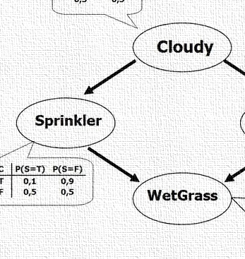


CS 5/7320
Artificial Intelligence
Probabilistic Reasoning:
Bayesian Networks
AIMA Chapter 13
Slides by Michael Hahsler
based on slides by Svetlana Lazepnik
with figures from the AIMA textbook
This work is licensed under a Creative Commons Attribution-ShareAlike 4.0 International License.
Online Material

Slide 2
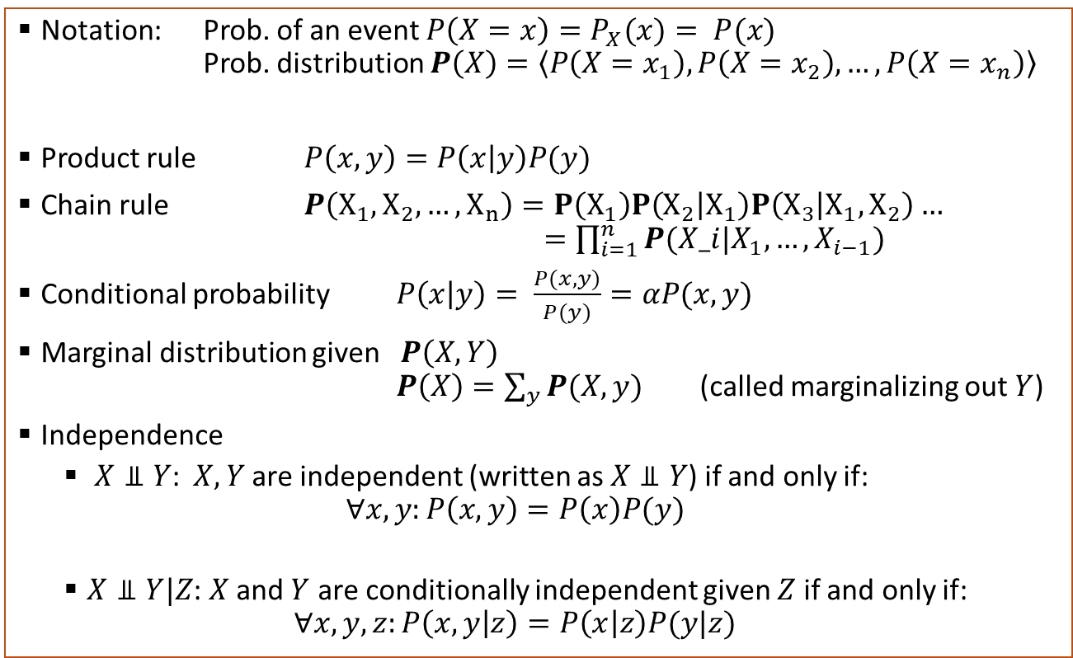
Probability Theory Recap
Notation: Prob. of an event $P\left(X=x\right)=P_{X}(x)= P(x)$
Prob. distribution $P\left(X\right)=\left\langle P\left(X=x_{1}\right), P\left(X=x_{2}\right), …, P\left(X=x_{n}\right)\right\rangle$
Product rule $P\left(x,y\right)=P\left(x | y\right)P(y)$
Chain rule $P\left(X_{1},X_{2},…,X_{n}\right)=P\left(X_{1}\right)P\left(X_{2} | X_{1}\right)P\left(X_{3} | X_{1},X_{2}\right)…$
$=\prod_{i=1}^{n}{P(X_i|X_{1},…,X_{i−1})}$
Conditional probability $P\left(x | y\right)= \frac{P(x,y)}{P(y)}=αP(x,y)$
Marginal distribution given $P\left(X,Y\right)$
$P\left(X\right)=\sum_{y}{P(X,y)}$ (called marginalizing out $Y$)
Independence
  $X⫫Y$: $X, Y$are independent (written as $X⫫Y$) if and only if:
  $∀x,y:P\left(x,y\right)=P\left(x\right)P(y)$
  $X⫫Y|Z$: $X$ and $Y$ are conditionally independent given $Z$ if and only if:
  $∀x,y,z:P\left(x,y | z\right)=P\left(x | z\right)P(y|z)$

Slide 3
Contents
Bayesian Networks to Model a Joint Probability Distribution
Exact Inference
Approximate Inference
Construction of Bayesian Networks

Slide 4

Bayesian Networks
A compact model of a joint probability distribution

Slide 5
Bayesian Networks
(aka Belief Networks)
Weather
Cavity
Toothache
Catch
A type of graphical model.
A way to specify dependence between random variables.
A compact specification of a full joint probability distribution.
A general and important model to reason with uncertainty in AI.

Slide 6
Structure of Bayesian Networks
Weather
Cavity
Nodes: Random variables
  Can be assigned (observed)
  or unassigned (unobserved)
Edges: Dependencies
  An arrow from one variable to another indicates direct influence.
  Show independence
    Weather is independent of the other variables (no connection).
    Toothache and Catch are conditionally independent given Cavity (directed arc).
  Must form a directed acyclic graph (DAG).
Relationship to states in AI: A network can be seen as a factored state representation. If we assign a value to all random variables, then we have a complete state of the system.
Toothache
Catch

Slide 7
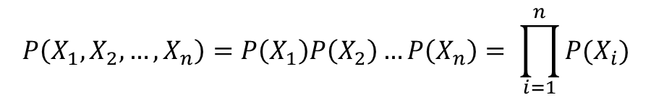
Example: N Independent Coin Flips
Complete independence: no interactions between variables representing the coin flips.
…
X₁
X₂
X_{n}
$$P\left(X_{1},X_{2},…,X_{n}\right)=P\left(X_{1}\right)P\left(X_{2}\right)…P\left(X_{n}\right)= \prod_{i=1}^{n}{P(X_{i})}$$
Joint probability distribution

Slide 8
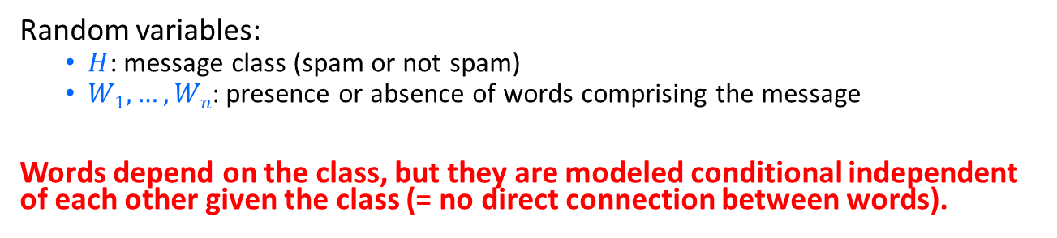
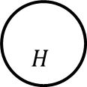
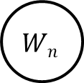
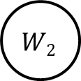

Example: Naïve Bayes Spam Filter
Random variables:
  $H$: message class (spam or not spam)
  $W1, …, Wn$: presence or absence of words comprising the message
Words depend on the class, but they are modeled conditional independent of each other given the class (= no direct connection between words).
$$H$$
…
$$W1$$
$$W2$$
$$Wn$$
$$P\left(W_{1},W_{2},…,W_{n}|H\right)=P\left(W_{1}|H\right)P\left(W_{2}|H\right)…P(W_{n}|H)$$

Slide 9
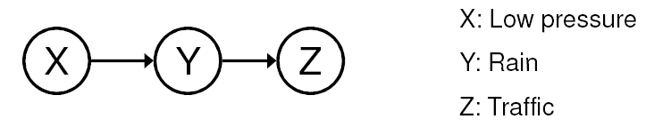
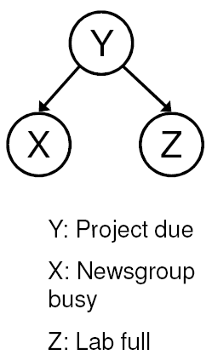
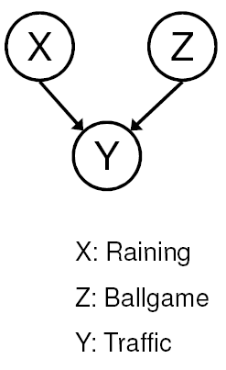
Common Structures
Causal Chains
Common Cause
Common Effect

Slide 10
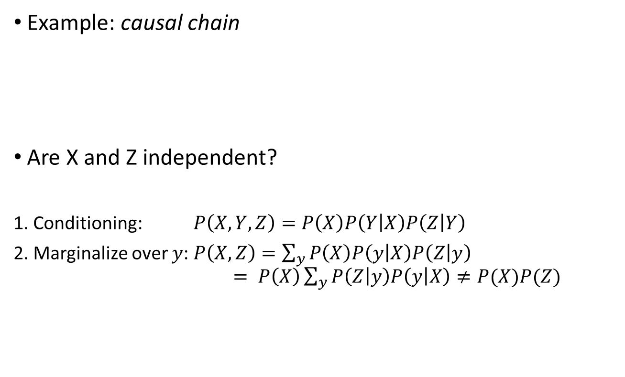
Causal Chains: Dependence
Example: causal chain
Are X and Z independent?
1. Conditioning: $P\left(X,Y,Z\right)=P\left(X\right)P\left(Y | X\right)P\left(Z | Y\right)$
2. Marginalize over $y$: $P\left(X,Z\right)=\sum_{y}{P\left(X\right)P\left(y | X\right)P\left(Z | y\right)}$
$= P\left(X\right)\sum_{y}{P\left(Z | y\right)P\left(y | X\right)≠P(X)P(Z) }$
We are not interested in y.
X and Z are not
independent!
Note: most Ps refer to probability distributions, but for convenience, we omit setting using a bold P!

Slide 11
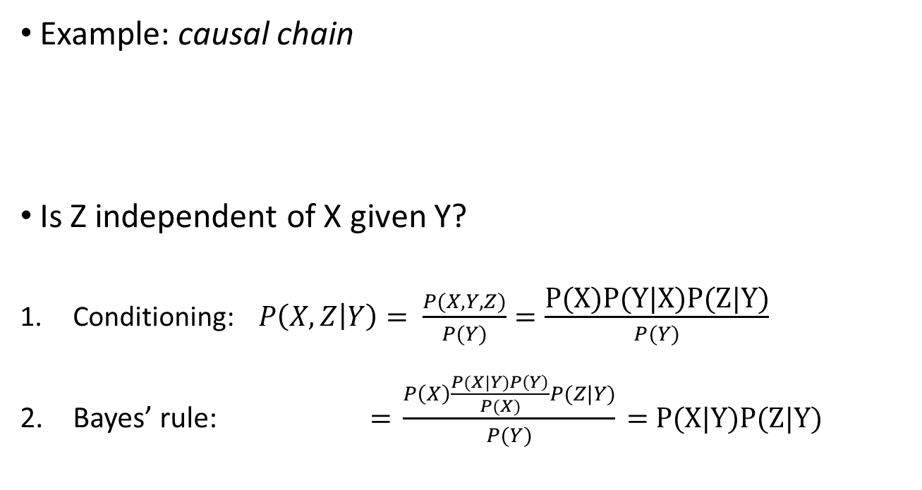
Causal Chains: Conditional Independence
Example: causal chain
Is Z independent of X given Y?
Conditioning: $P\left(X,Z | Y\right)= \frac{P(X,Y,Z)}{P(Y)}=\frac{\text{P}\text{(}\text{X}\text{)}\text{P}\text{(}\text{Y}\text{|}\text{X}\text{)}\text{P}\text{(}\text{Z}\text{|}\text{Y}\text{)}}{P(Y)}$
Bayes’ rule: $\text{= }\frac{P\left(X\right)\frac{P(X|Y)P\left(Y\right)}{P(X)}P(Z|Y)}{P(Y)}\text{ = }\text{P}\text{(}\text{X}\text{|}\text{Y}\text{)}\text{P}\text{(}\text{Z}\text{|}\text{Y}\text{)}$
= Definition of conditional independence
X and Z are conditionally
independent given Y

Slide 12
Common Cause vs. Common Effect
Common cause
Are X and Z independent?
  No. If Y is unknown, then it will influence both in the same way.
Are they conditionally independent given Y?
  Yes, the only variation comes from other, not shared, causes.
Common effect
Are X and Z independent?
  Yes, they do not share a parent.
Are they conditionally independent given Y?
  No. The observed Y can now be seen as a common cause for X and Z resulting in dependence.

Slide 13
Example: Burglar Alarm
Description: I have a burglar alarm that is sometimes set off by minor earthquakes. My two neighbors, John and Mary, promised to call me at work if they hear the alarm.
Example inference task: Suppose Mary calls, and John doesn’t call. What is the probability of a burglary?
What are the random variables?
  Burglary, Earthquake, Alarm, JohnCalls, MaryCalls
What are the direct influence relationships?
  A burglar can set off the alarm
  An earthquake can set off the alarm
  The alarm can cause Mary to call
  The alarm can cause John to call

Slide 14
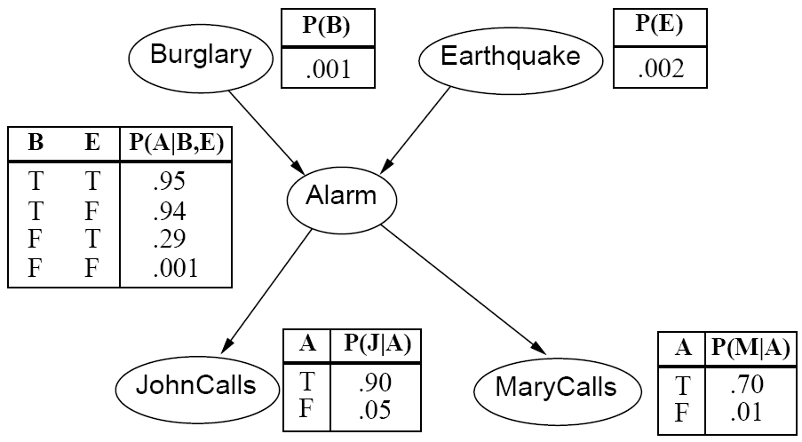
Example: Burglar Alarm as a Network
Direct influence relationships:
A burglar can set off the alarm
An earthquake can set off the alarm
The alarm can cause Mary to call
The alarm can cause John to call
What are the probabilities?

Slide 15






Model Parameters:
Conditional Probability Tables (CPTs)
The full joint distribution, can be broken down into conditional distribution for each node given its parents:
$$P(X | Parents(X))$$
These distributions are stored in conditional probability tables (CPTs)
…
Example:
$$Z1$$
$$Z2$$
$$Zn$$
$$X$$
  $$P(X | Z1, …, Zn)$$

Slide 16
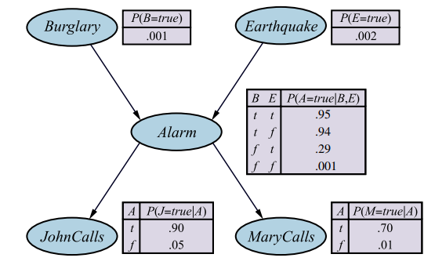
Example: Burglar Alarm with CPTs
No parents
2 parents
1 parent

Slide 17
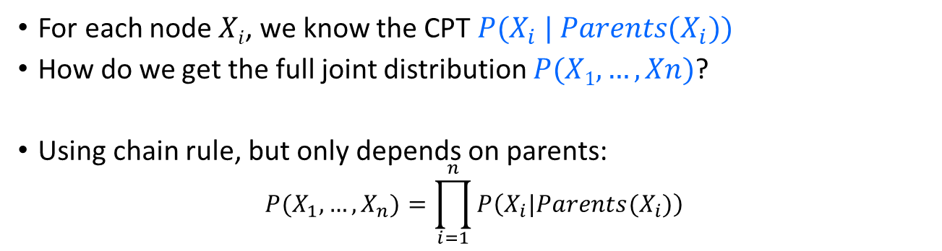
Extracting the Joint Probability Distribution
For each node $Xi$, we know the CPT $P(X_{i} | Parents(X_{i}))$
How do we get the full joint distribution $P(X1, …, Xn)$?
Using chain rule, but only depends on parents:
$$P(X_{1},…,X_{n})=\prod_{i=1}^{n}{P\left(X_{i}|Parents(X_{i})\right)}$$
Example:
Construct following arrows
$$P(J, M, A, B, E) = P(B) P(E) P(A | B, E) P(J | A) P(M | A)$$

Slide 18
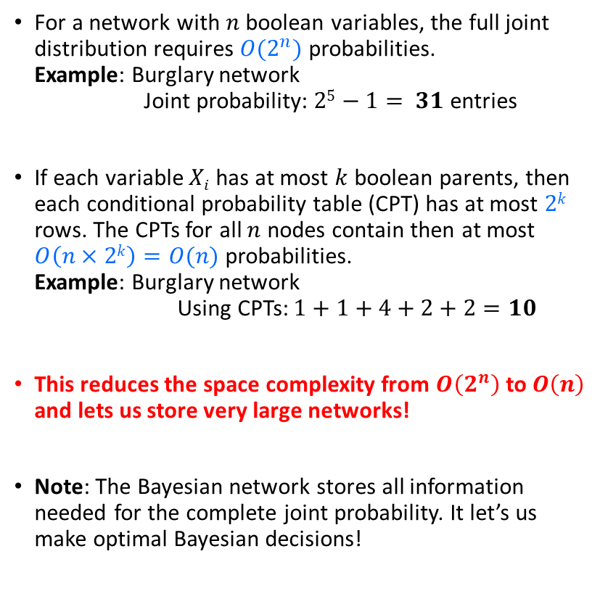
Compactness
For a network with $n$ boolean variables, the full joint distribution requires $O(2^{n})$probabilities.
Example: Burglary network
Joint probability: $25−1= 31$ entries
If each variable $Xi$ has at most $k$ boolean parents, then each conditional probability table (CPT) has at most $2k$ rows. The CPTs for all $n$ nodes contain then at most $O\left(n×2k\right)=O(n)$ probabilities.
Example: Burglary network
Using CPTs: $1+1+4+2+2=10$
This reduces the space complexity from $O\left(2^{n}\right)$ to $O\left(n\right)$ and lets us store very large networks!
Note: The Bayesian network stores all information needed for the complete joint probability. It let’s us make optimal Bayesian decisions!

Slide 19
Bayesian Networks
Constructing Bayesian Networks

Slide 20

Constructing Bayesian Networks
Once we know what variables to use, we need to create the structure of the network and create the conditional probability tables (CPTs).
Choose an ordering of variables $X1, … , Xn$
For $i = 1$to $n$
  add $Xi$to the network
  select parents from $X1, … ,X_{i−1}$ such that
  $P(X_{i} | Parents(X_{i})) = P(X_{i} | X1, … X_{i−1})$
  that is, add a connection only from nodes it directly depends on.
Note: There are many ways to order the variables. Networks are typically constructed by domain experts with causality in mind. E.g., Fire causes Smoke:
The network resulting from causal ordering is typically sparse and conditional probabilities are easier to judge because they represent causal relationships.
Algorithm
Fire
Smoke

Slide 21
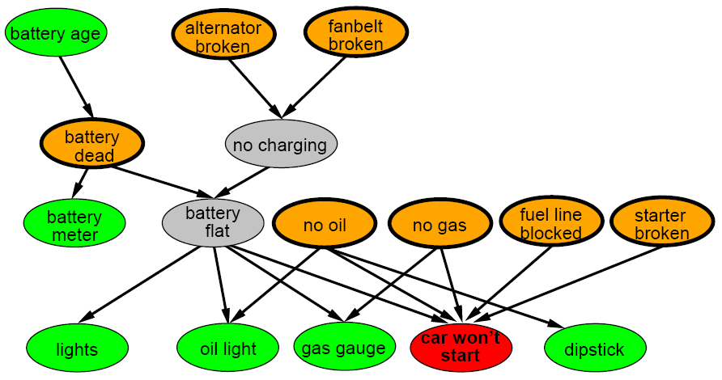
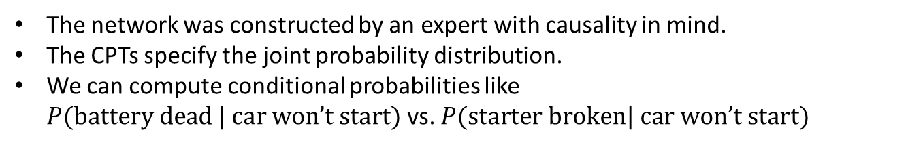
A Larger Bayes Network: Car diagnosis
Initial observation: car won’t start.
Green: testable evidence.
Orange: reasons: “if broken, then fix it”
Gray: “hidden variables” to ensure sparse structure, reduce parameters
Initial Observation
The network was constructed by an expert with causality in mind.
The CPTs specify the joint probability distribution.
We can compute conditional probabilities like
$P(\text{battery} \text{dead} | \text{car} \text{won}\text{’}\text{t} \text{start})$ vs. $P(\text{starter} \text{broken}| \text{car} \text{won}\text{’}\text{t} \text{start})$

Slide 22
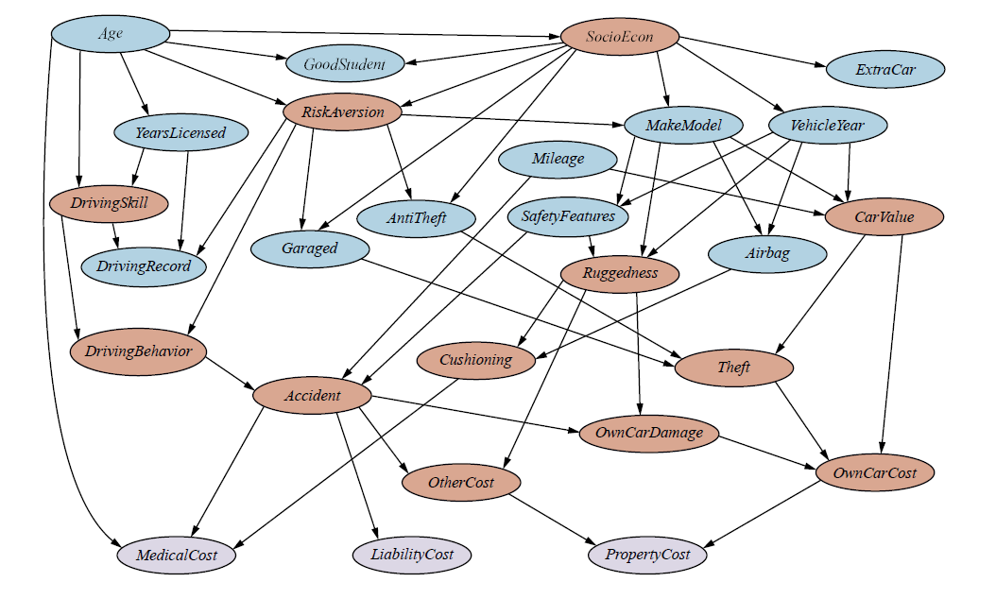
Car insurance: Cost is affected by many factors

Slide 23

Summary
Bayesian networks provide a natural representation for joint probabilities used to calculate conditional probabilities needed for inference (prediction).
Conditional independence (induced by causality) reduces the number of needed parameters and creates a compact network.
Bayesian networks let us make optimal decisions as long as independence assumptions hold.
Representation
  Topology (nodes and edges)
  Conditional probability tables (CPTs)
Construction
  Typically easy for domain experts
  to construct thinking about causality.
Use
  Calculating conditional probabilities for
  decision making is called inference.
$P(B, E, A, J, M)$ is defined by

Slide 24
Exact Inference in BN
Calculate the posterior probability given evidence

Slide 25
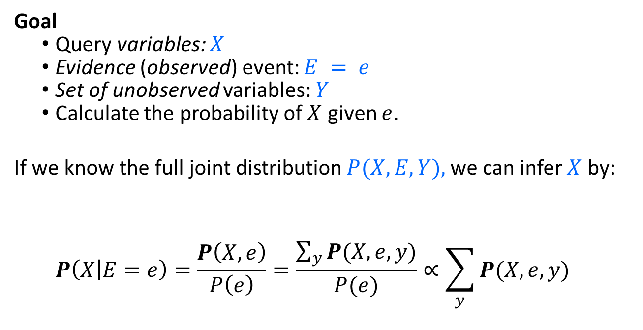
Exact Inference:
Calculating Conditional Distributions
Goal
  Query variables: $X$
  Evidence (observed) event: $E = e$
  Set of unobserved variables: $Y$
  Calculate the probability of $X$ given $e$.
If we know the full joint distribution $P(X, E, Y),$we can infer $X$ by:
  $$P\left(X | E=e\right)=\frac{P\left(X,e\right)}{P\left(e\right)}=\frac{\sum_{y}{P(X,e,y)}}{P(e)}∝\sum_{y}{P(X,e,y)}$$
Sum over values of unobservable variables = marginalizing them out.

Slide 26
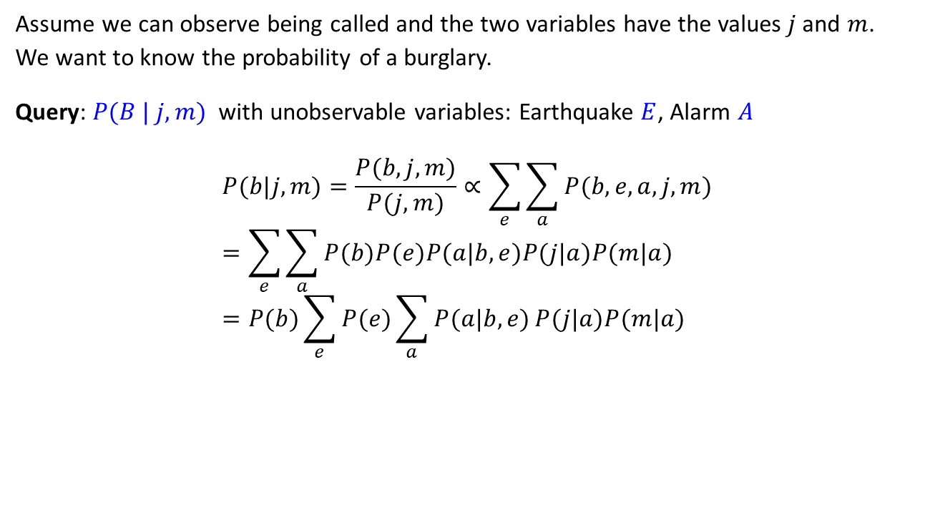
Exact inference:
Example – Calculation
Assume we can observe being called and the two variables have the values$j$and $m$.
We want to know the probability of a burglary.
Query: $P(B | j, m)$ with unobservable variables: Earthquake $E$, Alarm $A$
$$P(b|j,m)=\frac{P(b,j,m)}{P(j,m)}∝\sum_{e}{\sum_{a}{P(b,e,a,j,m)}} \\ =\sum_{e}{\sum_{a}{P(b)P(e)P(a|b,e)P(j|a)P(m|a)}} \\ =P(b)\sum_{e}{P(e)\sum_{a}{P(a|b,e)}P(j|a)P(m|a)}$$
Full joint probability and marginalize over E and A

Slide 27
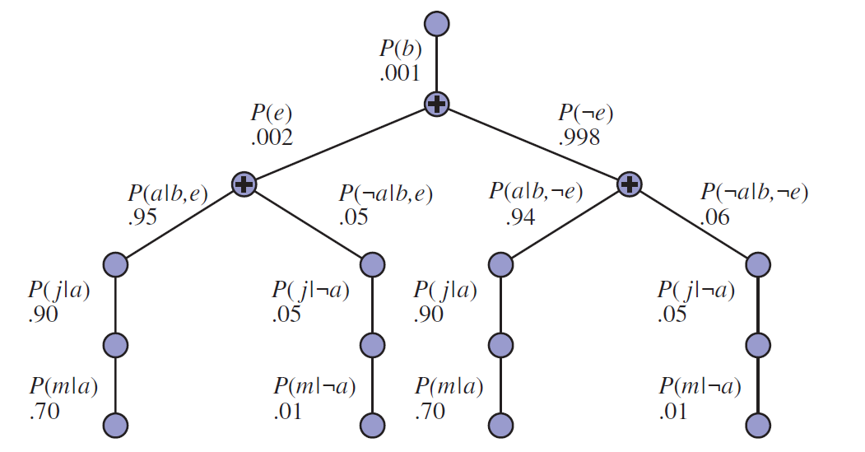

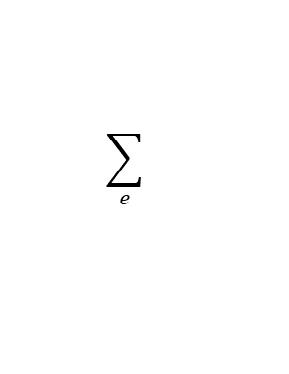
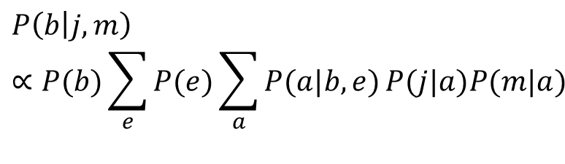
Exact inference:
Example – Evaluation Tree
$$P\left(b | j,m\right)∝P(b)\sum_{e}{P(e)\sum_{a}{P(a|b,e)}P(j|a)P(m|a)}$$
Implement as a traversal of the evaluation tree
(lines represent multiplications)
$$\sum_{e}{}$$
$$\sum_{a}{}$$

Slide 28
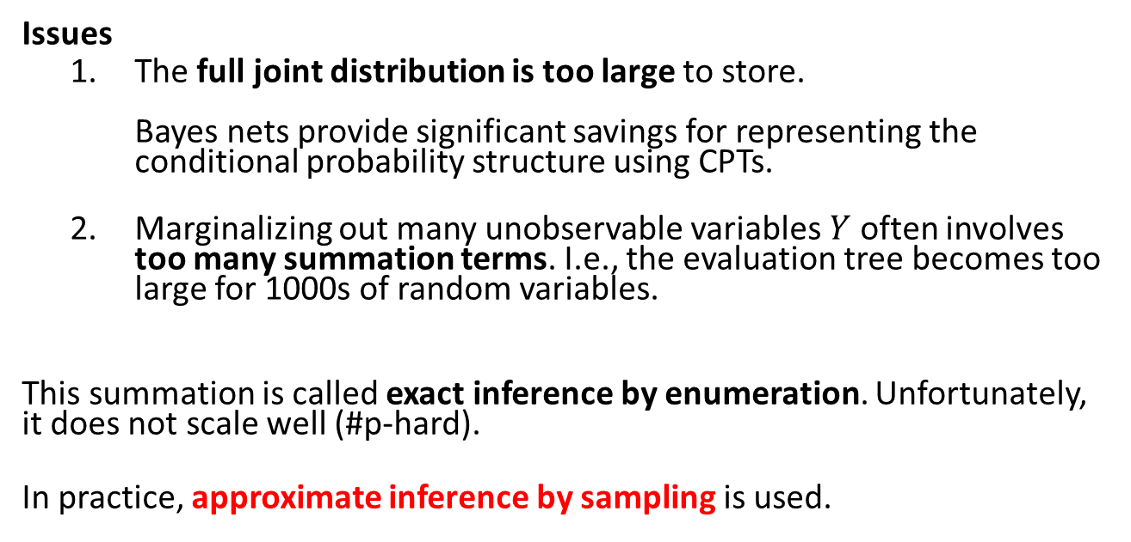
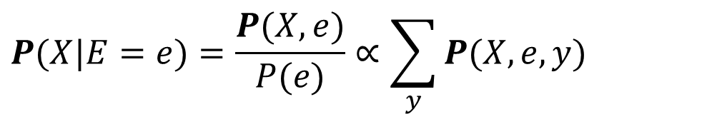
Issues with Exact Inference in AI
$$P(X|E=e)=\frac{P(X,e)}{P(e)}∝\sum_{y}{P(X,e,y)}$$
Issues
  The full joint distribution is too large to store.
  Bayes nets provide significant savings for representing the conditional probability structure using CPTs.
  Marginalizing out many unobservable variables $Y$ often involves too many summation terms. I.e., the evaluation tree becomes too large for 1000s of random variables.
This summation is called exact inference by enumeration. Unfortunately, it does not scale well (#p-hard).
In practice, approximate inference by sampling is used.

Slide 29
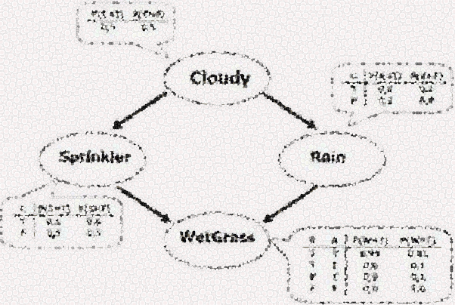
Approximate Inference in BN
Estimate the posterior probability given evidence

Slide 30
Bayesian Networks as a
Generative Models
Bayesian networks can be used as generative models.
Generative models allow us to efficiently generate samples from the joint distribution.
Idea: Generate samples from the network to estimate joint and conditional probability distributions using Monte Carlo simulation methods.

Slide 31
Estimating Joint and
Marginal Probability Distributions from BNs

Slide 32
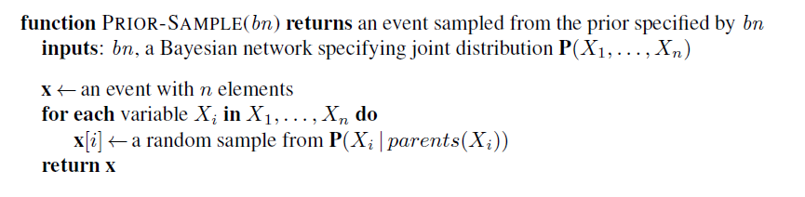
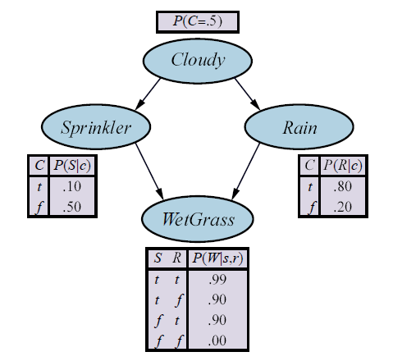
Prior-Sample Algorithm
Order is important! We need to start with the random variables that have no parents.
Variable Order
Note: This looks like playouts in games!

Slide 33
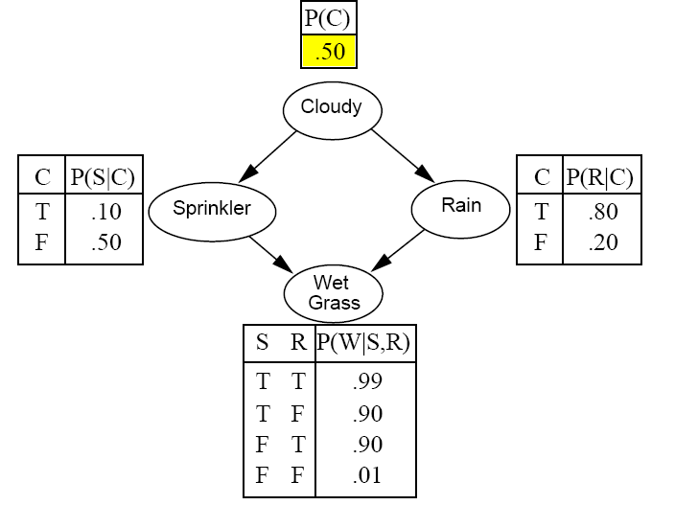
Example: Sampling from a Bayesian Network
Variable order

Slide 34
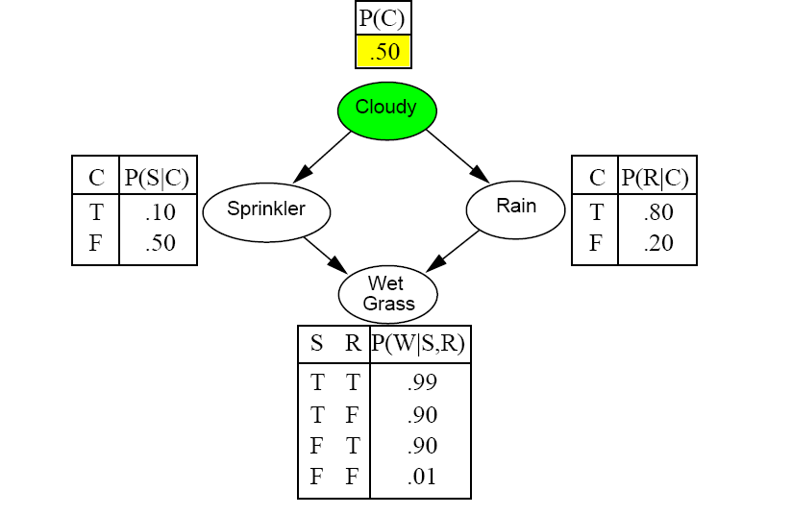
Example: Sampling from a Bayesian Network
Draw a random value
using the probability.

Slide 35
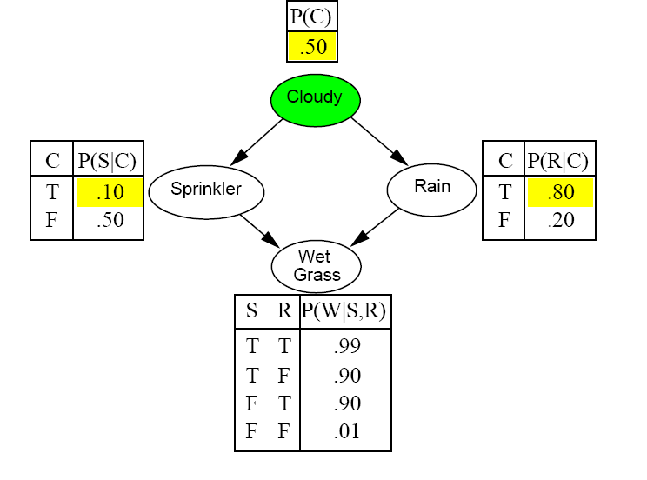
Example: Sampling from a Bayesian Network

Slide 36
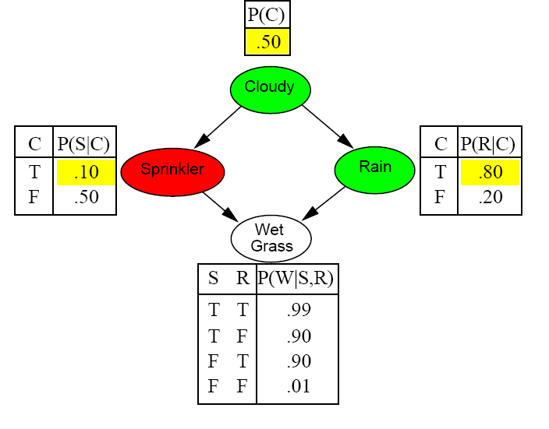
Example: Sampling from a Bayesian Network

Slide 37
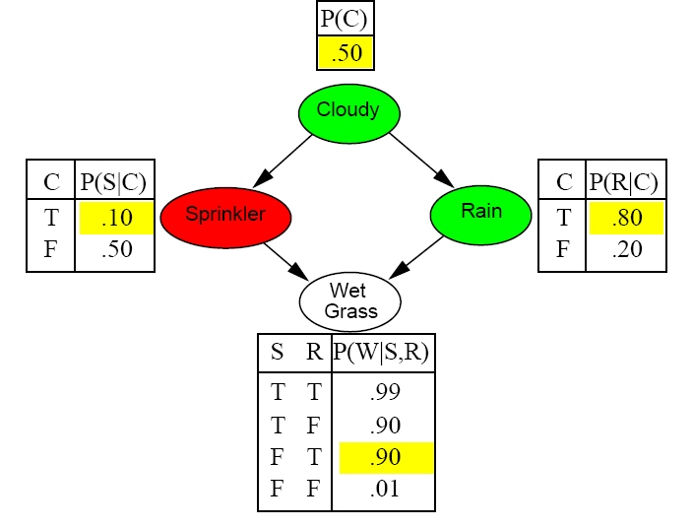
Example: Sampling from a Bayesian Network

Slide 38
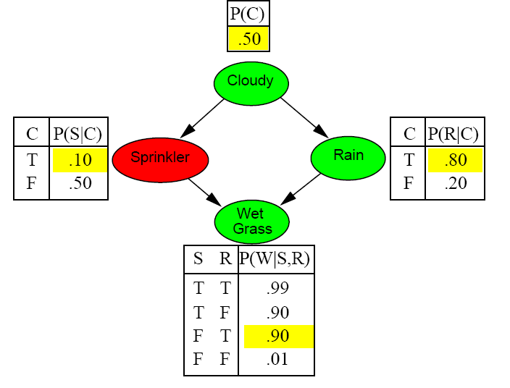
Example: Sampling from a Bayesian Network
Prior Sample returns the event:
[C = True, S = False,
R = True, W = True]

Slide 39
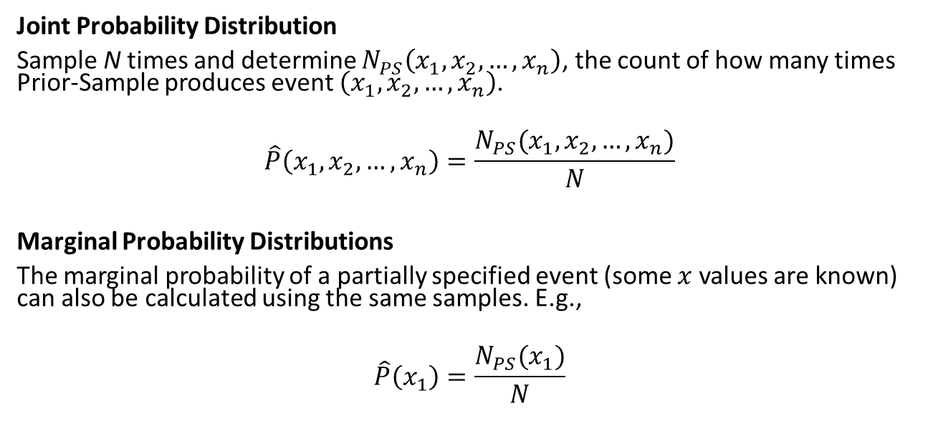
Estimating the Joint and Marginal Probability Distributions from Individual Samples
Joint Probability Distribution
Sample N times and determine $N_{PS}\left(x_{1},x_{2},…,x_{n}\right)$, the count of how many times Prior-Sample produces event $\left(x_{1},x_{2},…,x_{n}\right)$.
$$\hat{P}\left(x_{1},x_{2},…,x_{n}\right)=\frac{N_{PS}(x_{1},x_{2},…,x_{n})}{N}$$
Marginal Probability Distributions
The marginal probability of a partially specified event (some $x$ values are known) can also be calculated using the same samples. E.g.,
$$\hat{P}\left(x_{1}\right)=\frac{N_{PS}(x_{1})}{N}$$

Slide 40
Estimating
Conditional Probability Distributions from BNs
Estimate posterior probabilities for decision making

Slide 41
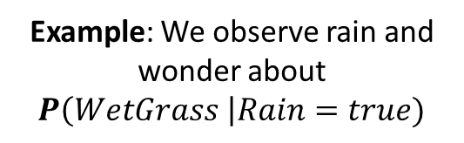
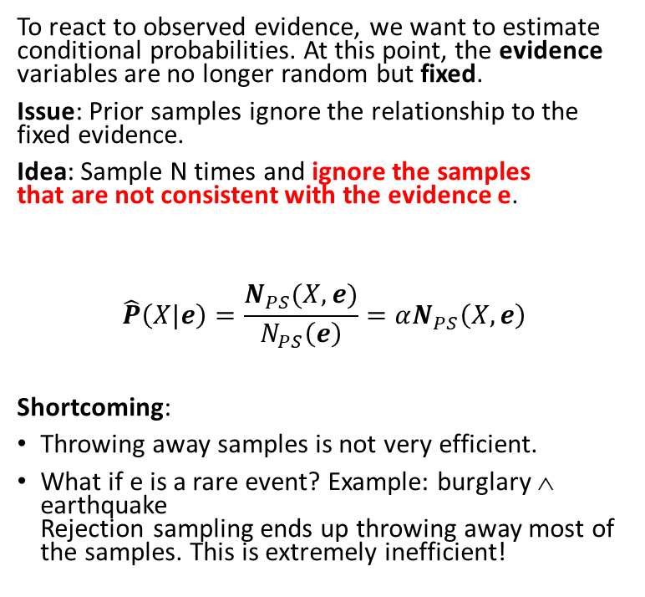
Estimating Conditional Probabilities:
Rejection Sampling
Example: We observe rain and wonder about $P\left(WetGrass \right|Rain=true)$
To react to observed evidence, we want to estimate conditional probabilities. At this point, the evidence variables are no longer random but fixed.
Issue: Prior samples ignore the relationship to the fixed evidence.
Idea: Sample N times and ignore the samples
that are not consistent with the evidence e.
$$\hat{P}\left(X|e\right)=\frac{N_{PS}(X,e)}{N_{PS}\left(e\right)}=αN_{PS}\left(X,e\right)$$
Shortcoming:
Throwing away samples is not very efficient.
What if e is a rare event? Example: burglary ∧ earthquake
Rejection sampling ends up throwing away most of the samples. This is extremely inefficient!
Evidence: true
Normalization trick

Slide 42
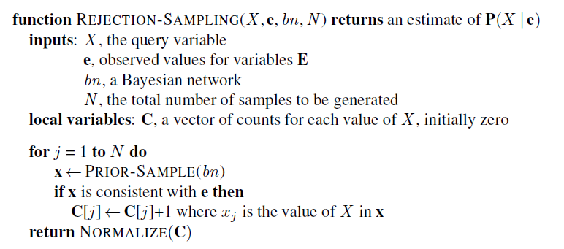
Estimating Conditional Probabilities:
Rejection Sampling
We throw away many samples if e is rare!

Slide 43
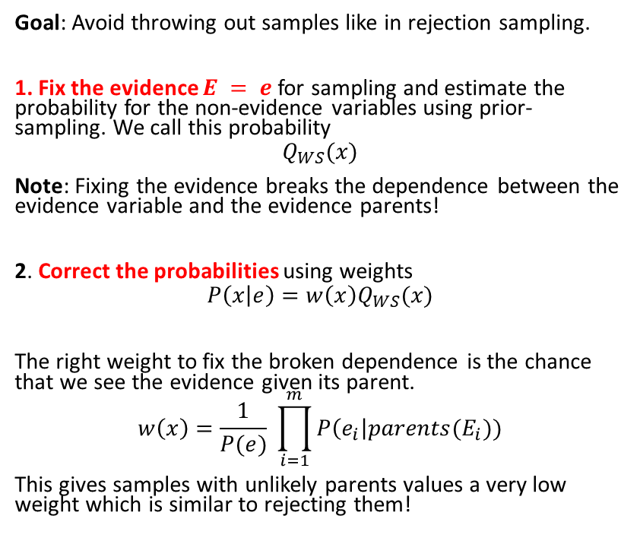
Estimating Conditional Probabilities:
Importance Sampling (likelihood weighting)
Goal: Avoid throwing out samples like in rejection sampling.
1. Fix the evidence $E = e$ for sampling and estimate the probability for the non-evidence variables using prior-sampling. We call this probability
$$Q_{WS}(x)$$
Note: Fixing the evidence breaks the dependence between the evidence variable and the evidence parents!
2. Correct the probabilities using weights
$$P\left(x | e\right)=w\left(x\right)Q_{WS}(x)$$
The right weight to fix the broken dependence is the chance that we see the evidence given its parent.
$$w\left(x\right)=\frac{1}{P(e)} \prod_{i=1}^{m}{P\left(e_{i}\right|parents(E_{i}))}$$
This gives samples with unlikely parents values a very low weight which is similar to rejecting them!
Example: Evidence = it rains
1. Fix as true

Slide 44
Approximate Inference in BN
Markov Chain Monte Carlo Sampling

Slide 45
Estimating Conditional Probabilities:
Markov Chain Monte Carlo Sampling (MCMC)
Idea: Instead of creating each sample individually from scratch, generate a sequence of samples.
The next sample in the sequence is created by making random changes to the current sample. Changes are controlled by a Markov Chain (MC) that is specifically created to have the desired probability distribution as its stationary distribution.
The stationary distribution of a MC can be estimated using Monte Carlo simulation by counting how often each state (=sample) is reached in a random walk through the MC.
Algorithms:
  Gibbs sampling works well for BNs since it needs conditional probabilities and we have CPTs.
  Metropolis-Hastings sampling is more general.
Notes:
  MCMC with Gibbs sampling is the most popular inference method.
  Simulated annealing local search is related to MCMC algorithms.

Slide 46
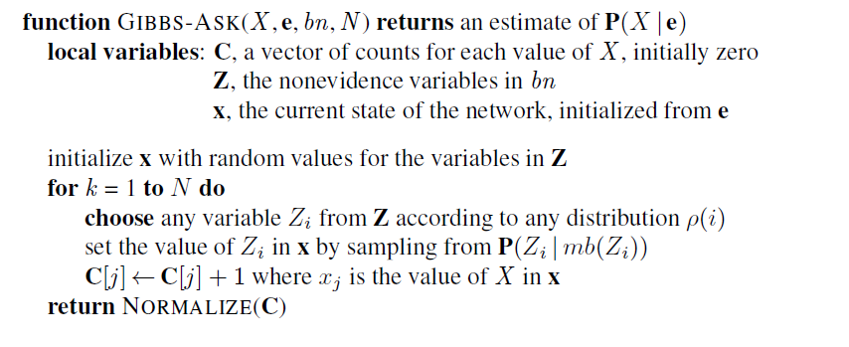
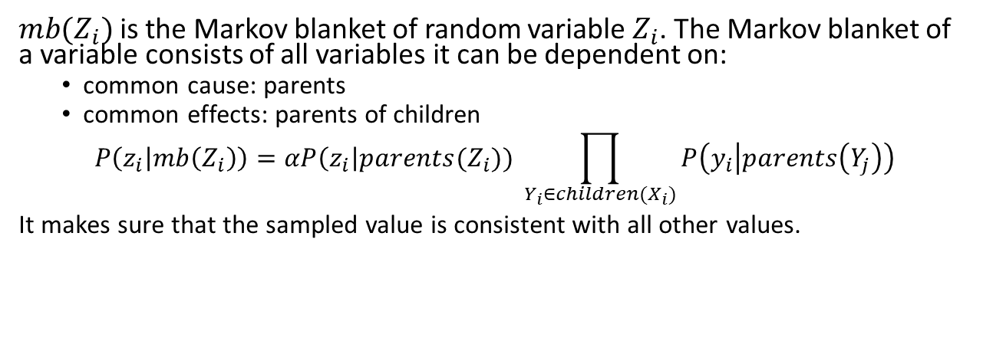
Gibbs Sampling in Bayes Networks
Start with a random state
Change one non-evidence variable at a time
Count
Convert to probabilities
$mb(Z_{i})$ is the Markov blanket of random variable $Z_{i}$. The Markov blanket of a variable consists of all variables it can be dependent on:
  common cause: parents
  common effects: parents of children
$$P\left(z_{i} | mb\left(Z_{i}\right)\right)=αP\left(z_{i}\right|parents(Z_{i})) \prod_{Y_{i}∈children(X_{i})}{P\left(y_{i} | parents\left(Y_{j}\right)\right)}$$
It makes sure that the sampled value is consistent with all other values.

Slide 47
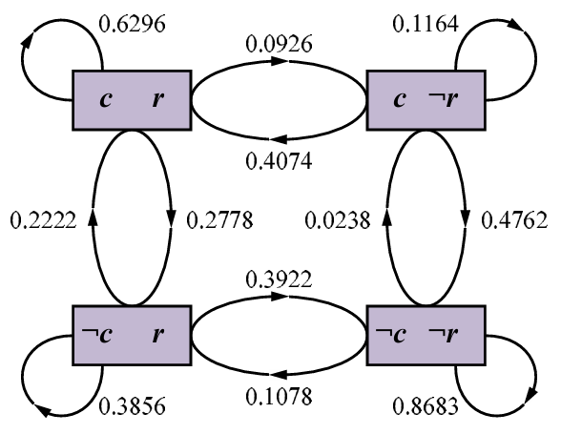
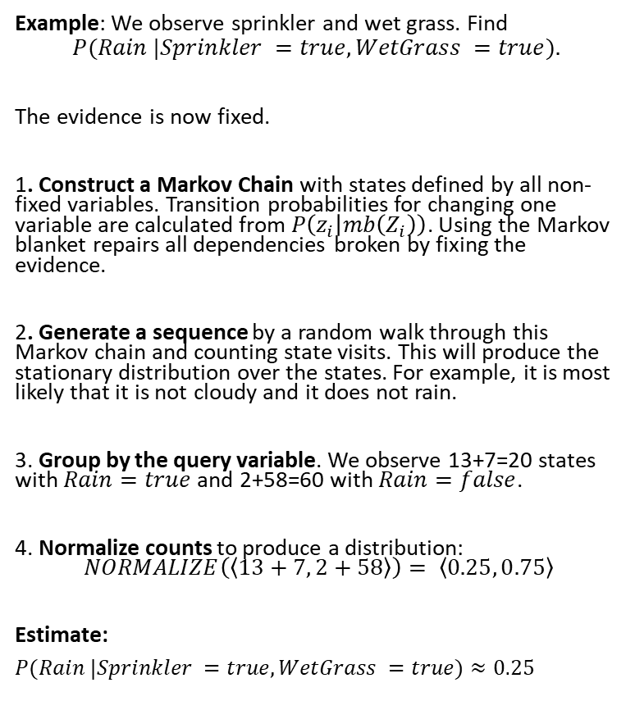
Gibbs Sampling: Example
unknown
Example: We observe sprinkler and wet grass. Find
$$P(Rain |Sprinkler =true,WetGrass =true).$$
The evidence is now fixed.
1. Construct a Markov Chain with states defined by all non-fixed variables. Transition probabilities for changing one variable are calculated from $P\left(z_{i} | mb\left(Z_{i}\right)\right)$. Using the Markov blanket repairs all dependencies broken by fixing the evidence.
2. Generate a sequence by a random walk through this Markov chain and counting state visits. This will produce the stationary distribution over the states. For example, it is most likely that it is not cloudy and it does not rain.
3. Group by the query variable. We observe 13+7=20 states with $Rain=true$and 2+58=60 with $Rain=false$.
4. Normalize counts to produce a distribution:
$$NORMALIZE\left(\left\langle 13+7, 2+58\right\rangle \right)= \left\langle 0.25, 0.75\right\rangle$$
Estimate:
$P(Rain |Sprinkler =true,WetGrass =true)≈0.25$
?
true
true
13 visits
2 visits
7 visits
58 visits
Note the self-loops: the state stays the same when the resampled value is the same.

Slide 48

Conclusion
Bayesian networks provide an efficient way to store a complete probabilistic model for an AI problem by exploiting (conditional) independence between variables.
Inference means querying the model for a conditional probability given some evidence.
Exact inference is difficult for all but tiny models.
The state-of-the-art is to use approximate inference by Markov Chain Monte Carlo sampling from the model.
Any software libraries provide general inference engines.

