Slide 1
Introduction to Data Mining Chapter 2 Data
by Michael Hahsler
Based in Slides by Tan, Steinbach, Karpatne, Kumar
This work is licensed under a Creative Commons Attribution-ShareAlike 4.0 International License.

Slide 2
R Code Examples
Available R Code examples are indicated on slides by the R logo
The Examples are available at https://mhahsler.github.io/Introduction_to_Data_Mining_R_Examples/

Slide 3
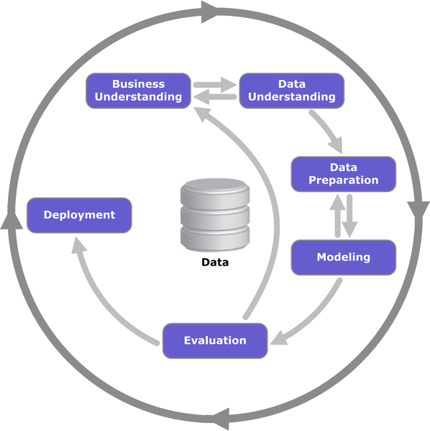
Tasks in the CRISP-DM Reference Model

Slide 4
Topics
Attributes/Features
Types of Data Sets
Data Quality
Data Preprocessing
Similarity and Dissimilarity
Density

Slide 5
What is Data?
Collection of data objects and their attributes
An attribute (in Data Mining and Machine learning often "feature") is a property or characteristic of an object
Examples: eye color of a person, temperature, etc.
Attribute is also known as variable, field, characteristic
A collection of attributes describe an object
Object is also known as record, point, case, sample, entity, or instance
Attributes
Tid | Refund | Marital Status | Taxable Income | Cheat
1 | Yes | Single | 125K | No
2 | No | Married | 100K | No
3 | No | Single | 70K | No
4 | Yes | Married | 120K | No
5 | No | Divorced | 95K | Yes
6 | No | Married | 60K | No
7 | Yes | Divorced | 220K | No
8 | No | Single | 85K | Yes
9 | No | Married | 75K | No
10 | No | Single | 90K | Yes
Objects

Slide 6
Attribute Values
Attribute values are numbers or symbols assigned to an attribute
Distinction between attributes and attribute values
Same attribute can be mapped to different attribute values
Example: height can be measured in feet or meters
Different attributes can be mapped to the same set of values
Example: Attribute values for ID and age are integers
But properties of attribute values can be different
ID has no limit but age has a maximum and minimum value

Slide 7
Types of Attributes - Scales
There are different types of attributes
Nominal
Examples: ID numbers, eye color, zip codes
Ordinal
Examples: rankings (e.g., taste of potato chips on a scale from 1-10), grades, height in {tall, medium, short}
Interval
Examples: calendar dates, temperatures in Celsius or Fahrenheit.
Ratio
Examples: temperature in Kelvin, length, time, counts
Categorical, Qualitative
Quantitative

Slide 8
Attribute Type | Description | Examples | Operations
Nominal | The values of a nominal attribute are just different names or labels, i.e., nominal attributes provide only enough information to distinguish one object from another. | zip codes, employee ID numbers, eye color, sex: {male, female} | $$=, ≠$$ mode, entropy, contingency correlation, $χ^{2}$ test
Ordinal | The values of an ordinal attribute provide enough information to order objects. | zip codes, employee ID numbers, eye color, sex: {male, female} | Nominal + $<, >$ median, percentiles, rank correlation, run tests, sign tests
Interval | For interval attributes, the differences between values are meaningful, i.e., a unit of measurement exists. | calendar dates, temperature in Celsius or Fahrenheit | Ordinal + $+,−$ mean, standard deviation, Pearson's correlation, t and F tests
Ratio | For ratio variables, both differences and ratios are meaningful. Double the number means twice as much. | temperature in Kelvin, monetary quantities, counts, age, mass, length, electrical current | Interval + $∗,/$ geometric mean, harmonic mean, percent variation

Slide 9
Attribute Level
Transformation
Comments
Nominal
Any permutation of values
If all employee ID numbers were reassigned, would it make any difference?
Ordinal
An order preserving change of values, i.e., new_value = f(old_value) where f is a monotonic function.
An attribute encompassing the notion of good, better best can be represented equally well by the values {1, 2, 3} or by { 0.5, 1, 10}.
Interval
new_value =a * old_value + b where a and b are constants
Thus, the Fahrenheit and Celsius temperature scales differ in terms of where their zero value is and the size of a unit (degree).
Ratio
new_value = a * old_value
Length can be measured in meters or feet.

Slide 10
Discrete and Continuous Attributes
Discrete Attribute
Has only a finite or countably infinite set of values
Examples: zip codes, counts, or the set of words in a collection of documents
Often represented as integer variables.
Note: binary attributes are a special case of discrete attributes
Continuous Attribute
Has real numbers as attribute values
Examples: temperature, height, or weight.
Practically, real values can only be measured and represented using a finite number of digits.
Continuous attributes are typically represented as floating-point variables.

Slide 11
Examples
What is the scale of measurement of:
Number of cars per minute (count data)
Age data grouped in: 0-4 years, 5-9, 10-14, …
Age data grouped in: <20 years, 21-30, 31-40, 41+

Slide 12
Topics
Attributes/Features
Types of Data Sets
Data Quality
Data Preprocessing
Similarity and Dissimilarity
Density

Slide 13
Types of data sets
Record
Data Matrix
Document Data
Transaction Data
Graph
World Wide Web
Molecular Structures
Ordered
Spatial Data
Temporal Data
Sequential Data
Genetic Sequence Data

Slide 14
Record Data
Data that consists of a collection of records, each of which consists of a fixed set of attributes (e.g., from a relational database)
Tid | Refund | Marital Status | Taxable Income | Cheat
1 | Yes | Single | 125K | No
2 | No | Married | 100K | No
3 | No | Single | 70K | No
4 | Yes | Married | 120K | No
5 | No | Divorced | 95K | Yes
6 | No | Married | 60K | No
7 | Yes | Divorced | 220K | No
8 | No | Single | 85K | Yes
9 | No | Married | 75K | No
10 | No | Single | 90K | Yes

Slide 15
Data Matrix
If data objects have the same fixed set of numeric attributes, then the data objects can be thought of as points in a multi-dimensional space, where each dimension represents a distinct attribute
Such data set can be represented by an m by n matrix, where there are m rows, one for each object, and n columns, one for each attribute
n attributes
Sepal.Length | Sepal.Width | Petal.Length | Petal.Width
5.6 | 2.7 | 4.2 | 1.3
6.5 | 3.0 | 5.8 | 2.2
6.8 | 2.8 | 4.8 | 1.4
5.7 | 3.8 | 1.7 | 0.3
5.5 | 2.5 | 4.0 | 1.3
4.8 | 3.0 | 1.4 | 0.1
5.2 | 4.1 | 1.5 | 0.1
m objects

Slide 16
Document Data
Each document becomes a `term' vector,
each term is a component (attribute) of the vector,
the value of each component is the number of times the corresponding term occurs in the document.
Terms

Slide 17
Transaction Data
A special type of record data, where
each record (transaction) involves a set of items.
For example, consider a grocery store. The set of products purchased by a customer during one shopping trip constitute a transaction, while the individual products that were purchased are the items.
TID | Items
1 | Bread, Coke, Milk
2 | Beer, Bread
3 | Beer, Coke, Diaper, Milk
4 | Beer, Bread, Diaper, Milk
5 | Coke, Diaper, Milk

Slide 18
Graph Data
Examples: Generic graph and HTML Links

Slide 19
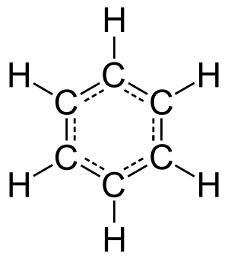
Chemical Data
Benzene Molecule: C6H6

Slide 20
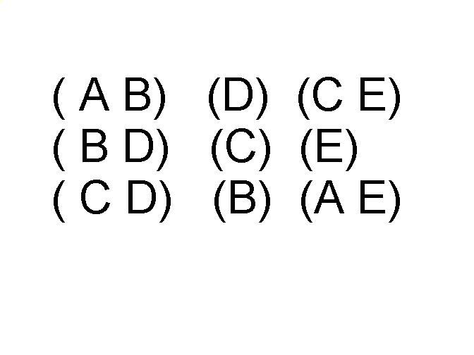
Ordered Data
Sequences of transactions
Items/Events
An element of the sequence

Slide 21
Ordered Data
Genomic sequence data
Subsequences

Slide 22
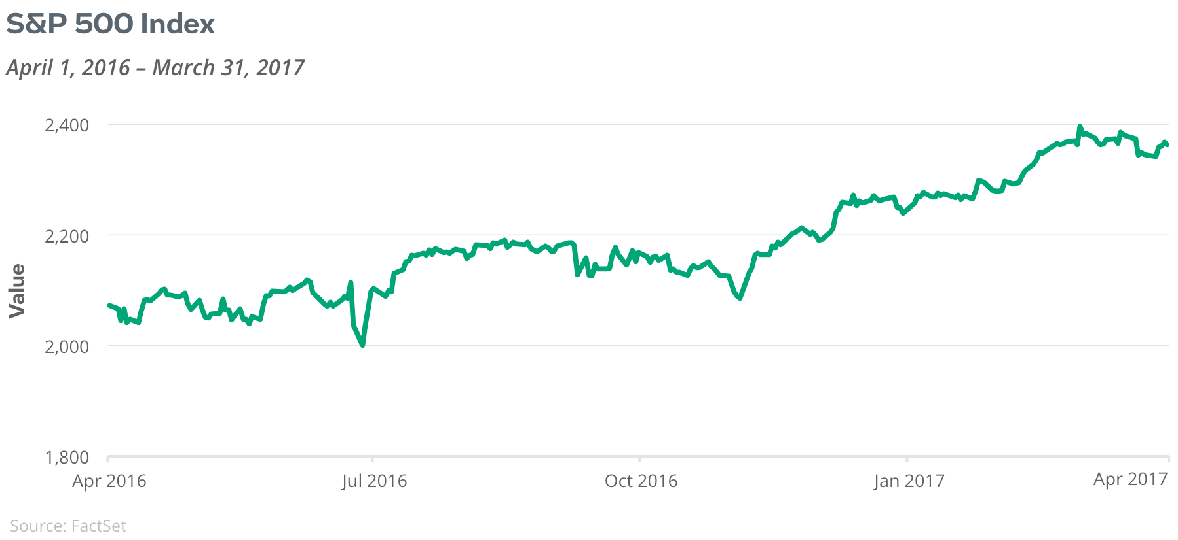
Ordered Data: Time Series Data

Slide 23
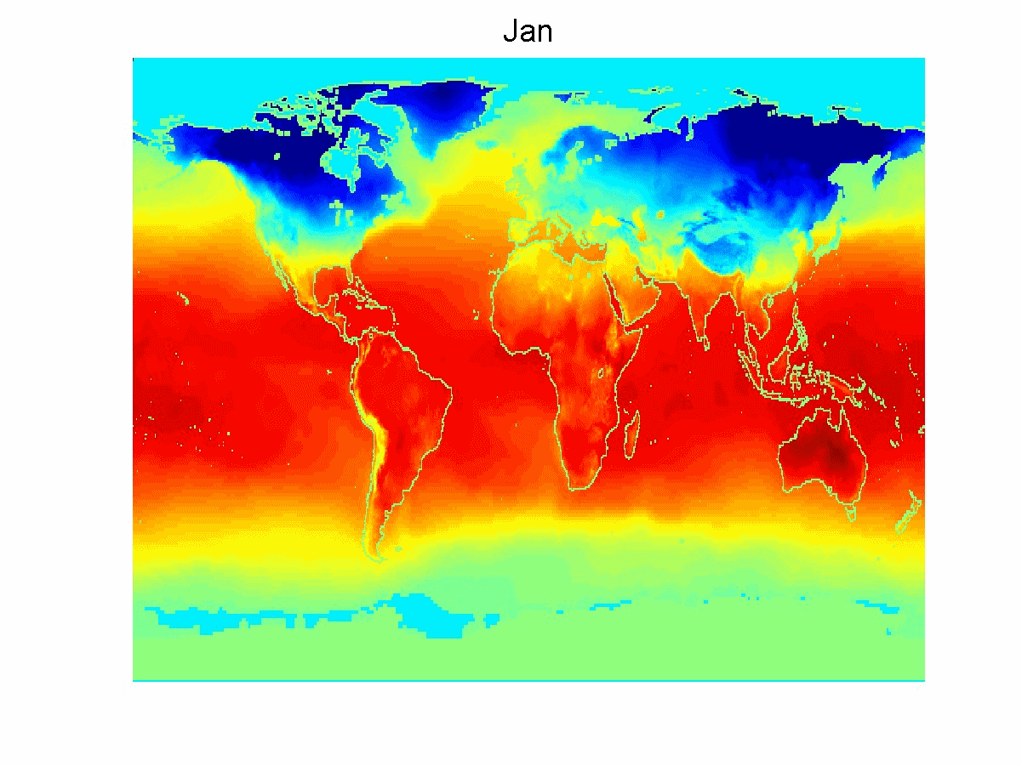
Ordered Data: Spatio-Temporal
, Feb, Mar, …
Average Monthly Temperature of land and ocean

Slide 24
Topics
Attributes/Features
Types of Data Sets
Data Quality
Data Preprocessing
Similarity and Dissimilarity
Density

Slide 25
Data Quality
What kinds of data quality problems?
How can we detect problems with the data?
What can we do about these problems?
Examples of data quality problems:
Noise and outliers
missing values
duplicate data

Slide 26
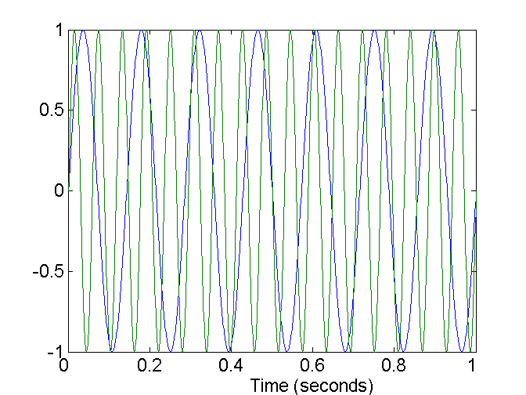
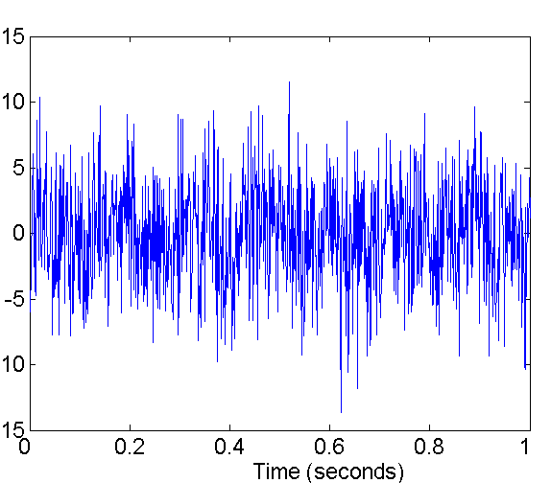
Noise
Noise refers to modification of original values
Examples: distortion of a person’s voice when talking on a poor phone, “snow” on television screen, measurement errors.
Signal: Two Sine Waves
Two Sine Waves + Noise
Noisy measurement
Find less noisy data
De-noise (signal processing)

Slide 27
Outliers
Outliers are data objects with characteristics that are considerably different than most of the other data objects in the data set
Outlier detection + remove outliers

Slide 28
Missing Values
Reasons for missing values
Information is not collected (e.g., people decline to give their age and weight)
Attributes may not be applicable to all cases (e.g., annual income is not applicable to children)
Handling missing values
Eliminate data objects with missing value
Eliminate feature with missing values
Ignore the missing value during analysis
Estimate missing values = Imputation (e.g., replace with mean or weighted mean where all possible values are weighted by their probabilities)

Slide 29
Duplicate Data
Data set may include data objects that are duplicates, or "close duplicates" of one another
Major issue when merging data from heterogeneous sources
Examples:
Same person with multiple email addresses
Data cleaning
Process of dealing with duplicate data issues
ETL tools typically support deduplication

Slide 30
Topics
Attributes/Features
Types of Data Sets
Data Quality
Data Preprocessing
Similarity and Dissimilarity
Density

Slide 31
Data Preprocessing
Aggregation
Sampling
Dimensionality Reduction
Feature subset selection
Feature creation
Discretization and Binarization
Attribute Transformation

Slide 32
Aggregation
Combining two or more attributes (or objects) into a single attribute (or object)
Purpose
Data reduction
Reduce the number of attributes or objects
Change of scale
Cities aggregated into regions, states, countries, etc
More “stable” data
Aggregated data tends to have less variability (e.g., reduce seasonality by aggregation to yearly data)

Slide 33
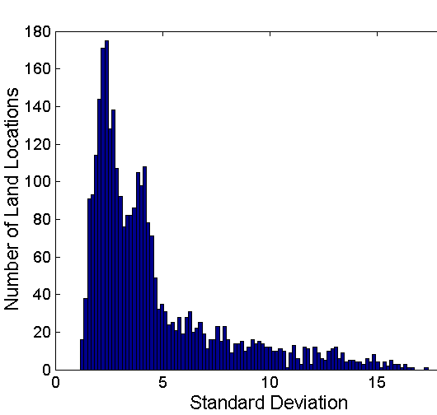
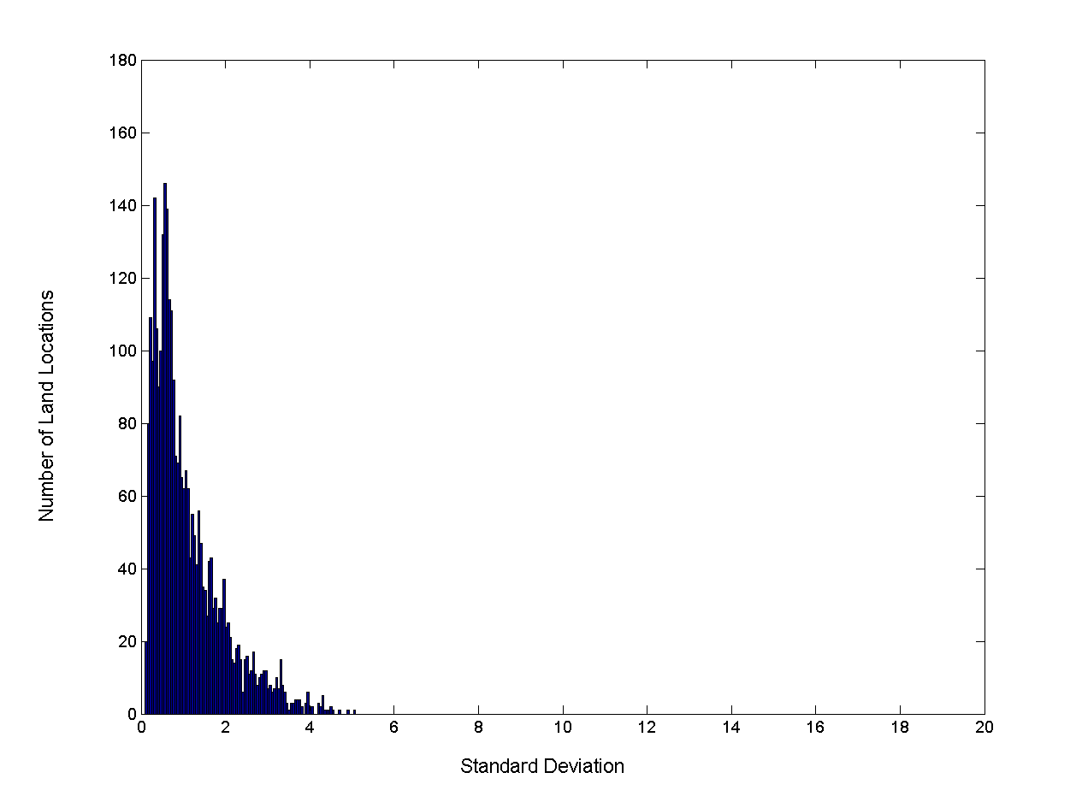
Aggregation
Variation of Precipitation in Australia
Standard Deviation of Average Monthly Precipitation
Standard Deviation of Average Yearly Precipitation

Slide 34
Sampling
Sampling is the main technique employed for data selection.
It is often used for both the preliminary investigation of the data and the final data analysis.
Statisticians sample because obtaining the entire set of data of interest is too expensive or time consuming.
Sampling is used in data mining because processing the entire set of data of interest is too expensive (e.g., does not fit into memory or is too slow).

Slide 35
Sampling …
The key principle for effective sampling is the following:
using a sample will work almost as well as using the entire data sets, if the sample is representative.
A sample is representative if it has approximately the same property (of interest) as the original set of data.

Slide 36
Types of Sampling
Sampling without replacement As each item is selected, it is removed from the population.
Sampling with replacement Objects are not removed from the population as they are selected for the sample. Note: the same object can be picked up more than once.
Replacement?
Simple random sampling There is an equal probability of selecting any particular item.
Stratified sampling Split the data into several partitions; then draw random samples from each partition.
Selection?

Slide 37
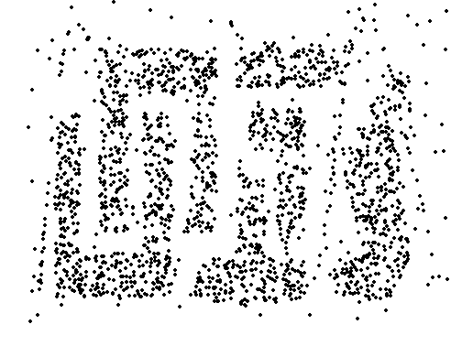
Sample Size
8000 points 2000 Points 500 Points

Slide 38
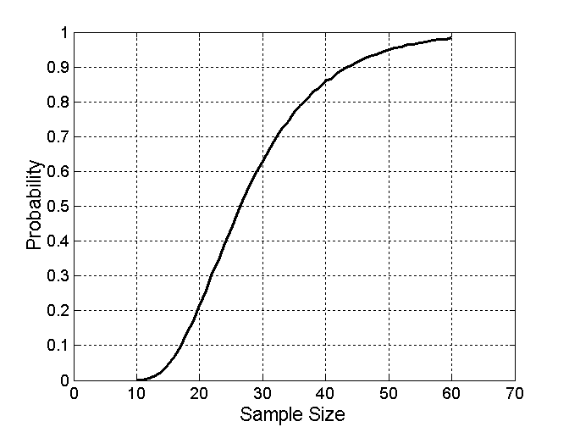
Sample Size
What sample size is necessary to get at least one object from each of 10 groups.
Sample size determination:
Statistics: confidence interval for parameter estimate or desired statistical power of test.
Machine learning: often more is better, cross-validated accuracy.

Slide 39
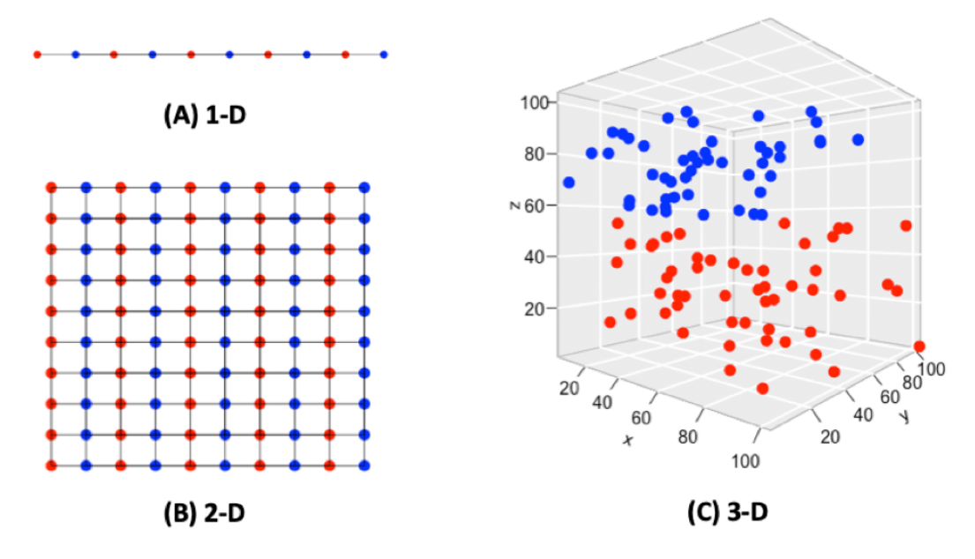
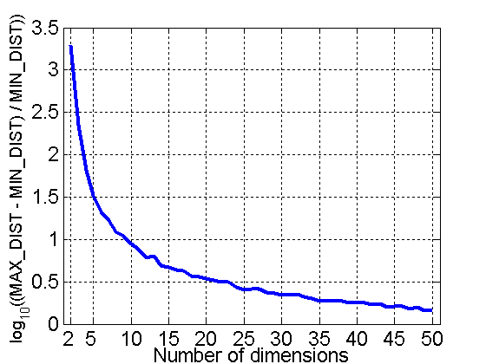
Curse of Dimensionality
When dimensionality increases, the size of the data space grows exponentially.
Definitions of density and distance between points, which is critical for clustering and outlier detection, become less meaningful
Density → 0
All points tend to have the same Euclidean distance to each other.
Points and space
Experiment: Randomly generate 500 points. Compute difference between max and min distance between any pair of points

Slide 40
Dimensionality Reduction
Purpose:
Avoid curse of dimensionality
Reduce amount of time and memory required by data mining algorithms
Allow data to be more easily visualized
May help to eliminate irrelevant features or reduce noise
Techniques
Principle Component Analysis
Singular Value Decomposition
Others: supervised and non-linear techniques

Slide 41
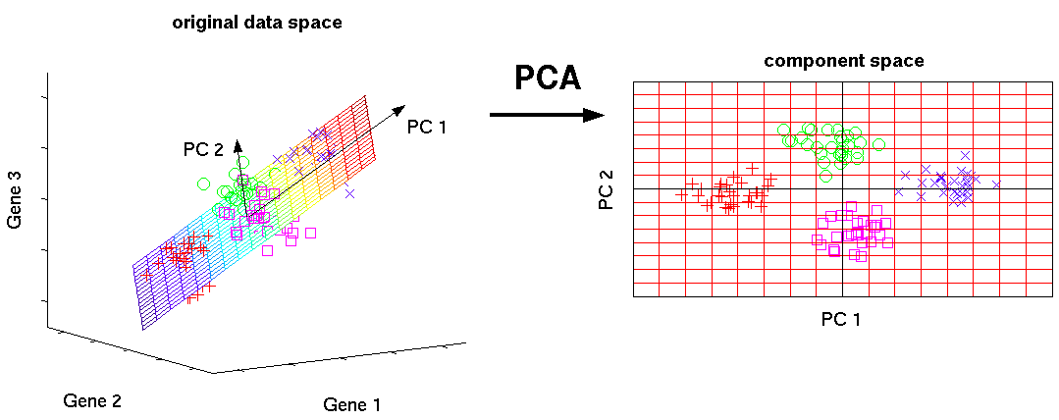
Dimensionality Reduction: Principal Components Analysis (PCA)
Goal: Map points to a lower dimensional space while preserving distance information.
Method: Find a projection (new axes) that captures the largest amount of variation in data. This can be done using eigenvectors of the covariance matrix or SVD (singular value decomposition).

Slide 42
Dimensionality Reduction: ISOMAP
Goal: Unroll the “swiss roll!“ (i.e., preserve distances on the roll)
Method: Use a non-metric space, i.e., distances are not measured by Euclidean distance, but along the surface of the roll (geodesic distances).
Construct a neighbourhood graph (k-nearest neighbors or within a radius).
For each pair of points in the graph, compute the shortest path distances = geodesic distances.
Create a lower dimensional embedding using the geodesic distances (multi-dimensional scaling; MDS)

Slide 43
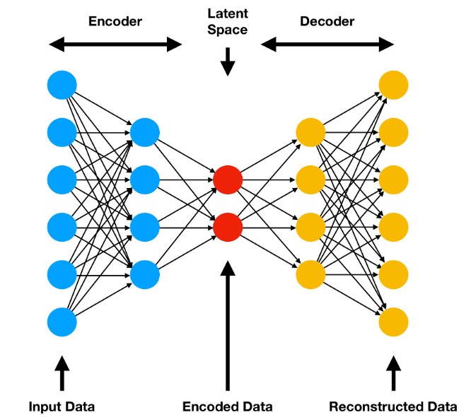
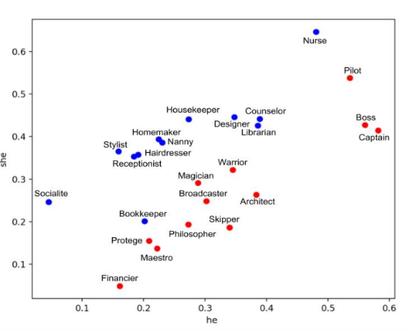
Low-dimensional Embedding
General notion of representing objects described in one space (i.e., set of features) in a different space using a map $f : X→Y$
PCA is an example where Y is the space spanned by the principal components and objects close in the original space X are embedded in space Y.
Low-dimensional embeddings can be produced with various other methods:
T-SNA: T-distributed Stochastic Neighbor Embedding; non-linear for visualization of high-dimensional datasets.
Autoencoders (deep learning): non-linear
Word embedding: Word2vec, GloVe, BERT
Distance is meaningful
Word Embedding
Autoencoder

Slide 44
Feature Subset Selection
= Remove features (columns):
Redundant features
duplicate information contained in multiple features (are correlated)
Example: purchase price of a product and the amount of sales tax paid
Irrelevant features
contain no information that is useful for the data mining task
Example: students' ID is often irrelevant to the task of predicting students' GPA
Methods
Embedded approaches:
Feature selection occurs naturally as part of the data mining algorithm (e.g., regression, decision trees).
Filter approaches:
Features are selected before data mining algorithm is run
(e.g., highly correlated features)
Brute-force approach:
Try all possible feature subsets as input to data mining algorithm and choose the best.
Wrapper approaches:
Use the data mining algorithm as a black box to find best subset of attributes (often using greedy search)

Slide 45
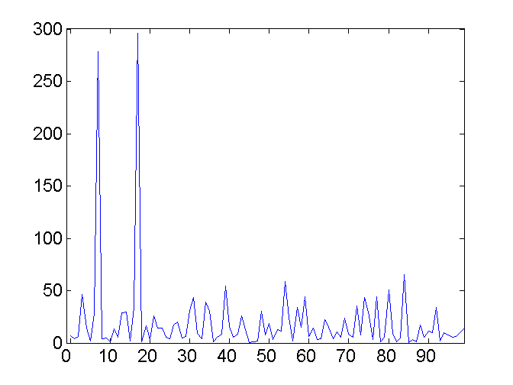
Feature Creation
Create new attributes that can capture the important information in a data set much more efficiently than the original attributes
Three general methodologies
Feature Extraction
Domain-specific (e.g., face recognition in image mining)
Feature Construction / Feature Engineering
combining features (interactions: multiply features)
Example: Calculate the body mass index from height and weight
Mapping Data to New Space
Example: Fourier transform/Wavelet transform
Two Sine Waves + Noise
Frequency Domain
Transform

Slide 46
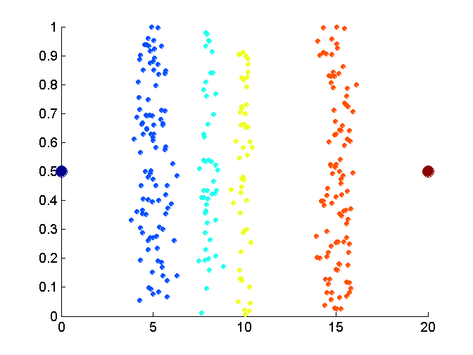
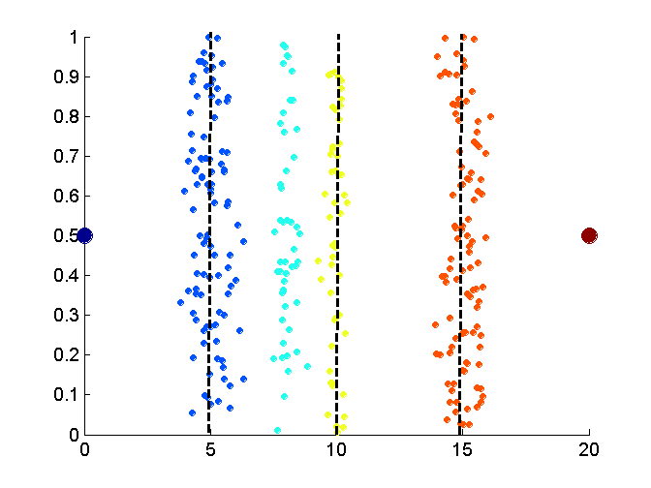
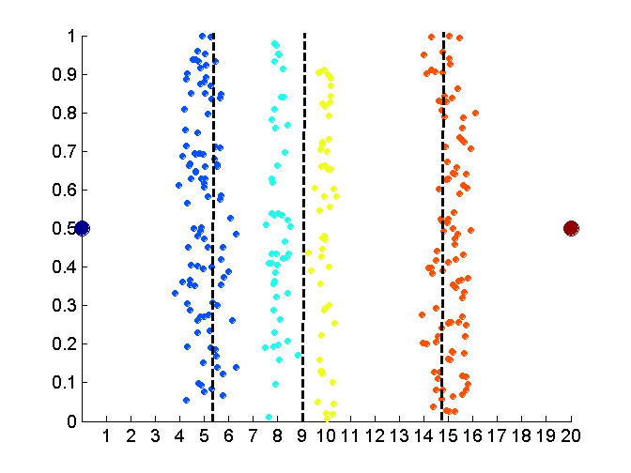
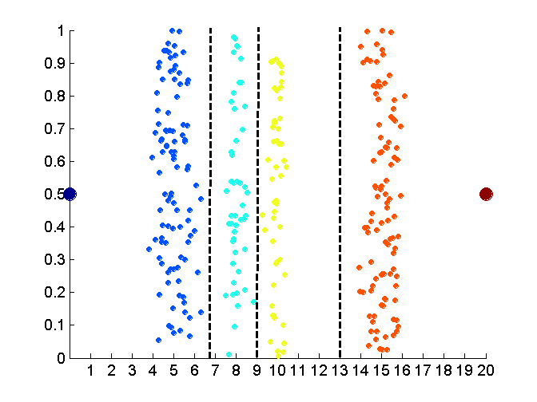
Unsupervised Discretization
Data
Equal interval width
Equal frequency
K-means

Slide 47
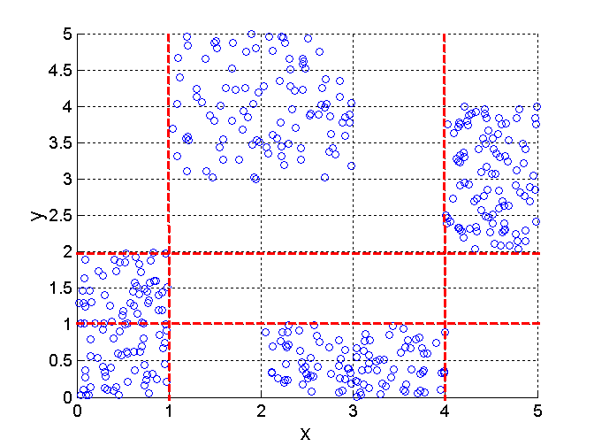
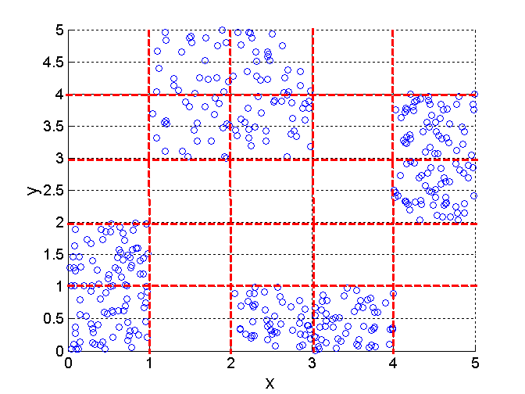
Supervised Discretization
Entropy based approach (entropy is a measure of unorder). Bisect data to reduce entropy.
A
B
C
D
3 categories for both x and y
5 categories for both x and y

Slide 48
Attribute Transformation
A function that maps the entire set of values of a given attribute to a new set of replacement values such that each old value can be identified with one of the new values
Simple functions: $x^{k}, log⁡(x), e^{x}, |x|$
Standardization and Normalization The z-score normalizes data roughly to an interval of $[−3,3].$
$$x^{′}= \frac{x−\overline{x}}{s_{x}}$$
$\overline{x}$ … column (attribute) mean
$s_{x}$… column (attribute) standard deviation

Slide 49
Topics
Attributes/Features
Types of Data Sets
Data Quality
Data Preprocessing
Similarity and Dissimilarity
Density

Slide 50
Similarity and Dissimilarity
Similarity
Numerical measure of how alike two data objects are.
Is higher when objects are more alike.
Often falls in the range [0,1]
Dissimilarity
Numerical measure of how different are two data objects
Lower when objects are more alike
Minimum dissimilarity is often 0
Upper limit varies
Proximity refers to a similarity or dissimilarity

Slide 51
Similarity/Dissimilarity for Simple Attributes
p and q are the attribute values for two data objects.
$$s=f\left(d\right)$$
f can be any strictly decreasing function.

Slide 52
Euclidean Distance
point | x | y
p | 0 | 2
q | 2 | 0
Euclidean Distance (for quantitative attribute vectors)
Where $p$ and $q$ are two objects represented by vectors. n is the number of dimensions (attributes) of the vectors and $p_{k}$ and $q_{k}$ are, respectively, the kth attributes (components) or data objects p and q.
${\left\|⋅\right\|}_{2}$ is the $L^{2}$ vector norm (i.e., length of a vector in Euclidean space).
Note: If ranges differ between components of $p$then standardization (z-scores) is necessary to avoid one variable to dominate the distance.
$$d_{E}= \sqrt{\sum_{k=1}^{n}{{\left(p_{k}−q_{k}\right)}^{2}}}= {\left\|p−q\right\|}_{2}$$

Slide 53
Euclidean Distance
point | x | y
p1 | 0 | 2
p2 | 2 | 0
p3 | 3 | 1
p4 | 5 | 1
 | p1 | p2 | p3 | p4
p1 | 0.00 | 2.83 | 3.16 | 5.10
p2 | 2.83 | 0.00 | 1.41 | 3.16
p3 | 3.16 | 1.41 | 0.00 | 2.00
p4 | 5.10 | 3.16 | 2.00 | 0.00
Distance Matrix

Slide 54
Minkowski Distance
point | x | y
p | 0 | 2
q | 2 | 0
Minkowski Distance is a generalization of Euclidean Distance
Where $p$ and $q$ are two objects represented by vectors. n is the number of dimensions (attributes) of the vectors and $p_{k}$ and $q_{k}$ are, respectively, the kth attributes (components) or data objects p and q.
Note: If ranges differ then standardization (z-scores) is necessary to avoid one variable to dominate the distance.
$$d_{M}= {\left(\sum_{k=1}^{n}{{\left|p_{k}−q_{k}\right|}^{r}}\right)}^{\frac{1}{r}}= {\left\|p−q\right\|}_{r}$$

Slide 55
Minkowski Distance: Examples
$r = 1$. City block (Manhattan, taxicab, $L^{1}$ norm) distance.
A common example of this is the Hamming distance, which is just the number of bits that are different between two binary vectors
$r = 2$. Euclidean distance ($L^{2}$ norm)
$r=∞$. “supremum” (maximum norm, $L^{∞}$ norm) distance.
This is the maximum difference between any component of the vectors
Do not confuse r with n, i.e., all these distances are defined for all numbers of dimensions.

Slide 56
Minkowski Distances
Distance Matrix
$$L^{1}$$ | p1 | p2 | p3 | p4
p1 | 0 | 4 | 4 | 6
p2 | 4 | 0 | 2 | 4
p3 | 4 | 2 | 0 | 2
p4 | 6 | 4 | 2 | 0
point | x | y
p1 | 0 | 2
p2 | 2 | 0
p3 | 3 | 1
p4 | 5 | 1
$$L^{2}$$ | p1 | p2 | p3 | p4
p1 | 0.00 | 2.83 | 3.16 | 5.10
p2 | 2.83 | 0.00 | 1.41 | 3.16
p3 | 3.16 | 1.41 | 0.00 | 2.00
p4 | 5.10 | 3.16 | 2.00 | 0.00
$$L^{∞}$$ | p1 | p2 | p3 | p4
p1 | 0 | 2 | 3 | 5
p2 | 2 | 0 | 1 | 3
p3 | 3 | 1 | 0 | 2
p4 | 5 | 3 | 2 | 0

Slide 57
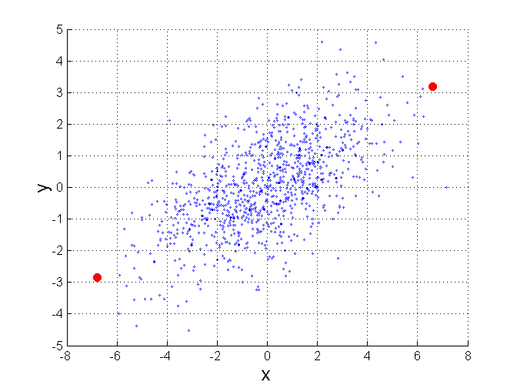
Mahalanobis Distance
$d_{mahalanobis}\left(p, q\right)= \sqrt{{\left(p−q\right)}^{T}S^{−1}\left(p−q\right)}$
$S^{−1}$ is the inverse of the covariance matrix of the input data
Measures how many standard deviations two points are away from each other → scale invariant measure
Example: For red points, the Euclidean distance is 14.7, Mahalanobis distance is 6.

Slide 58
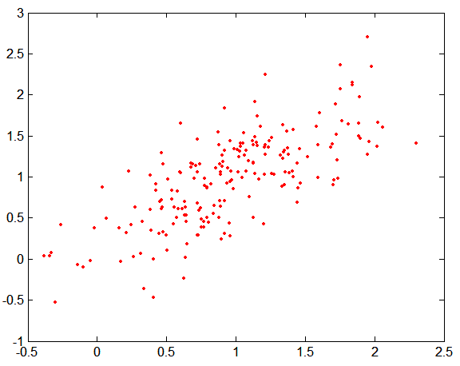
Mahalanobis Distance
y
Covariance Matrix:
$$S=\left[\begin{matrix}.3 & .2 \\ .2 & .3\end{matrix}\right]$$
C
A: (0.5, 0.5)
B: (0, 1)
C: (1.5, 1.5)
$$d_{mahal}\left(A,B\right)= 5 \\ d_{mahal}(A,C)= 4$$
B
A
x
Data varies in direction A-C more than in A-B!

Slide 59
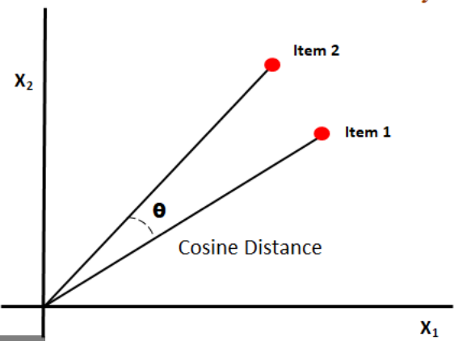
Cosine Similarity
For two vector A and B, the cosine similarity is defined as
Example:
A = 3 2 0 5 0 0 0 2 0 0
B = 1 0 0 0 0 0 0 1 0 2 $$A⋅B = 3∗1 + 2∗0 + 0∗0 + 5∗0 + 0∗0 + 0∗0 + 0∗0 + 2∗1 + 0∗0 + 0∗2 = 5$$
$$\left\|A\right\| = \left(3∗3+2∗2+0∗0+5∗5+0∗0+0∗0+0∗0+2∗2+0∗0+0∗0\right)0.5 = 6.481$$
$$\left\|B\right\| = (1∗1+0∗0+0∗0+0∗0+0∗0+0∗0+0∗0+1∗1+0∗0+2∗2) 0.5 = 2.245$$
$s_{cosine}= .315$0
Cosine similarity is often used for word count vectors to compare documents.

Slide 60
Similarity Between Binary Vectors
Common situation is that objects, p and q, have only binary attributes
Compute similarities using the following quantities
M01 = the number of attributes where p was 0 and q was 1
M10 = the number of attributes where p was 1 and q was 0
M00 = the number of attributes where p was 0 and q was 0
M11 = the number of attributes where p was 1 and q was 1
Simple Matching and Jaccard Coefficients
$s_{SMC}$ = number of matches / number of attributes
= (M11 + M00) / (M01 + M10 + M11 + M00)
$s_{J}$ = number of 11 matches / number of not-both-zero attribute values
= (M11) / (M01 + M10 + M11)
Note: Jaccard ignores 0s!

Slide 61
SMC versus Jaccard: Example
$$p = 1 0 0 0 0 0 0 0 0 0$$
$$q = 0 0 0 0 0 0 1 0 0 1$$
$M01 = 2$(the number of attributes where p was 0 and q was 1)
$M10 = 1$(the number of attributes where p was 1 and q was 0)
$M00 = 7$(the number of attributes where p was 0 and q was 0)
$M11 = 0$(the number of attributes where p was 1 and q was 1)
$$s_{SMC}=\frac{M11 + M00}{M01 + M10 + M11 + M00}= (0+7) / (2+1+0+7) = 0.7$$
$$s_{J}=\frac{M11}{M01 + M10 + M11}= 0 / (2 + 1 + 0) = 0$$

Slide 62
Extended Jaccard Coefficient (Tanimoto)
Variation of Jaccard for continuous or count attributes:
$$T\left(p,q\right)= \frac{p⋅q}{{\left\|p\right\|}^{2}+{\left\|q\right\|}^{2}−p⋅q}$$
where ∙ is the dot product between two vectors and ||∙||2 is the Euclidean norm (length of the vector).
Reduces to Jaccard for binary attributes

Slide 63
Dis(similarities) With Mixed Types
Sometimes attributes are of many different types (nominal, ordinal, ratio, etc.), but an overall similarity is needed.
Gower's (dis)similarity:
Ignores missing values
Final (dis)similarity is a weighted sum of variable-wise (dis)similarities

Slide 64
Common Properties of a Distance
Distances, such as the Euclidean distance, have some well-known properties.
$d\left(p, q\right)≥0$for all p and q and $d(p, q) = 0$only if p = q. (Positive definiteness)
$d(p, q) = d(q, p)$for all p and q. (Symmetry)
$d\left(p, r\right)≤d(p, q) + d(q, r)$for all points p, q, and r. (Triangle Inequality)
where $d(p, q)$is the distance (dissimilarity) between points (data objects), p and q.
A distance that satisfies these properties is a metric and forms a metric space.

Slide 65
Common Properties of a Similarity
Similarities, also have some well-known properties.
$s(p, q) = 1$(or maximum similarity) only if p = q.
$s(p, q) = s(q, p)$for all p and q. (Symmetry)
where $s(p, q)$is the similarity between points (data objects), p and q.

Slide 66
Exercise
 | x | y
A | 2 | 1
B | 4 | 3
C | 1 | 1
Calculate the Euclidean and the Manhattan distances between A and C and A and B
Calculate the Cosine similarity between A and C and A and B

Slide 67
Topics
Attributes/Features
Types of Data Sets
Data Quality
Data Preprocessing
Similarity and Dissimilarity
Density

Slide 68
Density
Density-based clustering require a notion of density
Examples:
Probability density (function) = describes the likelihood of a random variable taking a given value
Euclidean density = number of points per unit volume
Graph-based density = number of edges compared to a complete graph
Density of a matrix = proportion of non-zero entries.

Slide 69
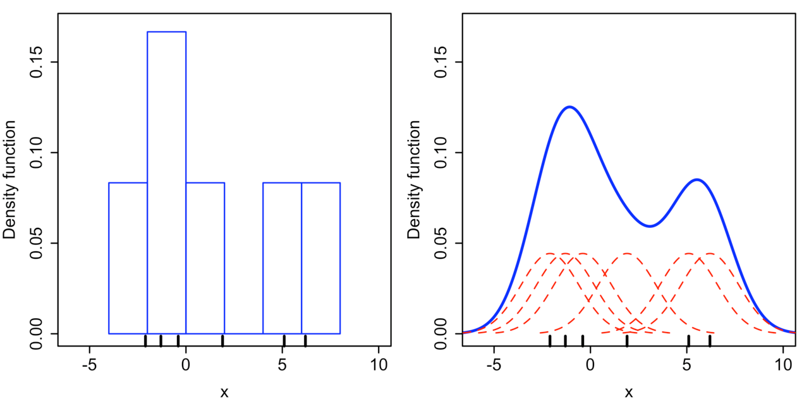
Kernel Density Estimation (KDE)
KDE is a non-parametric way to estimate the probability density function of a random variable.
K is the kernel (a non-negative function that integrates to one) and h > 0 is a smoothing parameter called the bandwidth. Often a Gaussian kernel is used.
Example:

Slide 70
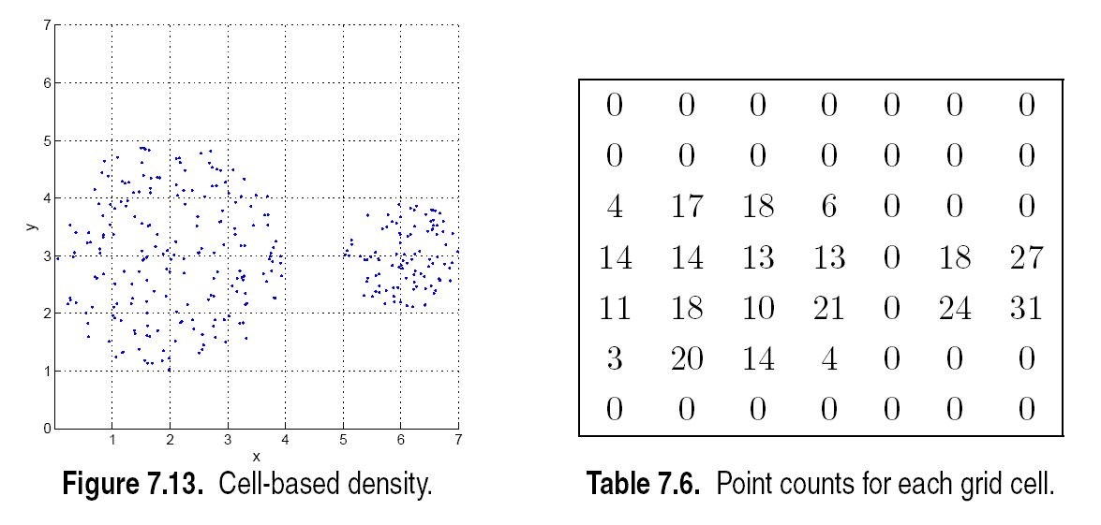
Euclidean Density – Cell-based
Simplest approach is to divide region into a number of rectangular cells of equal volume and define density as # of points the cell contains.

Slide 71
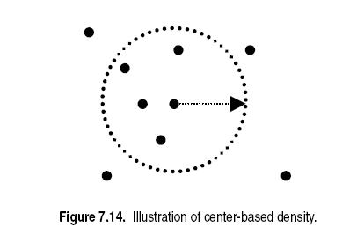
Euclidean Density – Center-based
Euclidean density is the number of points within a specified radius of the point
See Data Exploration

Slide 72
You should know now about…
Attributes/Features
Types of Data Sets
Data Quality
Data Preprocessing
Similarity and Dissimilarity
Density

