Slide 1
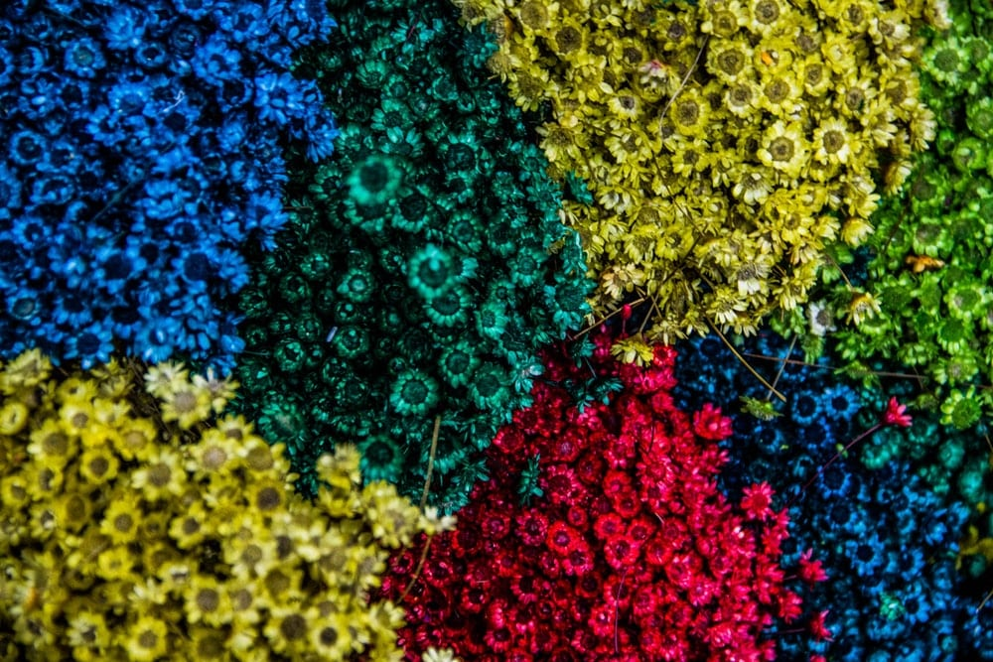
Introduction to
Data Mining
Chapter 7
Cluster Analysis
by Michael Hahsler
Based in Slides by Tan, Steinbach, Karpatne, Kumar

Slide 2


R Code Examples
Available R Code examples are indicated
on slides by the R logo
The Examples are available at
https://mhahsler.github.io/Introduction_to_Data_Mining_R_Examples/

Slide 3
Topics
Introduction
Types of Clustering
Types of Clusters
Clustering Algorithms
  K-Means Clustering
  Hierarchical Clustering
  Density-based Clustering
Cluster Evaluation

Slide 4
What is Cluster Analysis?
Finding groups of objects such that the objects in a group will be similar (or related) to one another and different from (or unrelated to) the objects in other groups.
A clustering is a set of clusters. Each cluster contains a set of points.
Inter-cluster distances are maximized
Intra-cluster distances are minimized

Slide 5
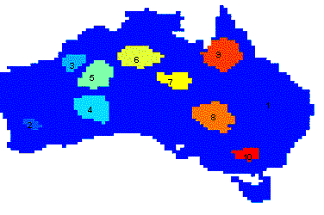
Applications of Cluster Analysis
Understanding
  Group related documents for browsing, group genes and proteins that have similar functionality, or group stocks with similar price fluctuations
Summarization
  Reduce the size of large data sets to a small number of groups.
Clustering precipitation in Australia

Slide 6
Measuring Similarity/Distances
How do we measure
similarity/dissimilarity/distance/proximity?
Examples
  Minkovsky distance: Manhattan distance, Euclidean Distance, etc.
  Jaccard index for binary data.
  Cosine similarity for word counts.
  Gower's distance for mixed data (ratio/interval and nominal).
  Correlation coefficient as similarity between variables.
See Chapter 2 on Data.

Slide 7
What is not Cluster Analysis?
Supervised classification
  Uses class label information.
Simple segmentation
  Dividing students into different registration groups alphabetically, by last name.
Results of a query
  Groupings are a result of an external specification.
→ Clustering uses only the data

Slide 8

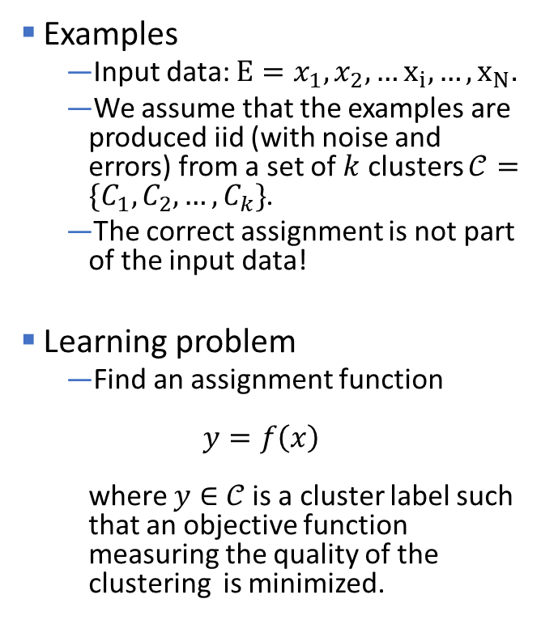



Clustering as Unsupervised Learning
Examples
  Input data: $E=x_{1},x_{2},…x_{i}, …, x_{N}.$
  We assume that the examples are produced iid (with noise and errors) from a set of $k$ clusters $𝒞=\{C_{1},C_{2},…, C_{k}\}$.
  The correct assignment is not part of the input data!
Learning problem
  Find an assignment function
  $y=f\left(x\right)$
  where $y∈$ $𝒞$ is a cluster label such that an objective function measuring the quality of the clustering is minimized.
Example
$$k = 3$$
$$C_{1}$$
$$C_{2}$$
$$C_{3}$$

Slide 9
Notion of a Cluster can be Ambiguous
How many clusters?

Slide 10
Notion of a Cluster can be Ambiguous
How many clusters?
Six Clusters
Two Clusters
Four Clusters

Slide 11
Topics
Introduction
Types of Clustering
Types of Clusters
Clustering Algorithms
  K-Means Clustering
  Hierarchical Clustering
  Density-based Clustering
Cluster Evaluation

Slide 12
Types of Clusterings
Partitional Clustering
A division data objects into non-overlapping subsets (clusters) such that each data object is in exactly one subset
Hierarchical clustering
A set of nested clusters organized as a hierarchical tree

Slide 13
Partitional Clustering
Original Points
A Partitional Clustering

Slide 14
Hierarchical Clustering

Slide 15
Other Distinctions Between Sets of Clusters
Exclusive versus non-exclusive
In non-exclusive clusterings, points may belong to multiple clusters.
Fuzzy versus non-fuzzy
In fuzzy clustering, a point belongs to every cluster with some membership weight between 0 and 1.
Membership weights must sum to 1.
Partial versus complete
In some cases, we only want to cluster some of the data.
E.g. don’t cluster outliers or noise data points.
Heterogeneous versus homogeneous
Cluster of widely different sizes, shapes, and densities
Typical clustering is: exclusive, crisp (non-fuzzy), complete, and homogeneous.

Slide 16
Topics
Introduction
Types of Clustering
Types of Clusters
Clustering Algorithms
  K-Means Clustering
  Hierarchical Clustering
  Density-based Clustering
Cluster Evaluation

Slide 17
Types of Clusters
Center-based clusters
Contiguous clusters
Density-based clusters
Conceptual clusters

Slide 18
Center-based Clusters
Not well separated
(overlapping)
Well separated
Cluster centers
A cluster is a set of objects such that an object in a cluster is closer (more similar) to the “center” of a cluster, than to the center of any other cluster
The center of a cluster is often a centroid, the average of all the points in the cluster, or a medoid, the most “representative” point of a cluster

Slide 19
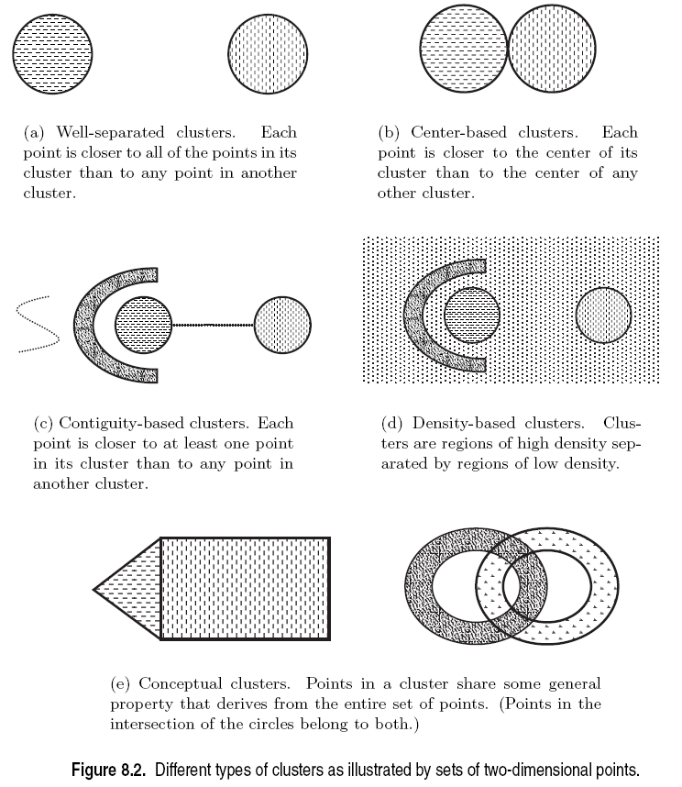
Contiguous and Density-based Clusters
High density

Slide 20
Conceptual Clusters
Conceptual clusters are hard to detect since they are often not:
  Center-based
  Contiguity-based
  Density-based

Slide 21

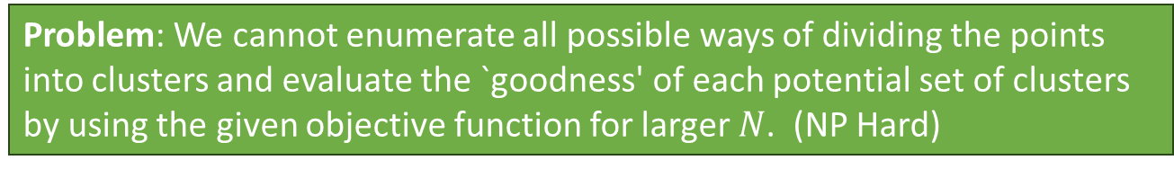
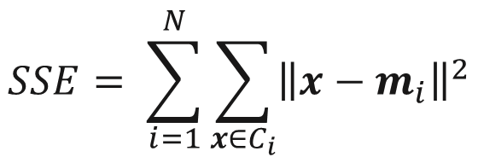
Objective Functions
The best clustering minimizes or maximizes an objective function.
Example: Minimize the Sum of Squared Errors
  $x$is a data point in cluster $C_{i}$, $m_{i}$ is the center for cluster $C_{i}$ as the mean of all points in the cluster and$\left\|⋅\right\|$ is the L2 norm (= Euclidean distance).
$$SSE= \sum_{i=1}^{N}{\sum_{x∈C_{i}}{{\left\|x−m_{i}\right\|}^{2}}}$$
Problem: We cannot enumerate all possible ways of dividing the points into clusters and evaluate the `goodness' of each potential set of clusters by using the given objective function for larger $N$. (NP Hard)

Slide 22
Objective Functions
Global objective function
Typically used in partitional clustering. k-means uses SSE.
Mixture Models assume that the data is a ‘mixture' of a number of parametric statistical distributions (e.g., a mixture of Gaussians). Maximize log-likelihood of the model.
Local objective function
Hierarchical clustering algorithms typically have local objectives.
Density-based clustering is based on local density estimates.
Graph based approaches. Graph partitioning (e.g., min-cut) and shared nearest neighbors.
We will talk about the objective functions when we talk about individual clustering algorithms.

Slide 23
Topics
Introduction
Types of Clustering
Types of Clusters
Clustering Algorithms
  K-Means Clustering
  Hierarchical Clustering
  Density-based Clustering
Cluster Evaluation

Slide 24
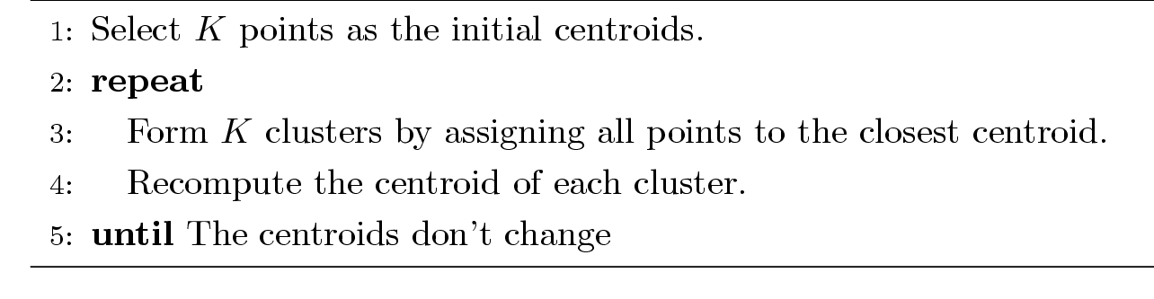
K-means Clustering
Partitional clustering approach
Each cluster is associated with a centroid (center point)
Each point is assigned to the cluster with the closest centroid
Number of clusters, K, must be specified
Lloyd’s algorithm (Voronoi iteration):

Slide 25
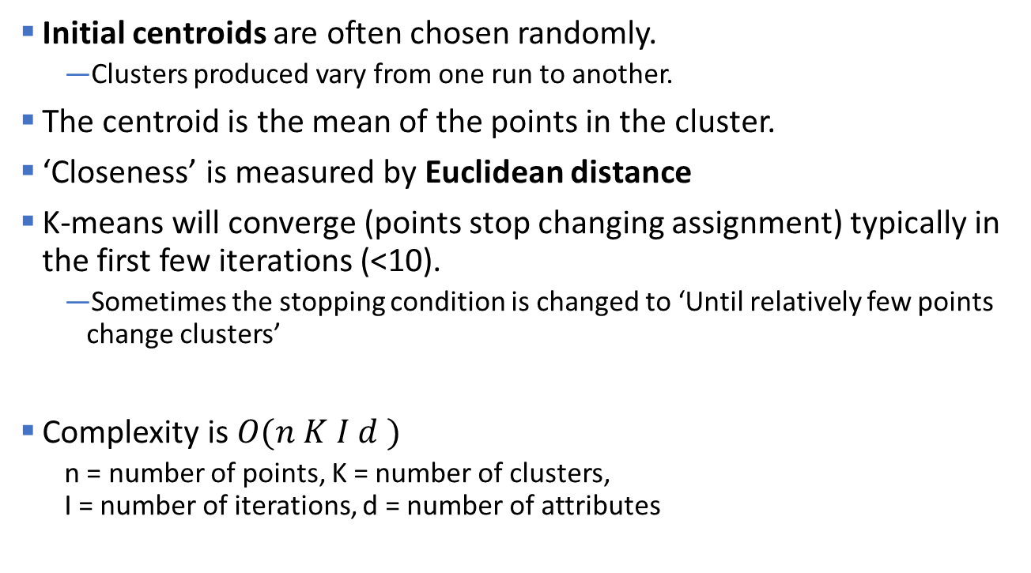
K-means Clustering – Details
Initial centroids are often chosen randomly.
  Clusters produced vary from one run to another.
The centroid is the mean of the points in the cluster.
‘Closeness’ is measured by Euclidean distance
K-means will converge (points stop changing assignment) typically in the first few iterations (<10).
  Sometimes the stopping condition is changed to ‘Until relatively few points change clusters’
Complexity is $O(n K I d )$
  n = number of points, K = number of clusters,
  I = number of iterations, d = number of attributes

Slide 26
K-Means Example
See visualization

Slide 27
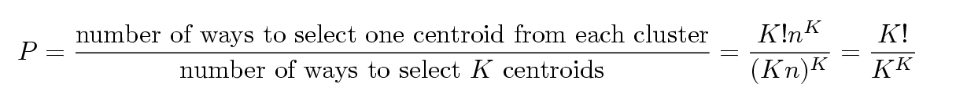
Problems with Selecting Initial Points
If there are K ‘real’ clusters then the chance of selecting one centroid from each cluster is small.
  Chance is relatively small when K is large
  If clusters are the same size, n, then
  For example, if K = 10, then probability = 10!/1010 = 0.00036
  Sometimes the initial centroids will readjust themselves in ‘right’ way, and sometimes they don’t
  Consider an example of five pairs of clusters

Slide 28
Importance of Choosing Initial Centroids …

Slide 29
Solutions to Initial Centroids Problem
Multiple runs. This is standard in most tools and typically helps.
Sample and use hierarchical clustering to determine initial centroids.
Select more than k initial centroids and then select among these initial centroids the ones that are far away from each other.

Slide 30
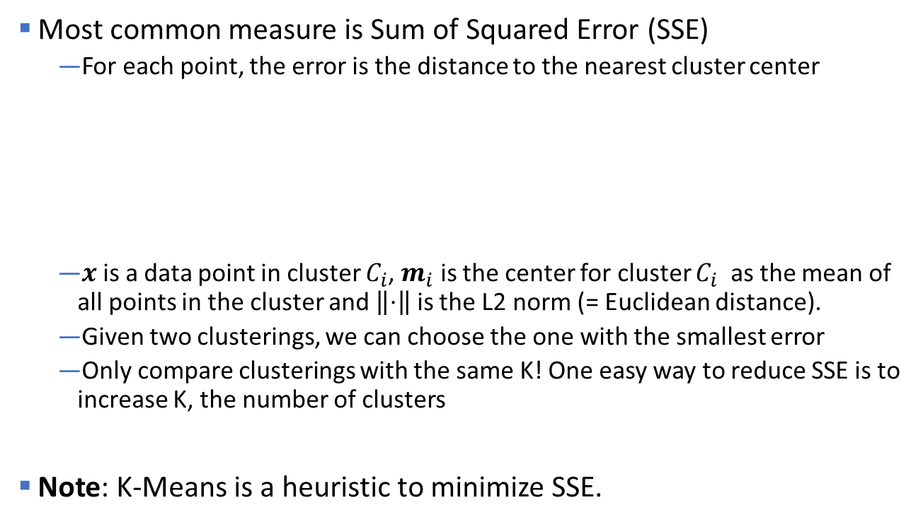
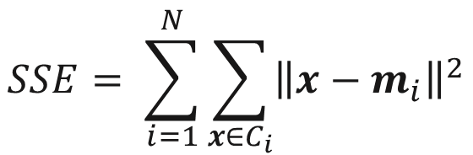
Evaluating K-means Clusters
Most common measure is Sum of Squared Error (SSE)
  For each point, the error is the distance to the nearest cluster center
  $x$is a data point in cluster $C_{i}$, $m_{i}$ is the center for cluster $C_{i}$ as the mean of all points in the cluster and $\left\|⋅\right\|$is the L2 norm (= Euclidean distance).
  Given two clusterings, we can choose the one with the smallest error
  Only compare clusterings with the same K! One easy way to reduce SSE is to increase K, the number of clusters
Note: K-Means is a heuristic to minimize SSE.
$$SSE= \sum_{i=1}^{N}{\sum_{x∈C_{i}}{{\left\|x−m_{i}\right\|}^{2}}}$$

Slide 31
Pre-processing and Post-processing
Pre-processing
  Normalize the data (e.g., scale to unit standard deviation)
  Eliminate outliers
Post-processing
  Eliminate small clusters that may represent outliers
  Split ‘loose’ clusters, i.e., clusters with relatively high SSE
  Merge clusters that are ‘close’ and that have relatively low SSE

Slide 32
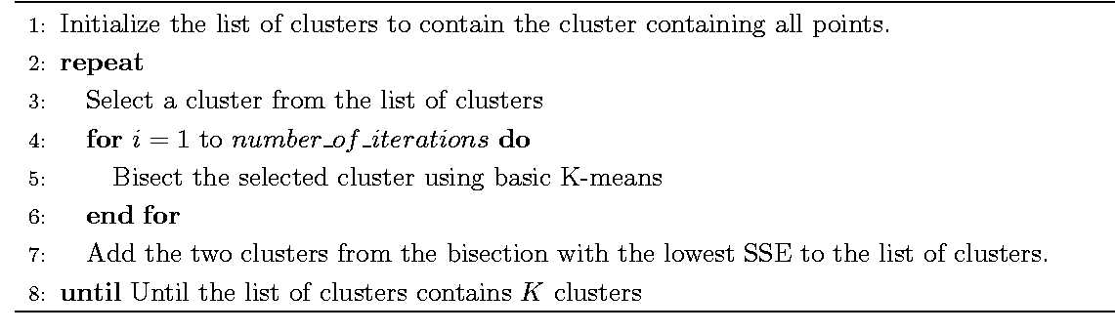
Bisecting K-means
Variant of K-means that can produce a partitional or a hierarchical clustering

Slide 33
Limitations of K-means
K-means has problems when clusters are of differing
  Sizes
  Densities
  Non-globular shapes
K-means has problems when the data contains outliers.

Slide 34
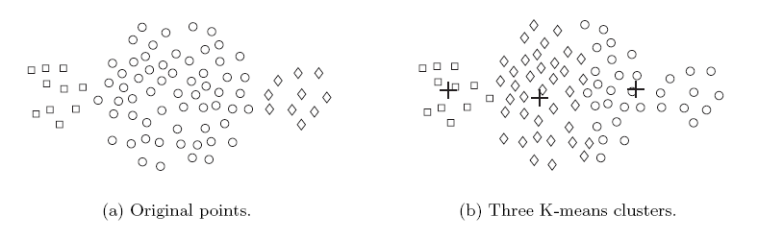
Limitations of K-means: Differing Sizes

Slide 35
Limitations of K-means: Differing Density

Slide 36
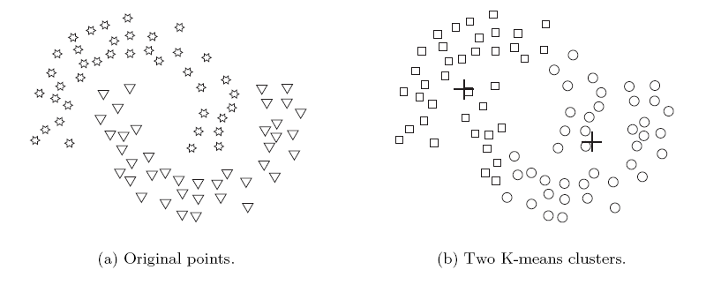
Limitations of K-means: Non-globular Shapes

Slide 37
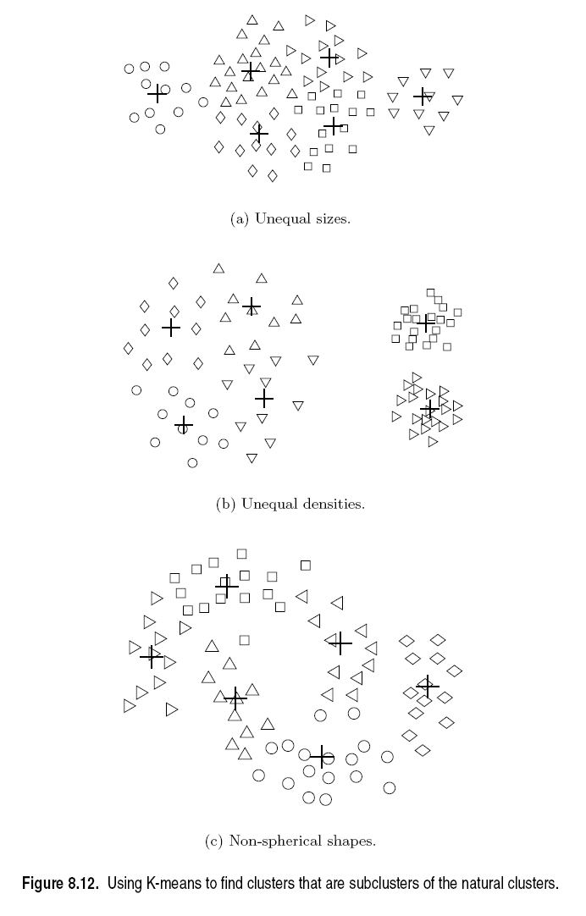
Overcoming K-means Limitations
Use a larger
number of clusters
Several clusters
represent a true
cluster

Slide 38
Overcoming K-means Limitations
Use a larger
number of clusters
Several clusters
represent a true
cluster

Slide 39
Topics
Introduction
Types of Clustering
Types of Clusters
Clustering Algorithms
  K-Means Clustering
  Hierarchical Clustering
  Density-based Clustering
Cluster Evaluation

Slide 40
Hierarchical Clustering
Produces a set of nested clusters organized as a hierarchical tree called a dendrogram. The dendrogram shows at what distance points join into a cluster.
Dendrogram
distance
0.2
0.15
0.1
0.05
0
1
3
2
5
4
6
Data points

Slide 41
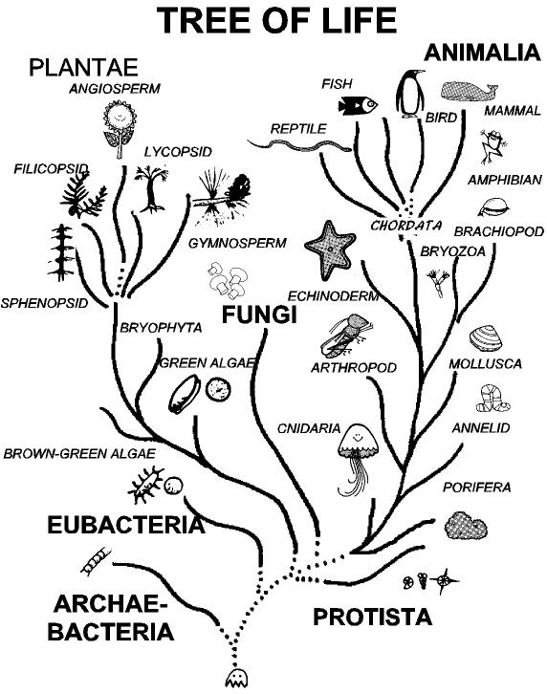
Strengths of Hierarchical Clustering
You do not have to assume any particular number of clusters
  Any desired number of clusters can be obtained by ‘cutting’ the dendogram at the proper level.
They may correspond to meaningful taxonomies
  Example in biological sciences (e.g., animal kingdom, phylogeny reconstruction, …)

Slide 42
Hierarchical Clustering
Two main types of hierarchical clustering
  Agglomerative:
    Start with the points as individual clusters
    At each step, merge the closest pair of clusters until only one cluster (or k clusters) left
  Divisive:
    Start with one, all-inclusive cluster
    At each step, split a cluster until each cluster contains a point (or there are k clusters)
Traditional hierarchical algorithms
  use a similarity or distance matrix
  merge or split one cluster at a time

Slide 43
Agglomerative Clustering Algorithm
Agglomerative approach is more popular.
Basic algorithm is straightforward
    Compute the proximity matrix
    Let each data point be a cluster
    Repeat
    Merge the two closest clusters
    Update the proximity matrix
    Until only a single cluster remains
A key operation is to compute the proximity between two clusters.

Slide 44
Starting Situation
Start with clusters of individual points and a proximity matrix
p1
p2
p3
p4
p5
. . .
y
p1
p2
p3
p4
p5
.
.
.
Proximity Matrix
...
x
Dendrogram

Slide 45
Intermediate Situation
C1
C2
C3
C4
C5
After some merging steps, we have some clusters
C1
y
C2
C3
C3
C4
C4
C5
Proximity Matrix
C1
C2
C5
...
x
C2 C5 C3
Dendrogram

Slide 46
Intermediate Situation
We want to merge the two closest clusters (C2 and C5) and update the proximity matrix.
C1
C2
C3
C4
C5
C1
y
C2
C3
C3
C4
C4
C5
Proximity Matrix
C1
C2
C5
...
...
x
C2 C5 C3
Dendrogram

Slide 47
After Merging
C2 U C5
The question is “How do we update the proximity matrix?”
C1
C3
C4
y
C1
?
C2 U C5
? ? ? ?
C3
C3
?
C4
C4
?
Proximity Matrix
C1
C2 U C5
...
...
x
C2 C5 C3
Dendrogram

Slide 48
How to Define Inter-Cluster Similarity
p1
p2
p3
p4
p5
. . .
p1
Similarity?
p2
p3
p4
p5
.
.
.
MIN
MAX
Group Average
Distance Between Centroids
Other methods driven by an objective function
  Ward’s Method uses squared error
Proximity Matrix

Slide 49
How to Define Inter-Cluster Similarity
p1
p2
p3
p4
p5
. . .
p1
p2
p3
p4
p5
MIN (Single Link)
MAX (Complete Link)
Group Average
Distance Between Centroids
Other methods driven by an objective function
  Ward’s Method uses squared error
.
.
.
Proximity Matrix

Slide 50
How to Define Inter-Cluster Similarity
p1
p2
p3
p4
p5
. . .
p1
p2
p3
p4
p5
MIN (Single Link)
MAX (Complete Link)
Group Average
Distance Between Centroids
Other methods driven by an objective function
  Ward’s Method uses squared error
.
.
.
Proximity Matrix

Slide 51
How to Define Inter-Cluster Similarity
p1
p2
p3
p4
p5
. . .
p1
p2
p3
p4
p5
MIN (Single Link)
MAX (Complete Link)
Group Average (Average Link)
Distance Between Centroids
Other methods driven by an objective function
  Ward’s Method uses squared error
.
.
.
Proximity Matrix

Slide 52
How to Define Inter-Cluster Similarity
p1
p2
p3
p4
p5
. . .
p1
×
×
p2
p3
p4
p5
.
.
.
MIN (Single Link)
MAX (Complete Link)
Group Average
Distance Between Centroids
Other methods driven by an objective function
  Ward’s Method uses squared error
Proximity Matrix

Slide 53
Single Link
Advantage: Non-spherical, non-convex clusters
Problem: Chaining

Slide 54
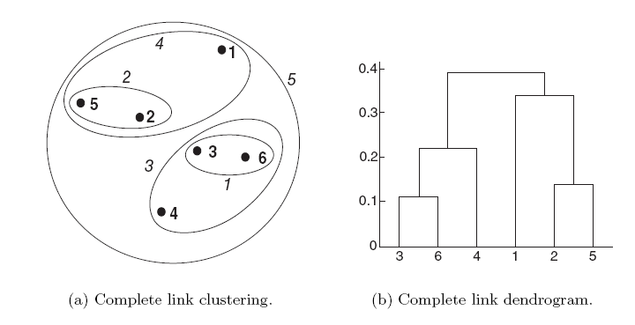
Complete Link
Advantage: more robust against noise (no chaining)
Problem: Tends to break large clusters,
Biased towards globular clusters

Slide 55
Average Link
Compromise between Single and Complete Link

Slide 56
Cluster Similarity: Ward’s Method
Similarity of two clusters is based on the increase in squared error when two clusters are merged.
Less susceptible to noise and outliers.
Biased towards globular clusters.
Hierarchical analogue of K-means.

Slide 57
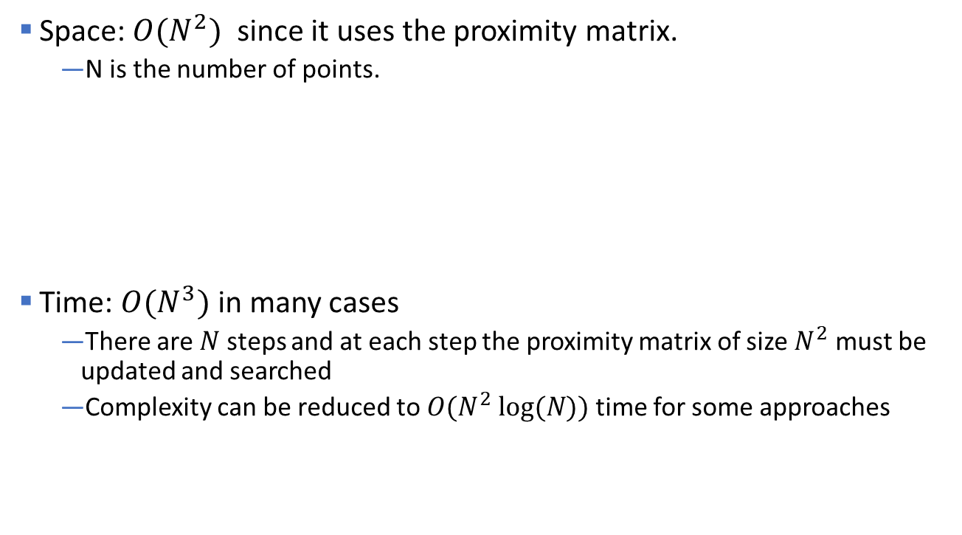
Hierarchical Clustering: Complexity
Space: $O(N^{2})$ since it uses the proximity matrix.
  N is the number of points.
Time: $O(N^{3})$in many cases
  There are$N$steps and at each step the proximity matrix of size $N^{2}$ must be updated and searched
  Complexity can be reduced to $O(N^{2} log⁡(N))$time for some approaches
This restricts the number of points that can be clustered!

Slide 58
Hierarchical Clustering: Limitations
Greedy: Once a decision is made to combine two clusters, it cannot be undone
No global objective function is directly minimized
Different schemes have problems with one or more of the following:
  Sensitivity to noise and outliers
  Difficulty handling different sized clusters and convex shapes
  Chaining, breaking large clusters

Slide 59
Topics
Introduction
Types of Clustering
Types of Clusters
Clustering Algorithms
  K-Means Clustering
  Hierarchical Clustering
  Density-based Clustering
Cluster Evaluation

Slide 60
Density-Based Spatial Clustering of Applications with Noise (DBSCAN)
Measures density around a point as the number of points within a specified radius eps called the eps-neighborhood.
density = 7 points

Slide 61
DBSCAN
Classifies points by the density of their eps-neighborhood:
A point is a core point if it has more than a specified number of points (MinPts) within Eps. These are points that form the interior of a cluster.
A border point has fewer than MinPts within Eps, but is in the neighborhood of a core point
A noise point is any point that is not a core point or a border point.
MinPts = 5

Slide 62
DBSCAN Algorithm
DBSCAN(D, eps, MinPts)
C = 0
for each unvisited point P in dataset D
mark P as visited
NeighborPts = regionQuery(P, eps)
if sizeof(NeighborPts) < MinPts
mark P as NOISE
else
C = next cluster
expandCluster(P, NeighborPts, C, eps, MinPts)
expandCluster(P, NeighborPts, C, eps, MinPts)
add P to cluster C
for each point P' in NeighborPts
if P' is not visited
mark P' as visited
NeighborPts' = regionQuery(P', eps)
if sizeof(NeighborPts') >= MinPts
NeighborPts = NeighborPts joined with NeighborPts'
if P' is not yet member of any cluster
add P' to cluster C

Slide 63
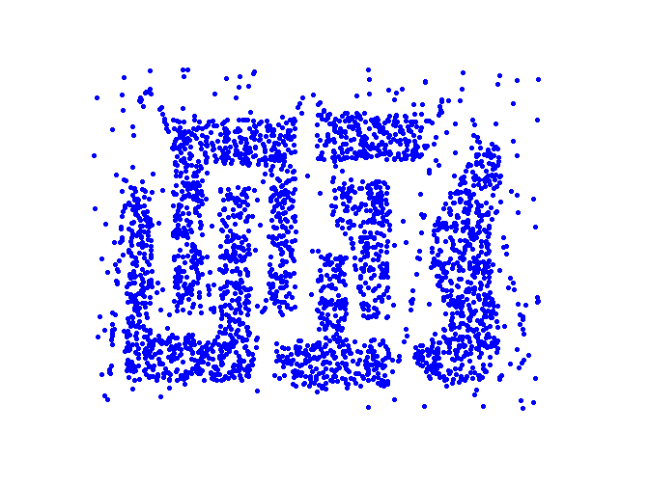
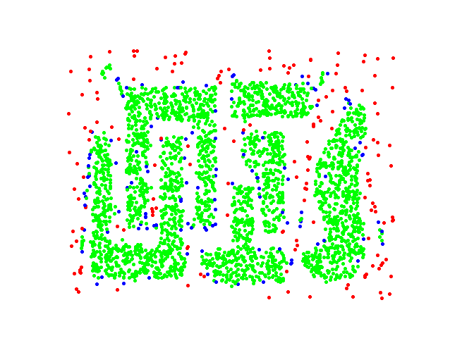
DBSCAN: Core, Border and Noise Points
Original Points
Point types: core, border and noise
Eps = 10, MinPts = 4

Slide 64
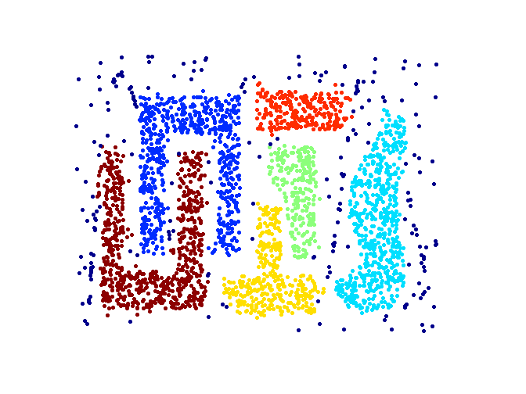
DBSCAN: Determine Clusters
Point types: core, border and noise
Clusters
Resistant to Noise
Can handle clusters of different shapes and sizes
Eps and MinPts depend on each other and can be hard to specify

Slide 65
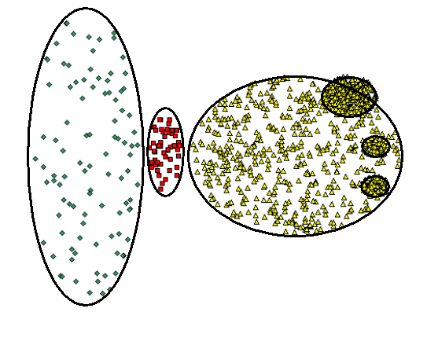
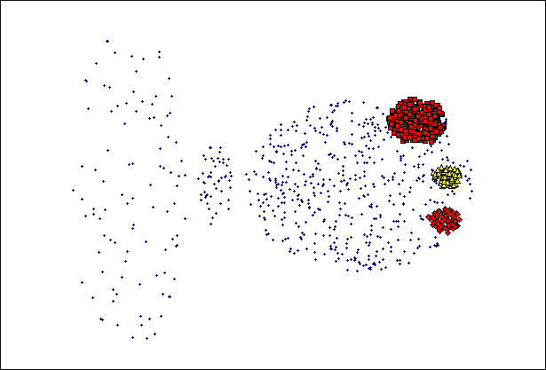
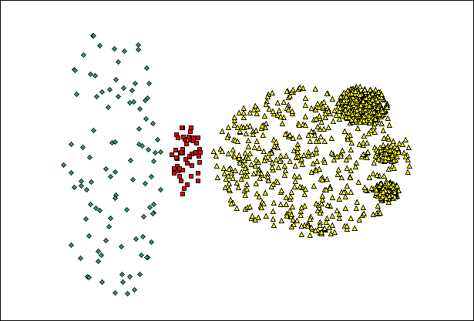
When DBSCAN Does NOT Work Well
(MinPts=4, Eps=9.75).
Original Points
Varying densities
High-dimensional data
(MinPts=4, Eps=9.92)

Slide 66
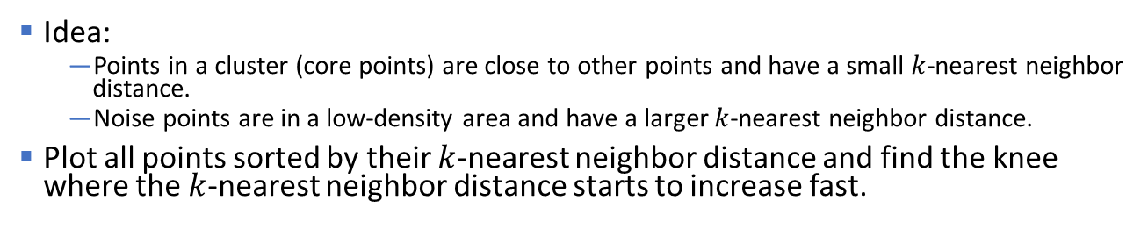


DBSCAN: Determining EPS and MinPts
Idea:
  Points in a cluster (core points) are close to other points and have a small $k$-nearest neighbor distance.
  Noise points are in a low-density area and have a larger $k$-nearest neighbor distance.
Plot all points sorted by their $k$-nearest neighbor distance and find the knee where the $k$-nearest neighbor distance starts to increase fast.
$$k=MinPts −1$$
$$Eps$$
Core Points

Slide 67
Topics
Introduction
Types of Clustering
Types of Clusters
Clustering Algorithms
  K-Means Clustering
  Hierarchical Clustering
  Density-based Clustering
  Other Methods
Cluster Evaluation

Slide 68
Some Other Clustering Algorithms
Center-based Clustering
  Fuzzy c-means
  PAM (Partitioning Around Medoids)
Mixture Models
  Expectation-maximization (EM) algorithm
Hierarchical
  CURE (Clustering Using Representatives): shrinks points toward center
  BIRCH (balanced iterative reducing and clustering using hierarchies)
Graph-based Clustering
  Graph partitioning on a sparsified proximity graph
  Shared nearest-neighbor (SNN graph)
Spectral Clustering
  Reduce the dimensionality using the spectrum of the similarity, and cluster in this space.
Subspace Clustering
Data Stream Clustering

Slide 69
Topics
Introduction
Types of Clustering
Types of Clusters
Clustering Algorithms
  K-Means Clustering
  Hierarchical Clustering
  Density-based Clustering
Cluster Evaluation

Slide 70
Cluster Evaluation
For supervised classification (= we have a class label) we have a variety of measures to evaluate how good our model is:
Accuracy, error rate, loss, precision, recall,…
For cluster analysis (=unsupervised learning), the analogous question is:
How to evaluate the “goodness” of the resulting clusters?

Slide 71
Clusters found in Random Data (Overfitting)
Random Points
DBSCAN
K-means
Complete Link
If you tell a clustering algorithm to find clusters then it will!

Slide 72
Different Aspects of Cluster Evaluation
Determining the clustering tendency of a set of data, i.e., distinguishing whether a non-random structure actually exists in the data (e.g., to avoid overfitting).
Supervised Evaluation: Compare the results of a cluster analysis to externally known group labels (ground truth).
Unsupervised Evaluation: Evaluate how well the results of a cluster analysis fit the data without reference to external group information.
Compare different clusterings to determine which one is better.
Determining the ‘correct’ number of clusters.
For 2, 3, and 4, we can further distinguish whether we want to evaluate the entire clustering or just individual clusters.

Slide 73
Measures for Cluster Evaluation
Numerical measures that are applied to judge various aspects of cluster quality, are classified into the following three types.
Internal Index (unsupervised evaluation): Used to measure the goodness of a clustering structure without respect to external information.
  E.g.: Sum of Squared Error (SSE), Silhouette coefficient, Correlation between proximity and incidence matrix
External Index (supervised evaluation): Used to measure the extent to which cluster labels match externally supplied group labels.
  E.g., Entropy, Purity, Rand index, …
Relative Index: Used to compare two different clusterings or clusters.
  Often an external or internal index is used for this function, e.g., SSE or entropy

Slide 74
Measures for Cluster Evaluation
Numerical measures that are applied to judge various aspects of cluster quality, are classified into the following three types.
Internal Index (unsupervised evaluation): Used to measure the goodness of a clustering structure without respect to external information.
  E.g.: Sum of Squared Error (SSE), Silhouette coefficient
External Index (supervised evaluation): Used to measure the extent to which cluster labels match externally supplied group labels.
  E.g., Entropy, Purity, Rand index, …
Relative Index: Used to compare two different clusterings or clusters.
  Often an external or internal index is used for this function, e.g., SSE or entropy

Slide 75
Visual Method: Similarity Matrix Visualization
Order the similarity matrix with respect to cluster labels and inspect visually.
Clustered Data
Reordered Similarity Matrix
Clusters appear as crisp squares

Slide 76
Visual Method: Similarity Matrix Visualization
Random data
DBSCAN
No crisp clusters!
k-means
Complete L. HC

Slide 77
Framework for Cluster Validity
Need a framework to interpret any measure.
  For example, if our measure of evaluation has the value, 10, is that good, fair, or poor?
Statistics provide a framework for cluster validity
  The more “atypical” a clustering result is, the more likely it represents valid structure in the data
  Can compare the values of an index that result from random data or clusterings to those of a clustering result.
    If the value of the index is unlikely, then the cluster results are valid
  These approaches are more complicated and harder to understand.
For comparing the results of two different sets of cluster analyses, a framework is less necessary.
  However, there is the question of whether the difference between two index values is significant

Slide 78
Statistical Framework for SSE
Example
  Compare SSE of 0.005 against three clusters in random data
  Histogram shows SSE of three clusters in 500 sets of random data points of size 100 distributed over the range 0.2 – 0.8 for x and y values

Slide 79
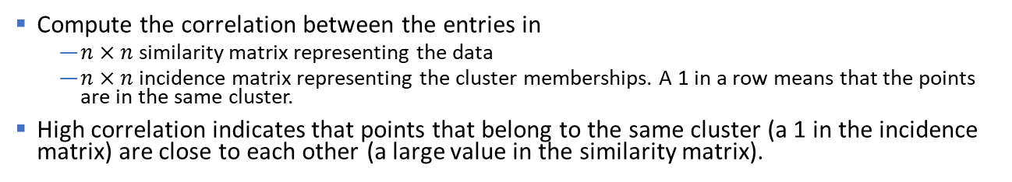
Correlation between Distances and Incidence Matrix
Compute the correlation between the entries in
  $n×n$ similarity matrix representing the data
  $n×n$ incidence matrix representing the cluster memberships. A 1 in a row means that the points are in the same cluster.
High correlation indicates that points that belong to the same cluster (a 1 in the incidence matrix) are close to each other (a large value in the similarity matrix).
Good Cluster Structure
Random Data
Corr = 0.9235
Corr = 0.5810

Slide 80
Internal Index: Cohesion and Separation
Several indices are based on the concept of cohesion and separation.
Cluster Cohesion: Measures how closely related objects in a cluster are.
Cluster Separation: Measure how distinct or well-separated a cluster is from other clusters.
cohesion
separation

Slide 81


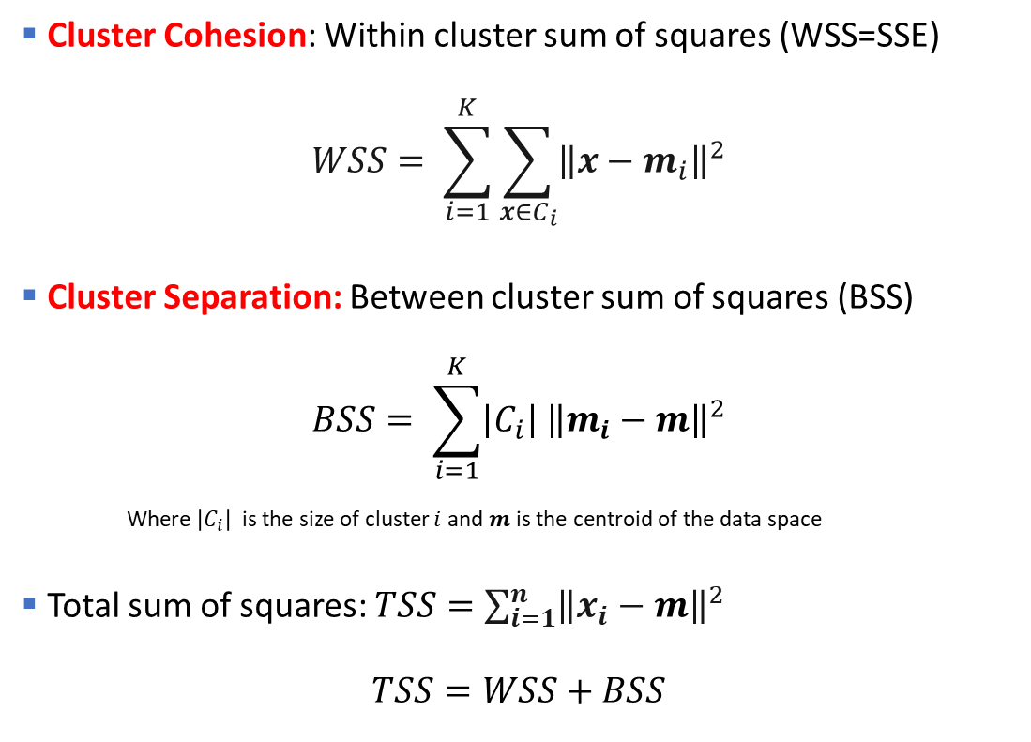








Internal Index: Sum of Squared Errors
$$C_{i}$$
Cluster Cohesion: Within cluster sum of squares (WSS=SSE)
$$WSS= \sum_{i=1}^{K}{\sum_{x∈C_{i}}{{\left\|x−m_{i}\right\|}^{2}}}$$
Cluster Separation: Between cluster sum of squares (BSS)
$$BSS= \sum_{i=1}^{K}{\left|C_{i}\right|{ \left\|m_{i}−m\right\|}^{2}}$$
    Where $\left|C_{i}\right|$ is the size of cluster $i$ and $m$is the centroid of the data space
Total sum of squares: $TSS=\sum_{i=1}^{n}{{\left\|x_{i}−m\right\|}^{2}}$
$$TSS=WSS+BSS$$
$$m_{i}$$
$$C_{2}$$
$$m_{2}$$
$$C_{1}$$
$$m$$
+
$$m_{1}$$
$$C_{3}$$
$$m_{3}$$
$$m$$
+

Slide 82
Internal Index: Sum of Squared Errors
TSS = BSS + WSS = constant for a given data set
m=m₁
×
K=1 cluster:
1
2
3
4
5
K=2 clusters:
×
m
×
1
m₁
2
3
4
m₂
5

Slide 83
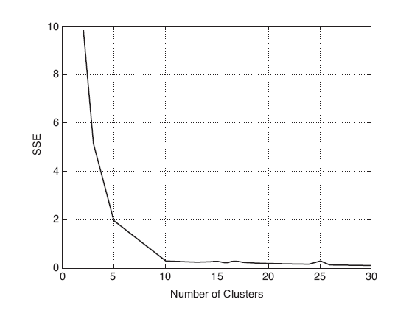
Choosing k with the Sum of Squared Errors
The SSE is good for comparing two different clusterings with the same number of clusters. E.g., several random restarts of k-means.
We cannot directly compare the SSE between clusterings with different k. As k goes up, SSE tends to go down.
We can also be used to estimate the number of clusters using the “knee” method.
Used data has 10 clusters
Look for
the knee
y
x

Slide 84
Similarity-Graph Based Internal Index
A proximity graph-based approach can also be used for cohesion and separation. The edges in the graph represent similarities.
Cluster cohesion is the sum of the similarities of all links within a cluster.
Cluster separation is the sum of the similarities between nodes in the cluster and nodes outside the cluster.
cohesion
separation

Slide 85


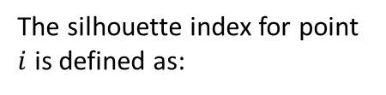
Internal Index: Silhouette Coefficient
The silhouette applies the similarity-graph based index to individual points. For an individual point $i$:
  Calculate $a(i)$= average dissimilarity of $i$ to all other points in its cluster
  Calculate $b(i)$ = lowest average dissimilarity of $i$ to any other)
The closer to 1, the better.
We can calculate the Average Silhouette Width (ASW) for a cluster or a clustering.
The silhouette index for point $i$ is defined as:
a(i)
i
b(i)
Range:
Cohersion
Separation

Slide 86
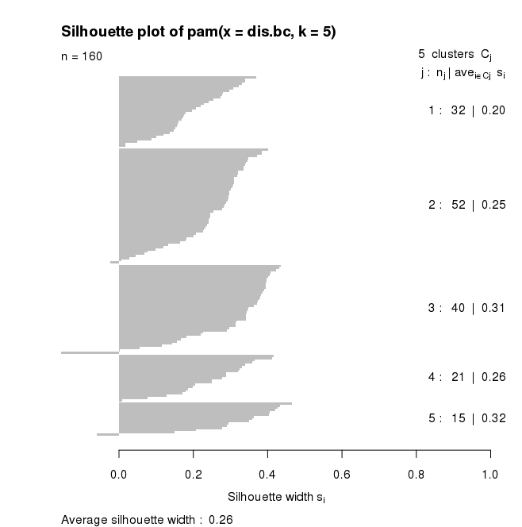
Internal Index: Silhouette Plot
Large, positive silhouettes represent good clusters

Slide 87
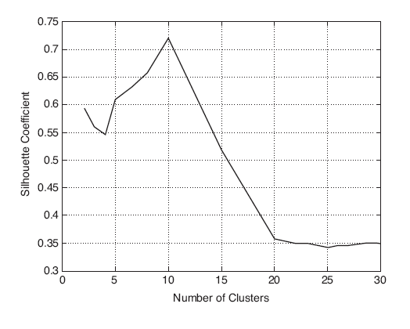
Choosing k using the Average Silhouette Width
Calculate the ASW for different values of k and choose the k with the maximum ASW (also called silhouette coefficient).
Used data has 10 clusters
y
x

Slide 88
Measures for Cluster Evaluation
Numerical measures that are applied to judge various aspects of cluster quality, are classified into the following three types.
Internal Index (unsupervised evaluation): Used to measure the goodness of a clustering structure without respect to external information.
  E.g.: Sum of Squared Error (SSE), Silhouette coefficient, Correlation between proximity and incidence matrix
External Index (supervised evaluation): Used to measure the extent to which cluster labels match externally supplied group labels.
  E.g., Entropy, Purity, Rand index, …
Relative Index: Used to compare two different clusterings or clusters.
  Often an external or internal index is used for this function, e.g., SSE or entropy

Slide 89
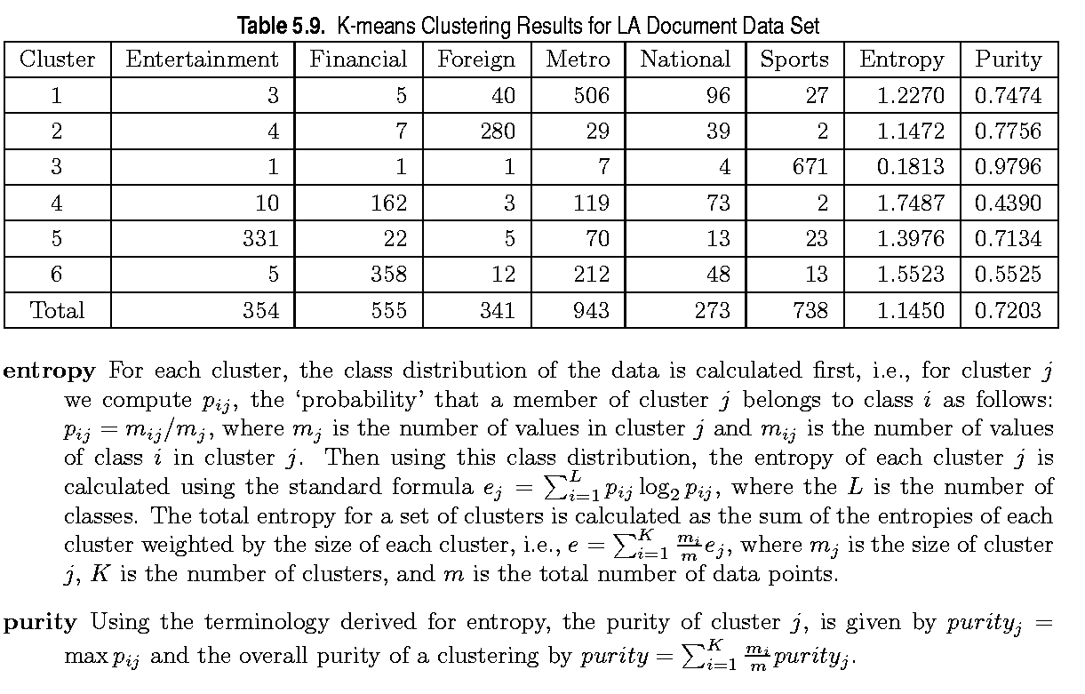
External Measures of Cluster Validity: Entropy and Purity
Other measures: Rand/ARI, variation of information (VI) index

Slide 90




Supervised Index: Purity
Purity is a measure of the extent to which clusters contain a single class.
  For each cluster, count the number of data points from the majority class.
  Sum the count over all clusters and divide by the total number of data points.
Example
$$y$$
$$C_{2}$$
male
female
 | # male | # female | # total | # majority | Purity
Cluster 1
Cluster 2
Total
$$C_{1}$$
$$x$$

Slide 91
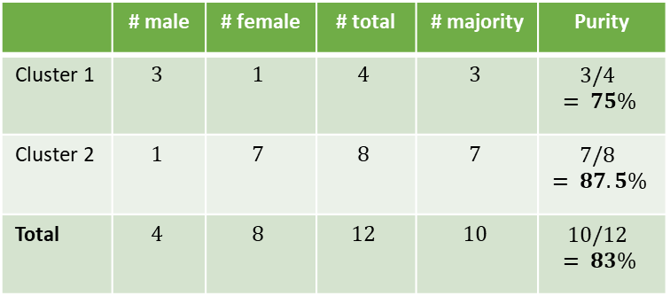
Supervised Index: Purity
Purity is a measure of the extent to which clusters contain a single class.
  For each cluster, count the number of data points from the majority class.
  Sum the count over all clusters and divide by the total number of data points.
Example
$$y$$
$$C_{2}$$
male
female
 | # male | # female | # total | # majority | Purity
Cluster 1 | $$3$$ | $$1$$ | $$4$$ | $$3$$ | $$3/4 = 75\%$$
Cluster 2 | $$1$$ | $$7$$ | $$8$$ | $$7$$ | $$7/8 = 87.5\%$$
Total | $$4$$ | $$8$$ | $$12$$ | $$10$$ | $$10/12 = 83\%$$
$$C_{1}$$
$$x$$

Slide 92
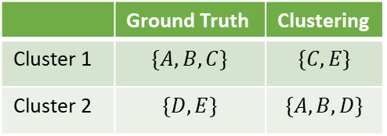
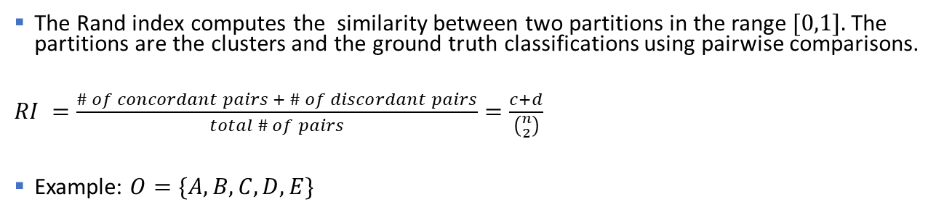


Supervised Index: Rand Index
The Rand index computes the similarity between two partitions in the range $[0,1].$The partitions are the clusters and the ground truth classifications using pairwise comparisons.
$RI =\frac{\# of concordant pairs + \# of discordant pairs}{total \# of pairs}=\frac{c+d}{\left({n \atop 2}\right)}$
Example: $O=\{A,B,C,D,E\}$
Concordant = objects are in both in the same cluster
Discordant = objects are in a different cluster
Pairs:
$$c = ?$$
$d = ?$
 | Ground Truth | Clustering
Cluster 1 | $$\{A,B,C\}$$ | $$\{C,E\}$$
Cluster 2 | $$\{D, E\}$$ | $$\{A,B,D\}$$
$$RI = ?$$
Adjusted Rand: corrected for agreement by chance.

Slide 93



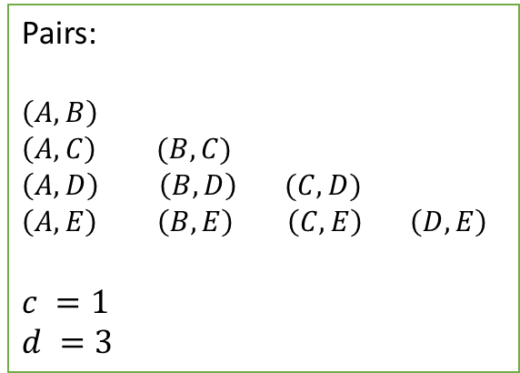
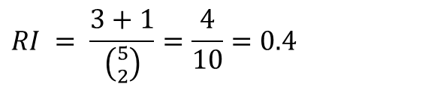

Supervised Index: Rand Index
The Rand index computes the similarity between two partitions in the range $[0,1].$The partitions are the clusters and the ground truth classifications using pairwise comparisons.
$RI =\frac{\# of concordant pairs + \# of discordant pairs}{total \# of pairs}=\frac{c+d}{\left({n \atop 2}\right)}$
Example: $O=\{A,B,C,D,E\}$
Concordant = objects are in both in the same cluster
Discordant = objects are in a different cluster
Pairs:
$$\left(A,B\right)$$
$$\left(A,C\right) (B,C)$$
$$\left(A,D\right) \left(B,D\right) (C,D)$$
$$\left(A,E\right) \left(B,E\right) \left(C,E\right) \left(D,E\right)$$
$$c =1$$
$d =3$
 | Ground Truth | Clustering
Cluster 1 | $$\{A,B,C\}$$ | $$\{C,E\}$$
Cluster 2 | $$\{D, E\}$$ | $$\{A,B,D\}$$
$$c$$
$$d$$
$$d$$
$$d$$
$$RI = \frac{3+1}{\left({5 \atop 2}\right)}=\frac{4}{10}=0.4$$
Adjusted Rand: corrected for agreement by chance.

Slide 94
Final Comment on Cluster Evaluation
“The validation of clustering structures is the most difficult and frustrating part of cluster analysis.
Without a strong effort in this direction, cluster analysis will remain a black art accessible only to those true believers who have experience and great courage.”
Algorithms for Clustering Data, Jain and Dubes

Slide 95
Conclusion
Clustering is an important method to organize large data sets into a small number of clusters. Cluster labels can be used as features in other data mining algorithms.
Meaning is given to clusters by an expert by looking at the characteristics of the cluster (cluster profile). E.g., customers who live in urban areas and spend lots of money for Starbucks coffee.
Clustering is based on similarities/density and therefore:
  the features in your data needs to be scaled to similar ranges!
  Outliers affect complete clustering algorithms.
  Euclidean distance may not always be the right way to measure similarity.
Deciding on the number of clusters and cluster evaluation is tricky!
Data may not have a clustering tendency, but most algorithms will still return a clustering with the specified number of clusters.

