Slide 1



Reinforcement Learning
Introduction
Textbook Chapter 1
Michael Hahsler, SMU
Based on slides by Oliver Wallscheid (Paderborn University) and material by David Silver (University College London)

Slide 2
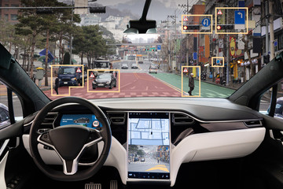
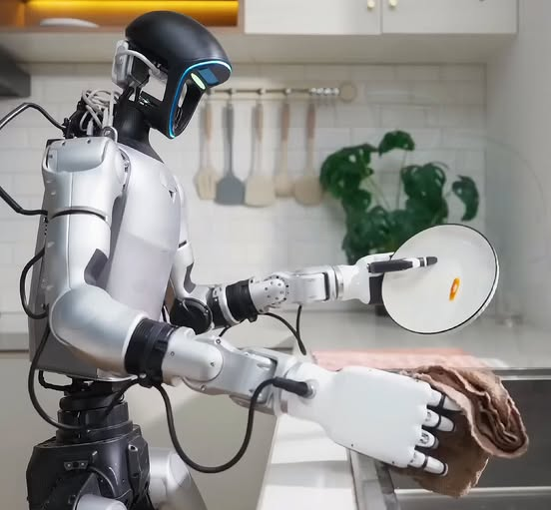
How Do We Build Intelligent Systems?
Options:
Explicitly program behavior: Rule-based agent, planning
Learn behavior from labeled data offline: Supervised learning
Learn behavior using feedback from interacting with the environment (online): Reinforcement Learning

Slide 3
Topics of this Course
Introduction to reinforcement learning
Markov decision processes
Part I: Tabular Methods
  Dynamic programming
  Monte Carlo methods
  Temporal-difference learning
  Multi-step bootstrapping
  Planning and learning with tabular methods
Part II: Approximate Solution Methods
  Prediction and Control using Approximation
  Eligibility Traces
  Policy Gradient Methods
Part III: Modern RL Methods
  Deep Reinforcement Learning
  Current Applications

Slide 4
Recommended Readings
Richard S. Sutton, Andrew G. Barto,
Reinforcement Learning: An Introduction,
2nd edition, MIT Press, Cambridge, MA, 2018.
Vincent François-Lavet, Peter Henderson, Riashat Islam, Marc G. Bellemare and Joelle Pineau,
An Introduction to Deep Reinforcement Learning,
Foundations and Trends in Machine Learning, 11:3-4, pp 219-354, 2018.

Slide 5
Table of Contents
What is RL?
Elements of RL
A small example
RL and planning

Slide 6
What is RL?

Slide 7
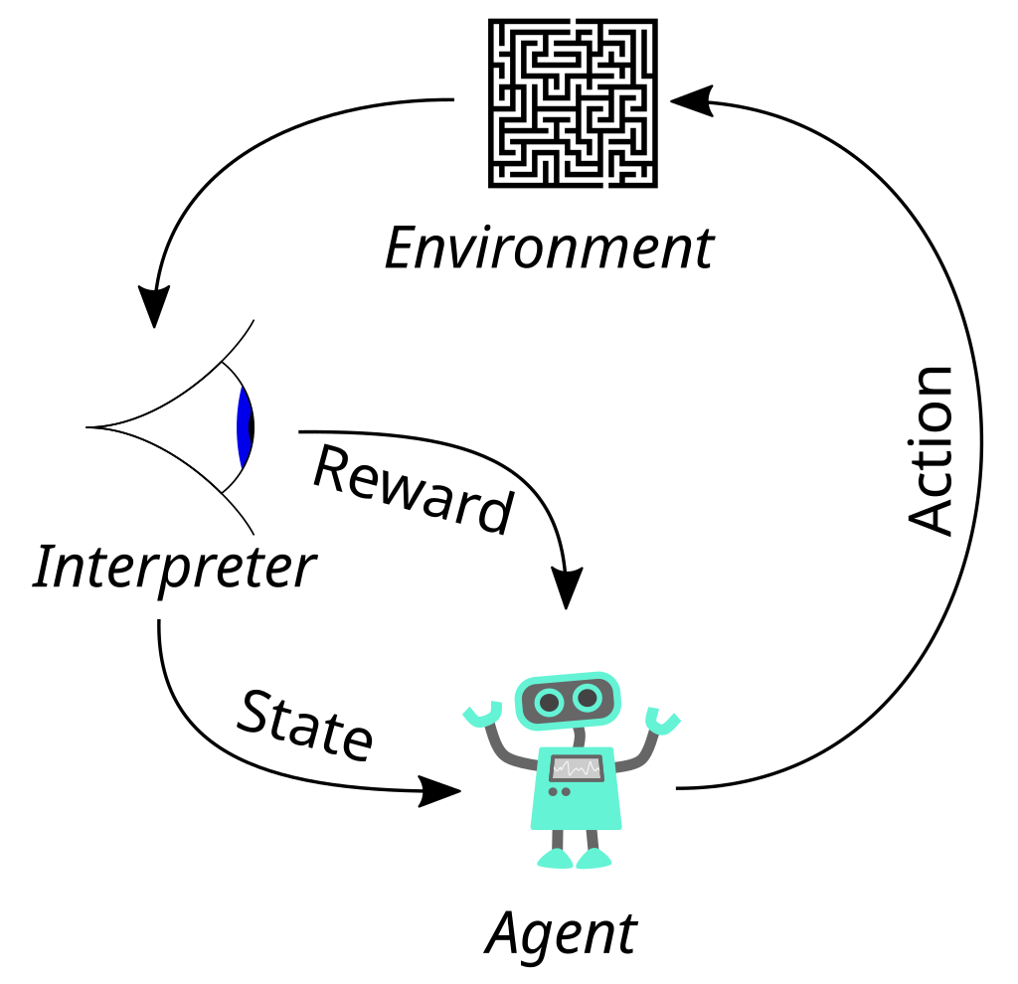



The Basic Reinforcement Learning Structure
$$a_{t}$$
Goal: Map a situation to an action to maximize the reward
Key characteristics:
Uncertainty about the environment leads to a need for sensing.
No supervisor: discover actions by trying them (data-driven)
Sequential decision making: Agent actions affect subsequent data. Agent maximizes over future (delayed) rewards which need to be estimated!
Action discovery and maximization lead to a tradeoff: exploit vs. explore
Observation
$$r_{t}$$
$$s_{t}$$
The basic RL operation principle
(derivative of www.wikipedia.org, CC0 1.0)

Slide 8
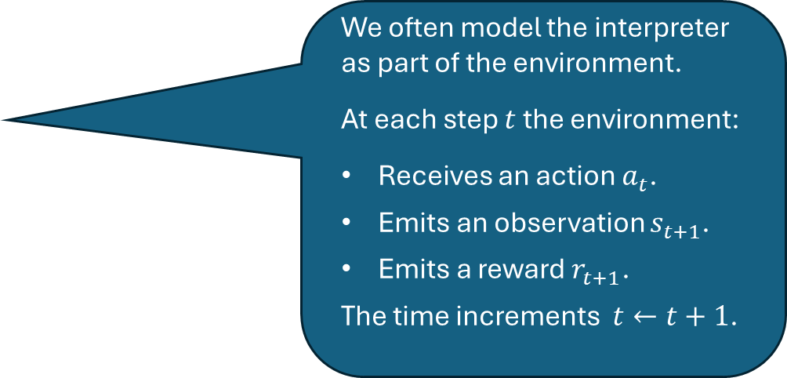

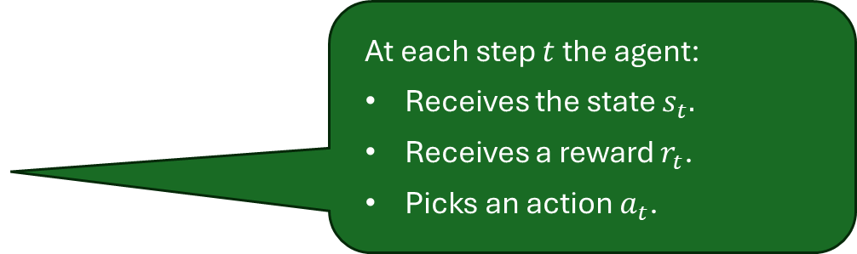


Agent and Environment
We often model the interpreter as part of the environment.
At each step $t$ the environment:
Receives an action $a_{t}$.
Emits an observation $s_{t+1}$.
Emits a reward $r_{t+1}$.
The time increments $t←t+1$.
Observation
$$a_{t}$$
$$r_{t}$$
At each step $t$ the agent:
Receives the state $s_{t}.$
Receives a reward $r_{t}$.
Picks an action $a_{t}$.
$$s_{t}$$
Remark on time: In AI, we often assume a time delay of one unit between executing the action and receiving the next state as well as the reward. This is called a discrete-time process (vs. a continuous-time process).

Slide 9






RL and Machine Learning
Machine learning is studied in AI to learn from examples.
RL is a 3rd type of machine learning
Unsupervised Learning
Process and interpret data based only
on the input
Clustering
Dimension Reduction
Supervised Learning
Develop models to map input and output data
Regression
Machine Learning
Classification
Reinforcement Learning
Learn optimal control actions to maximize long-term reward
Single-Agent
Multi-Agent

Slide 10

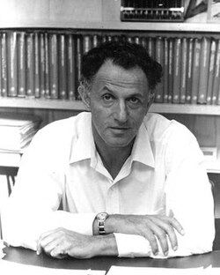






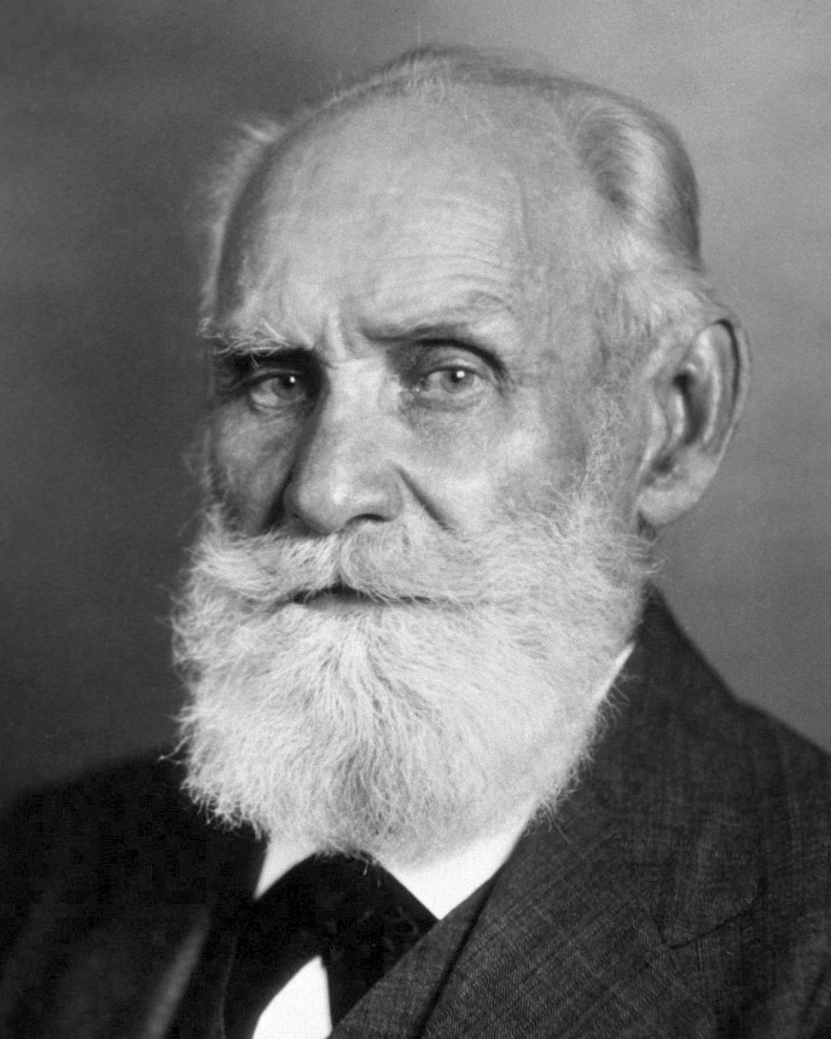
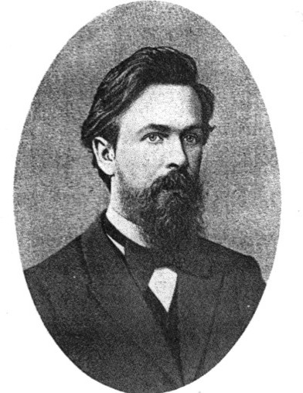
Many Faces of Reinforcement Learning
Optimal sequential
decision making
Richard E. Bellman (1920-1984)
American applied mathematician, who introduced dynamic programming and the Bellman equation. Foundation of optimal control theory.
Computer Science
Engineering
Machine Learning
Neuroscience
Optimal Control
Reward System
Classical conditioning
Reinforcement Learning
Operations Classical/Operant Research Conditioning
Bounded Rationality
Stochastic process formalism
Mathematics
Psychology
Ivan Pavlov (1849-1936)
Russian physiologist and Nobel laureate who discovered classical conditioning through his experiments with dogs.
Economics
Andrei Markov (1856-1922)
Russian mathematician developed the groundwork for Markov chains to model dynamical systems.
RL and its neighboring domains
(source: D. Silver, “Reinforcement learning”, 2015. CC BY-NC 4.0)

Slide 11
Contemporary application examples
RL has led to superhuman performance for many games and simple toy examples
Playing Atari Breakout
Play strategy board game Go at super-human performance
Simulated classic control problems
Swinging-up and balance a cart-pole / an inverted pendulum
Using RL for real applications is promising, but much more difficult. Here are some examples:
Controlling electric drive systems
Flipping pancakes with a roboter arm
Drifting with a RC-car
Driving an autonomous car
Nuclear fusion reactor plasma control
Training chat bots (like chatGPT)
...
Reasons for difficulty:
Real environments are complicated.
Sensors (observations) are noisy.
We often have partial observability.
The number of different actions can be large.
Measuring reward can be difficult.
No access to a fast, perfect simulation environment.

Slide 12
Elements of RL

Slide 13
Elements of RL
Observation
$$r_{t}$$
We will discuss:
State, Interpreter, Observations and Reward
Actions and Policy

Slide 14
Elements of RL
State, Interpreter, Observations and Reward

Slide 15


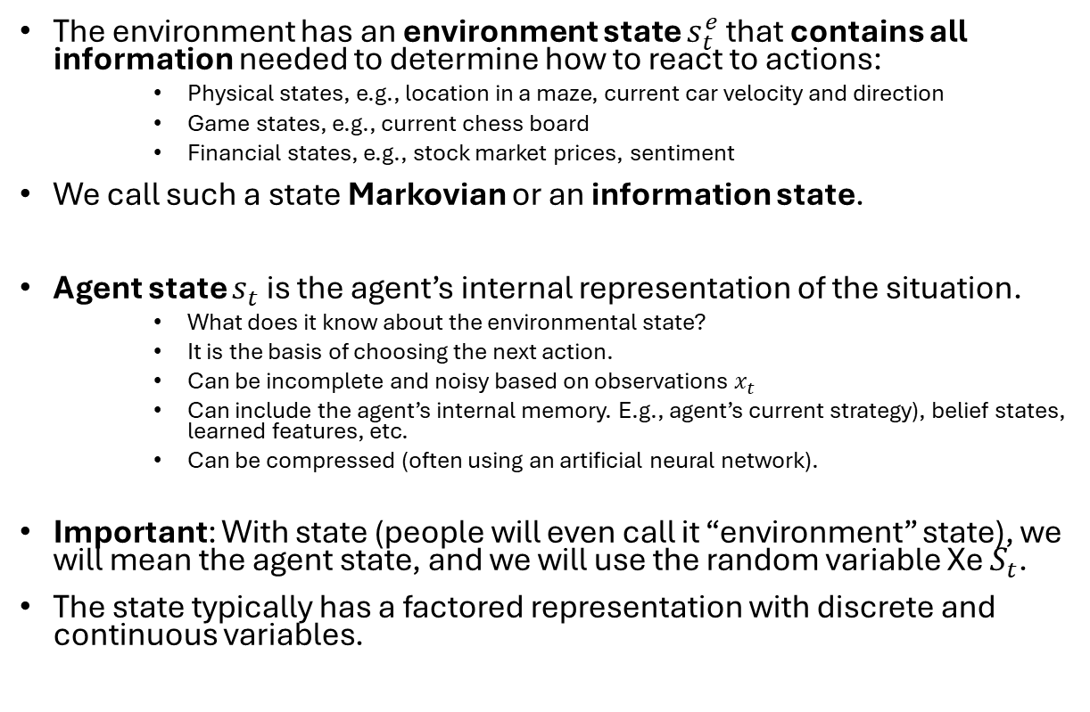


State
$s_{t}^{e}$
The environment has an environment state $s_{t}^{e}$ that contains all information needed to determine how to react to actions:
    Physical states, e.g., location in a maze, current car velocity and direction
    Game states, e.g., current chess board
    Financial states, e.g., stock market prices, sentiment
We call such a state Markovian or an information state.
Agent state $s_{t}$ is the agent’s internal representation of the situation.
    What does it know about the environmental state?
    It is the basis of choosing the next action.
    Can be incomplete and noisy based on observations $x_{t}$
    Can include the agent’s internal memory. E.g., agent’s current strategy), belief states, learned features, etc.
    Can be compressed (often using an artificial neural network).
Important: With state (people will even call it “environment” state), we will mean the agent state, and we will use the random variable Xe $S_{t}$.
The state typically has a factored representation with discrete and continuous variables.
$$a_{t}$$
Observation
$$x_{t}$$
$$r_{t}$$
$$s_{t}$$

Slide 16
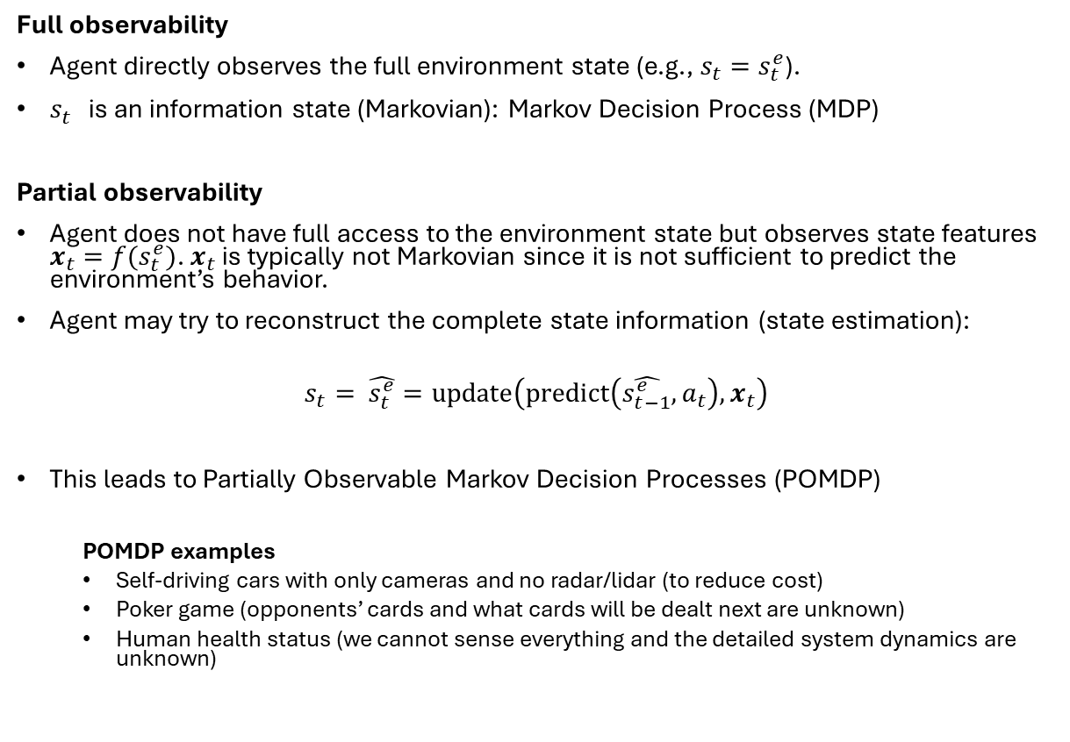

Degree of Observability
$s_{t}^{e}$
Full observability
Agent directly observes the full environment state (e.g., $s_{t}=s_{t}^{e}$).
$s_{t}^{}$ is an information state (Markovian): Markov Decision Process (MDP)
Partial observability
Agent does not have full access to the environment state but observes state features $x_{t}=f(s_{t}^{e})$. $x_{t}$ is typically not Markovian since it is not sufficient to predict the environment’s behavior.
Agent may try to reconstruct the complete state information (state estimation):
$$s_{t}= \hat{s_{t}^{e}}=\text{update}\left(\text{predict}\left(\hat{s_{t−1}^{e}},a_{t}\right), x_{t}\right)$$
This leads to Partially Observable Markov Decision Processes (POMDP)
  POMDP examples
  Self-driving cars with only cameras and no radar/lidar (to reduce cost)
  Poker game (opponents’ cards and what cards will be dealt next are unknown)
  Human health status (we cannot sense everything and the detailed system dynamics are unknown)
$$a_{t}$$
Observation
$$x_{t}$$
$$r_{t}$$
$$s_{t}$$
The agent design often includes designing the interpreter

Slide 17

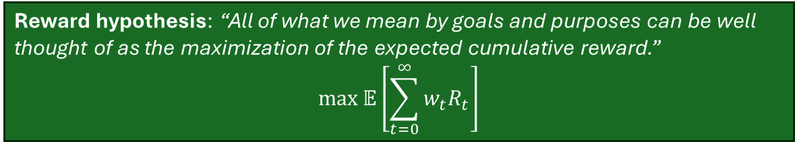

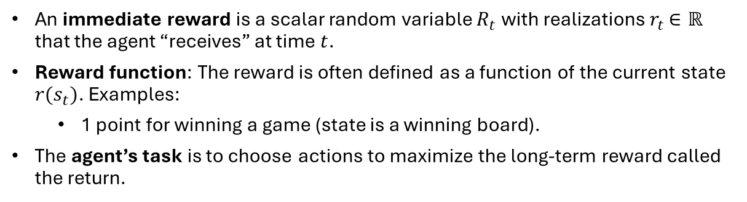




Reward
$s_{t}^{e}$
An immediate reward is a scalar random variable $R_{t}$ with realizations $r_{t}$ $∈ℝ$ that the agent “receives” at time $t$.
Reward function: The reward is often defined as a function of the current state $r(s_{t})$. Examples:
  1 point for winning a game (state is a winning board).
The agent’s task is to choose actions to maximize the long-term reward called the return.
$$a_{t}$$
Observation
$$x_{t}$$
$$r_{t}$$
Reward hypothesis: “All of what we mean by goals and purposes can be well thought of as the maximization of the expected cumulative reward.”
$$\max{𝔼\left[\sum_{t=0}^{∞}{{w_{t}R}_{t}}\right]}$$
$$s_{t}$$
The reward hypothesis is a foundational assumption of RL! The reward structure fully determines the goal.
The designer’s task is to design the reward signal so the agent can learn how to achieve the goal. This is called reward shaping. E.g., add a reward for intermediate goals, such as achieving 3 in a row in Connect-4.
The agent design often includes designing the interpreter
Note: $w_{t}$ is just a weight that depends only on $t .$

Slide 18
Reward Characteristics
Rewards are highly dependent on the given problem:
Actions may have short and long-term consequences.
  The reward for a certain action may be delayed, leading to the credit assignment problem.
  Examples: Stock trading, strategic board games,…
Rewards can be positive and negative values.
  Certain situations (e.g., car hits a wall) might lead to a negative reward (= a cost).
Exogenous impacts might introduce stochastic reward components.
  Example: A wind gust pushes an autonomous helicopter into a tree.

Slide 19
Reward Examples
Flipping a pancake:
Pos. reward: catching the flipped pancake
Neg. reward: dropping the pancake on the floor
Stock trading:
Trading portfolio monetary value
Playing Atari games:
Highscore value at the end of a game episode
Driving an autonomous car:
Pos. reward: getting safely from A to B without crashing
Neg. reward: hitting another car, pedestrian, bicycle,...
Classical control task (e.g., electric drive, inverted pendulum,...):
Pos. reward: following a given reference trajectory precisely
Neg. reward: violating a system constraint or producing a large control error

Slide 20
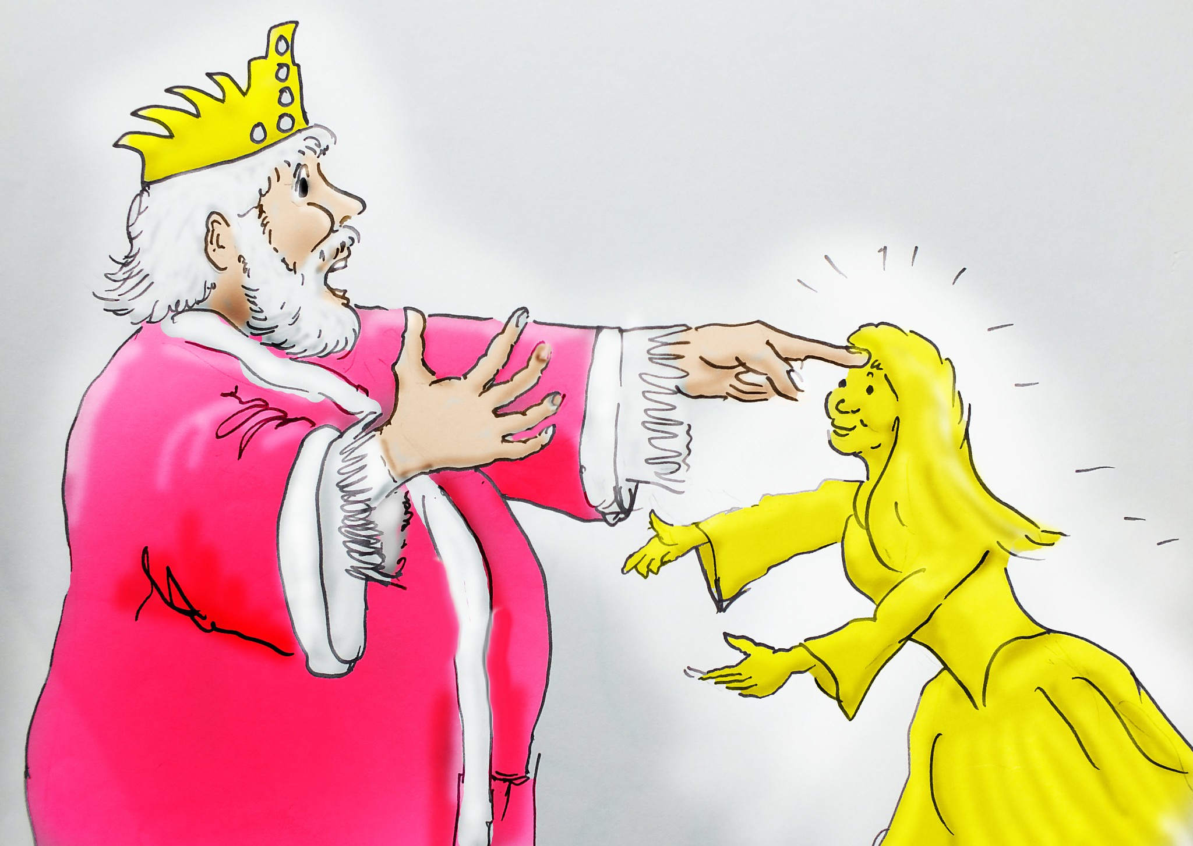
Issues With the Reward Function
“Be careful what you wish for - you might get it” (proverb)
“...it grants what you ask for, not what you should have asked for or what you intend.”
(Norbert Wiener, American mathematician)
Designing an effective reward function is crucial for successful RL applications!
It is hard to define a good reward function:
The RL agent’s learning process heavily depends on the reward distribution over time.
Alignment problem and reward hacking.
Midas and daughter (good as gold)
(source: www.flickr.com, by Robin Hutton CC BY-NC-ND 2.0)

Slide 21
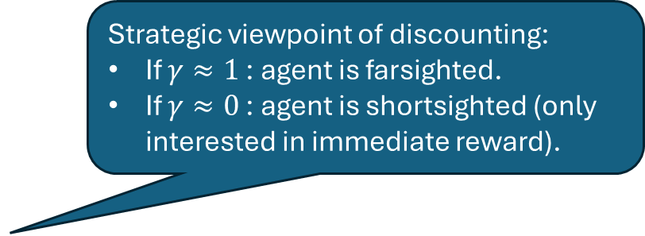
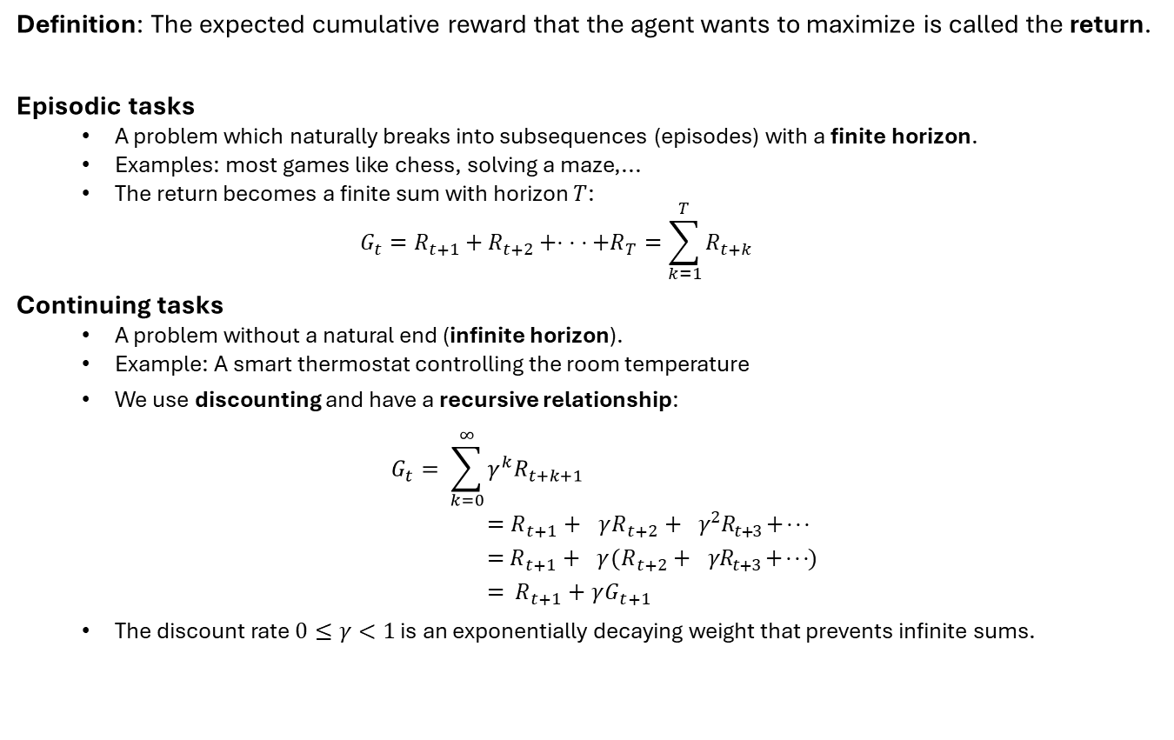
Definition: Return
Definition: The expected cumulative reward that the agent wants to maximize is called the return.
Episodic tasks
  A problem which naturally breaks into subsequences (episodes) with a finite horizon.
  Examples: most games like chess, solving a maze,...
  The return becomes a finite sum with horizon $T$:
  $$G_{t}=R_{t+1}+R_{t+2}+⋅ ⋅ ⋅+R_{T}=\sum_{k=1}^{T}{R_{t+k}}$$
Continuing tasks
  A problem without a natural end (infinite horizon).
  Example: A smart thermostat controlling the room temperature
  We use discounting and have a recursive relationship:
  $$G_{t}= \sum_{k=0}^{∞}{γ^{k}R_{t+k+1}} \\ =R_{t+1}+{γR}_{t+2}+γ^{2}R_{t+3}+ ⋅ ⋅ ⋅ \\ =R_{t+1}+{γ(R}_{t+2}+γR_{t+3}+ ⋅ ⋅ ⋅) \\ = R_{t+1}+γG_{t+1}$$
  The discount rate $0≤γ<1$ is an exponentially decaying weight that prevents infinite sums.
Strategic viewpoint of discounting:
If $γ≈1$: agent is farsighted.
If $γ≈0$: agent is shortsighted (only interested in immediate reward).

Slide 22
Elements of RL
Actions and Policy

Slide 23
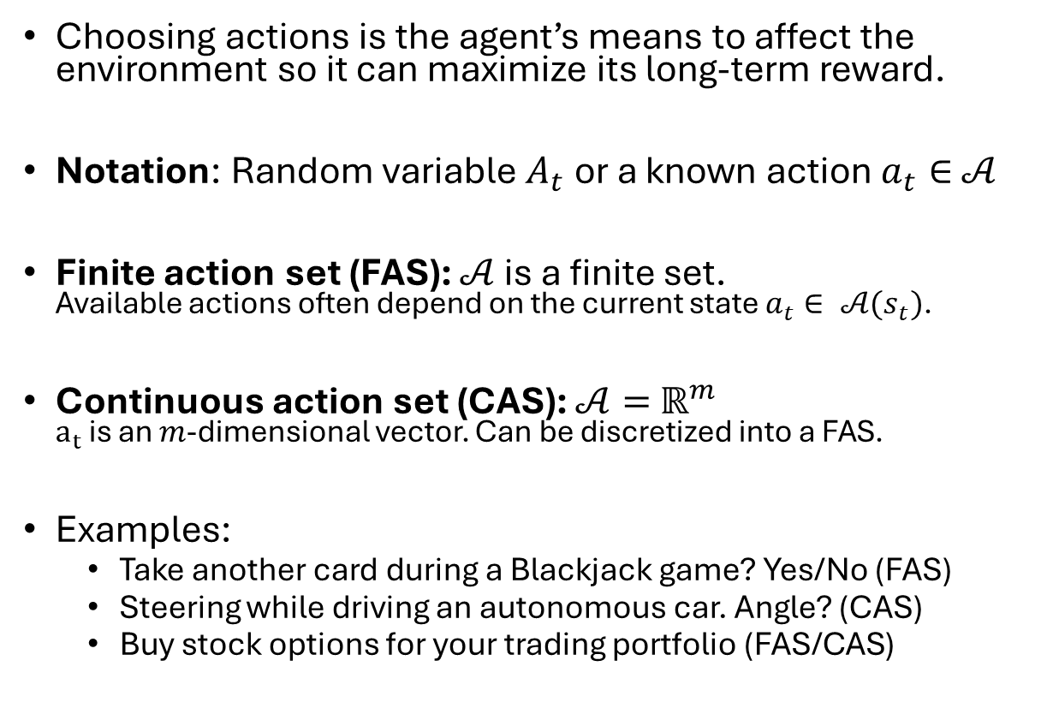

Action
$s_{t}^{e}$
Choosing actions is the agent’s means to affect the environment so it can maximize its long-term reward.
Notation: Random variable $A_{t}$ or a known action $a_{t}∈$ $𝒜$
Finite action set (FAS): $𝒜$ is a finite set.
Available actions often depend on the current state $a_{t}∈ 𝒜(s_{t})$.
Continuous action set (CAS): $𝒜=$ $ℝ^{m}$
$a_{t}$ is an $m$-dimensional vector. Can be discretized into a FAS.
Examples:
  Take another card during a Blackjack game? Yes/No (FAS)
  Steering while driving an autonomous car. Angle? (CAS)
  Buy stock options for your trading portfolio (FAS/CAS)
$$a_{t}$$
Observation
$$x_{t}$$
$$r_{t}$$
$$s_{t}$$

Slide 24
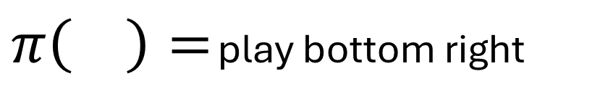
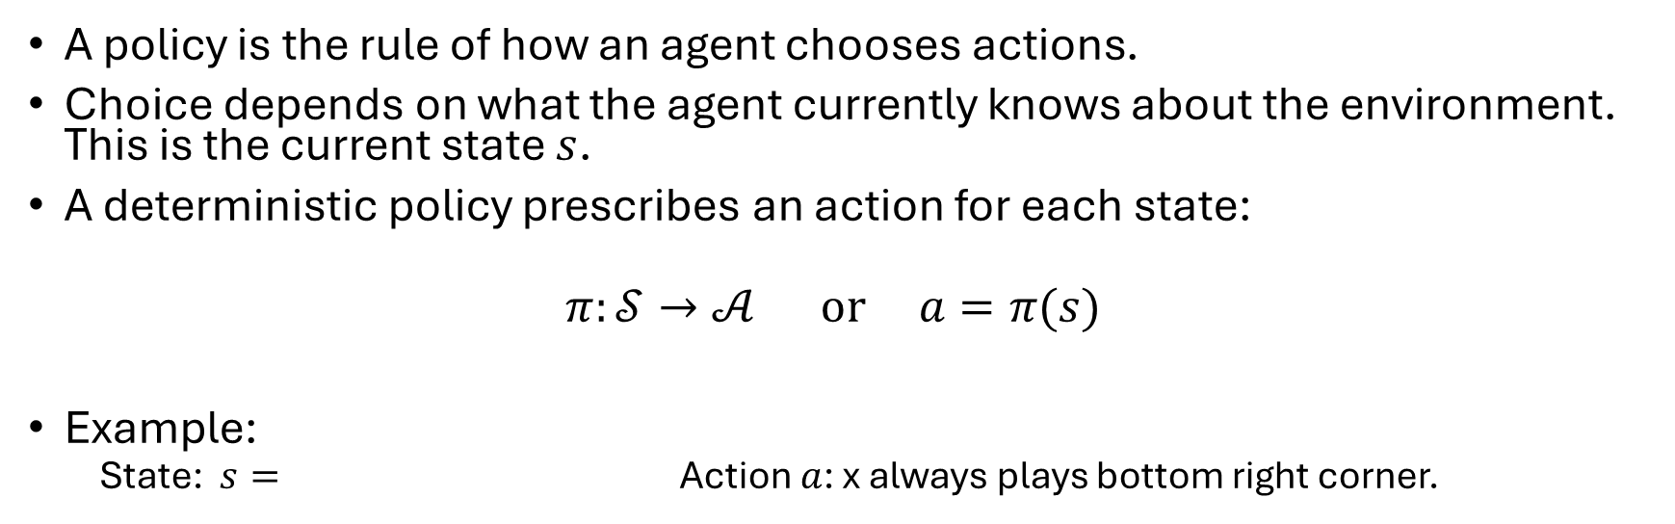
Deterministic Policy
A policy is the rule of how an agent chooses actions.
Choice depends on what the agent currently knows about the environment. This is the current state $s$.
A deterministic policy prescribes an action for each state:
$$π:𝒮→𝒜 \text{or} a=π(s)$$
Example:
  State: $s=$ Action $a$: x always plays bottom right corner.
x
$π\left( \right)=$ play bottom right
x
x
o
x
o
o
o

Slide 25
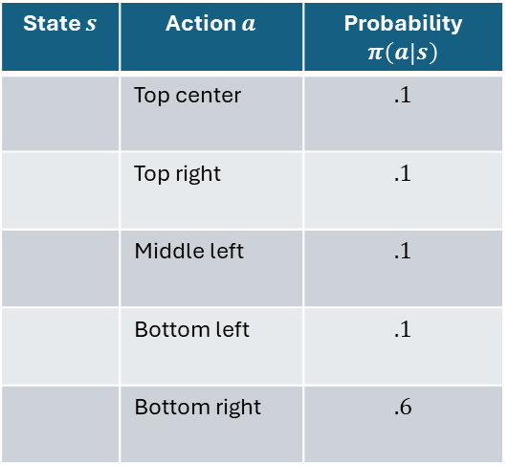
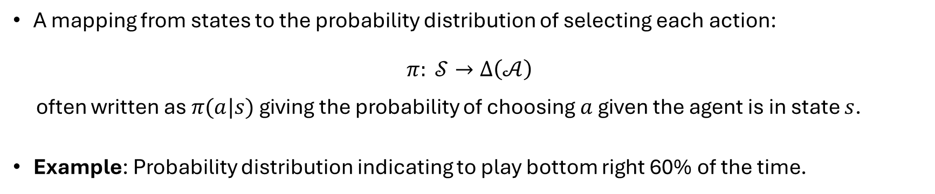
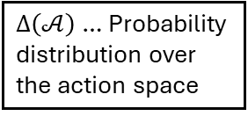
Stochastic Policy
$∆\left(𝒜\right)$… Probability distribution over the action space
A mapping from states to the probability distribution of selecting each action:
$$π: 𝒮→∆\left(𝒜\right)$$
often written as $π(a|s)$ giving the probability of choosing $a$given the agent is in state $s$.
Example: Probability distribution indicating to play bottom right 60% of the time.
State $s$ | Action $a$ | Probability $π\left(a | s\right)$
 | Top center | $$.1$$
 | Top right | $$.1$$
 | Middle left | $$.1$$
 | Bottom left | $$.1$$
 | Bottom right | $$.6$$
x
x
o
o
x
x
o
o
Note: The deterministic policy is just a special case with 1 for the chosen action and 0 for all others.
x
x
o
o
x
x
o
o
x
x
o
o

Slide 26


Exploration vs. Exploitation
Issue: The agent has to learn a good policy using the reward signal while it is evaluated at the same time.
At any point in time, the agent can choose actions to perform:
  Exploitation: Follow the currently known best policy to maximize the return.
  Exploration: Try new actions to find out more about the environment. This could improve the policy.
Trade-off problem: What is the best split between both strategies?
Exploitation: Eat more of my current favorites
Exploration: Try something new
Figure: The exploration-exploitation dilemma

Slide 27
A Small Example
Simple Maze

Slide 28





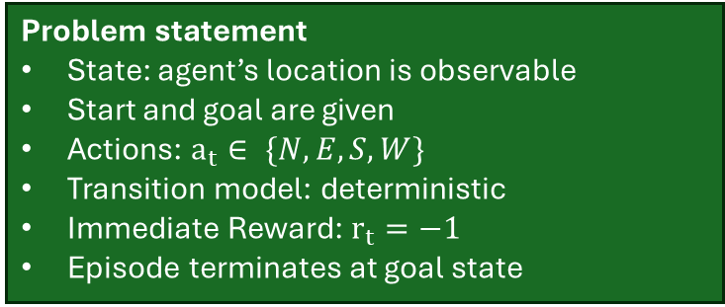

Maze Example
$s_{t}^{e}$
Observation
$$a_{t}$$
$$x_{t}$$
$$r_{t}$$
Start
$$s_{t}$$
Problem statement
State: agent’s location is observable
Start and goal are given
Actions: $a_{t}∈ \{N,E,S,W\}$
Transition model: deterministic
Immediate Reward: $r_{t}=−1$
Episode terminates at goal state
Goal
Maze setup
(source: D. Silver, “Reinforcement learning”, 2015. CC BY-NC 4.0)
Episodic problem! To maximize the return, it needs to minimize the number of steps to get to the goal!

Slide 29

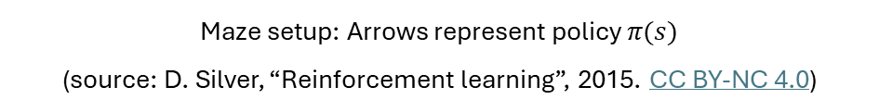
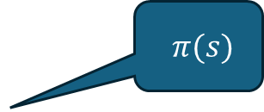
Maze Example: RL-Solution as a Policy
$$π(s)$$
Key characteristics of the policy:
Specify an action (direction) for each state (position in the maze).
Policy can be explicitly stored as a table.
Start
Goal
Maze setup: Arrows represent policy $π(s)$
(source: D. Silver, “Reinforcement learning”, 2015. CC BY-NC 4.0)

Slide 30

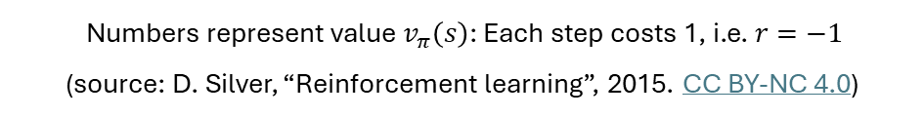
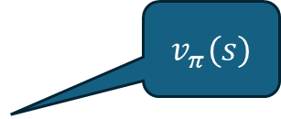
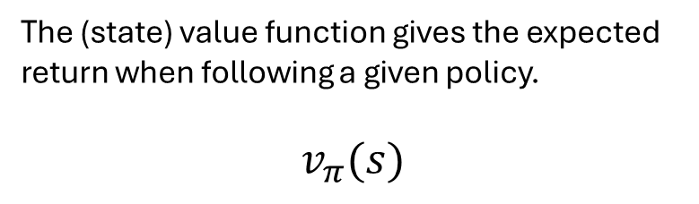
Maze Example: RL-Solution as a Value Function
$$v_{π}(s)$$
The (state) value function gives the expected return when following a given policy.
$$v_{π}(s)$$
-14 -13 -12 -11 -10 -9
Start
-16 -15
-12
-8
-16 -17
-6
-7
Key characteristics
The policy is implicitly defined by the state values:
The agent always chooses actions to move to states with better state values. This is called a “greedy” policy.
-18 -19
-5
-24
-20
-4
-3
-23 -22 -21 -22
-2
-1
Goal
Numbers represent value $v_{π}\left(s\right)$: Each step costs 1, i.e. $r=−1$
(source: D. Silver, “Reinforcement learning”, 2015. CC BY-NC 4.0)

Slide 31
RL and Planning
Model-based vs. Model-free Methods

Slide 32
Model-based vs. Model-free RL
Model-based RL
Model-free RL
Known Environment: The agent has a complete model of the environment.
  Transition model
  Reward model
The agent does not need to interact with the environment: The agent can use the model to plan offline and find the optimal policy.
Important issues:
  Computational complexity (time and space)
  Model errors compound
Unknown environment: Model is unknown.
The agent needs to interact with the environment: The agent uses online trial & error by trying actions and updating its policy based on the received reward.
Important issues:
  Sample efficiency (how fast can we learn)
  Exploitation vs. exploration

Slide 33
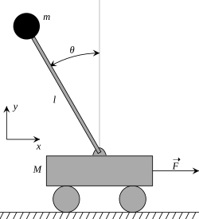
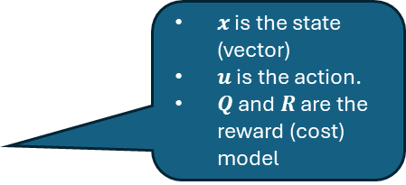
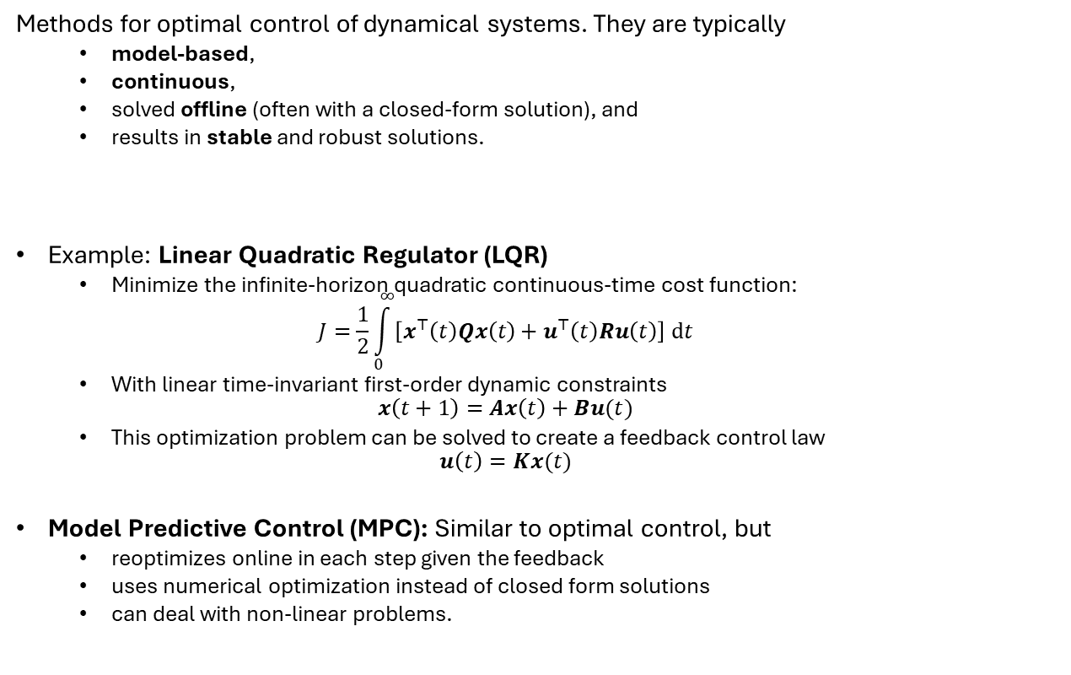
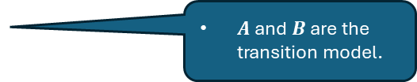
Side Note: Optimal Control Theory
State:
cart velocity
Pole angle
Pole angular velocity
Action: Force
Methods for optimal control of dynamical systems. They are typically
  model-based,
  continuous,
  solved offline (often with a closed-form solution), and
  results in stable and robust solutions.
Example: Linear Quadratic Regulator (LQR)
  Minimize the infinite-horizon quadratic continuous-time cost function:
  $$J=\frac{1}{2}\int_{0}^{∞}{\left[x^{⊤}\left(t\right)Qx\left(t\right)+u^{⊤}\left(t\right)Ru\left(t\right)\right] dt}$$
  With linear time-invariant first-order dynamic constraints
  $$x\left(t+1\right)=Ax\left(t\right)+Bu(t)$$
  This optimization problem can be solved to create a feedback control law
  $$u\left(t\right)=Kx(t)$$
Model Predictive Control (MPC): Similar to optimal control, but
  reoptimizes online in each step given the feedback
  uses numerical optimization instead of closed form solutions
  can deal with non-linear problems.
$x$ is the state (vector)
$u$ is the action.
$Q$ and $R$ are the reward (cost) model
Example: Cart Pole Balancing
Balance the weight by moving forth and back.
$A$ and $B$ are the transition model.
This course will focus on RL and not Optimal Control Theory or MPC.

Slide 34
Summary: What You Should Know
Understand the basic RL interaction loop: agent, environment, and the role of the interpreter.
Basic RL vocabulary: state, action, immediate reward, return, policy, value function.
Appreciate the significance of proper reward formulation.
Differentiate between model-based (planning) and model-free reinforcement learning methods.

