Slide 1



Reinforcement Learning Monte Carlo Methods Sutton/Barto* Chapter 5
Michael Hahsler, SMU
With figures from Sutton/Barto*
*Sutton and Barto, Reinforcement Learning: An Introduction, 2nd edition, MIT Press, Cambridge, MA, 2018

Slide 2
Topics of this Course
Introduction to reinforcement learning
Markov decision processes
Part I: Tabular Methods
Dynamic programming
Monte Carlo methods
Temporal-difference learning
Multi-step bootstrapping
Planning and learning with tabular methods
Part II: Approximate Solution Methods
Prediction and Control using Approximation
Eligibility Traces
Policy Gradient Methods
Part III: Modern RL Methods
Deep Reinforcement Learning
Current Applications

Slide 3
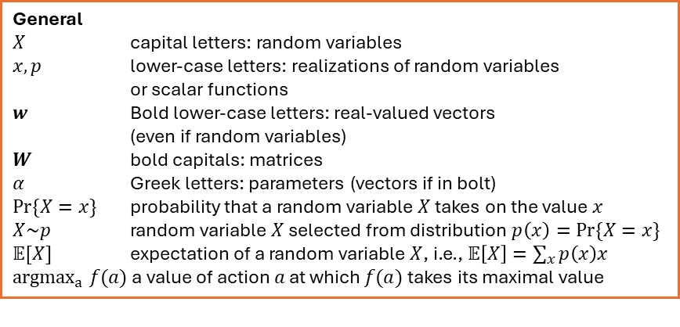
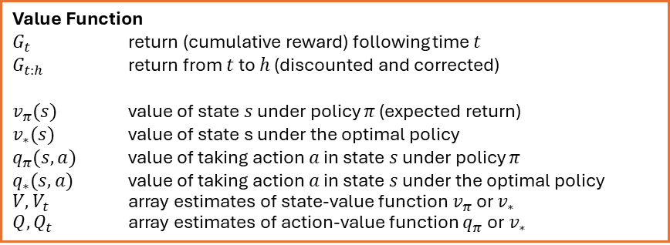
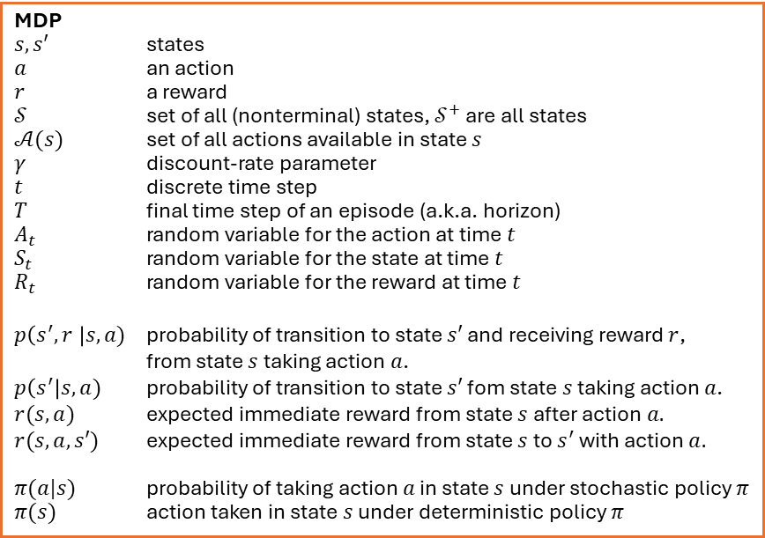
Summary of Notation
General
$X$ capital letters: random variables $x, p$ lower-case letters: realizations of random variables or scalar functions
$w$ Bold lower-case letters: real-valued vectors (even if random variables)
$W$ bold capitals: matrices
$α$ Greek letters: parameters (vectors if in bolt)
$Pr⁡\{X=x\}$ probability that a random variable $X$ takes on the value $x$
$X\sim p$ random variable $X$ selected from distribution $p\left(x\right)=Pr⁡\{X=x\}$
$𝔼[X]$ expectation of a random variable $X$, i.e., $𝔼\left[X\right]=\sum_{x}{p\left(x\right)x}$
${argmax}_{a} f(a)$ a value of action $a$ at which $f(a)$ takes its maximal value
MDP
$s, s′$ states
$a$ an action
$r$ a reward
$𝒮$ set of all (nonterminal) states, $𝒮^{+}$ are all states
$𝒜(s)$ set of all actions available in state $s$
$γ$ discount-rate parameter
$t$ discrete time step
$T$ final time step of an episode (a.k.a. horizon)
$A_{t}$ random variable for the action at time $t$
$S_{t}$ random variable for the state at time $t$
$R_{t}$ random variable for the reward at time $t$
$p\left(s^{′},r \right|s, a)$ probability of transition to state $s′$ and receiving reward $r$, from state $s$ taking action $a$.
$p\left(s^{′}\right|s, a)$ probability of transition to state $s′$ fom state $s$ taking action $a$.
$r(s,a)$ expected immediate reward from state $s$ after action $a.$
$r(s,a,s′)$ expected immediate reward from state $s$ to $s^{′}$ with action $a.$
$π(a|s)$ probability of taking action $a$ in state $s$ under stochastic policy $π$
$π(s)$ action taken in state $s$ under deterministic policy $π$
Value Function
$G_{t}$ return (cumulative reward) following time $t$
$G_{t:h}$ return from $t$ to $h$ (discounted and corrected)
$v_{π}(s)$ value of state $s$ under policy $π$ (expected return)
$v_{∗}(s)$ value of state s under the optimal policy
$q_{π}(s,a)$ value of taking action $a$ in state $s$ under policy $π$
$q_{∗}(s,a)$ value of taking action $a$ in state $s$ under the optimal policy
$V, V_{t}$ array estimates of state-value function $v_{π}$or $v_{∗}$
$Q,Q_{t}$ array estimates of action-value function $q_{π}$or $v_{∗}$

Slide 4
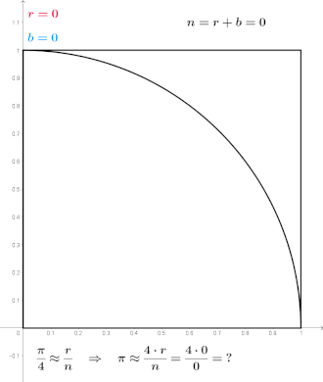
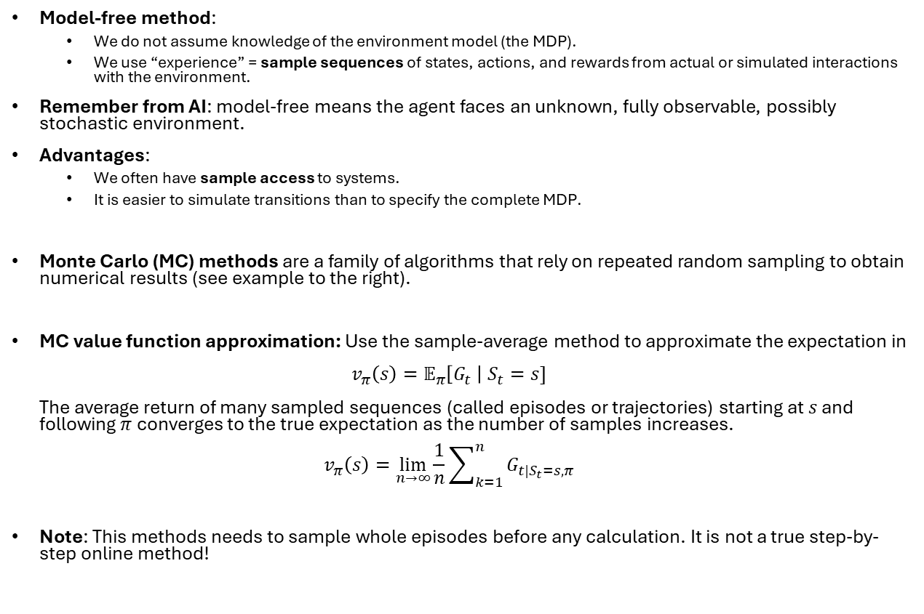
Introduction
The number of randomly sampled points is proportional to the area.
Model-free method:
We do not assume knowledge of the environment model (the MDP).
We use “experience” = sample sequences of states, actions, and rewards from actual or simulated interactions with the environment.
Remember from AI: model-free means the agent faces an unknown, fully observable, possibly stochastic environment.
Advantages:
We often have sample access to systems.
It is easier to simulate transitions than to specify the complete MDP.
Monte Carlo (MC) methods are a family of algorithms that rely on repeated random sampling to obtain numerical results (see example to the right).
MC value function approximation: Use the sample-average method to approximate the expectation in $v_{π}\left(s\right)=𝔼_{π}\left[G_{t} \right| S_{t}=s]$ The average return of many sampled sequences (called episodes or trajectories) starting at $s$ and following $π$converges to the true expectation as the number of samples increases. $v_{π}\left(s\right)=\lim_{n→∞}{\frac{1}{n}\sum_{k=1}^{n}{G_{t|S_{t}=s,π}}}$
Note: This methods needs to sample whole episodes before any calculation. It is not a true step-by-step online method!
Monte Carlo method applied to approximating the value of π Source: Wikipedia

Slide 5
Monte Carlo Prediction
Estimate state values by sampling with a given policy.

Slide 6
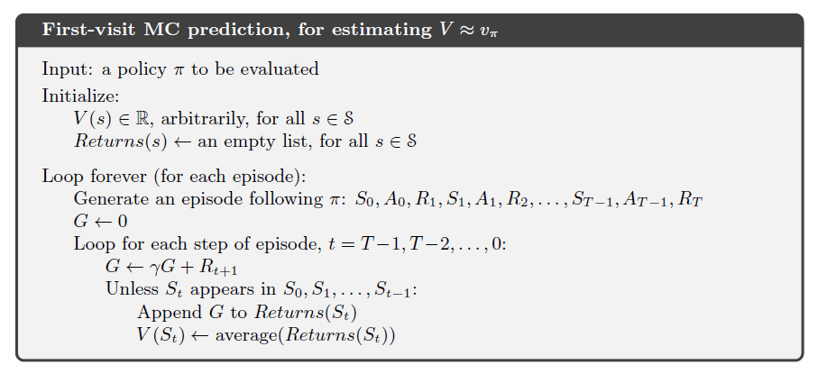

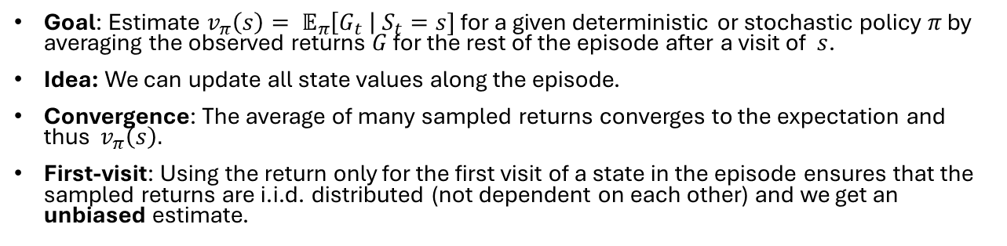

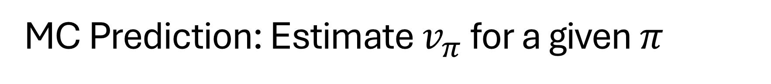
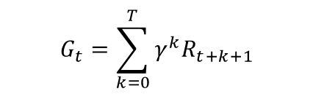

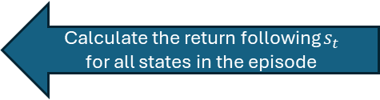
MC Prediction: Estimate $v_{π}$ for a given $π$
Goal: Estimate $v_{π}\left(s\right)= 𝔼_{π}\left[G_{t} \right| S_{t}=s]$ for a given deterministic or stochastic policy $π$ by averaging the observed returns $G$ for the rest of the episode after a visit of $s$.
Idea: We can update all state values along the episode.
Convergence: The average of many sampled returns converges to the expectation and thus $v_{π}\left(s\right).$
First-visit: Using the return only for the first visit of a state in the episode ensures that the sampled returns are i.i.d. distributed (not dependent on each other) and we get an unbiased estimate.
Episode
$$s_{0}$$
$$s_{t}$$
$$s_{T}$$
$$G_{t}=\sum_{k=0}^{T}{γ^{k}R_{t+k+1}}$$
Calculate the return following $s_{t}$ for all states in the episode
We observe a sequence of rewards
Calculate remaining returns in reverse order!
Uses only the first visit.
This sample average approximates the expected return.
Note: This can be implemented with incremental updating of the averages!

Slide 7
Monte Carlo Control
Find a good policy while using it to sample the data.

Slide 8
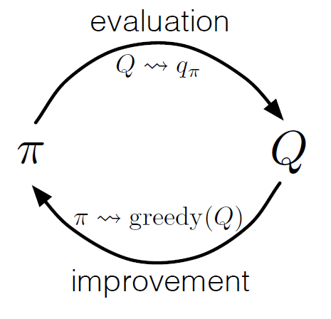
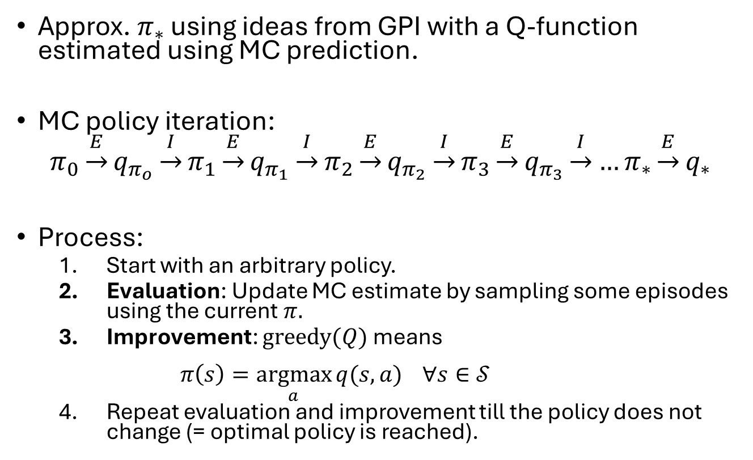
MC Control as Generalized Policy Iteration (GPI)
Approx. $π_{∗}$ using ideas from GPI with a Q-function estimated using MC prediction.
MC policy iteration:
$$π_{0}\underset{→}{E}q_{π_{o}}\underset{→}{I}π_{1}\underset{→}{E}q_{π_{1}}\underset{→}{I}π_{2}\underset{→}{E}q_{π_{2}}\underset{→}{I}π_{3}\underset{→}{E}q_{π_{3}}\underset{→}{I}…π_{∗}\underset{→}{E}q_{∗}$$
Process:
Start with an arbitrary policy.
Evaluation: Update MC estimate by sampling some episodes using the current $π.$
Improvement: $\text{greedy}(Q)$ means $π\left(s\right)=\underset{a}{argmax}{q(s,a)} ∀s∈𝒮$
Repeat evaluation and improvement till the policy does not change (= optimal policy is reached).
MC Prediction
GPI

Slide 9
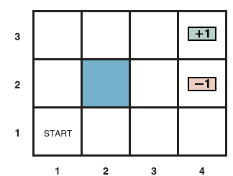
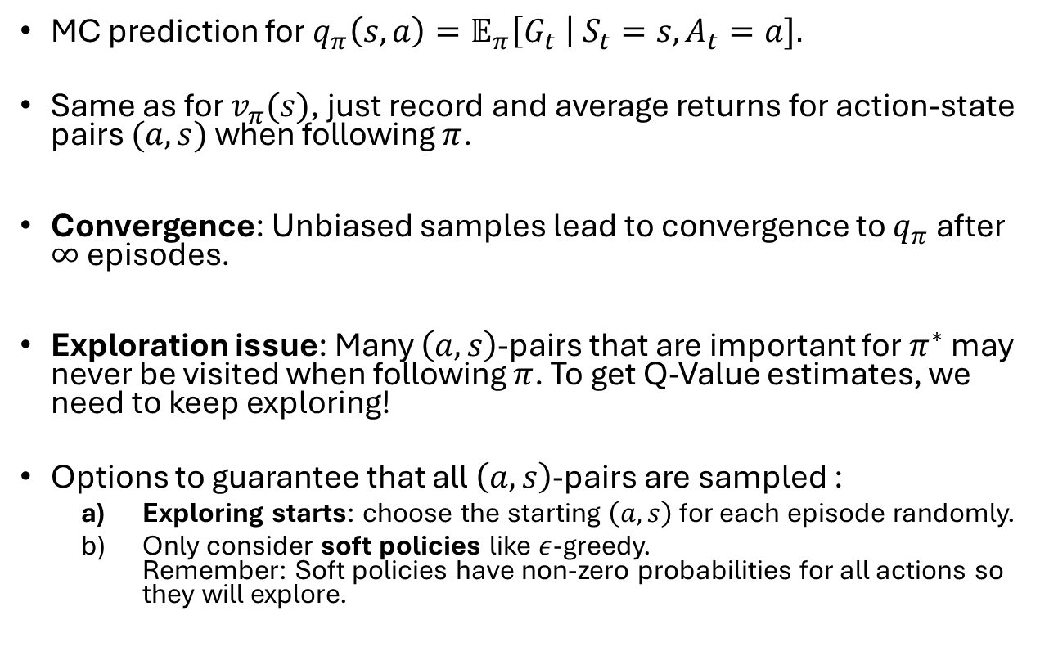
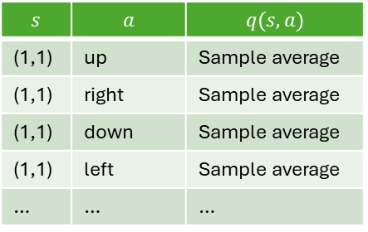
MC Prediction to Estimate Q-Values
MC prediction for $q_{π}\left(s,a\right)=𝔼_{π}\left[G_{t} \right| S_{t}=s,A_{t}=a].$
Same as for $v_{π}(s)$, just record and average returns for action-state pairs $(a,s)$ when following $π$.
Convergence: Unbiased samples lead to convergence to $q_{π}$ after $∞$ episodes.
Exploration issue: Many $\left(a,s\right)$-pairs that are important for $π^{∗}$ may never be visited when following $π$. To get Q-Value estimates, we need to keep exploring!
Options to guarantee that all $\left(a,s\right)$-pairs are sampled :
Exploring starts: choose the starting $\left(a,s\right)$ for each episode randomly.
Only consider soft policies like $ε$-greedy. Remember: Soft policies have non-zero probabilities for all actions so they will explore.
Q-Table
$$s$$ | $$a$$ | $$q(s,a)$$
(1,1) | up | Sample average
(1,1) | right | Sample average
(1,1) | down | Sample average
(1,1) | left | Sample average
… | … | …

Slide 10

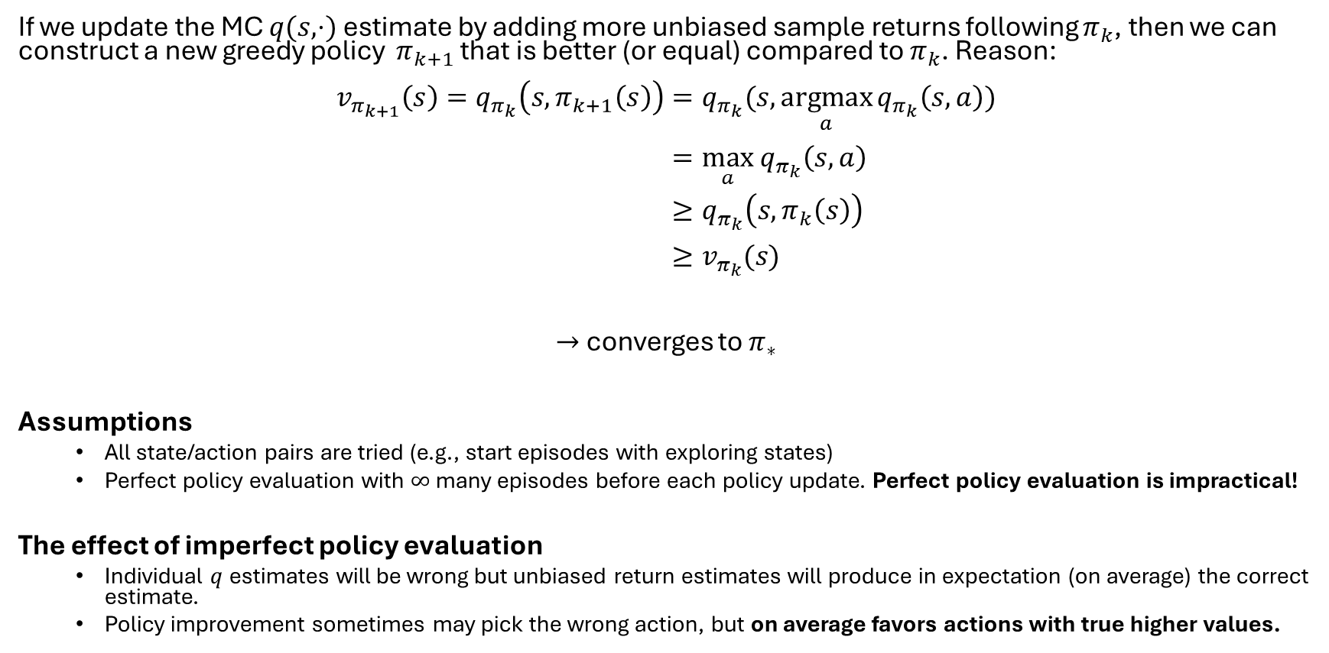
Remember: Policy Improvement Theorem
If we update the MC $q(s,⋅)$ estimate by adding more unbiased sample returns following $π_{k}$, then we can construct a new greedy policy $π_{k+1}$ that is better (or equal) compared to $π_{k}$. Reason:
$$v_{π_{k+1}}\left(s\right)=q_{π_{k}}\left(s, π_{k+1}\left(s\right)\right)=q_{π_{k}}(s, \underset{a}{argmax}{q_{π_{k}}\left(s,a\right)}) \\ =\max_{a} q_{π_{k}}\left(s,a\right) \\ ≥q_{π_{k}}\left(s,π_{k}\left(s\right)\right) \\ ≥v_{π_{k}}(s)$$
$→$ converges to $π_{∗}$
Assumptions
All state/action pairs are tried (e.g., start episodes with exploring states)
Perfect policy evaluation with $∞$ many episodes before each policy update. Perfect policy evaluation is impractical!
The effect of imperfect policy evaluation
Individual $q$estimates will be wrong but unbiased return estimates will produce in expectation (on average) the correct estimate.
Policy improvement sometimes may pick the wrong action, but on average favors actions with true higher values.
$π_{k+1}$ chooses greedy action for $s$
Choosing the best action will never lead to a lower value!

Slide 11
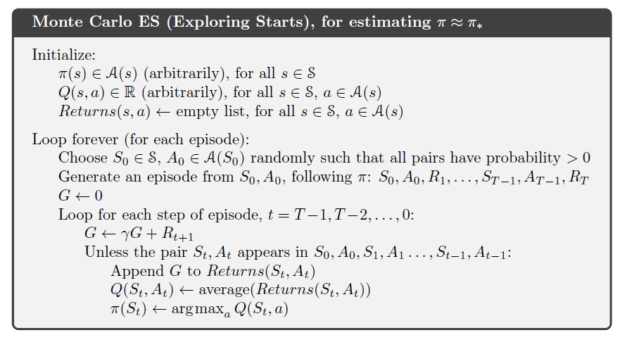
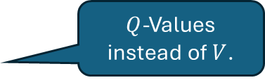
Alg. MC Control with Exploring Starts
So all state-action pairs are tired.
Learn policy
$Q$-Values instead of $V$.
Exploring starts
First-visit
Greedy policy update

Slide 12
Code…

Slide 13
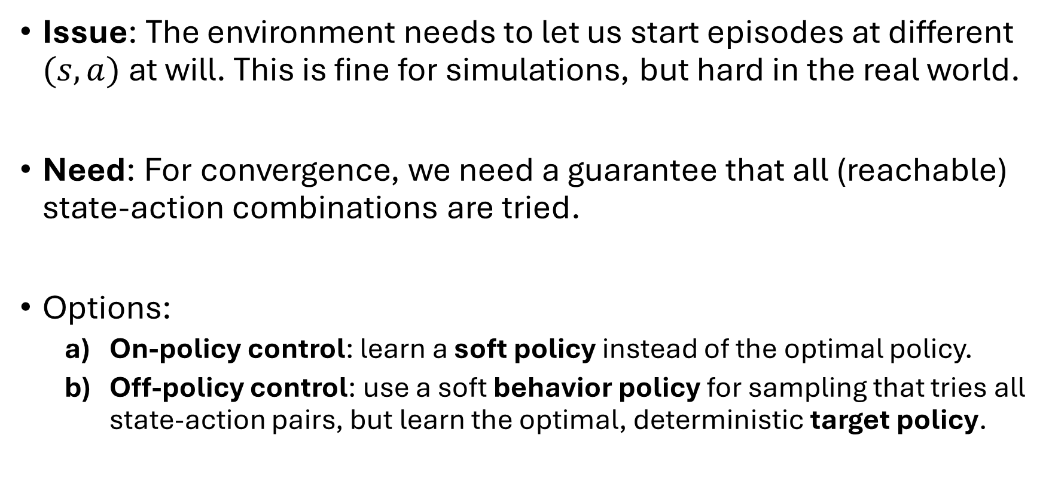
MC Control without Exploring Starts
Issue: The environment needs to let us start episodes at different $(s,a)$ at will. This is fine for simulations, but hard in the real world.
Need: For convergence, we need a guarantee that all (reachable) state-action combinations are tried.
Options:
On-policy control: learn a soft policy instead of the optimal policy.
Off-policy control: use a soft behavior policy for sampling that tries all state-action pairs, but learn the optimal, deterministic target policy.

Slide 14
On-Policy Monte Carlo Control
Find a good policy while using it to sample.

Slide 15
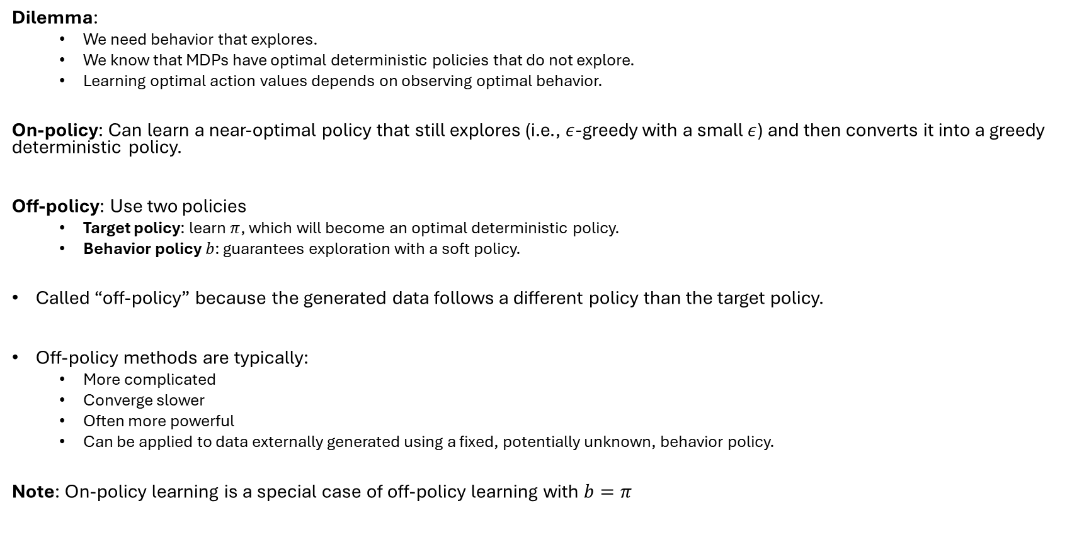
On-Policy vs. Off-Policy Control
Dilemma:
We need behavior that explores.
We know that MDPs have optimal deterministic policies that do not explore.
Learning optimal action values depends on observing optimal behavior.
On-policy: Can learn a near-optimal policy that still explores (i.e., $ε$-greedy with a small $ε$) and then converts it into a greedy deterministic policy.
Off-policy: Use two policies
Target policy: learn $π$, which will become an optimal deterministic policy.
Behavior policy $b$: guarantees exploration with a soft policy.
Called “off-policy” because the generated data follows a different policy than the target policy.
Off-policy methods are typically:
More complicated
Converge slower
Often more powerful
Can be applied to data externally generated using a fixed, potentially unknown, behavior policy.
Note: On-policy learning is a special case of off-policy learning with $b=π$

Slide 16
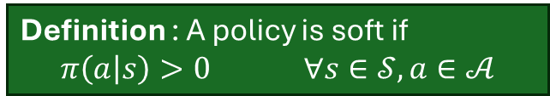
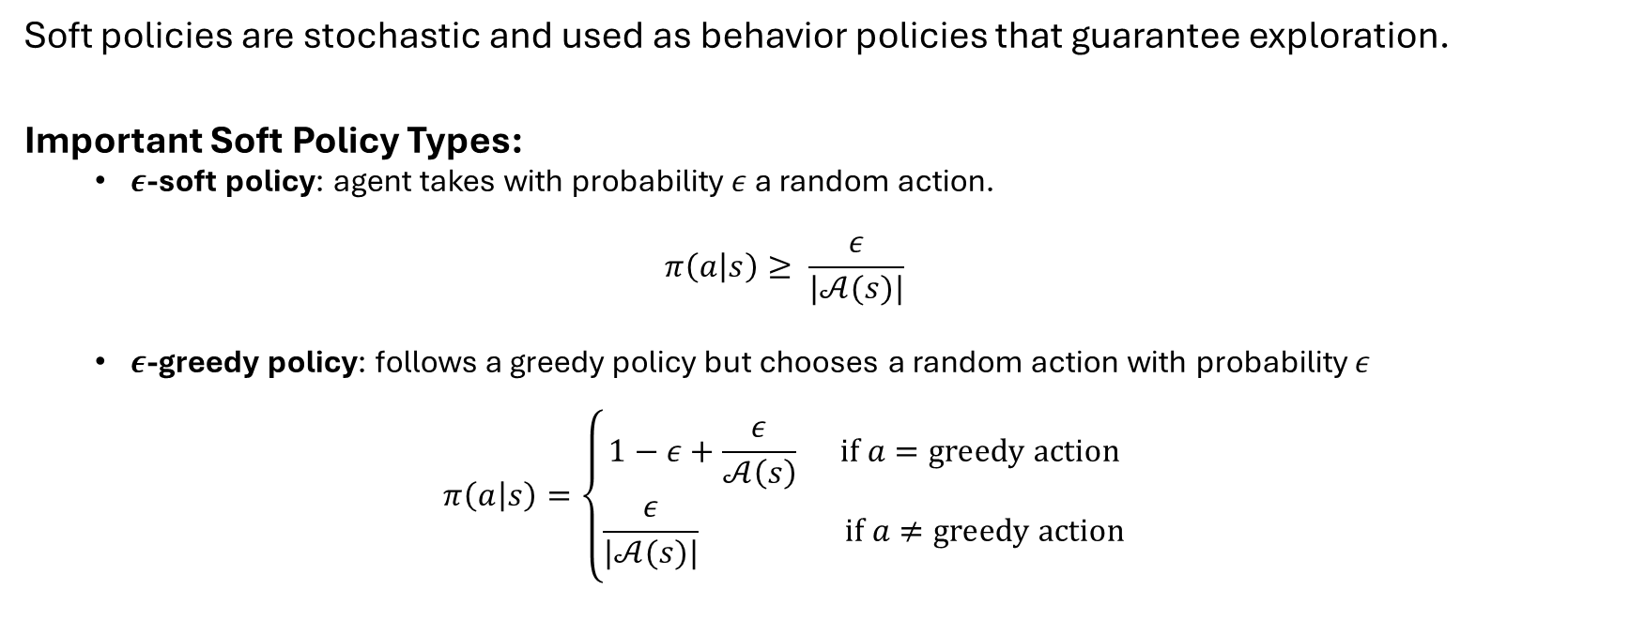
Types of Soft Policies for Exploration
Definition : A policy is soft if
$$π\left(a | s\right)>0 ∀s∈𝒮, a∈𝒜$$
Soft policies are stochastic and used as behavior policies that guarantee exploration.
Important Soft Policy Types:
$ε$-soft policy: agent takes with probability $ε$ a random action.
$$π\left(a | s\right)≥ \frac{ε}{|𝒜(s)|}$$
$ε$-greedy policy: follows a greedy policy but chooses a random action with probability $ε$
$$π\left(a | s\right)=\left\{\begin{aligned}1−ε+\frac{ε}{𝒜\left(s\right)} \text{if} a=\text{greedy} \text{action} \\ \frac{ε}{|𝒜(s)|} \text{if} a≠\text{greedy} \text{action}\end{aligned}\right.$$

Slide 17
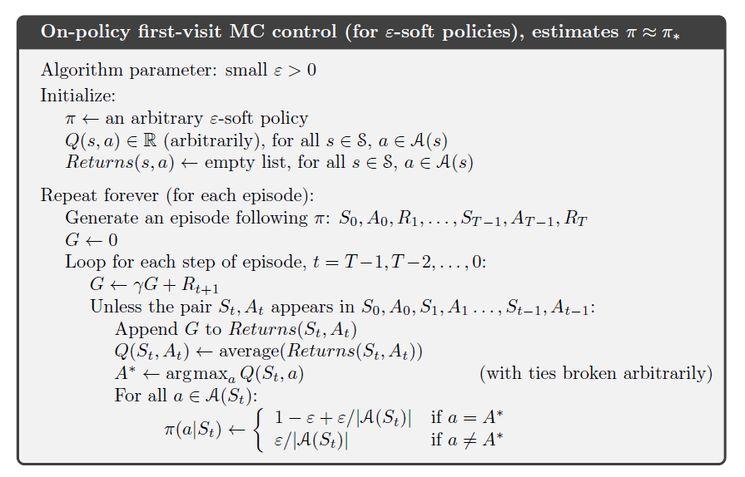
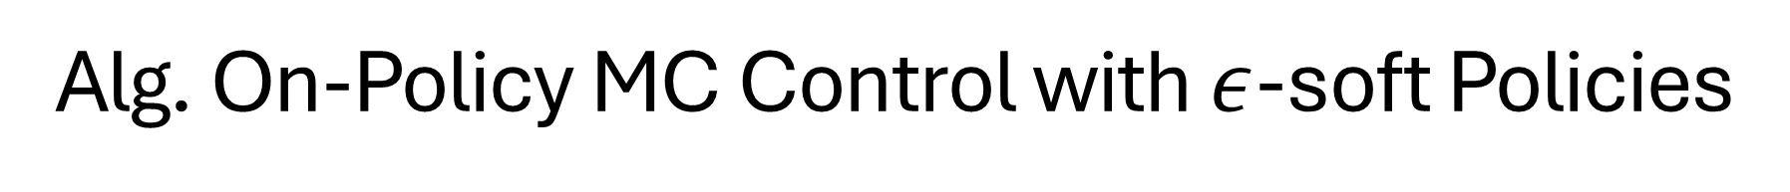

Alg. On-Policy MC Control with $ε$-soft Policies
Start with soft policy
No exploring starts!
Create $ε$-greedy policy
Important: On-policy learns the best $ε$-greedy policy, but not the optimal deterministic policy!

Slide 18
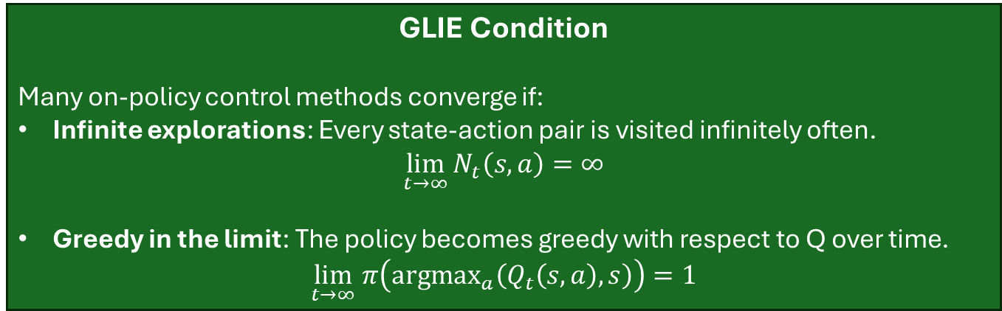

GLIE: Greedy in the Limit with Infinite Exploration
Issue: On-policy MC control algorithms change the policy and average over returns from different policies. This could be a problem for convergence!
Reason: Early wrong return samples from “bad policies” will eventually be dominated by many new samples from the optimal/near-deterministic policy.
Implementation:
Infinite exploration: Use many episodes and an $ε$-greedy policy for exploration.
Greedy in the limit: Use an $ε$-greedy policy where $ε$ is reduced over time. E.g., $ε_{t}=\frac{1}{t}$
GLIE Condition
Many on-policy control methods converge if:
Infinite explorations: Every state-action pair is visited infinitely often. $\lim_{t→∞}{N_{t}\left(s,a\right)=∞}$
Greedy in the limit: The policy becomes greedy with respect to Q over time. $\lim_{t→∞} π\left(\text{argma}{\text{x}}_{a}\left(Q_{t}\left(s,a\right),s\right)\right)=1$

Slide 19
Off-Policy Prediction
Estimate a value function for a policy different from the sampling policy.

Slide 20
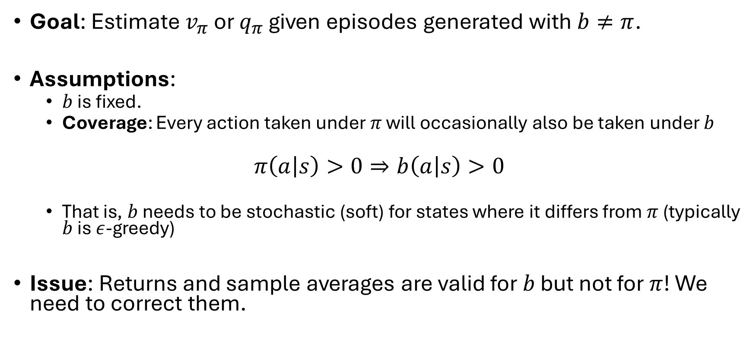
Off-Policy Prediction
Goal: Estimate $v_{π}$ or $q_{π}$ given episodes generated with $b≠π$.
Assumptions:
$b$ is fixed.
Coverage: Every action taken under $π$ will occasionally also be taken under $b$
$$π\left(a | s\right)>0⇒b\left(a | s\right)>0$$
That is, $b$ needs to be stochastic (soft) for states where it differs from $π$ (typically $b$ is $ε$-greedy)
Issue: Returns and sample averages are valid for $b$ but not for $π$! We need to correct them.

Slide 21
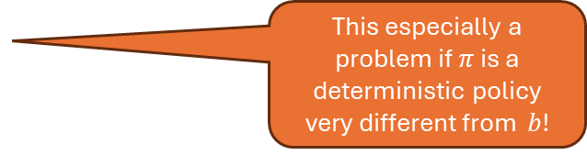
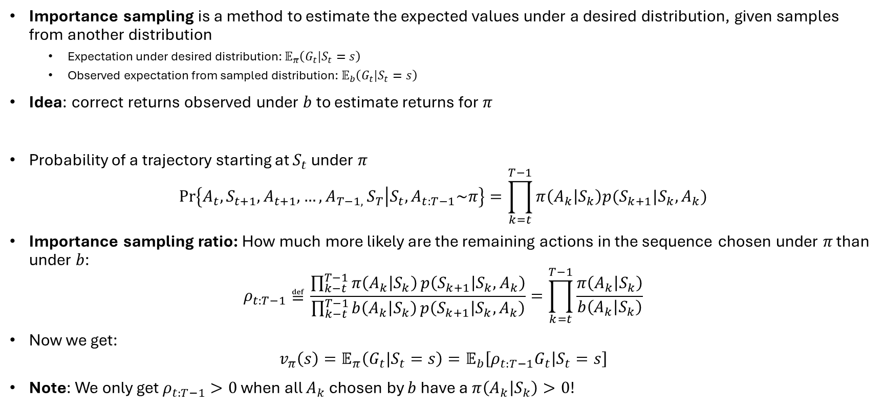
Importance Sampling
Importance sampling is a method to estimate the expected values under a desired distribution, given samples from another distribution
Expectation under desired distribution: $𝔼_{π}\left(G_{t}|S_{t}=s\right)$
Observed expectation from sampled distribution: $𝔼_{b}\left(G_{t}|S_{t}=s\right)$
Idea: correct returns observed under $b$ to estimate returns for $π$
Probability of a trajectory starting at $S_{t}$ under $π$
$$\operatorname{Pr}\left\{A_{t},S_{t+1},A_{t+1},…,{A_{T−1, }S}_{T} | S_{t}, A_{t:T−1}\sim π\right\}=\prod_{k=t}^{T−1}{π\left(A_{k} | S_{k}\right)p(S_{k+1}|S_{k},A_{k})}$$
Importance sampling ratio: How much more likely are the remaining actions in the sequence chosen under 𝜋 than under 𝑏:
$$ρ_{t:T−1}≝\frac{\prod_{k−t}^{T−1}{π\left(A_{k} | S_{k}\right)}p\left(S_{k+1} | S_{k},A_{k}\right)}{\prod_{k−t}^{T−1}{b\left(A_{k} | S_{k}\right)}p\left(S_{k+1} | S_{k},A_{k}\right)}=\prod_{k=t}^{T−1}{\frac{π\left(A_{k} | S_{k}\right)}{b\left(A_{k} | S_{k}\right)}}$$
Now we get:
$$v_{π}\left(s\right)=𝔼_{π}\left(G_{t}|S_{t}=s\right)=𝔼_{b}\left[{ρ_{t:T−1}G}_{t} | S_{t}=s\right]$$
Note: We only get $ρ_{t:T−1}>0$ when all $A_{k}$ chosen by $b$ have a $π\left(A_{k} | S_{k}\right)>0$!
Needs unknown transition probabilities!
Luckily, the unknown transition probabilities cancel out!
This especially a problem if $π$ is a deterministic policy very different from $b$!

Slide 22
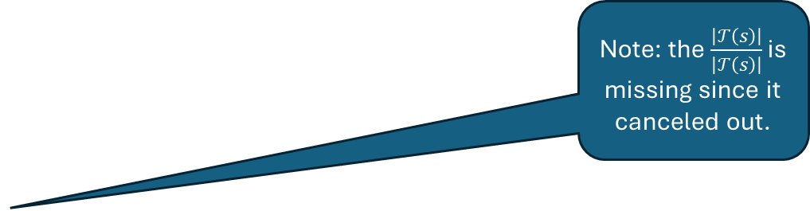
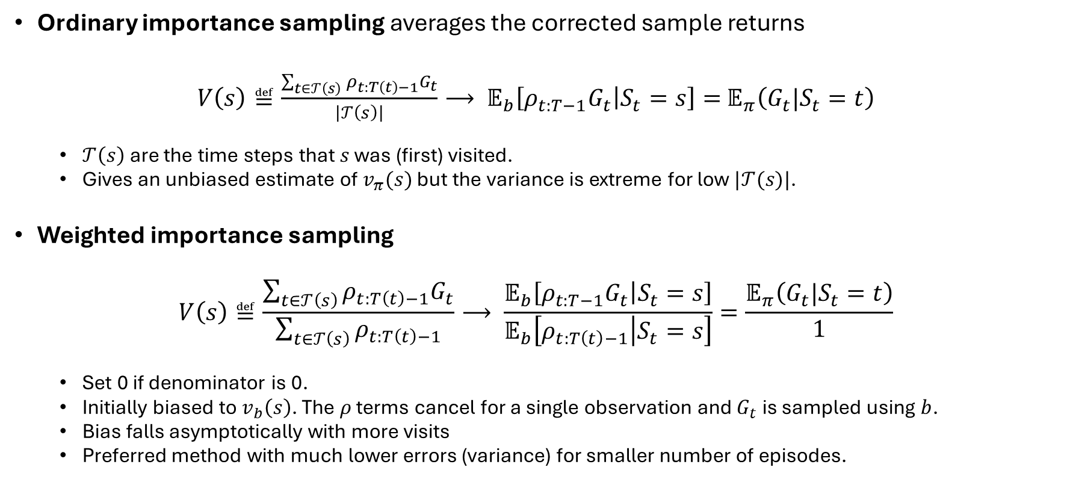
Ordinary vs. Weighted Importance Sampling
Ordinary importance sampling averages the corrected sample returns
$V\left(s\right)≝\frac{\sum_{t∈𝒯\left(s\right)}{ρ_{t:T\left(t\right)−1}G_{t}}}{\left|𝒯\left(s\right)\right|}⟶ 𝔼_{b}\left[{ρ_{t:T−1}G}_{t} | S_{t}=s\right]=$ $𝔼_{π}\left(G_{t}|S_{t}=t\right)$
$𝒯\left(s\right)$ are the time steps that $s$ was (first) visited.
Gives an unbiased estimate of $v_{π}(s)$ but the variance is extreme for low $|𝒯(s)|$.
Weighted importance sampling
$$V\left(s\right)≝\frac{\sum_{t∈𝒯\left(s\right)}{ρ_{t:T\left(t\right)−1}G_{t}}}{\sum_{t∈𝒯\left(s\right)}{ρ_{t:T\left(t\right)−1}}}⟶ \frac{𝔼_{b}\left[{ρ_{t:T−1}G}_{t} | S_{t}=s\right]}{𝔼_{b}\left[ρ_{t:T\left(t\right)−1} | S_{t}=s\right]}=\frac{𝔼_{π}\left(G_{t}|S_{t}=t\right)}{1}$$
Set 0 if denominator is 0.
Initially biased to $v_{b}\left(s\right)$. The $ρ$ terms cancel for a single observation and $G_{t}$ is sampled using $b$.
Bias falls asymptotically with more visits
Preferred method with much lower errors (variance) for smaller number of episodes.
Note: the $\frac{\left|𝒯\left(s\right)\right|}{\left|𝒯\left(s\right)\right|}$ is missing since it canceled out.

Slide 23
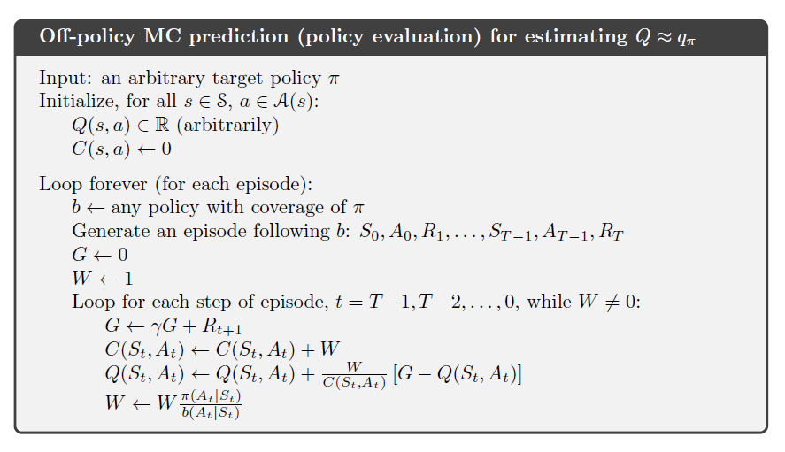



Alg. Off-Policy Prediction
Weighted importance sampling + incremental average update
cumulative sum of weights for $(s,a)$ for incremental update of the average return.
$b$ can change every episode! Practical choice is $b=\text{ϵ}\text{-}\text{greedy}(π)$
Importance sampling ratio $ρ$
Can only learn from the end of the episode where the action chosen from $b$ can also be chosen by $π$!
Incremental update + Correct the update

Slide 24
Off-Policy Control
Find a good policy while following a different behavior policy.

Slide 25
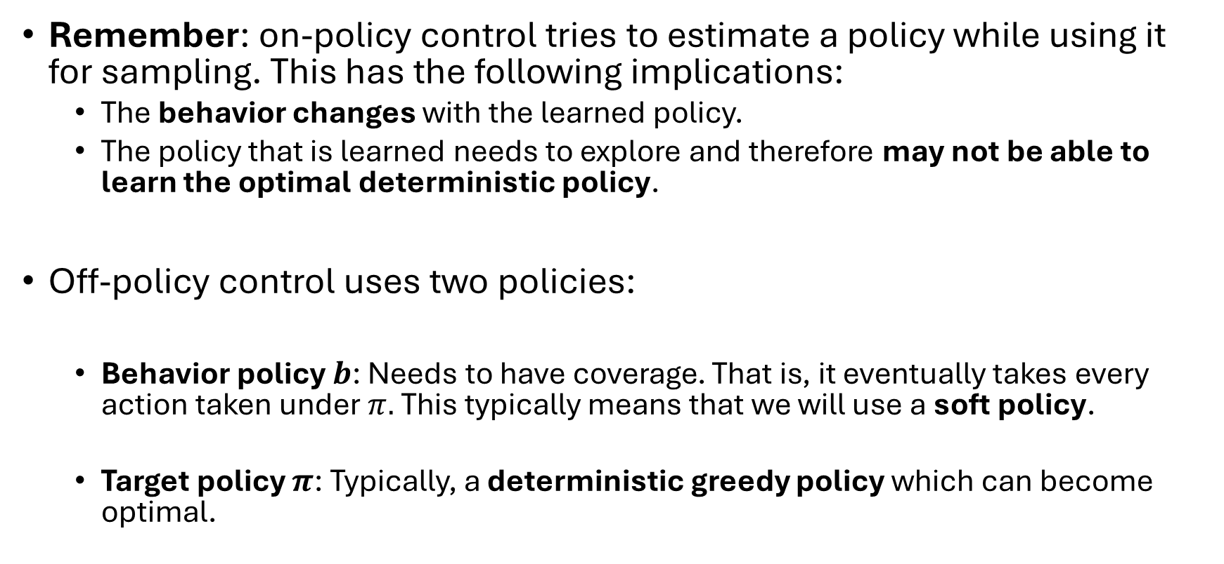
Off-Policy MC Control
Remember: on-policy control tries to estimate a policy while using it for sampling. This has the following implications:
The behavior changes with the learned policy.
The policy that is learned needs to explore and therefore may not be able to learn the optimal deterministic policy.
Off-policy control uses two policies:
Behavior policy $b$: Needs to have coverage. That is, it eventually takes every action taken under $π.$This typically means that we will use a soft policy.
Target policy $π$: Typically, a deterministic greedy policy which can become optimal.

Slide 26
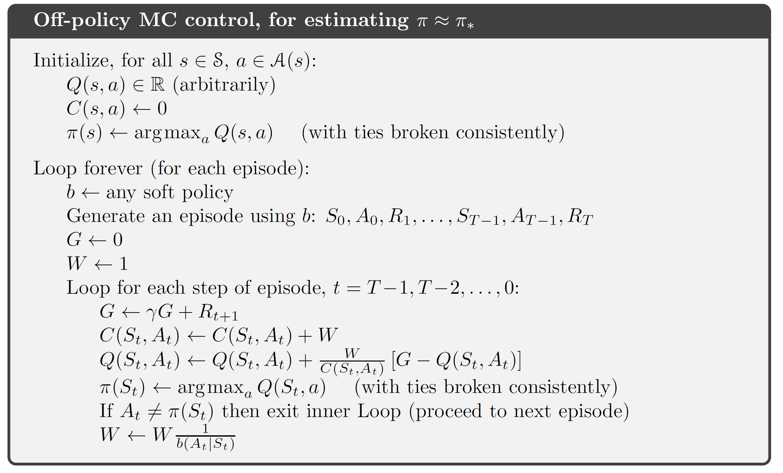
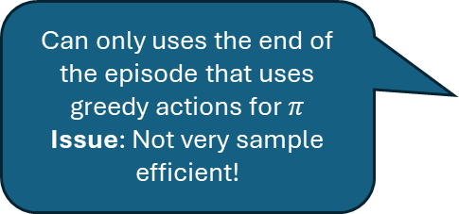
Alg. Off-Policy MC Control
Add the greedy target policy
Can only uses the end of the episode that uses greedy actions for $π$ Issue: Not very sample efficient!
We use $π$ to select a. So the probability is 1.

Slide 27
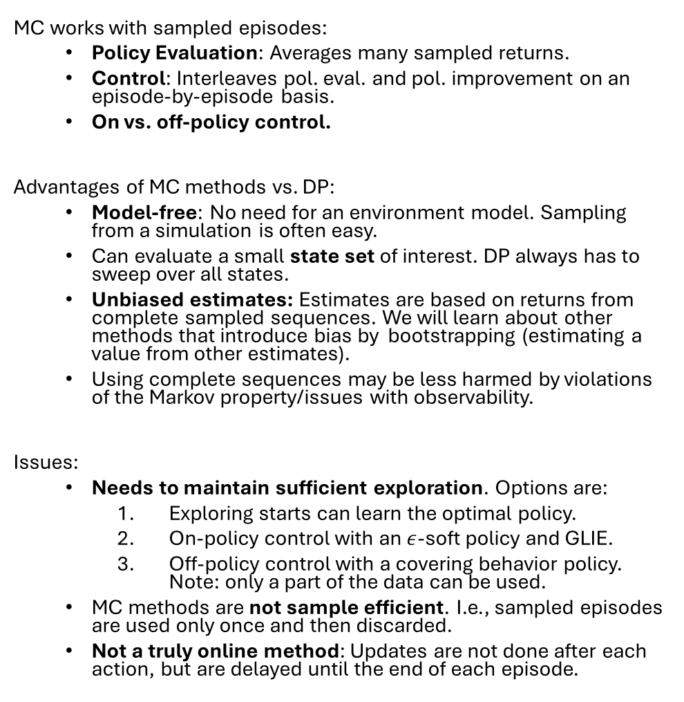
What you Should Know
MC works with sampled episodes:
Policy Evaluation: Averages many sampled returns.
Control: Interleaves pol. eval. and pol. improvement on an episode-by-episode basis.
On vs. off-policy control.
Advantages of MC methods vs. DP:
Model-free: No need for an environment model. Sampling from a simulation is often easy.
Can evaluate a small state set of interest. DP always has to sweep over all states.
Unbiased estimates: Estimates are based on returns from complete sampled sequences. We will learn about other methods that introduce bias by bootstrapping (estimating a value from other estimates).
Using complete sequences may be less harmed by violations of the Markov property/issues with observability.
Issues:
Needs to maintain sufficient exploration. Options are:
Exploring starts can learn the optimal policy.
On-policy control with an $ε$-soft policy and GLIE.
Off-policy control with a covering behavior policy. Note: only a part of the data can be used.
MC methods are not sample efficient. I.e., sampled episodes are used only once and then discarded.
Not a truly online method: Updates are not done after each action, but are delayed until the end of each episode.

