Slide 1
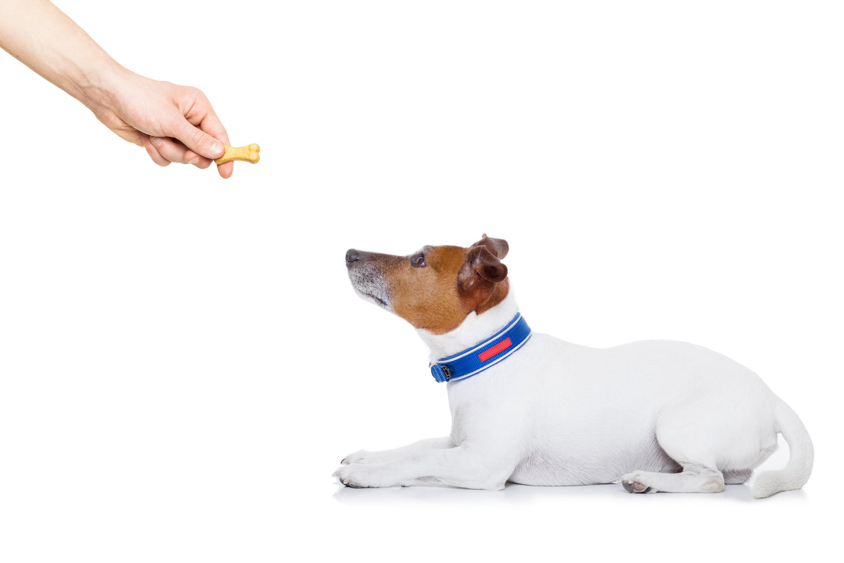


Reinforcement Learning Planning and Learning with Tabular Methods Sutton/Barto* Chapter 8
Michael Hahsler, SMU
With figures from Sutton/Barto*
*Sutton and Barto, Reinforcement Learning: An Introduction, 2nd edition, MIT Press, Cambridge, MA, 2018

Slide 2
Topics of this Course
Introduction to reinforcement learning
Markov decision processes
Part I: Tabular Methods
Dynamic programming
Monte Carlo methods
Temporal-difference learning
Multi-step bootstrapping
Planning and learning with tabular methods
Part II: Approximate Solution Methods
Prediction and Control using Approximation
Eligibility Traces
Policy Gradient Methods
Part III: Modern RL Methods
Deep Reinforcement Learning
Current Applications

Slide 3
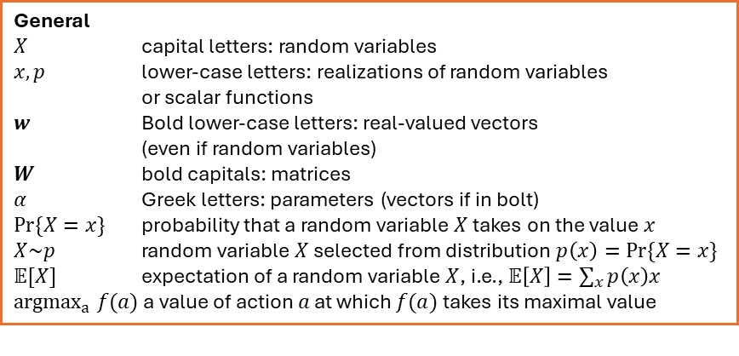
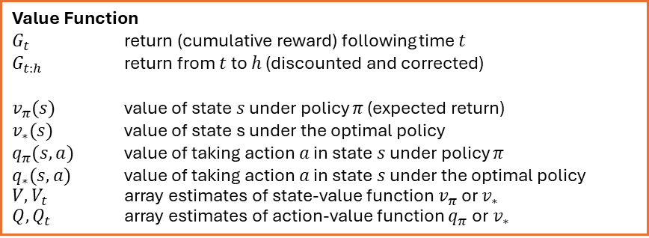
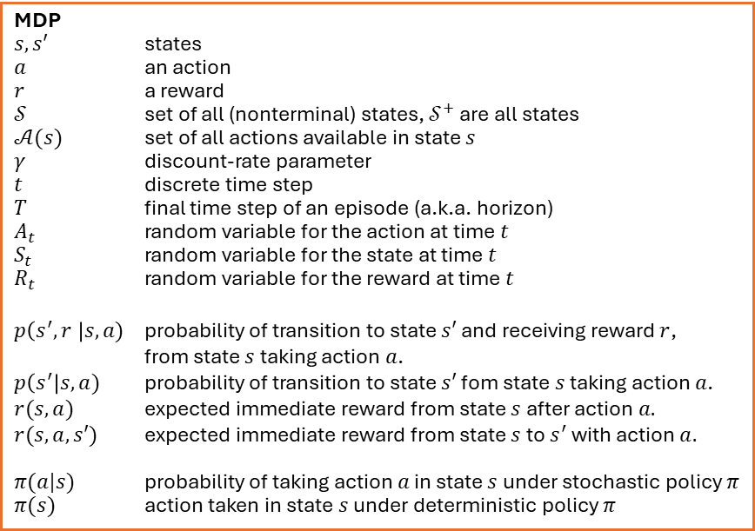
Summary of Notation
General
$X$ capital letters: random variables $x, p$ lower-case letters: realizations of random variables or scalar functions
$w$ Bold lower-case letters: real-valued vectors (even if random variables)
$W$ bold capitals: matrices
$α$ Greek letters: parameters (vectors if in bolt)
$Pr⁡\{X=x\}$ probability that a random variable $X$ takes on the value $x$
$X\sim p$ random variable $X$ selected from distribution $p\left(x\right)=Pr⁡\{X=x\}$
$𝔼[X]$ expectation of a random variable $X$, i.e., $𝔼\left[X\right]=\sum_{x}{p\left(x\right)x}$
${argmax}_{a} f(a)$ a value of action $a$ at which $f(a)$ takes its maximal value
MDP
$s, s′$ states
$a$ an action
$r$ a reward
$𝒮$ set of all (nonterminal) states, $𝒮^{+}$ are all states
$𝒜(s)$ set of all actions available in state $s$
$γ$ discount-rate parameter
$t$ discrete time step
$T$ final time step of an episode (a.k.a. horizon)
$A_{t}$ random variable for the action at time $t$
$S_{t}$ random variable for the state at time $t$
$R_{t}$ random variable for the reward at time $t$
$p\left(s^{′},r \right|s, a)$ probability of transition to state $s′$ and receiving reward $r$, from state $s$ taking action $a$.
$p\left(s^{′}\right|s, a)$ probability of transition to state $s′$ fom state $s$ taking action $a$.
$r(s,a)$ expected immediate reward from state $s$ after action $a.$
$r(s,a,s′)$ expected immediate reward from state $s$ to $s^{′}$ with action $a.$
$π(a|s)$ probability of taking action $a$ in state $s$ under stochastic policy $π$
$π(s)$ action taken in state $s$ under deterministic policy $π$
Value Function
$G_{t}$ return (cumulative reward) following time $t$
$G_{t:h}$ return from $t$ to $h$ (discounted and corrected)
$v_{π}(s)$ value of state $s$ under policy $π$ (expected return)
$v_{∗}(s)$ value of state s under the optimal policy
$q_{π}(s,a)$ value of taking action $a$ in state $s$ under policy $π$
$q_{∗}(s,a)$ value of taking action $a$ in state $s$ under the optimal policy
$V, V_{t}$ array estimates of state-value function $v_{π}$or $v_{∗}$
$Q,Q_{t}$ array estimates of action-value function $q_{π}$or $v_{∗}$

Slide 4
Planning vs. Learning

Slide 5
Planning vs. Learning
Model-based RL
Model-free RL
Requires knowledge of the MDP model.
Methods: Dynamic Programming, heuristic search
Use the known model to plan
Model is unknown.
Methods: MC, TD
Learn from interactions with the environment (sampling).
All methods:
Compute a value function/policy.
Look ahead to future events and compute a backed-up value to update an approximate value function.

Slide 6
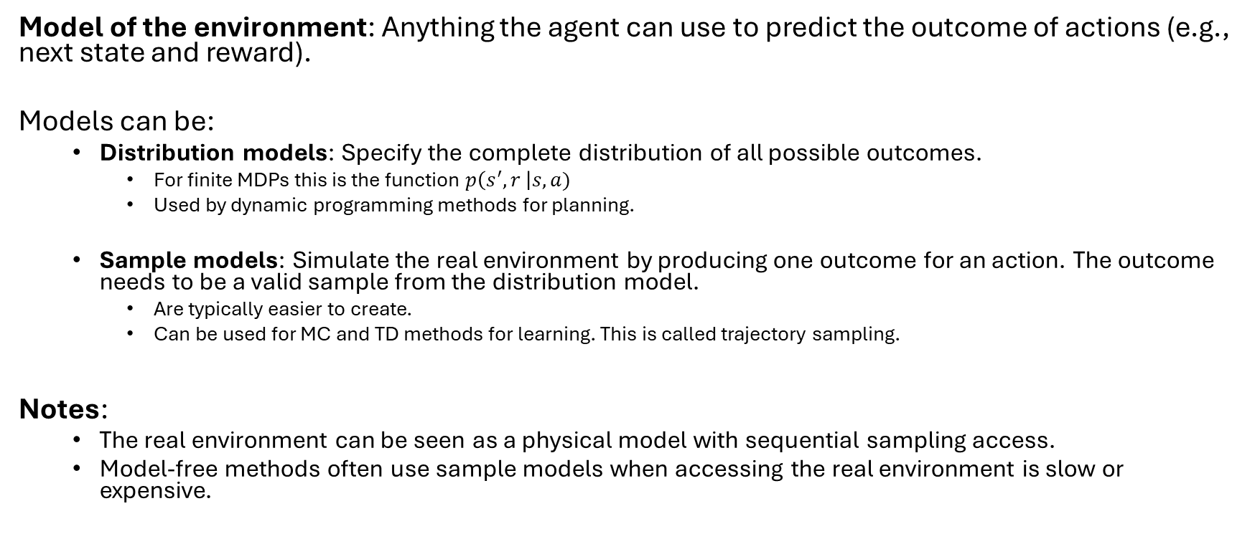
What is a Model
Model of the environment: Anything the agent can use to predict the outcome of actions (e.g., next state and reward).
Models can be:
Distribution models: Specify the complete distribution of all possible outcomes.
For finite MDPs this is the function $p\left(s^{′},r \right|s,a)$
Used by dynamic programming methods for planning.
Sample models: Simulate the real environment by producing one outcome for an action. The outcome needs to be a valid sample from the distribution model.
Are typically easier to create.
Can be used for MC and TD methods for learning. This is called trajectory sampling.
Notes:
The real environment can be seen as a physical model with sequential sampling access.
Model-free methods often use sample models when accessing the real environment is slow or expensive.
Can we integrate learning and planning?

Slide 7
Dyna
Integrating Planning, Acting, and Learning

Slide 8
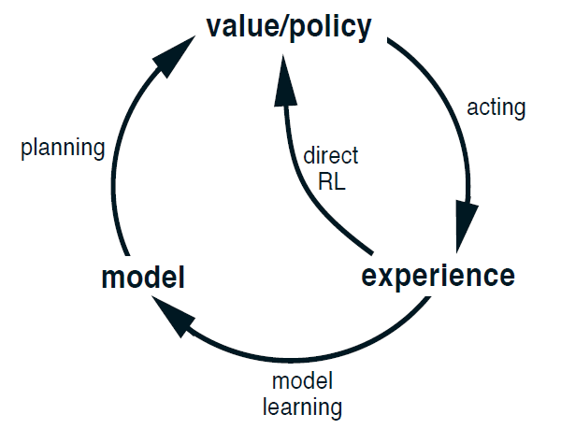
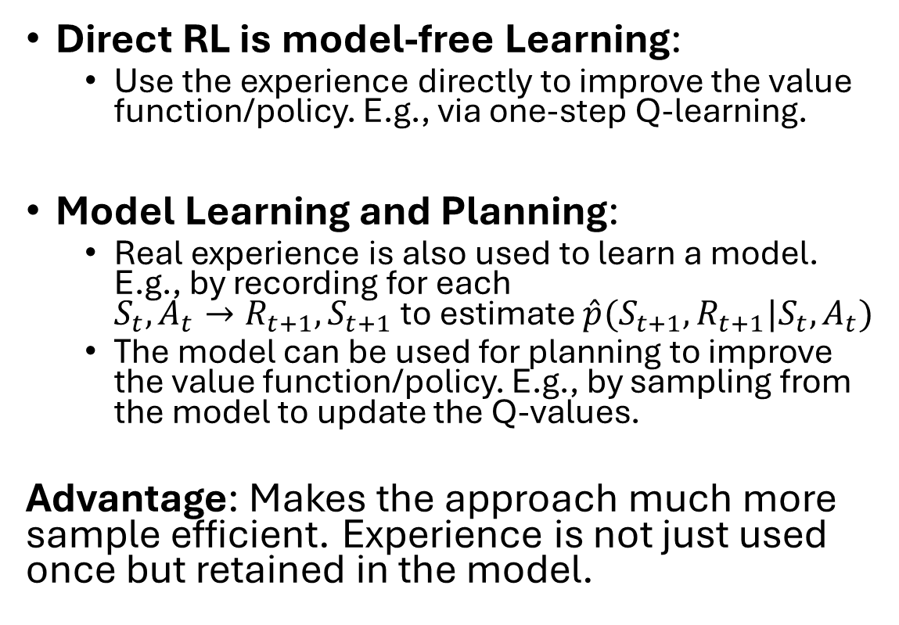
Integrating Planning, Acting, and Learning
Direct RL is model-free Learning:
Use the experience directly to improve the value function/policy. E.g., via one-step Q-learning.
Model Learning and Planning:
Real experience is also used to learn a model. E.g., by recording for each $S_{t},A_{t}→R_{t+1}, S_{t+1}$ to estimate $\hat{p}(S_{t+1},R_{t+1}|S_{t},A_{t})$
The model can be used for planning to improve the value function/policy. E.g., by sampling from the model to update the Q-values.
Advantage: Makes the approach much more sample efficient. Experience is not just used once but retained in the model.

Slide 9
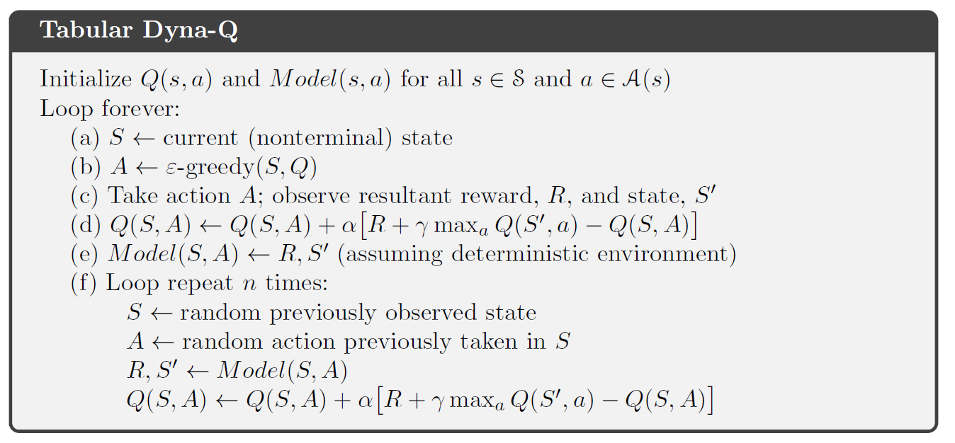
Alg. Tabular Dyna-Q
Direct RL
Model learning
Planning

Slide 10
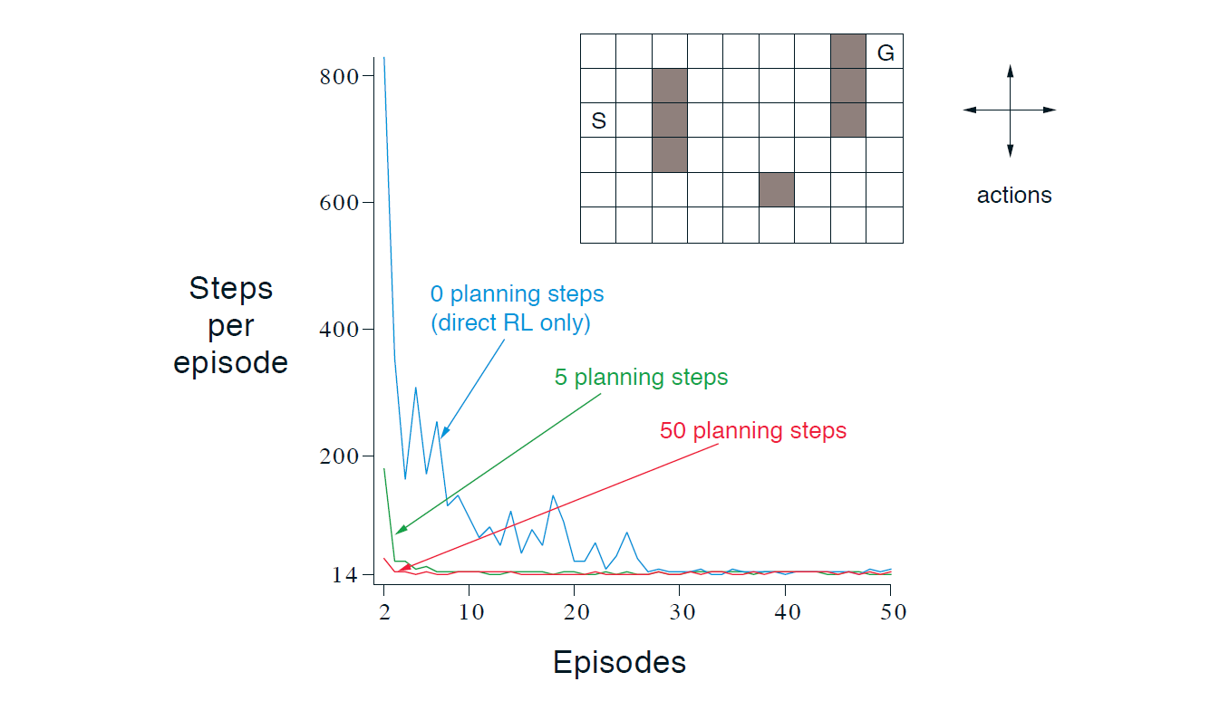
The Effect of Planning
Benefit: Adding planning speeds learning by reusing sampled experience.
Issues: Planning is a problem if the model is wrong:
Based on an insufficient number of samples.
Function approximation not great.
Environment changes
Dyna quickly corrects too optimistic predictions since they will be selected for the next real action.
For changing environments:
Keep exploring.
Keep track of long action/state combinations that were not tried.

Slide 11
Sampling
Base updates on sampled experience

Slide 12
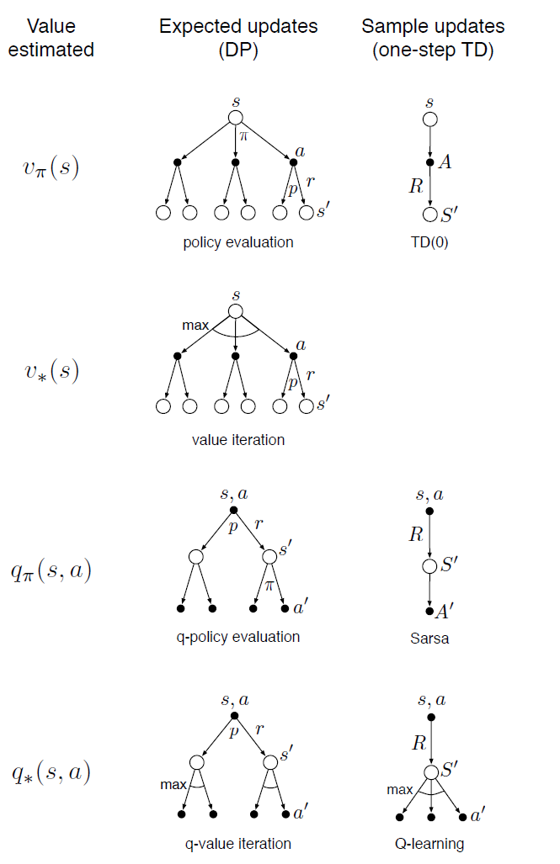
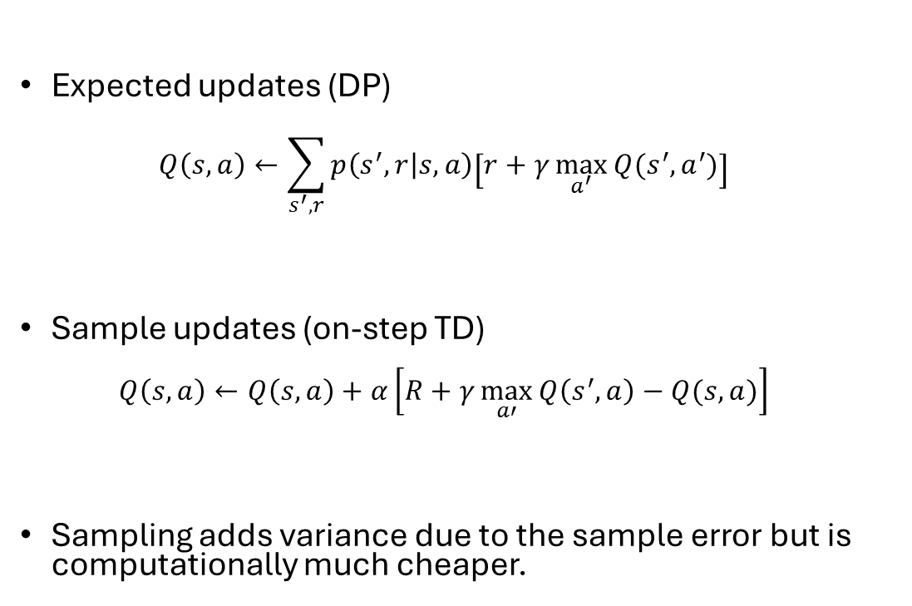
Expected vs. Sample Updates
Expected updates (DP) $Q\left(s,a\right)←\sum_{s^{′},r}{p\left(s^{′},r | s,a\right)\left[r+γ\max_{a^{′}}{Q(s^{′},a^{′})}\right]}$
Sample updates (on-step TD) $Q\left(s,a\right)←Q\left(s,a\right)+α\left[R+γ\max_{a′}{Q\left(s^{′},a\right)−Q(s,a)}\right]$
Sampling adds variance due to the sample error but is computationally much cheaper.

Slide 13
Heuristic Search and Rollout Algorithms
Decision-time planning

Slide 14
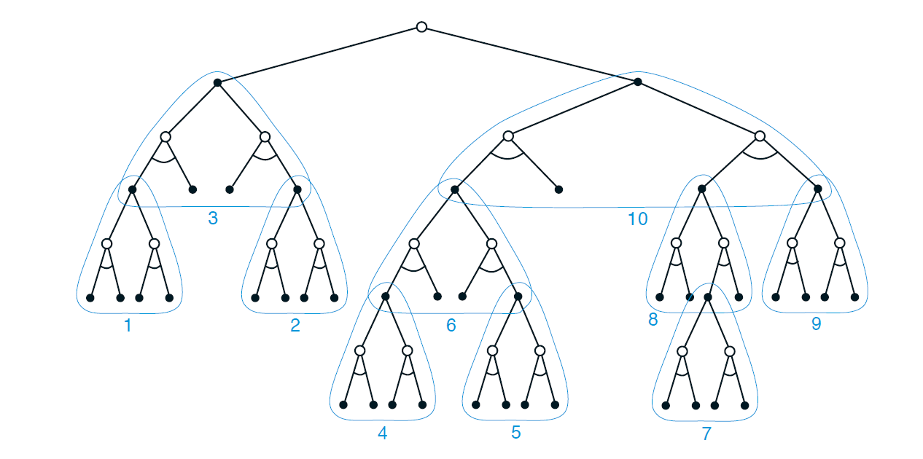
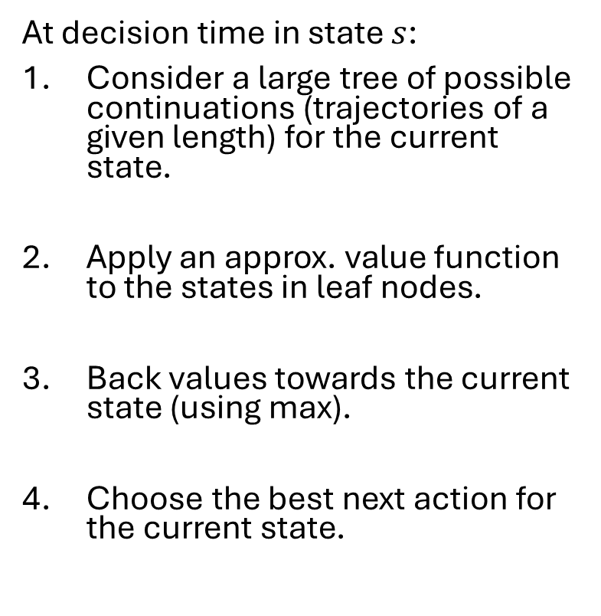
Option 1: Heuristic Search
4. Pick best action
At decision time in state $s$:
Consider a large tree of possible continuations (trajectories of a given length) for the current state.
Apply an approx. value function to the states in leaf nodes.
Back values towards the current state (using max).
Choose the best next action for the current state.
3. backup
2. Estimate values
Note: This is like heuristic min-max search for games.

Slide 15
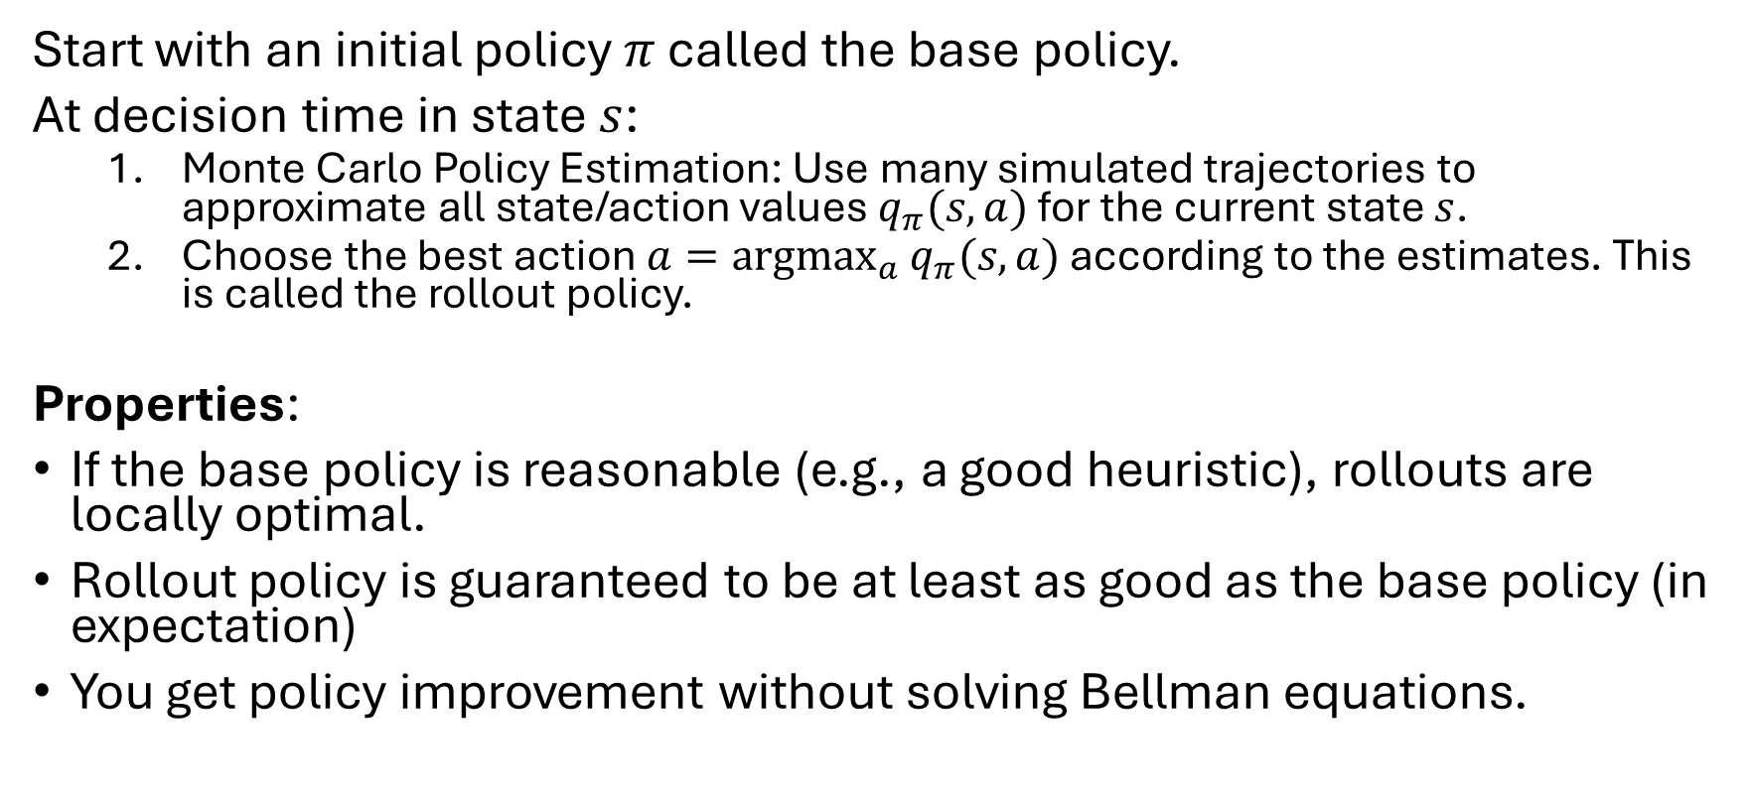
Option 2: Rollout Algorithms
Start with an initial policy $π$ called the base policy.
At decision time in state $s$:
Monte Carlo Policy Estimation: Use many simulated trajectories to approximate all state/action values $q_{π}(s,a)$ for the current state $s$.
Choose the best action $a=\underset{a}{argmax}{q_{π}(s,a)}$ according to the estimates. This is called the rollout policy.
Properties:
If the base policy is reasonable (e.g., a good heuristic), rollouts are locally optimal.
Rollout policy is guaranteed to be at least as good as the base policy (in expectation)
You get policy improvement without solving Bellman equations.

Slide 16
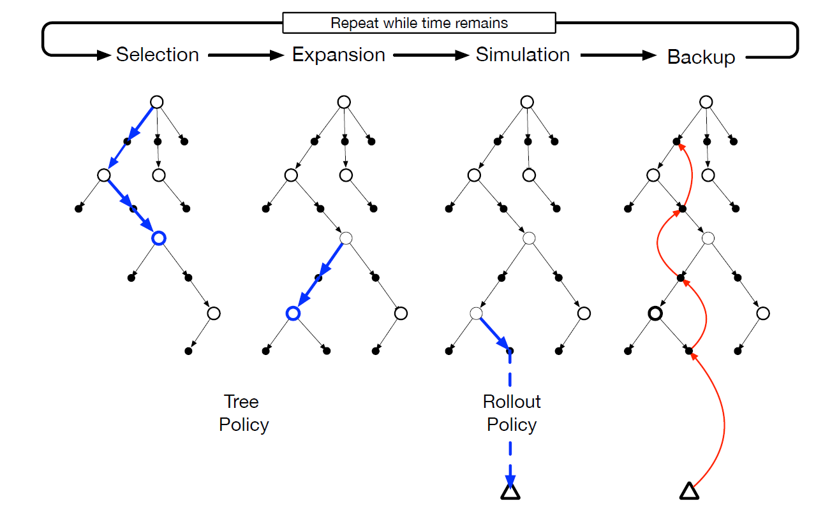
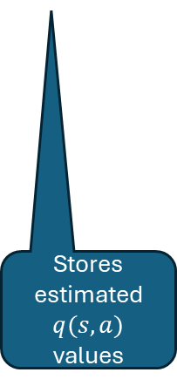
Rollout Algorithm: Monte Carlo Tree Search
MCTS is a rollout algorithm that stores some intermediate estimates in a depth-limited tree structure.
Selection: Pick the currently best leaf node (e.g., greedy, UCB).
Expansion: Add new nodes, but keep the tree small enough.
Simulation: From a selected node, simulate complete episode(s).
Backup: update the tree with the result of the playout.
Advantage: selection steers the simulation towards better trajectories. This avoids approximating the full value function.
Stores estimated $q(s,a)$ values
MTCS can be seen as an RL method that selectively approximates q-values useful for choosing good actions.

Slide 17
What you Should Know
Planning requires a model of the environment.
Distribution model
Sample model
DP requires a distribution model because it uses expected updates.
Model-free RL, like TD, can use a sample model to perform sample updates.
Decision-time planning can also use a sample model. E.g., rollout algorithms sample trajectories.
Planning and learning are related: They try to estimate the same value function.

Slide 18
Summary of Part I: Tabular Solution Methods

Slide 19
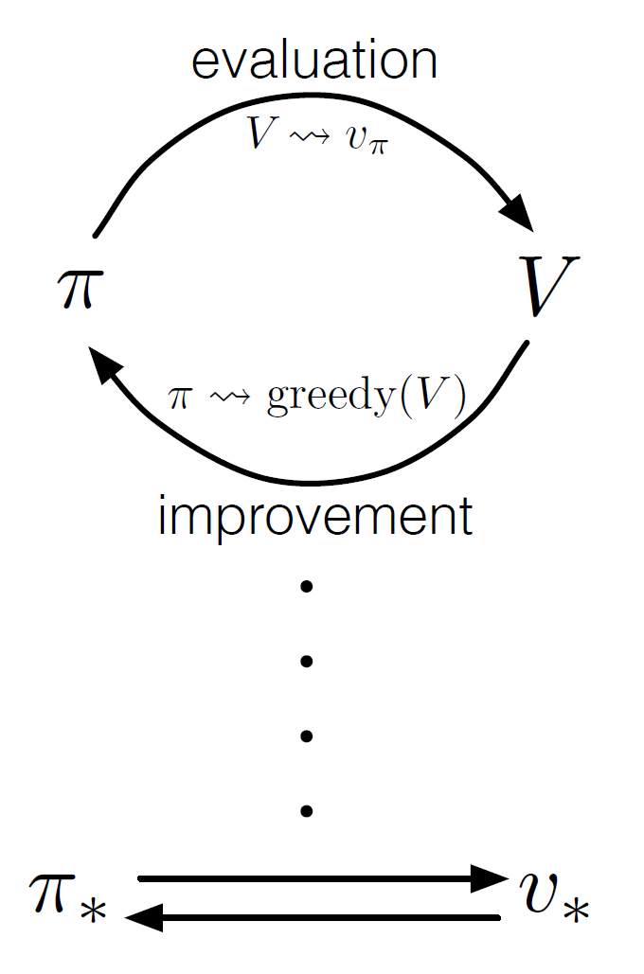
Common Ideas
GPI
Estimate a value function.
Back up along actual or possible state trajectories.
Generalized policy iteration (GPI): maintain an approx. value function and an approx. policy. Each is used to update the other. Converges due to the policy improvement theorem.

Slide 20
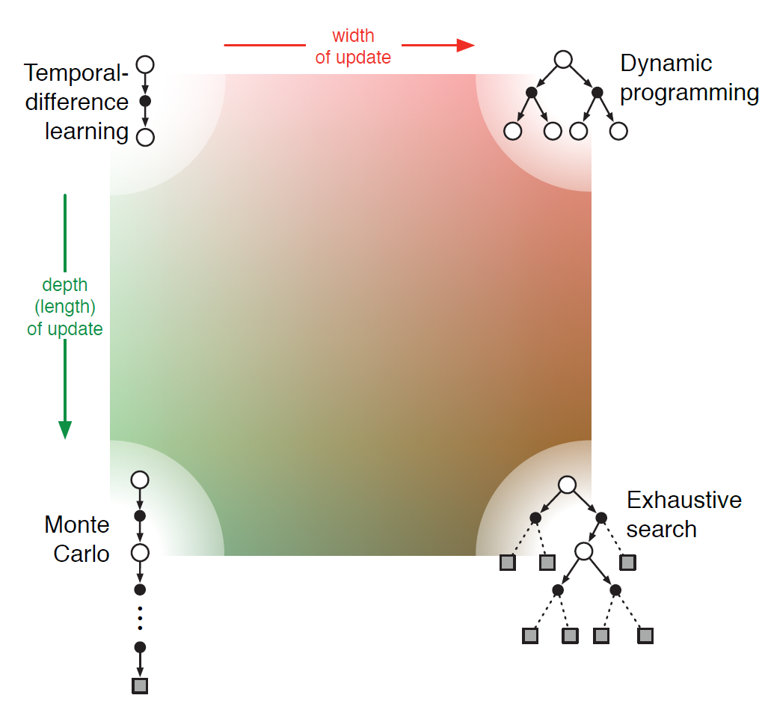
Update Depth vs. Update Width
One-step methods
Each method is located somewhere in this continuum.
n-step methods
Rollout Algorithms
Full-return methods
Sampled trajectory
Consider all actions

Slide 21
On-Policy vs. Off-Policy
On-Policy: Learn the policy the agent is following.
Off-Policy: Learn a target policy that is different from the followed behavior policy.
Off-Policy is useful because:
Learn optimal policies while exploring
Reuse of data: sample efficiency, offline, and batch RL
Safe learning and exploration
Off-Policy learning is harder because:
Requires distributional correction: E.g., importance sampling
May suffer from high variance (due to importance sampling)
Instability with non-linear function approximation (deep RL)

Slide 22
Other Dimensions
Definition of return: Episodic vs. continuing task; discounted vs. undiscounted.
Action values vs. state values
Exploration vs Exploitation: This is a trade-off. Many methods need exploration for convergence.
Synchronous vs. Asynchronous: Are all states updated at once or one by one in some order?
Real vs. Simulated: Are real experiences, simulations, or both used for updates?

Slide 23
Relationship With Reflex Agents
Tabular methods create a policy that defines the action for each state.
We can implement this policy by a set of rules, one for each state.
This means that tabular RL learns a reflex agent.
Cases:
Fully observable case (MDPs): Learn a simple reflex agent.
Partially observable case: The agent constantly updates its agent state to approximate the environment state. The agent stores the agent state and uses it to decide on actions. It learns a model-based reflex agent.

Slide 24
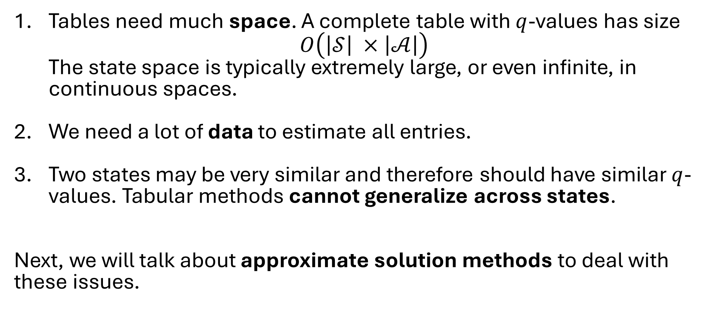
Issues with Tabular Methods
Tables need much space. A complete table with $q$-values has size $O\left(\left|𝒮\right| ×\left|𝒜\right|\right)$ The state space is typically extremely large, or even infinite, in continuous spaces.
We need a lot of data to estimate all entries.
Two states may be very similar and therefore should have similar $q$-values. Tabular methods cannot generalize across states.
Next, we will talk about approximate solution methods to deal with these issues.

