Slide 1



Reinforcement Learning Prediction and Control with Approximation Sutton/Barto* Chapter 9-11
Michael Hahsler, SMU
With figures from Sutton/Barto*
*Sutton and Barto, Reinforcement Learning: An Introduction, 2nd edition, MIT Press, Cambridge, MA, 2018

Slide 2
Topics of this Course
Introduction to reinforcement learning
Markov decision processes
Part I: Tabular Methods
Dynamic programming
Monte Carlo methods
Temporal-difference learning
Multi-step bootstrapping
Planning and learning with tabular methods
Part II: Approximate Solution Methods
Prediction and Control using Approximation
Eligibility Traces
Policy Gradient Methods
Part III: Modern RL Methods
Deep Reinforcement Learning
Current Applications

Slide 3
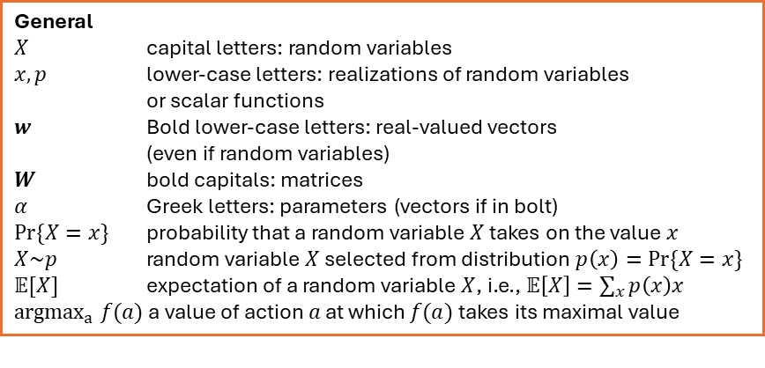
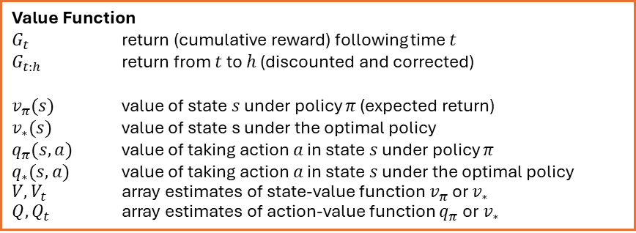
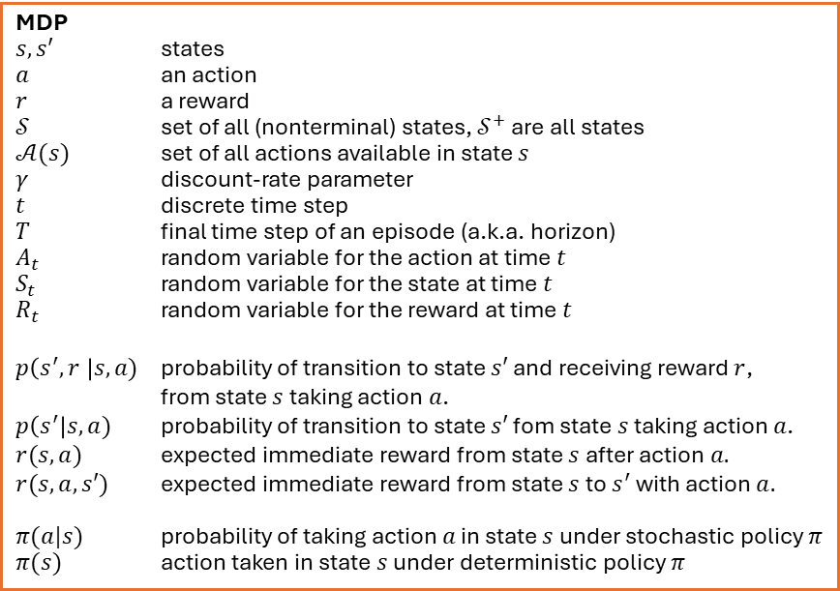
Summary of Notation
General
$X$ capital letters: random variables $x, p$ lower-case letters: realizations of random variables or scalar functions
$w$ Bold lower-case letters: real-valued vectors (even if random variables)
$W$ bold capitals: matrices
$α$ Greek letters: parameters (vectors if in bolt)
$Pr⁡\{X=x\}$ probability that a random variable $X$ takes on the value $x$
$X\sim p$ random variable $X$ selected from distribution $p\left(x\right)=Pr⁡\{X=x\}$
$𝔼[X]$ expectation of a random variable $X$, i.e., $𝔼\left[X\right]=\sum_{x}{p\left(x\right)x}$
${argmax}_{a} f(a)$ a value of action $a$ at which $f(a)$ takes its maximal value
MDP
$s, s′$ states
$a$ an action
$r$ a reward
$𝒮$ set of all (nonterminal) states, $𝒮^{+}$ are all states
$𝒜(s)$ set of all actions available in state $s$
$γ$ discount-rate parameter
$t$ discrete time step
$T$ final time step of an episode (a.k.a. horizon)
$A_{t}$ random variable for the action at time $t$
$S_{t}$ random variable for the state at time $t$
$R_{t}$ random variable for the reward at time $t$
$p\left(s^{′},r \right|s, a)$ probability of transition to state $s′$ and receiving reward $r$, from state $s$ taking action $a$.
$p\left(s^{′}\right|s, a)$ probability of transition to state $s′$ fom state $s$ taking action $a$.
$r(s,a)$ expected immediate reward from state $s$ after action $a.$
$r(s,a,s′)$ expected immediate reward from state $s$ to $s^{′}$ with action $a.$
$π(a|s)$ probability of taking action $a$ in state $s$ under stochastic policy $π$
$π(s)$ action taken in state $s$ under deterministic policy $π$
Value Function
$G_{t}$ return (cumulative reward) following time $t$
$G_{t:h}$ return from $t$ to $h$ (discounted and corrected)
$v_{π}(s)$ value of state $s$ under policy $π$ (expected return)
$v_{∗}(s)$ value of state s under the optimal policy
$q_{π}(s,a)$ value of taking action $a$ in state $s$ under policy $π$
$q_{∗}(s,a)$ value of taking action $a$ in state $s$ under the optimal policy
$V, V_{t}$ array estimates of state-value function $v_{π}$or $v_{∗}$
$Q,Q_{t}$ array estimates of action-value function $q_{π}$or $v_{∗}$

Slide 4
Approximate Solution Methods

Slide 5
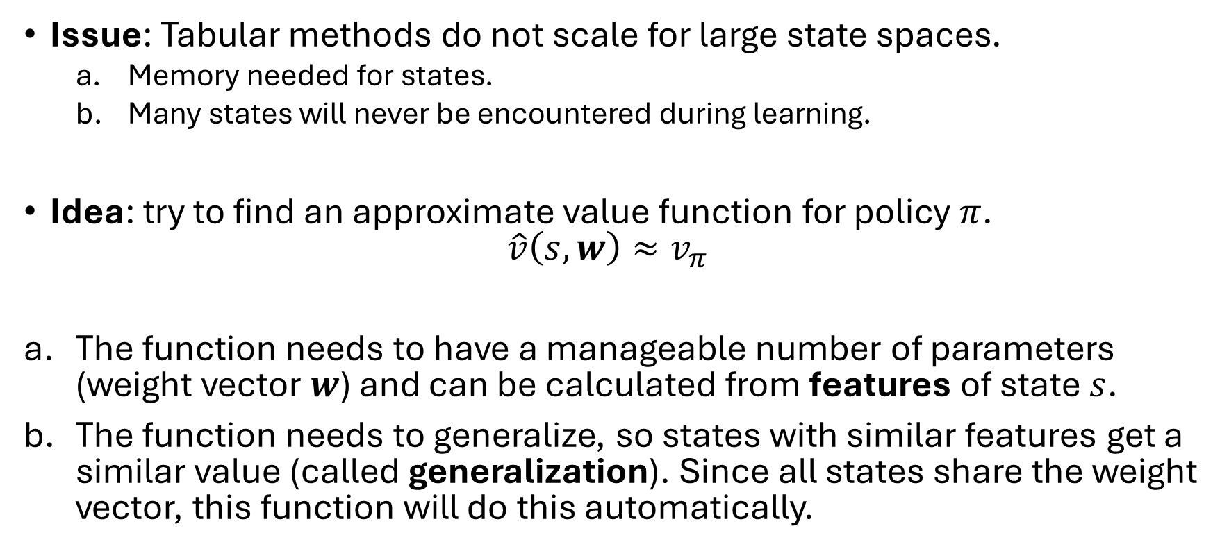
Motivation
Issue: Tabular methods do not scale for large state spaces.
Memory needed for states.
Many states will never be encountered during learning.
Idea: try to find an approximate value function for policy $π$. $\hat{v}\left(s,w\right)≈v_{π}$
The function needs to have a manageable number of parameters (weight vector $w$) and can be calculated from features of state $s$.
The function needs to generalize, so states with similar features get a similar value (called generalization). Since all states share the weight vector, this function will do this automatically.

Slide 6
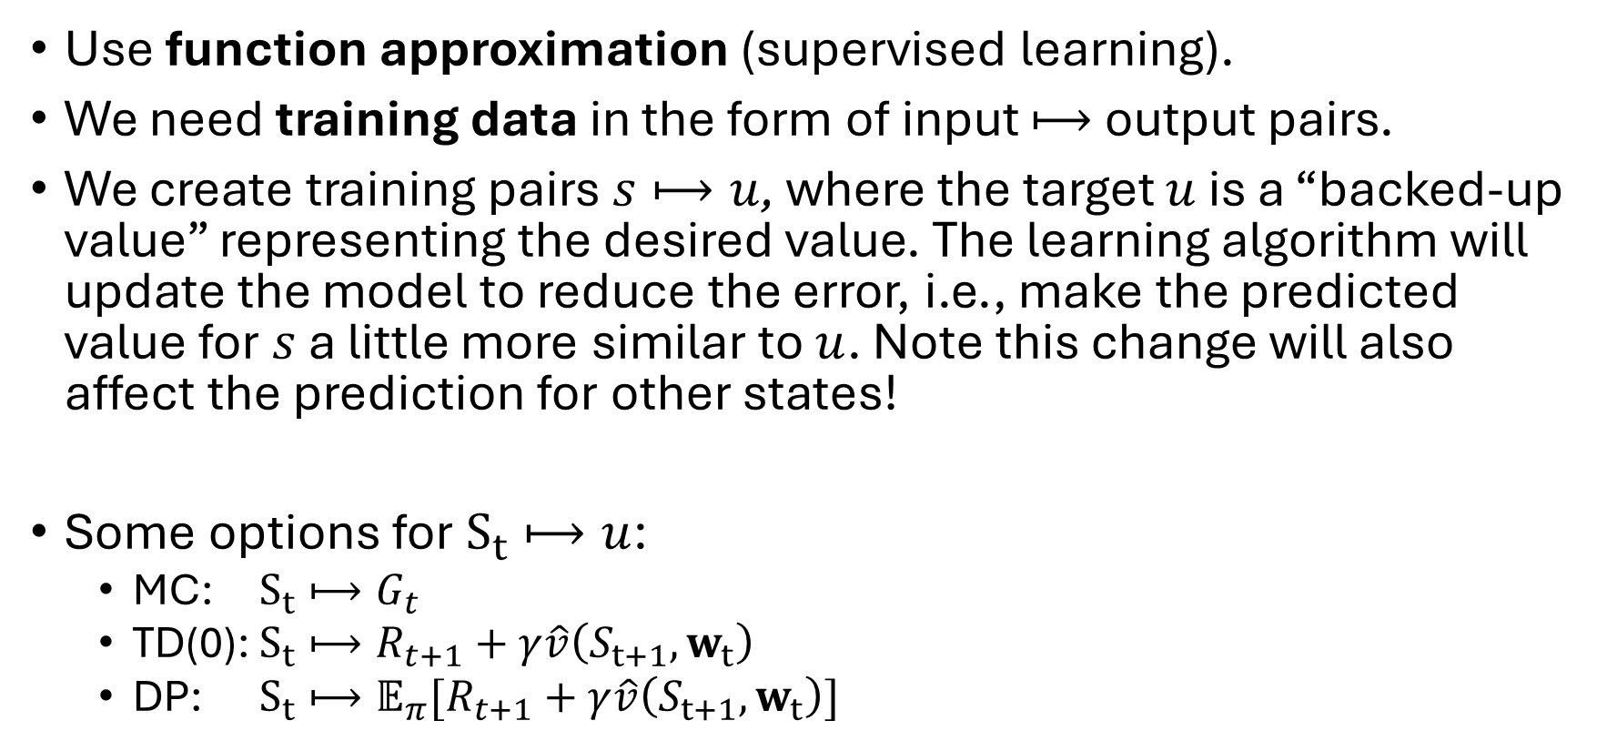
Value Function Approximation (Prediction)
Use function approximation (supervised learning).
We need training data in the form of input $⟼$ output pairs.
We create training pairs $s⟼u$, where the target $u$ is a “backed-up value” representing the desired value. The learning algorithm will update the model to reduce the error, i.e., make the predicted value for $s$ a little more similar to $u$. Note this change will also affect the prediction for other states!
Some options for $S_{t}⟼u$:
MC: $S_{t}⟼G_{t}$
TD(0): $S_{t}⟼R_{t+1}+γ\hat{v}\left(S_{t+1},w_{t}\right)$
DP: $S_{t}⟼𝔼_{π}[R_{t+1}+γ\hat{v}\left(S_{t+1},w_{t}\right)]$

Slide 7
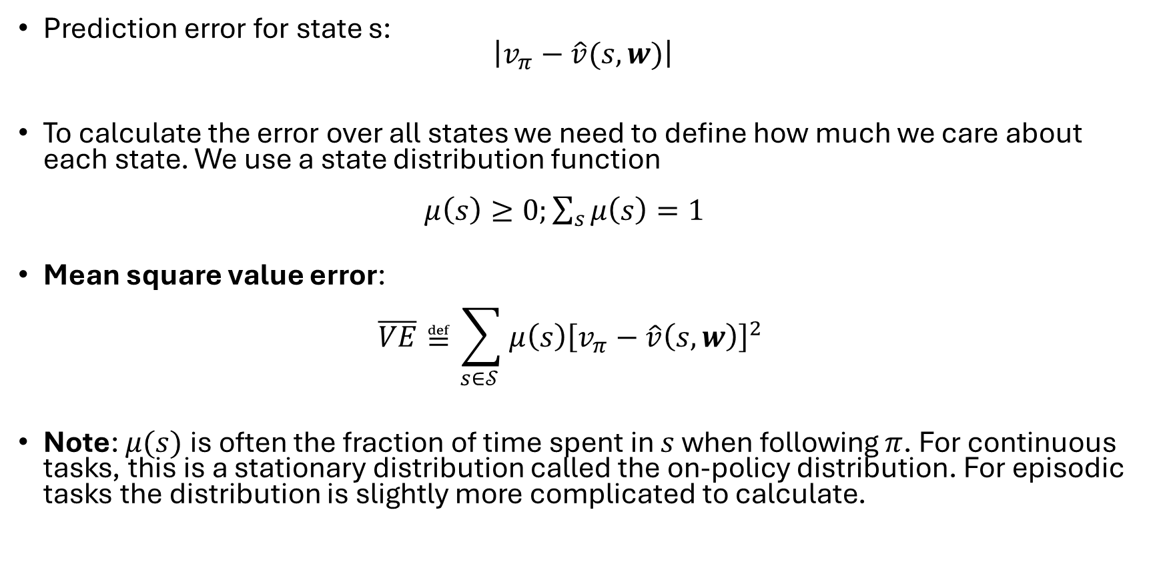
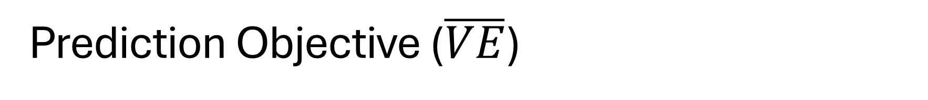
Prediction Objective ($\overline{VE}$)
Prediction error for state s: $\left|v_{π}−\hat{v}(s,w)\right|$
To calculate the error over all states we need to define how much we care about each state. We use a state distribution function $μ\left(s\right)≥0;\sum_{s}{μ\left(s\right)}=1$
Mean square value error: $\overline{VE}≝\sum_{s∈𝒮 }{μ\left(s\right){\left[v_{π}−\hat{v}\left(s,w\right)\right]}^{2}}$
Note: $μ(s)$ is often the fraction of time spent in $s$ when following $π$. For continuous tasks, this is a stationary distribution called the on-policy distribution. For episodic tasks the distribution is slightly more complicated to calculate.

Slide 8
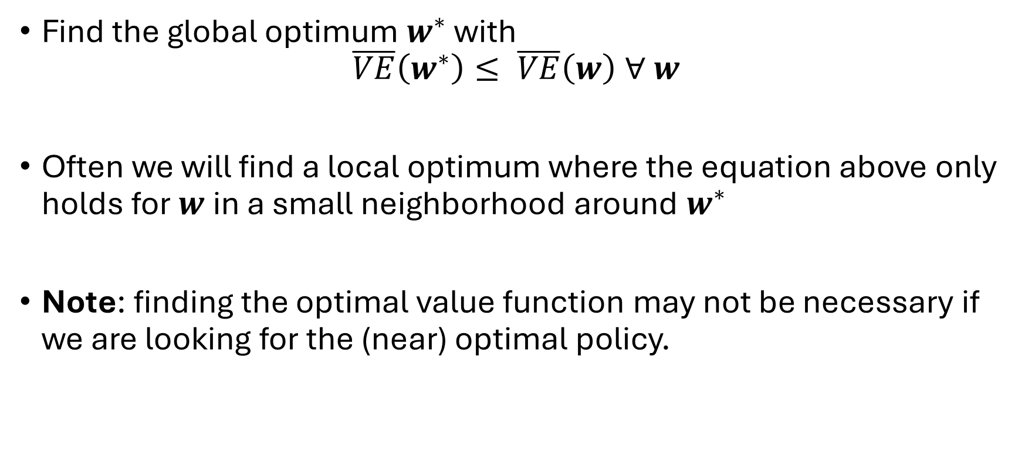
Learning Goal
Find the global optimum $w^{∗}$ with $\overline{VE}\left(w^{∗}\right)≤ \overline{VE}\left(w\right) ∀ w$
Often we will find a local optimum where the equation above only holds for $w$in a small neighborhood around $w^{∗}$
Note: finding the optimal value function may not be necessary if we are looking for the (near) optimal policy.

Slide 9
Stochastic-gradient and Semi-gradient Methods

Slide 10
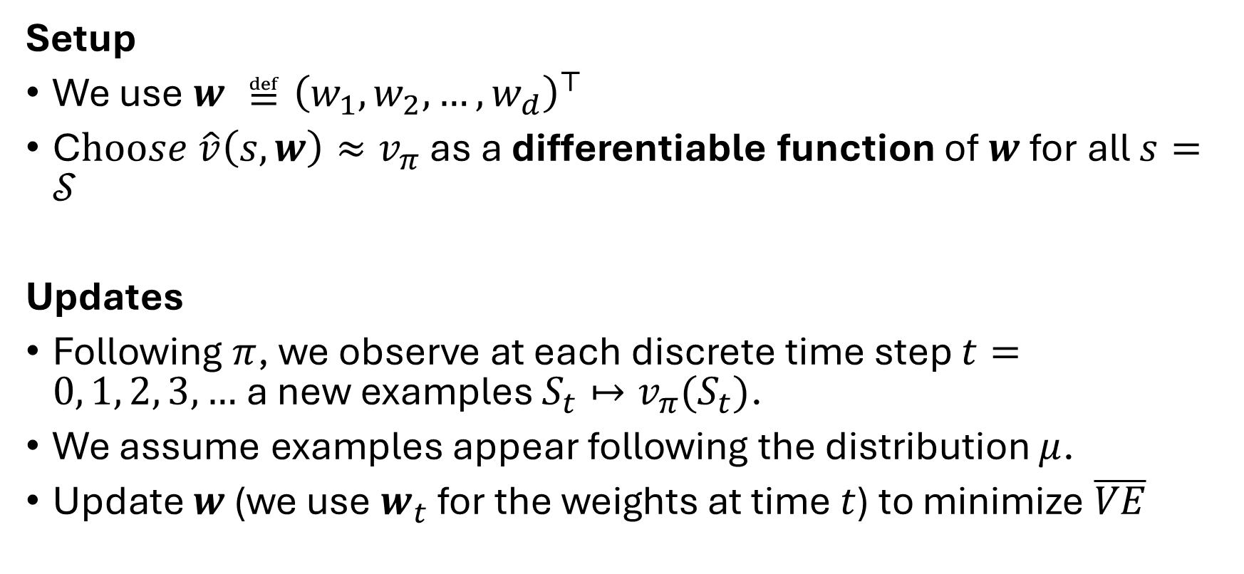
Learning Method
Setup
We use $w ≝{\left(w_{1},w_{2},…,w_{d}\right)}^{⊤}$
C$hoose \hat{v}\left(s,w\right)≈v_{π}$ as a differentiable function of $w$ for all $s=𝒮$
Updates
Following $π$, we observe at each discrete time step $t=0, 1, 2, 3, …$a new examples $S_{t}↦v_{π}(S_{t})$.
We assume examples appear following the distribution $μ$.
Update $w$ (we use $w_{t}$ for the weights at time $t$) to minimize $\overline{VE}$

Slide 11
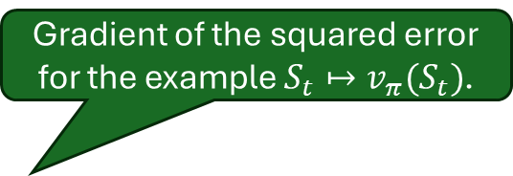
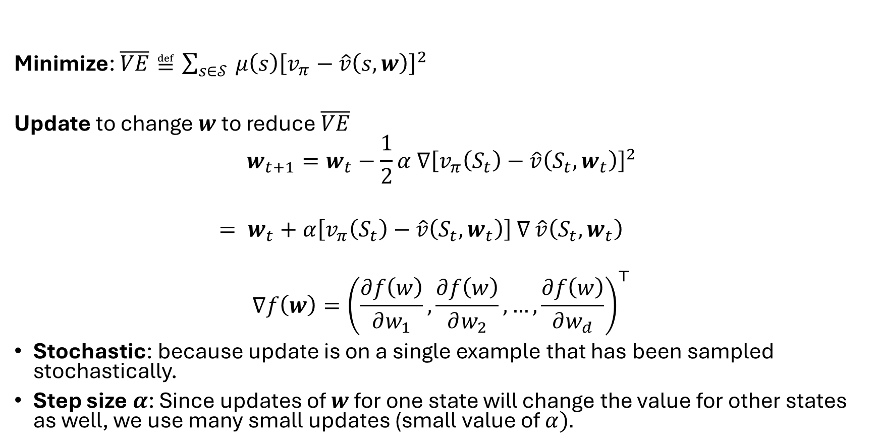

Stochastic-gradient Descend (SGD)
Minimize: $\overline{VE}≝\sum_{s∈𝒮 }{μ\left(s\right){\left[v_{π}−\hat{v}\left(s,w\right)\right]}^{2}}$
Update to change $w$ to reduce $\overline{VE}$
$$w_{t+1}=w_{t}−\frac{1}{2}α ∇{\left[v_{π}\left(S_{t}\right)−\hat{v}\left(S_{t},w_{t}\right)\right]}^{2}$$ $= w_{t}+α\left[v_{π}\left(S_{t}\right)−\hat{v}\left(S_{t},w_{t}\right)\right]$ $∇$ $\hat{v}\left(S_{t},w_{t}\right)$
$$∇f\left(w\right)={\left(\frac{∂f\left(w\right)}{∂w_{1}},\frac{∂f\left(w\right)}{∂w_{2}},…,\frac{∂f\left(w\right)}{∂w_{d}}\right)}^{⊤}$$
Stochastic: because update is on a single example that has been sampled stochastically.
Step size $α$: Since updates of $w$ for one state will change the value for other states as well, we use many small updates (small value of $α).$
Gradient of the squared error for the example $S_{t}↦v_{π}(S_{t})$.
Gradient of $f$ with respect to $w$

Slide 12
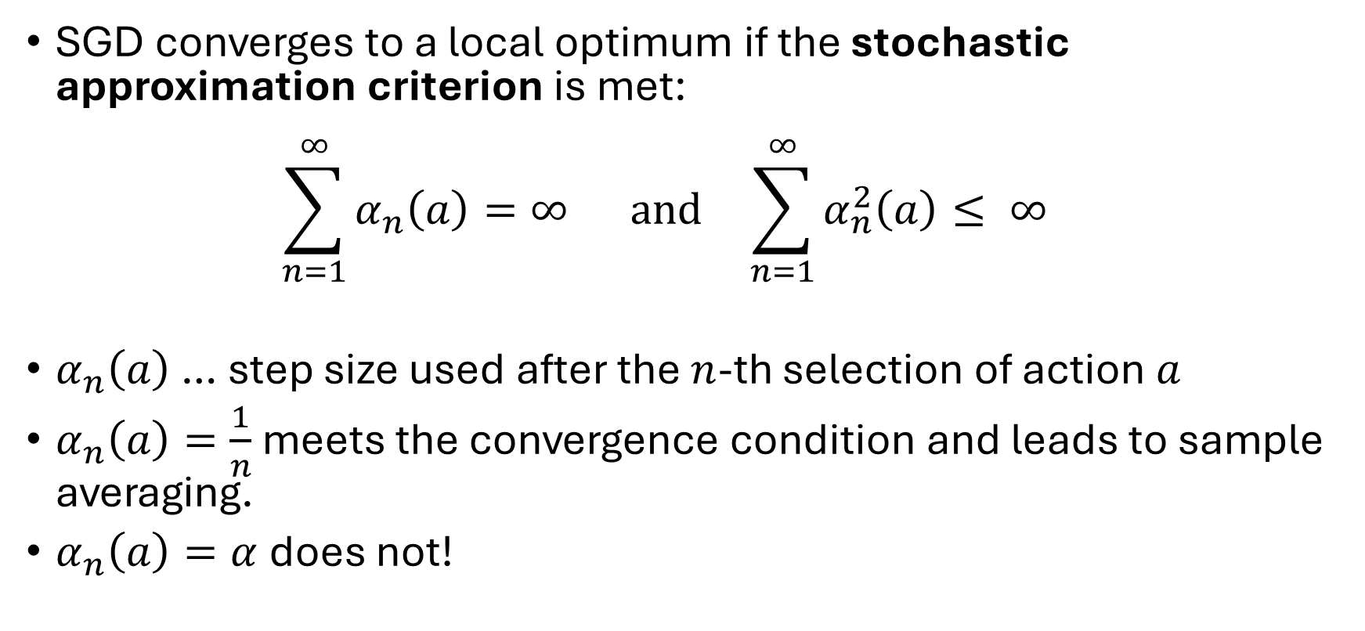
Step Size for SGD
SGD converges to a local optimum if the stochastic approximation criterion is met: $\sum_{n=1}^{∞}{α_{n}\left(a\right)=∞ \text{and} }\sum_{n=1}^{∞}{α_{n}^{2}\left(a\right)≤ ∞ }$
$α_{n}\left(a\right)$ … step size used after the $n$-th selection of action $a$
$α_{n}\left(a\right)=\frac{1}{n}$ meets the convergence condition and leads to sample averaging.
$α_{n}\left(a\right)=α$ does not!

Slide 13
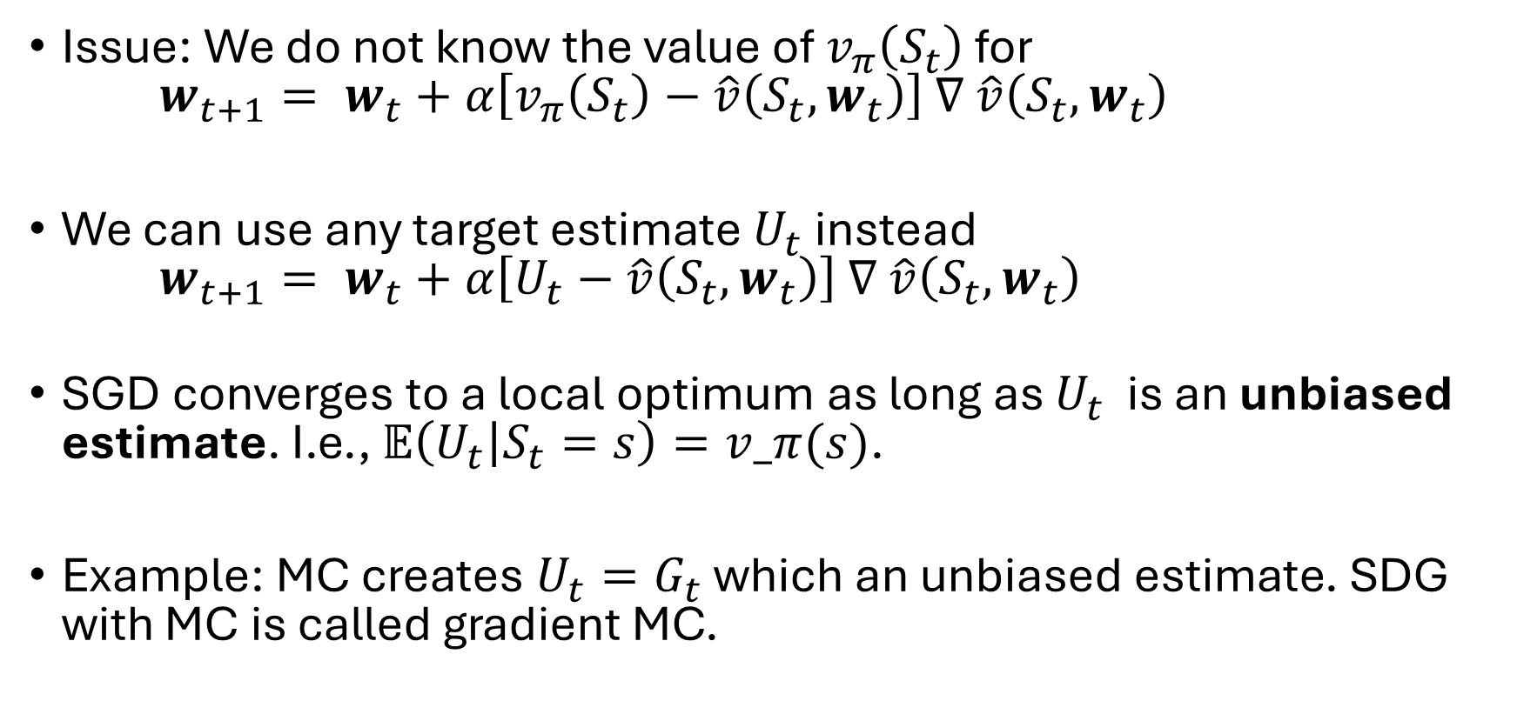
Using a Target Estimate for SGD
Issue: We do not know the value of $v_{π}\left(S_{t}\right)$ for $w_{t+1}= w_{t}+α\left[v_{π}\left(S_{t}\right)−\hat{v}\left(S_{t},w_{t}\right)\right]$ $∇$ $\hat{v}\left(S_{t},w_{t}\right)$
We can use any target estimate $U_{t}$ instead $w_{t+1}= w_{t}+α\left[U_{t}−\hat{v}\left(S_{t},w_{t}\right)\right]$ $∇$ $\hat{v}\left(S_{t},w_{t}\right)$
SGD converges to a local optimum as long as $U_{t}$ is an unbiased estimate. I.e., $𝔼\left(U_{t} | S_{t}=s\right)=v_π(s)$.
Example: MC creates $U_{t}=G_{t}$ which an unbiased estimate. SDG with MC is called gradient MC.

Slide 14
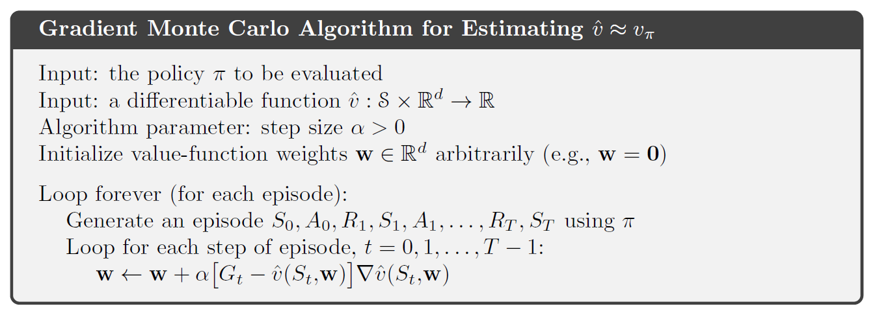

Gradient Monte Carlo Algorithm
Remember from MC: $$G_{t}=\sum_{k=0}^{T}{γ^{k}R_{t+k+1}}$$

Slide 15
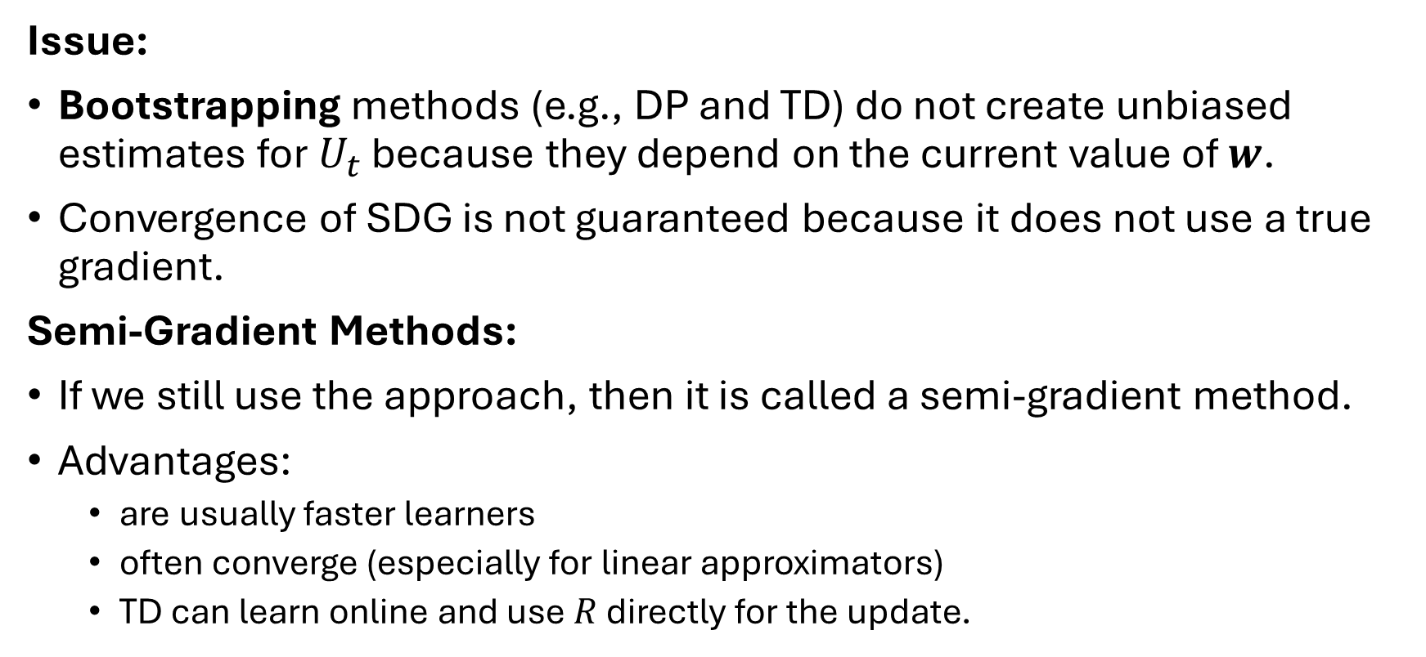
Semi-gradient Methods
Issue:
Bootstrapping methods (e.g., DP and TD) do not create unbiased estimates for $U_{t}$ because they depend on the current value of $w$.
Convergence of SDG is not guaranteed because it does not use a true gradient.
Semi-Gradient Methods:
If we still use the approach, then it is called a semi-gradient method.
Advantages:
are usually faster learners
often converge (especially for linear approximators)
TD can learn online and use $R$ directly for the update.

Slide 16
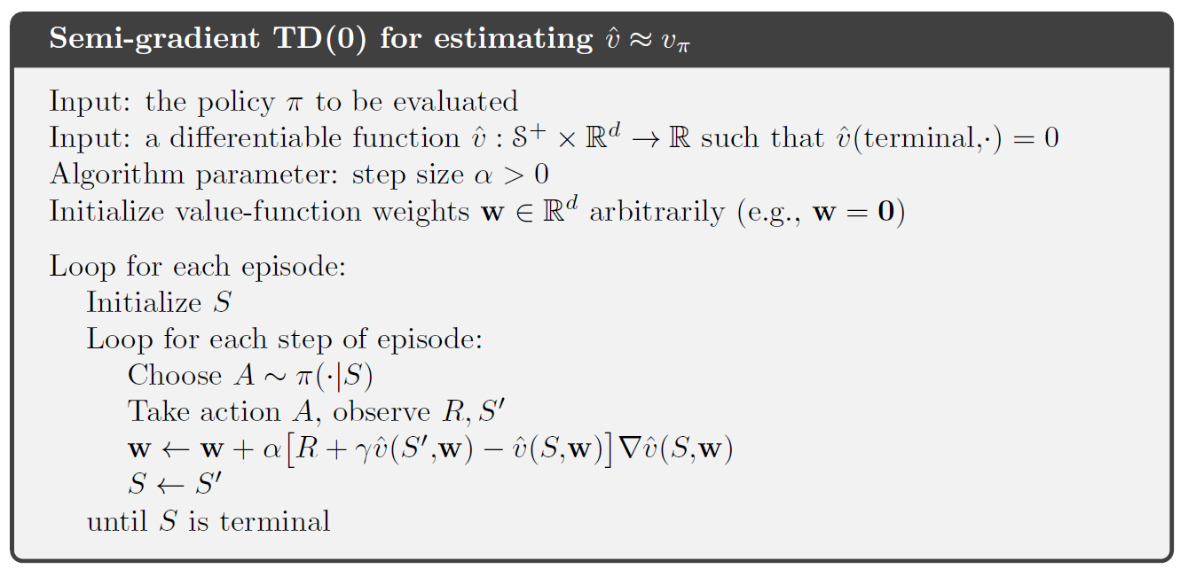
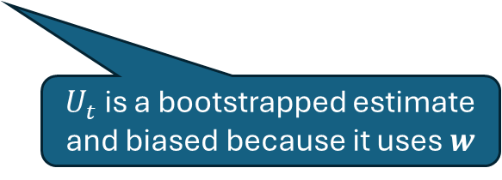
Semi-gradient TD(0)
$U_{t}$ is a bootstrapped estimate and biased because it uses $w$

Slide 17
Linear Approximation Methods
Linear Regression + Feature Construction

Slide 18
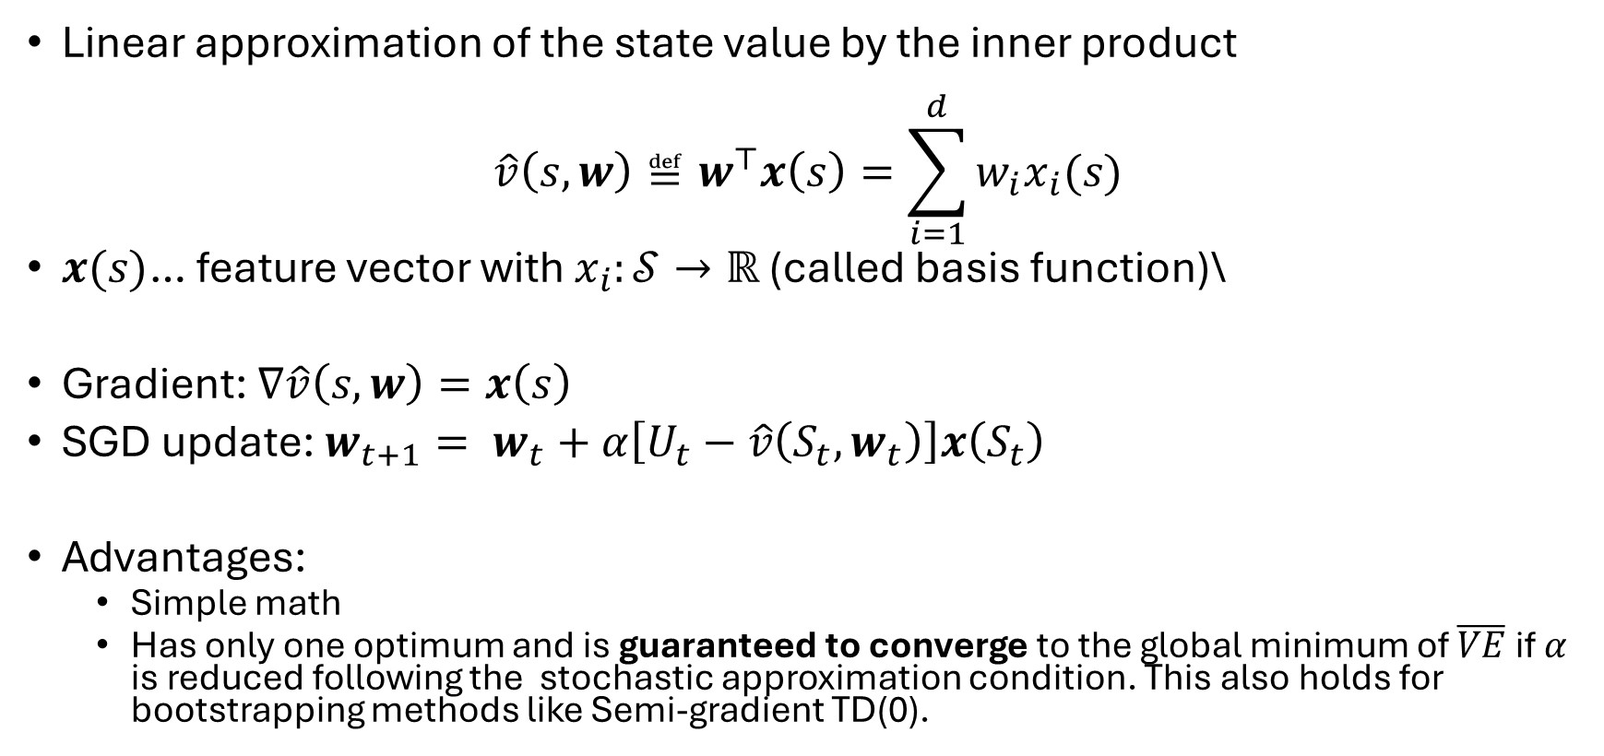
Linear Methods
Linear approximation of the state value by the inner product
$$\hat{v}\left(s,w\right)≝w^{⊤}x\left(s\right)=\sum_{i=1}^{d}{w_{i}x_{i}(s)}$$
$x(s)$… feature vector with $x_{i}:𝒮→ℝ$ (called basis function)\
Gradient: $∇\hat{v}\left(s,w\right)=x\left(s\right)$
SGD update: $w_{t+1}= w_{t}+α\left[U_{t}−\hat{v}\left(S_{t},w_{t}\right)\right]x\left(S_{t}\right)$
Advantages:
Simple math
Has only one optimum and is guaranteed to converge to the global minimum of $\overline{VE}$if $α$ is reduced following the stochastic approximation condition. This also holds for bootstrapping methods like Semi-gradient TD(0).

Slide 19
Feature Construction
Linear methods of value estimation = interpolation/linear regression task
Features need to describe the state.
Linear regression cannot take interactions between features into account: We need to create “interaction features”
Idea: construct features based on the state description.
We will focus on the most popular feature construction methods that work well for RL:
Fourier Basis
Tile Coding (coarse coding using tiles)
Other methods
Polynomials
Coarse Coding using spherical reception fields
Radial Basis Functions

Slide 20
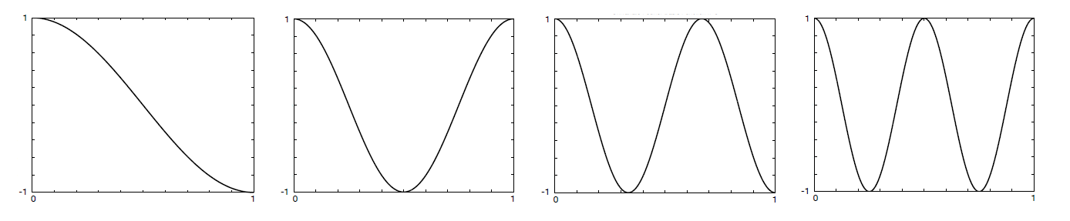


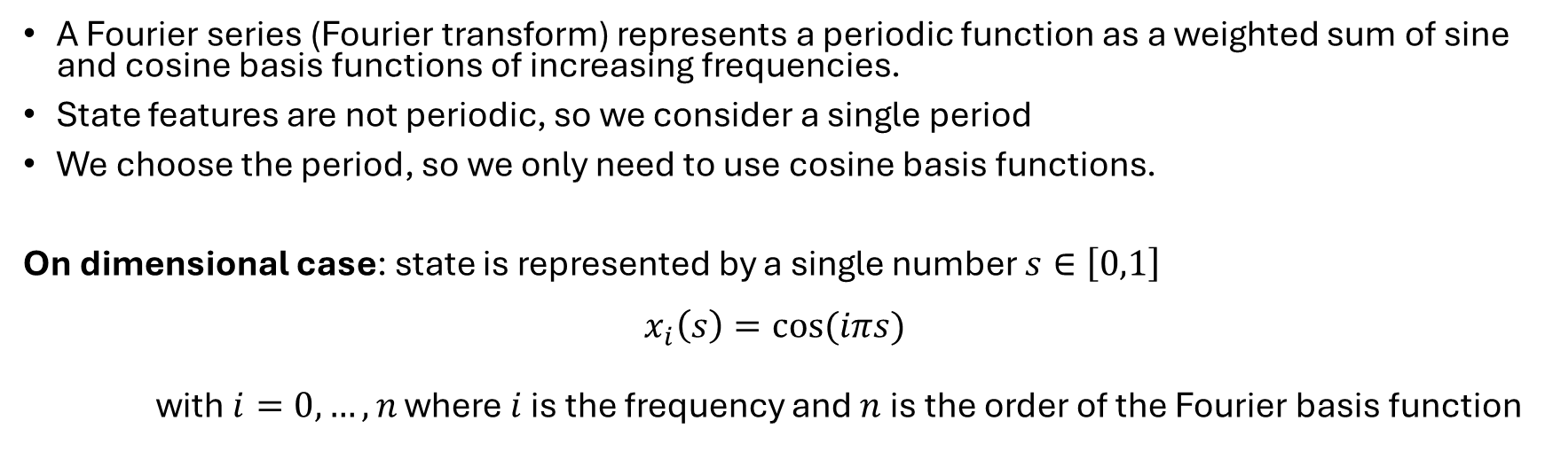




Example: Fourier Basis
A Fourier series (Fourier transform) represents a periodic function as a weighted sum of sine and cosine basis functions of increasing frequencies.
State features are not periodic, so we consider a single period
We choose the period, so we only need to use cosine basis functions.
On dimensional case: state is represented by a single number $s∈\left[0,1\right]$ $$x_{i}\left(s\right)=\cos{(iπs)}$$
with$i=0,…,n$ where $i$ is the frequency and $n$ is the order of the Fourier basis function
Note: $π$ is 180° in radians
Example: order-4 Fourier cosine basis creates 4 features plus the intercept for $i=0$for linear approximation.
$$i=1$$
$$i=2$$
$$i=3$$
$$i=4$$
$$s$$

Slide 21
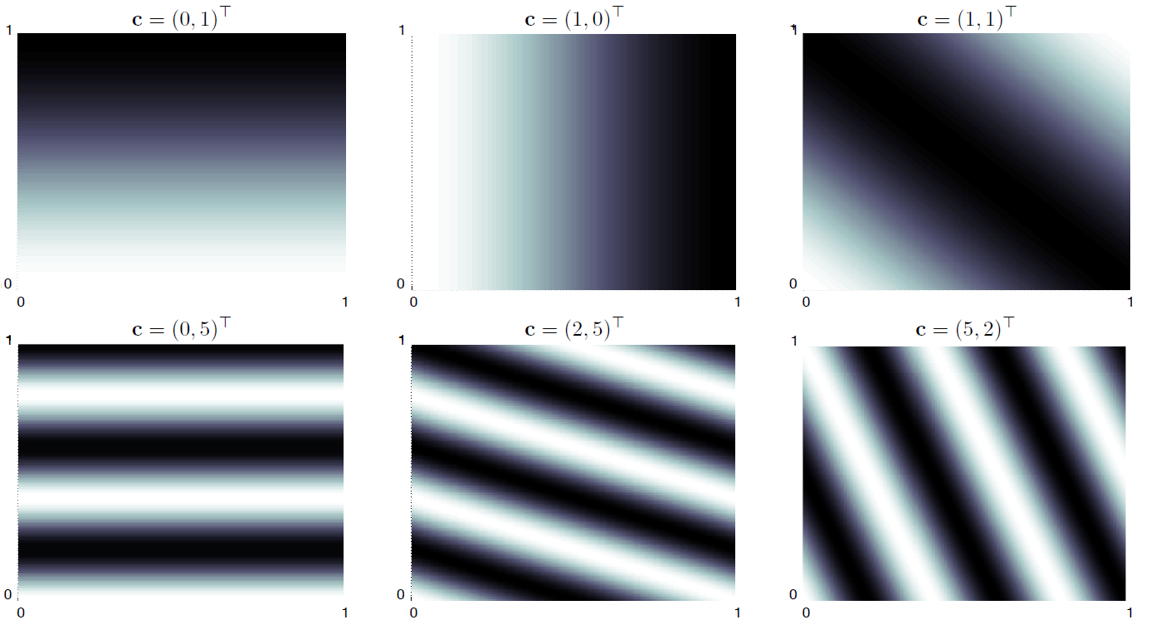
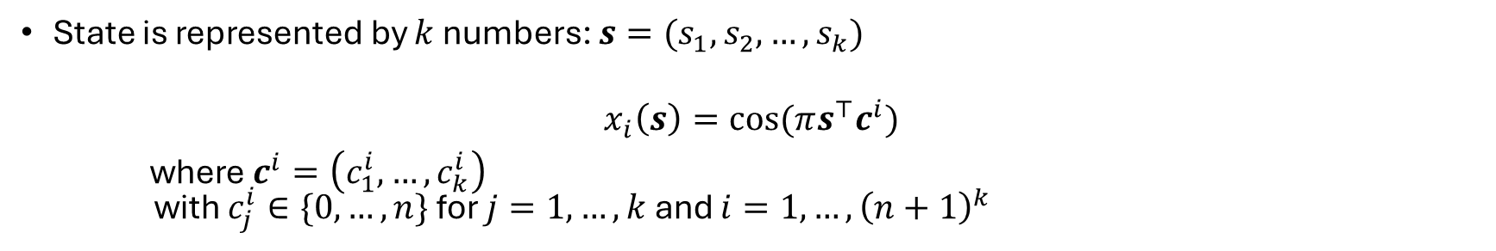
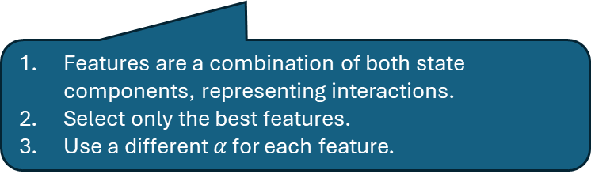
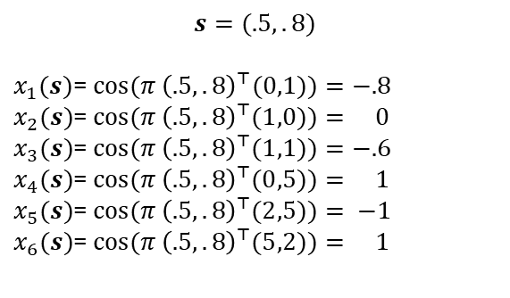
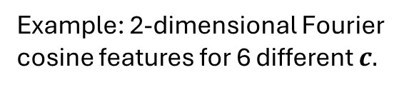
Example: Multi-dimensional Fourier Basis
State is represented by $k$ numbers: $s=(s_{1},s_{2},…,s_{k})$
$$x_{i}\left(s\right)=\cos{(πs^{⊤}c^{i})}$$
where $c^{i}=\left(c_{1}^{i},…,c_{k}^{i}\right)$ with $c_{j}^{i}∈\{0,…,n\}$ for $j=1,…,k$ and $i=1,…,{\left(n+1\right)}^{k}$
>0 is the frequency
0 means it is constant in that dimension
Example: 2-dimensional Fourier cosine features for 6 different $c.$
.8
$$s=(.5,.8)$$
$x_{1}(s)$= $\cos{(π{ \left(.5,.8\right)}^{⊤}(0,1))}=−.8$
$x_{2}(s)$= $\cos{(π{ \left(.5,.8\right)}^{⊤}(1,0))}= 0$
$x_{3}(s)$= $\cos{(π{ \left(.5,.8\right)}^{⊤}(1,1))}=−.6$
$x_{4}(s)$= $\cos{(π{ \left(.5,.8\right)}^{⊤}(0,5))}= 1$
$x_{5}(s)$= $\cos{(π{ \left(.5,.8\right)}^{⊤}(2,5))}= −1$ $x_{6}(s)$= $\cos{(π{ \left(.5,.8\right)}^{⊤}(5,2))}= 1$
.5
Features are a combination of both state components, representing interactions.
Select only the best features.
Use a different $α$ for each feature.

Slide 22
Example: Maze
TODO

Slide 23
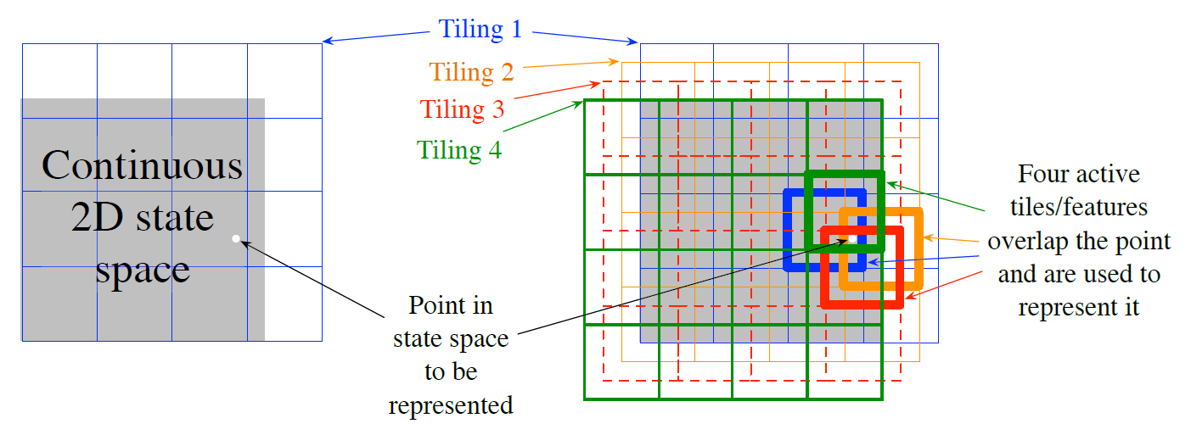
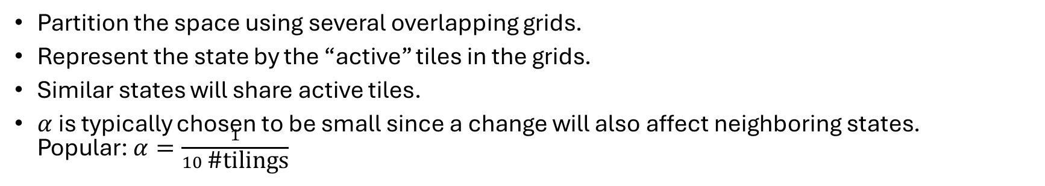
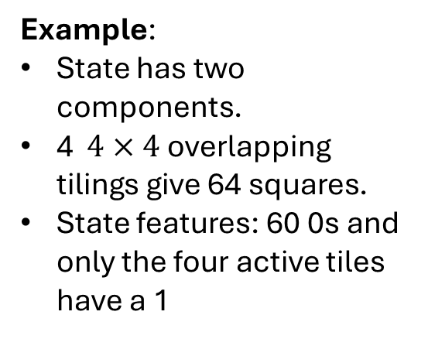
Example: Tile Coding
Partition the space using several overlapping grids.
Represent the state by the “active” tiles in the grids.
Similar states will share active tiles.
$α$ is typically chosen to be small since a change will also affect neighboring states. Popular: $α=\frac{1}{10 \text{\#}\text{tilings}}$
Example:
State has two components.
4 $4×4$ overlapping tilings give 64 squares.
State features: 60 0s and only the four active tiles have a 1
0
0
0
0
0
0
0
0
0
0
1
0
0
0
0
0

Slide 24
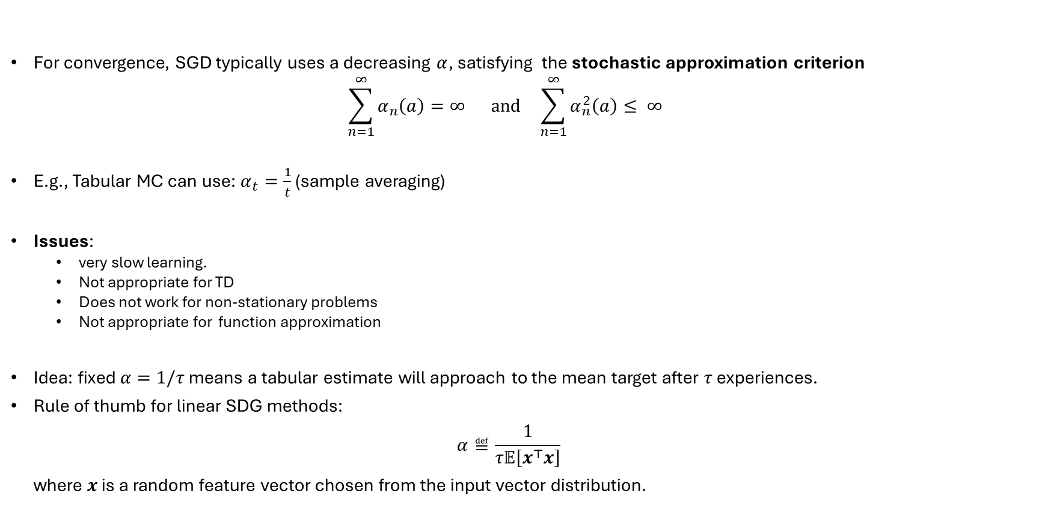
Step Size Selection
For convergence, SGD typically uses a decreasing $α$, satisfying the stochastic approximation criterion $\sum_{n=1}^{∞}{α_{n}\left(a\right)=∞ \text{and} }\sum_{n=1}^{∞}{α_{n}^{2}\left(a\right)≤ ∞ }$
E.g., Tabular MC can use: $α_{t}=\frac{1}{t}$ (sample averaging)
Issues:
very slow learning.
Not appropriate for TD
Does not work for non-stationary problems
Not appropriate for function approximation
Idea: fixed $α=1/τ$ means a tabular estimate will approach to the mean target after $τ$ experiences.
Rule of thumb for linear SDG methods: $α≝\frac{1}{τ𝔼\left[x^{⊤}x\right]}$ where $x$ is a random feature vector chosen from the input vector distribution.
Average of the squared feature vector length

Slide 25
Non-Linear Function Approximation
Artificial Neural Networks

Slide 26




Approximation with ANNs
$$S$$
Uses simple networks with a single hidden layer or deep architectures to approximate the value function.
Methods:
Recurrent networks
Convolution networks
Transformers
Regularization, dropout, weight sharing
Deep residual learning…
Networks are trained like linear models using SGD. For deep networks this uses backpropagation.
ANNs are non-linear universal approximators so they can learn any value function.
Issues due to nonlinearity:
Instability
Convergence is not guaranteed.
More in Deep Reinforcement Learning (DRL).
$$A$$
$$s$$
$$Q(s, a)$$
Q-network

Slide 27
On-Policy Control with Approximation

Slide 28
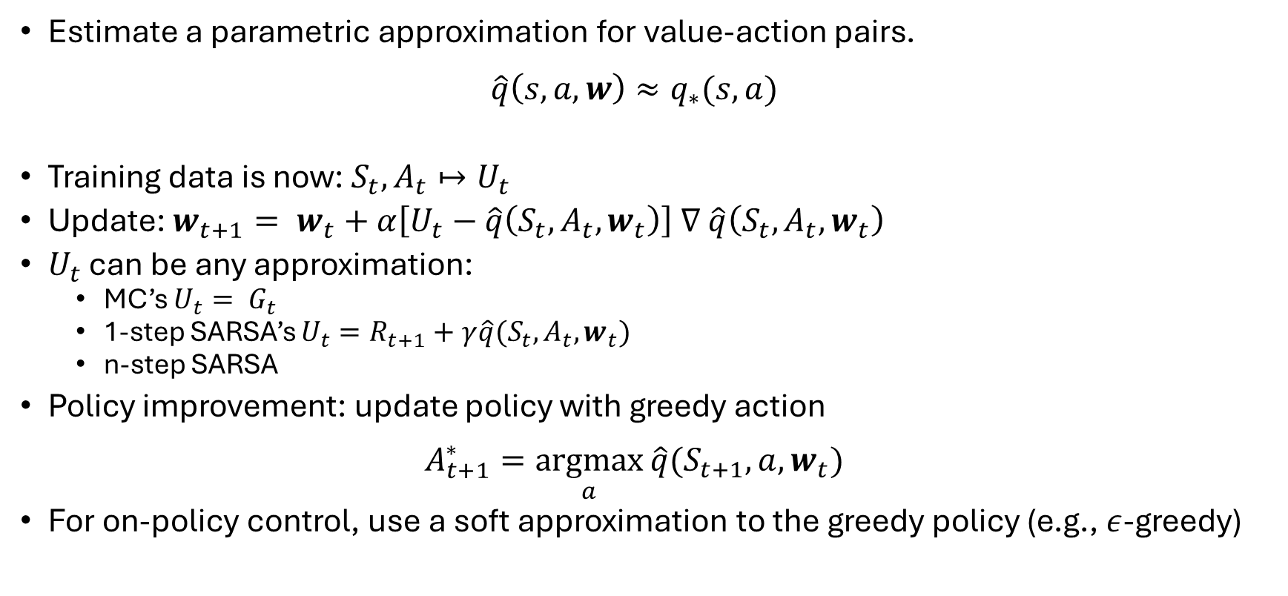
Control Problem
Estimate a parametric approximation for value-action pairs. $\hat{q}\left(s,a,w\right)≈q_{∗}(s,a)$
Training data is now: $S_{t},A_{t}↦U_{t}$
Update: $w_{t+1}= w_{t}+α\left[U_{t}−\hat{q}\left(S_{t},A_{t}, w_{t}\right)\right]$ $∇$ $\hat{q}\left(S_{t},A_{t},w_{t}\right)$
$U_{t}$ can be any approximation:
MC’s $U_{t}= G_{t}$
1-step SARSA’s $U_{t}=R_{t+1}+γ\hat{q}(S_{t}, A_{t},w_{t})$
n-step SARSA
Policy improvement: update policy with greedy action $A_{t+1}^{∗}=\underset{a}{argmax}{\hat{q}(S_{t+1},a, w_{t})}$
For on-policy control, use a soft approximation to the greedy policy (e.g., $ε$-greedy)

Slide 29
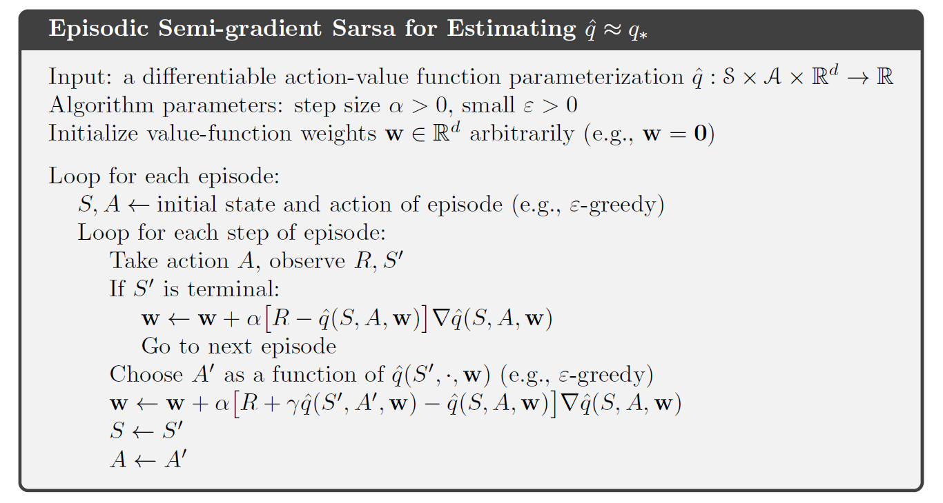
Episodic Semi-gradient Sarsa

Slide 30
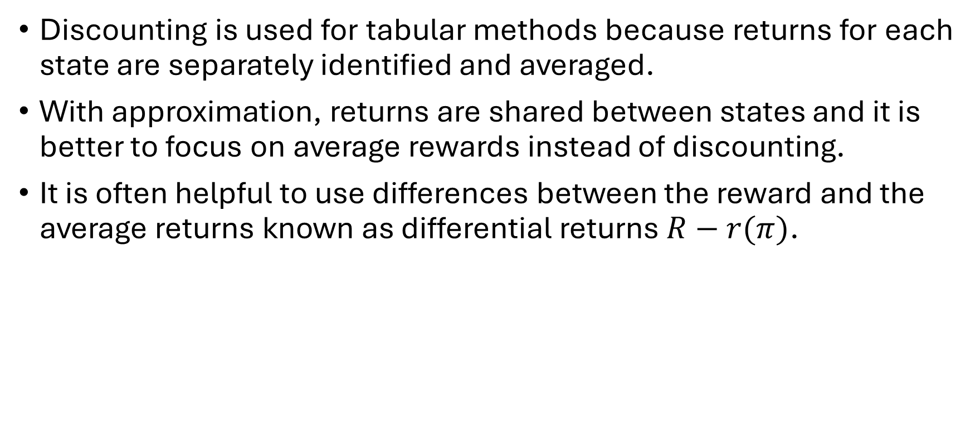
Considerations for Continuing Tasks
Discounting is used for tabular methods because returns for each state are separately identified and averaged.
With approximation, returns are shared between states and it is better to focus on average rewards instead of discounting.
It is often helpful to use differences between the reward and the average returns known as differential returns $R−r(π)$.

Slide 31
Summary

Slide 32
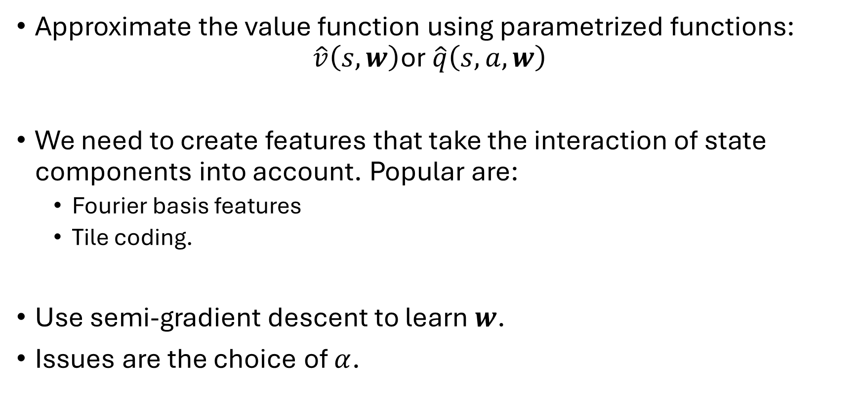
Summary
Approximate the value function using parametrized functions: $\hat{v}\left(s,w\right)$or $\hat{q}\left(s,a,w\right)$
We need to create features that take the interaction of state components into account. Popular are:
Fourier basis features
Tile coding.
Use semi-gradient descent to learn $w$.
Issues are the choice of $α$.

