Slide 1



Reinforcement Learning Policy Gradient Methods Sutton/Barto* Chapter 13
Michael Hahsler, SMU
With figures from Sutton/Barto*
*Sutton and Barto, Reinforcement Learning: An Introduction, 2nd edition, MIT Press, Cambridge, MA, 2018

Slide 2
Topics of this Course
Introduction to reinforcement learning
Markov decision processes
Part I: Tabular Methods
Dynamic programming
Monte Carlo methods
Temporal-difference learning
Multi-step bootstrapping
Planning and learning with tabular methods
Part II: Approximate Solution Methods
Prediction and Control using Approximation
Eligibility Traces
Policy Gradient Methods
Part III: Modern RL Methods
Deep Reinforcement Learning
Current Applications

Slide 3
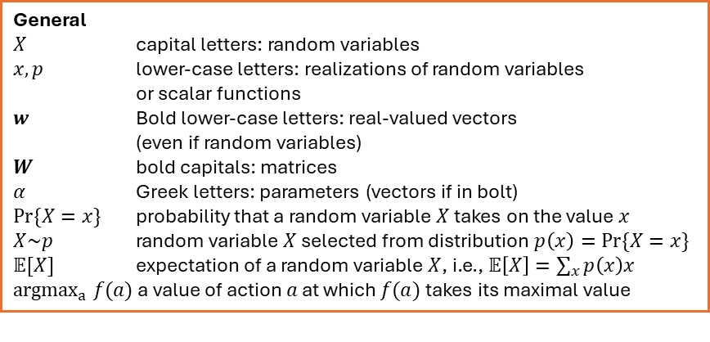
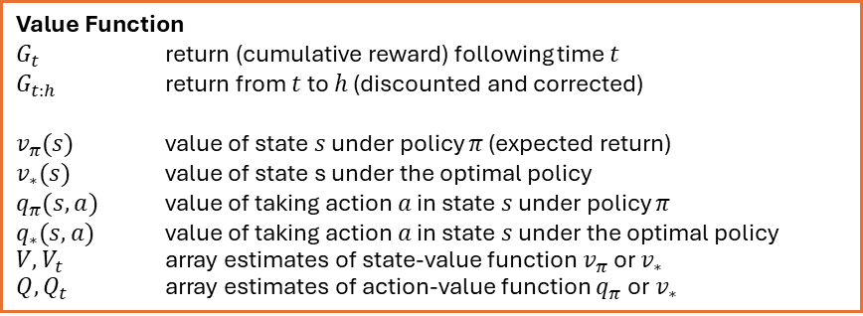
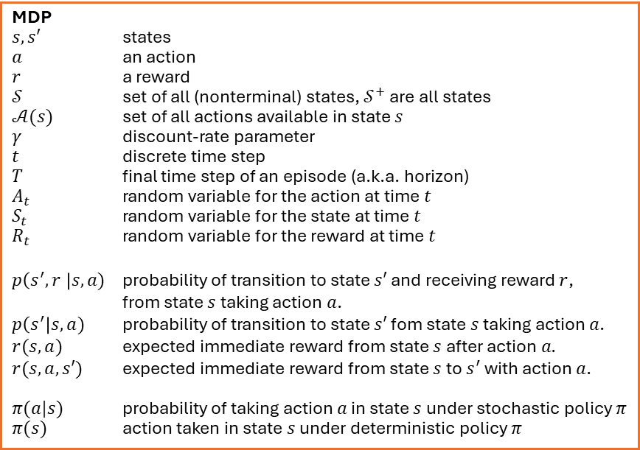
Summary of Notation
General
$X$ capital letters: random variables $x, p$ lower-case letters: realizations of random variables or scalar functions
$w$ Bold lower-case letters: real-valued vectors (even if random variables)
$W$ bold capitals: matrices
$α$ Greek letters: parameters (vectors if in bolt)
$Pr⁡\{X=x\}$ probability that a random variable $X$ takes on the value $x$
$X\sim p$ random variable $X$ selected from distribution $p\left(x\right)=Pr⁡\{X=x\}$
$𝔼[X]$ expectation of a random variable $X$, i.e., $𝔼\left[X\right]=\sum_{x}{p\left(x\right)x}$
${argmax}_{a} f(a)$ a value of action $a$ at which $f(a)$ takes its maximal value
MDP
$s, s′$ states
$a$ an action
$r$ a reward
$𝒮$ set of all (nonterminal) states, $𝒮^{+}$ are all states
$𝒜(s)$ set of all actions available in state $s$
$γ$ discount-rate parameter
$t$ discrete time step
$T$ final time step of an episode (a.k.a. horizon)
$A_{t}$ random variable for the action at time $t$
$S_{t}$ random variable for the state at time $t$
$R_{t}$ random variable for the reward at time $t$
$p\left(s^{′},r \right|s, a)$ probability of transition to state $s′$ and receiving reward $r$, from state $s$ taking action $a$.
$p\left(s^{′}\right|s, a)$ probability of transition to state $s′$ fom state $s$ taking action $a$.
$r(s,a)$ expected immediate reward from state $s$ after action $a.$
$r(s,a,s′)$ expected immediate reward from state $s$ to $s^{′}$ with action $a.$
$π(a|s)$ probability of taking action $a$ in state $s$ under stochastic policy $π$
$π(s)$ action taken in state $s$ under deterministic policy $π$
Value Function
$G_{t}$ return (cumulative reward) following time $t$
$G_{t:h}$ return from $t$ to $h$ (discounted and corrected)
$v_{π}(s)$ value of state $s$ under policy $π$ (expected return)
$v_{∗}(s)$ value of state s under the optimal policy
$q_{π}(s,a)$ value of taking action $a$ in state $s$ under policy $π$
$q_{∗}(s,a)$ value of taking action $a$ in state $s$ under the optimal policy
$V, V_{t}$ array estimates of state-value function $v_{π}$or $v_{∗}$
$Q,Q_{t}$ array estimates of action-value function $q_{π}$or $v_{∗}$

Slide 4
Parametrized Policies
Learn policies directly

Slide 5
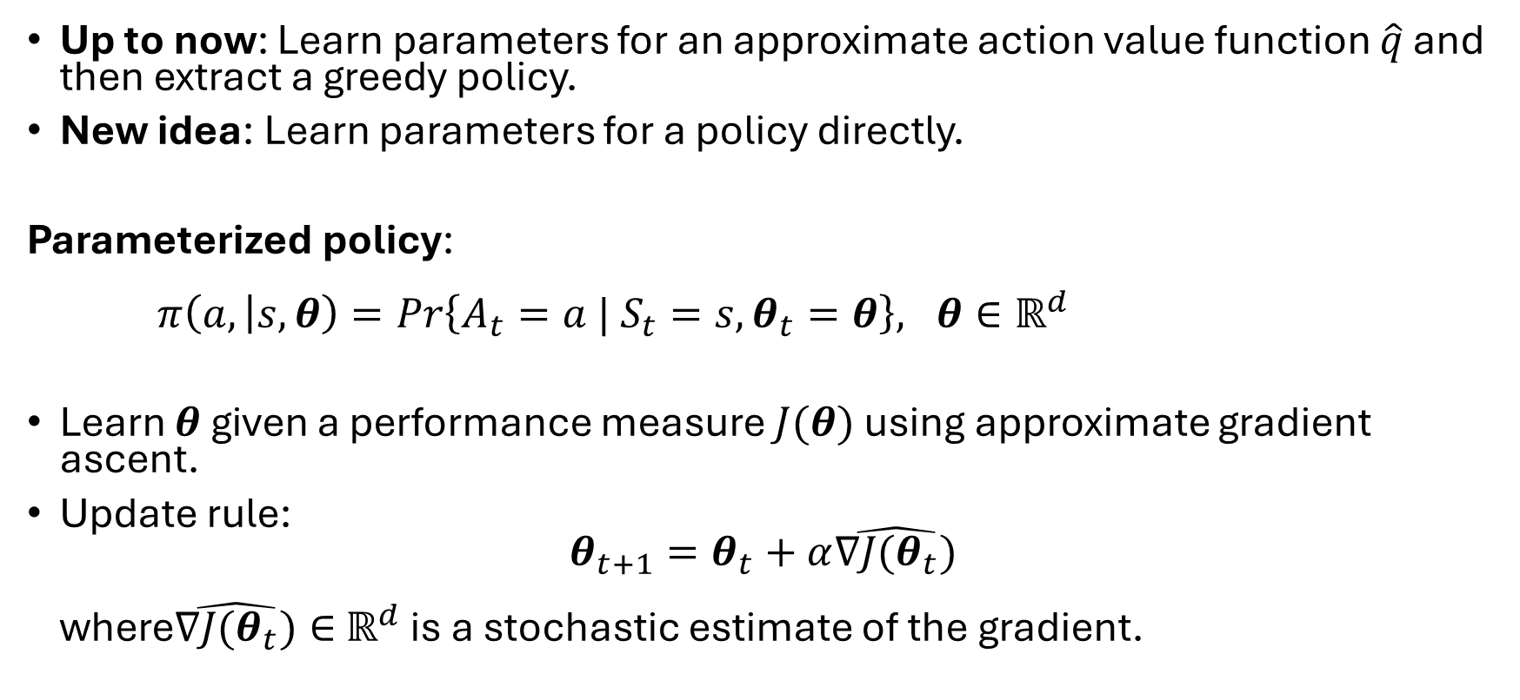
Learn a Parameterized Policy
Up to now: Learn parameters for an approximate action value function $\hat{q}$ and then extract a greedy policy.
New idea: Learn parameters for a policy directly.
Parameterized policy: $π\left(a, | s,θ\right)=Pr\left\{A_{t}=a | S_{t}=s, θ_{t}=θ\right\}, θ∈ℝ^{d}$
Learn $θ$ given a performance measure $J(θ)$ using approximate gradient ascent.
Update rule: $θ_{t+1}=θ_{t}+α\hat{∇J(θ_{t})}$ where$\hat{∇J(θ_{t})}∈$ $ℝ^{d}$ is a stochastic estimate of the gradient.

Slide 6
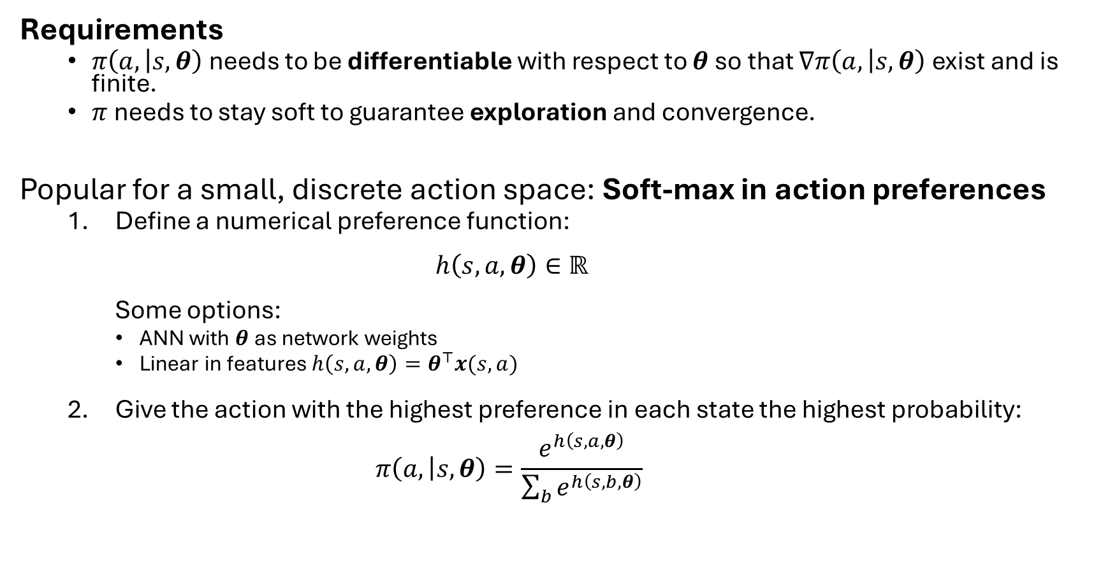
Parametrized Policy Example
Requirements
$π\left(a, | s,θ\right)$ needs to be differentiable with respect to $θ$ so that $∇π\left(a, | s,θ\right)$ exist and is finite.
$π$ needs to stay soft to guarantee exploration and convergence.
Popular for a small, discrete action space: Soft-max in action preferences
Define a numerical preference function: $h\left(s,a,θ\right)∈ℝ$ Some options:
ANN with $θ$ as network weights
Linear in features $h\left(s,a,θ\right)=θ^{⊤}x(s,a)$
Give the action with the highest preference in each state the highest probability: $π\left(a, | s,θ\right)=\frac{e^{h\left(s,a,θ\right)}}{\sum_{b}{e^{h\left(s,b,θ\right)}}}$

Slide 7
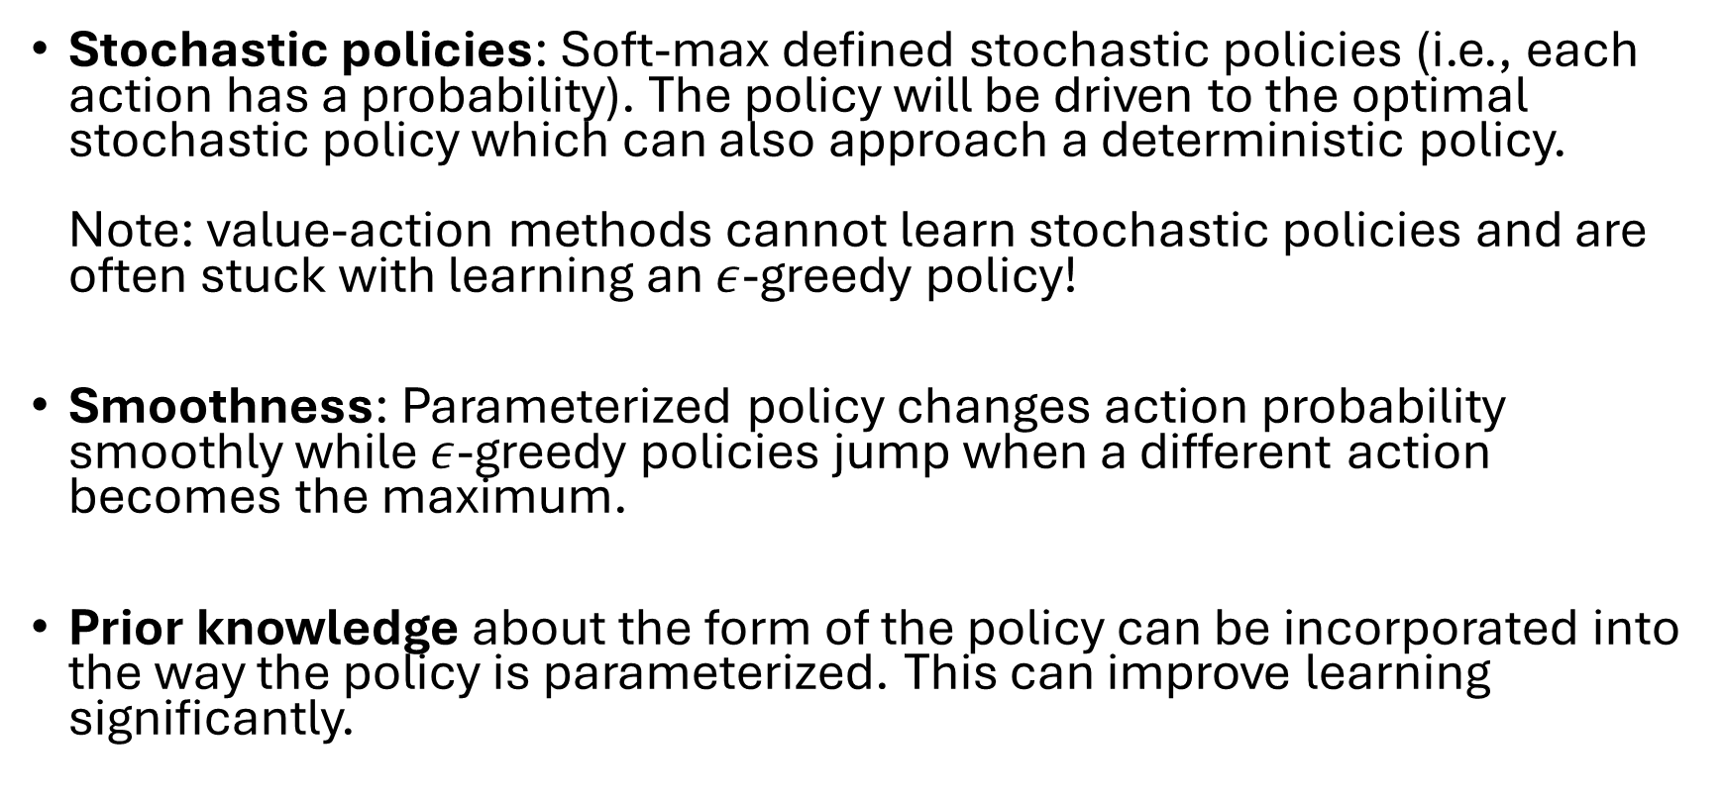

Advantages over $ε$-greedy Action Selection
Stochastic policies: Soft-max defined stochastic policies (i.e., each action has a probability). The policy will be driven to the optimal stochastic policy which can also approach a deterministic policy. Note: value-action methods cannot learn stochastic policies and are often stuck with learning an $ε$-greedy policy!
Smoothness: Parameterized policy changes action probability smoothly while $ε$-greedy policies jump when a different action becomes the maximum.
Prior knowledge about the form of the policy can be incorporated into the way the policy is parameterized. This can improve learning significantly.

Slide 8
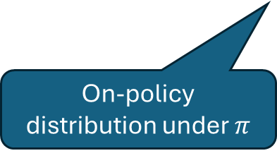
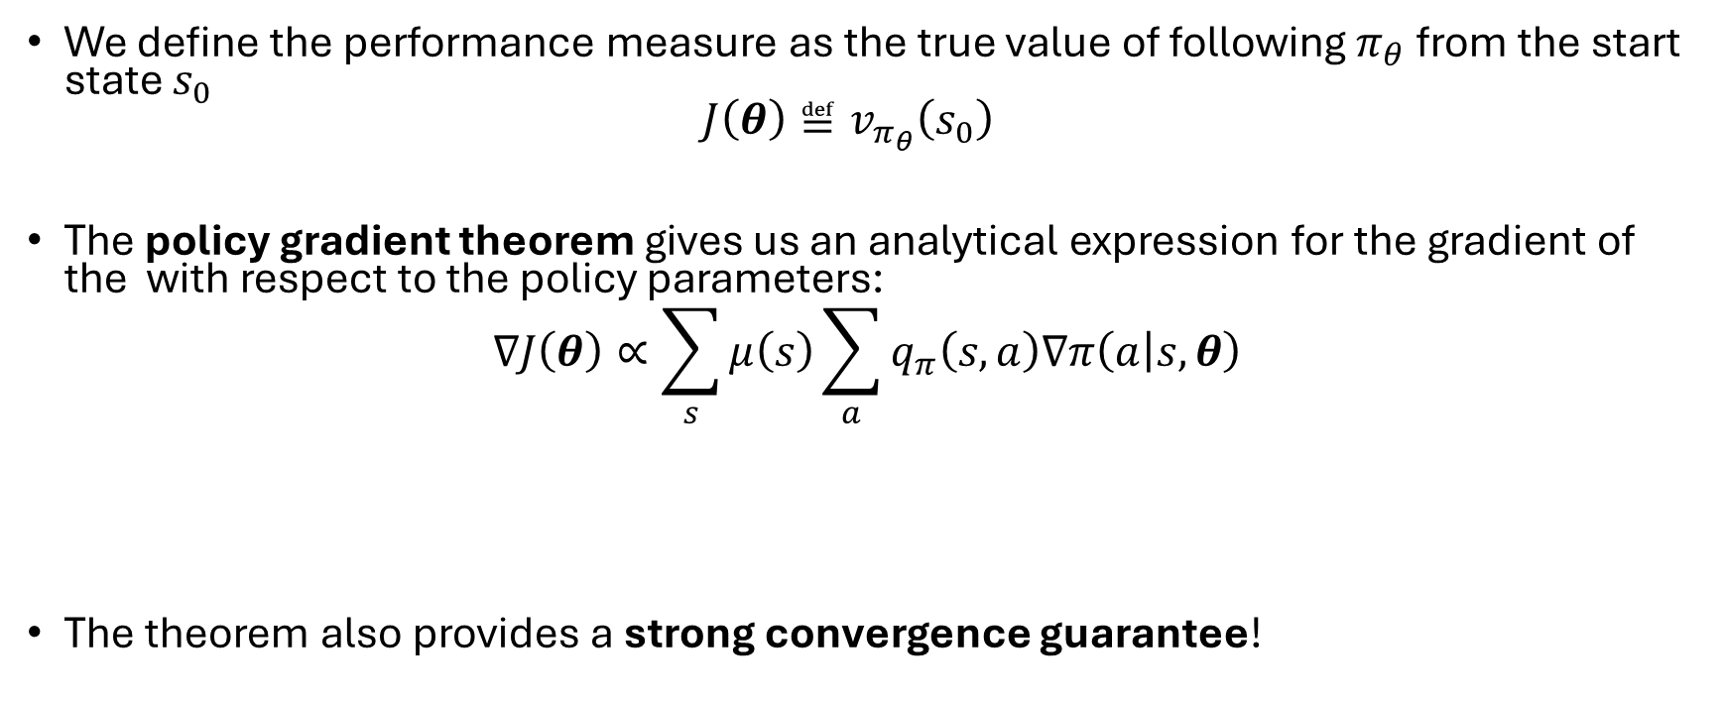
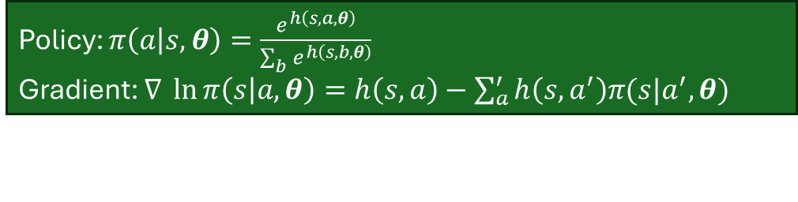
Policy Gradient Theorem
We define the performance measure as the true value of following $π_{θ}$ from the start state $s_{0}$ $J\left(θ\right)≝v_{π_{θ}}\left(s_{0}\right)$
The policy gradient theorem gives us an analytical expression for the gradient of the with respect to the policy parameters:
$$∇J\left(θ\right)∝\sum_{s}{μ\left(s\right)\sum_{a}{q_{π}\left(s,a\right)∇π\left(a | s,θ\right)}}$$
The theorem also provides a strong convergence guarantee!
On-policy distribution under $π$
Depends on estimates for q
Derived from the def. of the policy.
Policy: $π\left(a | s,θ\right)=\frac{e^{h\left(s,a,θ\right)}}{\sum_{b}{e^{h\left(s,b,θ\right)}}}$
Gradient: $∇ \ln{π\left(s | a, θ\right)=h\left(s,a\right)−\sum_{a}^{′}{h\left(s,a^{′}\right)π(s|a^{′}, θ)}}$

Slide 9
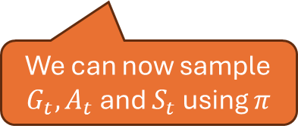


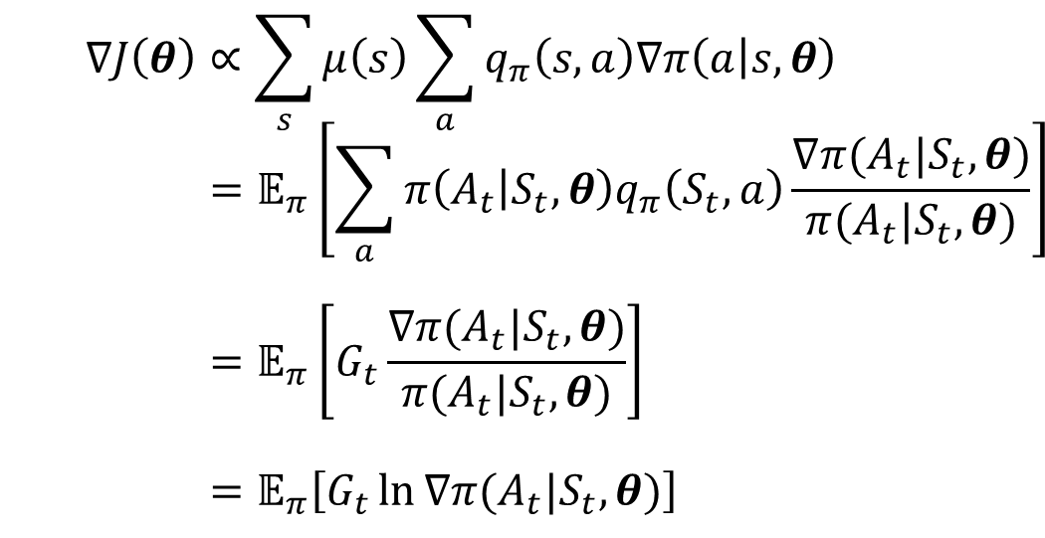
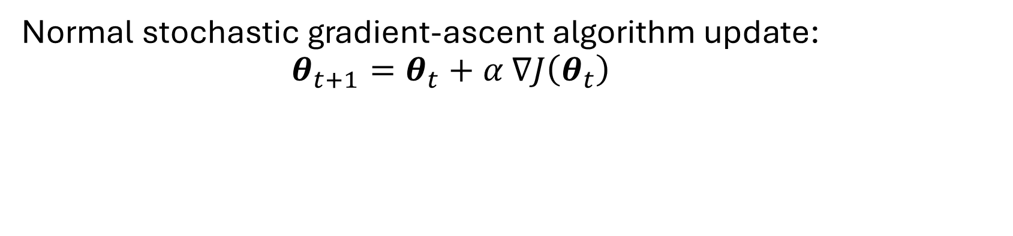


REINFORCE Update
Normal stochastic gradient-ascent algorithm update: $θ_{t+1}=θ_{t}+α$ $∇J\left(θ_{t}\right)$
$$∇J\left(θ\right)∝\sum_{s}{μ\left(s\right)\sum_{a}{q_{π}\left(s,a\right)∇π\left(a | s,θ\right)}} \\ =𝔼_{π}\left[\sum_{a}{π\left(A_{t} | S_{t},θ\right)q_{π}\left(S_{t},a\right)\frac{∇π(A_{t}|S_{t},θ)}{π(A_{t}|S_{t},θ)}}\right] \\ =𝔼_{π}\left[G_{t}\frac{∇π(A_{t}|S_{t},θ)}{π(A_{t}|S_{t},θ)}\right] \\ =𝔼_{π}\left[G_{t}\ln{∇π(A_{t}|S_{t},θ)}\right]$$
(replace $s$ by the sampled $S_{t}\sim μ$)
(replace $a$ by the sampled $A_{t}\sim π$)
(because $𝔼_{π}\left[G_{t}|S_{t},A_{t}\right]=q_{π}(S_{t},A_{t})$)
(because $∇\ln{x=\frac{∇x}{x}}$)
We can now sample $G_{t}, A_{t}$ and $S_{t}$ using $π$

Slide 10
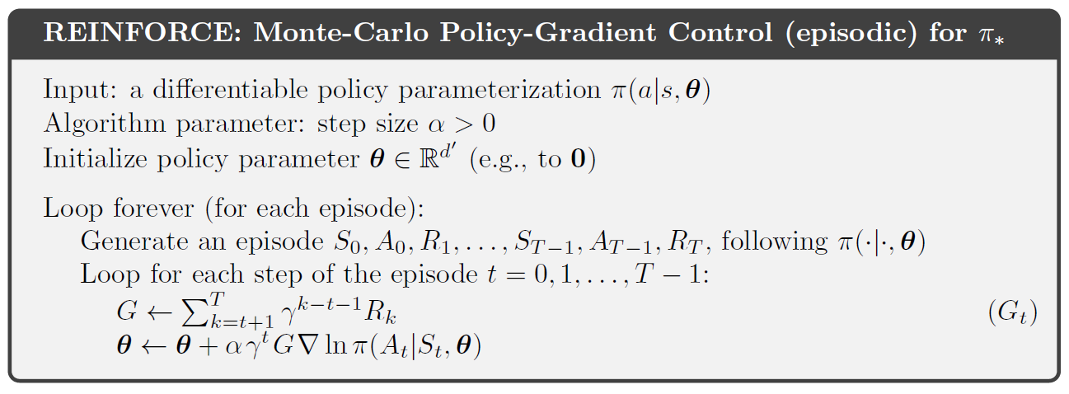
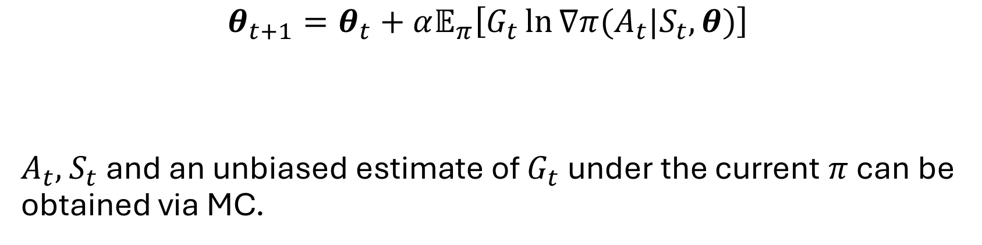

MC Policy Gradient
$$θ_{t+1}=θ_{t}+α𝔼_{π}\left[G_{t}\ln{∇π(A_{t}|S_{t},θ)}\right]$$
$A_{t},$ $S_{t}$ and an unbiased estimate of $G_{t}$ under the current $π$ can be obtained via MC.
Proportional to $∇J\left(θ\right)$

Slide 11
Actor-Critic Methods
Combining parameterized policies with parameterized value functions

Slide 12
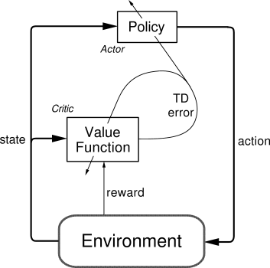
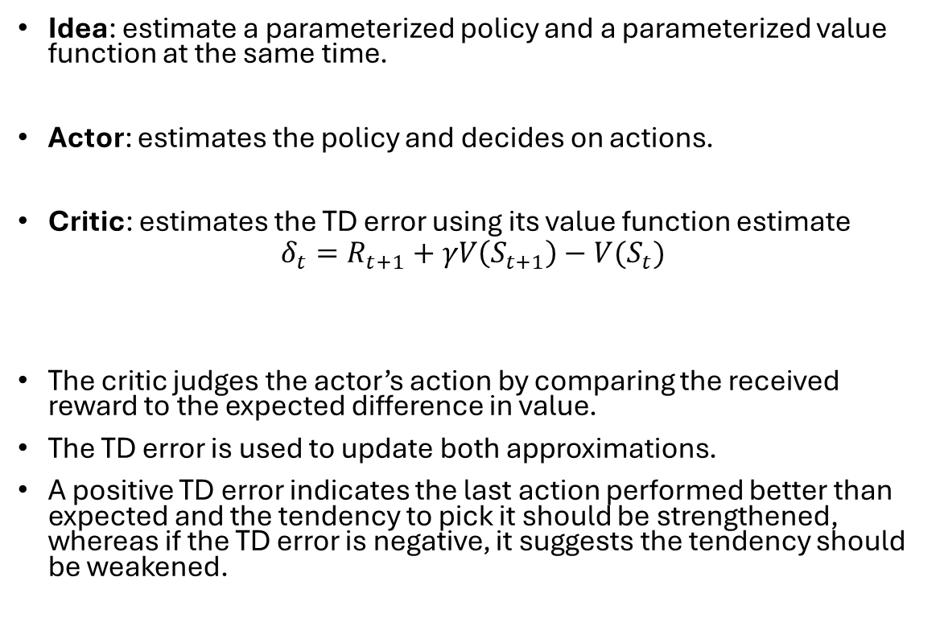

Actor-Critic Methods
Idea: estimate a parameterized policy and a parameterized value function at the same time.
Actor: estimates the policy and decides on actions.
Critic: estimates the TD error using its value function estimate
$$δ_{t}=R_{t+1}+γV\left(S_{t+1}\right)−V(S_{t})$$
The critic judges the actor’s action by comparing the received reward to the expected difference in value.
The TD error is used to update both approximations.
A positive TD error indicates the last action performed better than expected and the tendency to pick it should be strengthened, whereas if the TD error is negative, it suggests the tendency should be weakened.
$$G_{t}$$

Slide 13
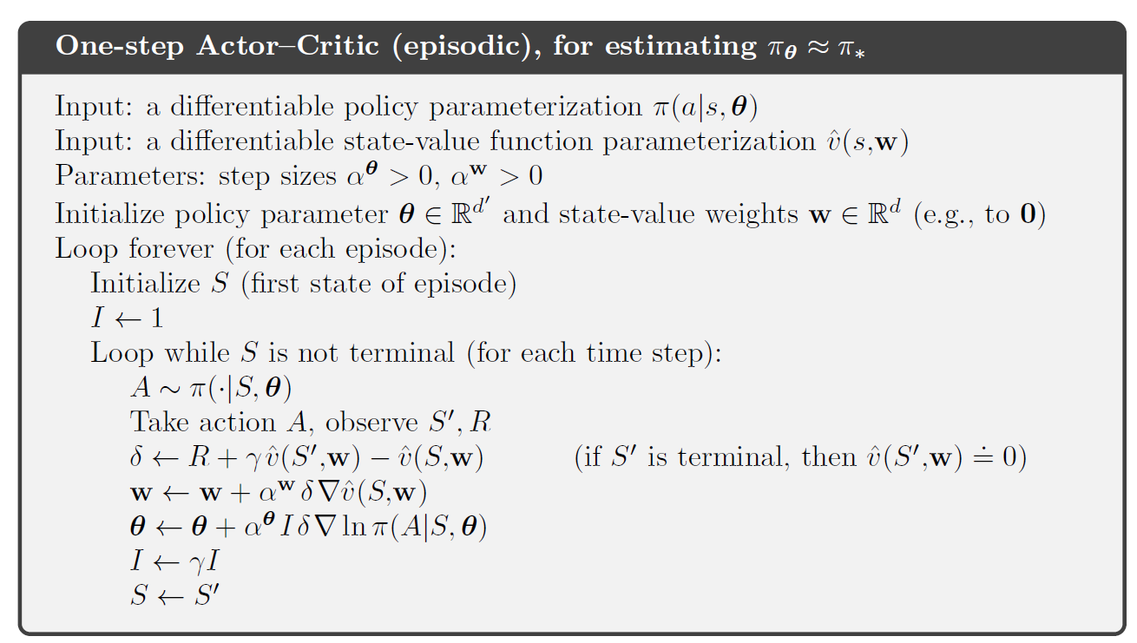


One-Step Actor-Critic Algorithm
actor
critic
Takes care of discounting $γ^{t}$
TD error: how much is $G$ better than $\hat{v}$
Update the critic (value function) = $TD(0)$
Update the actor (policy) = REINFORCE

Slide 14
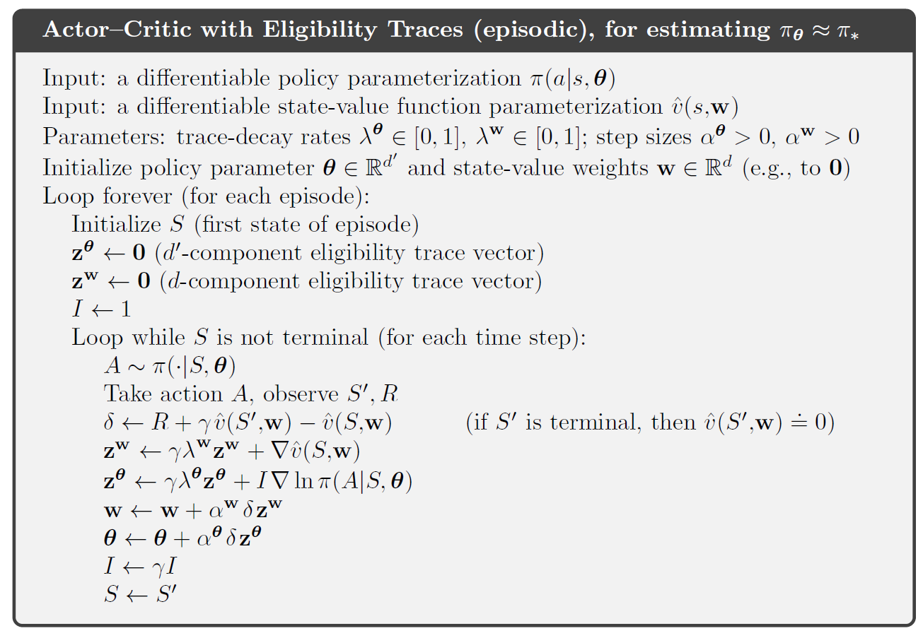
Actor-Critic Methods with Eligibility Traces

Slide 15
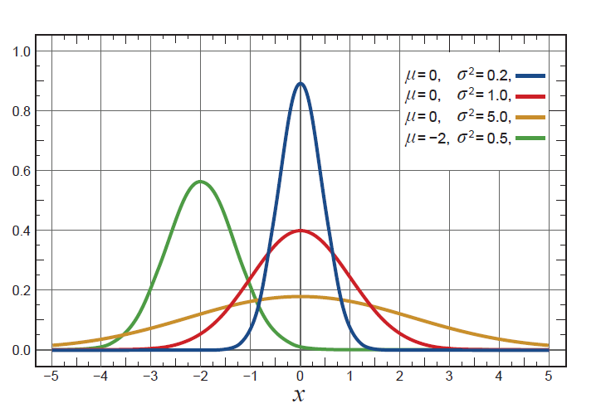
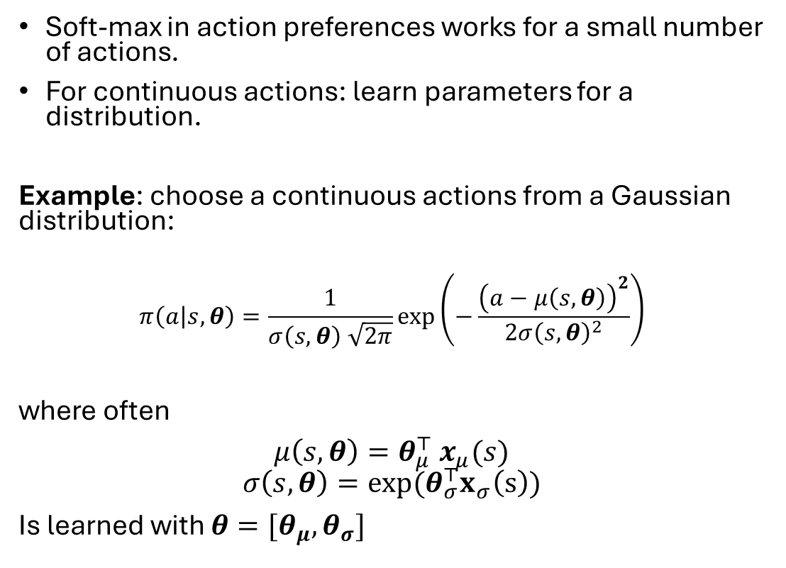
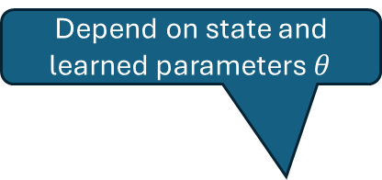

Policy Parameterization for Continuous Actions
Soft-max in action preferences works for a small number of actions.
For continuous actions: learn parameters for a distribution.
Example: choose a continuous actions from a Gaussian distribution:
$$π\left(a | s,θ\right)=\frac{1}{σ\left(s,θ\right) \sqrt{2π}}\exp\left(−\frac{{\left(a−μ\left(s,θ\right)\right)}^{2}}{2σ{\left(s,θ\right)}^{2}}\right)$$
where often
$μ\left(s,θ\right)=θ_{μ}^{⊤} x_{μ}(s)$
$$σ\left(s,θ\right)=exp⁡(θ_{σ}^{⊤}x_{σ}\left(s\right))$$
Is learned with $θ=[θ_{μ},θ_{σ}]$
Depend on state and learned parameters $θ$
Probability density
Action value $a$
Linear in state features

Slide 16
Summary
Learning a parameterized policy without action-values estimates has many advantages:
Learn probabilities for taking an action (stochastic policies).
Can handle continuous action spaces.
Policy gradient theorem provides strong performance bounds.
In general, policy gradient methods, including actor-critic, have a different set of strengths and weaknesses compared to action-value methods, and the best choice depends on the problem.

